Slide 1
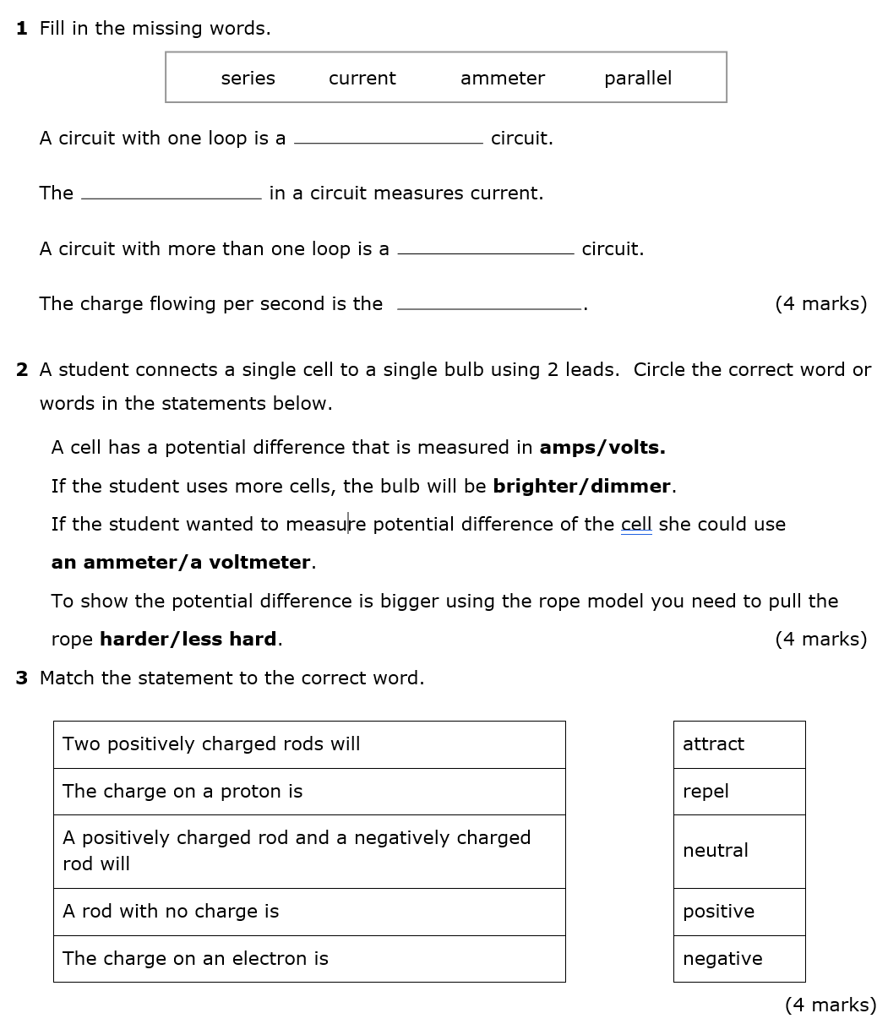
Mark scheme with Mr Toyne

Slide 2
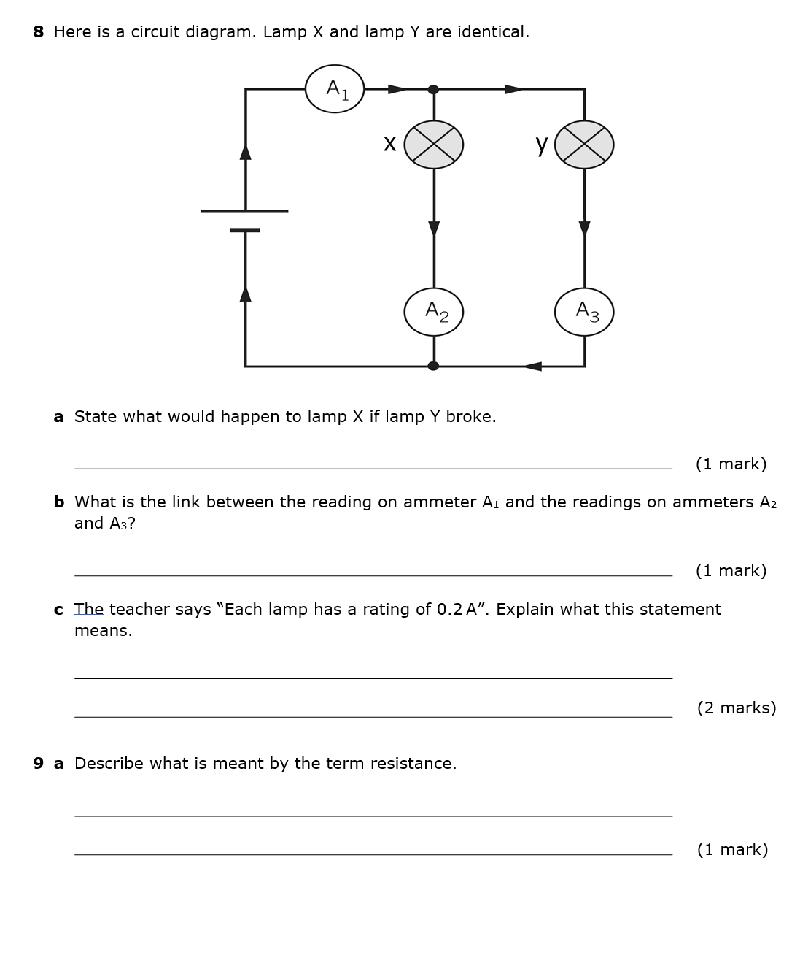
Mark scheme with Mr Toyne

Slide 3
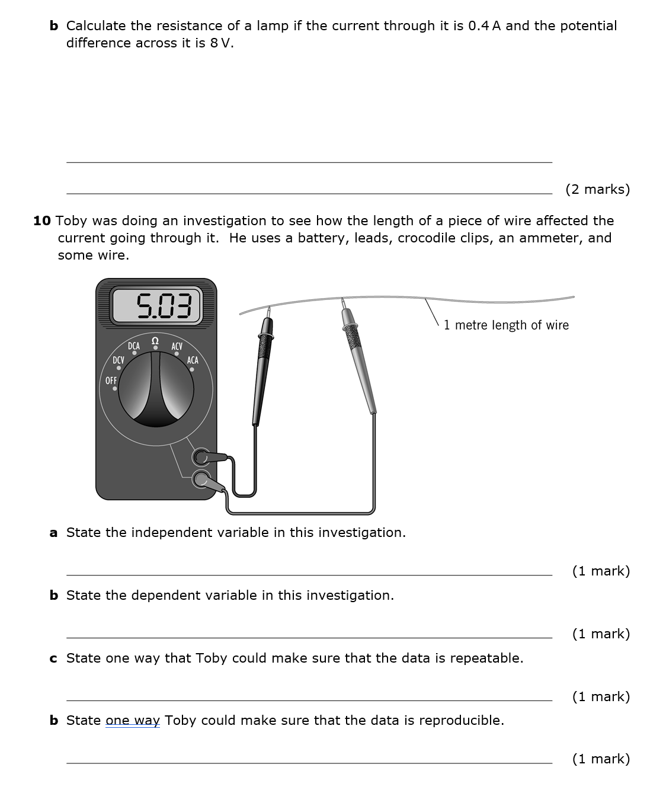
Mark scheme with Mr Toyne

Slide 4
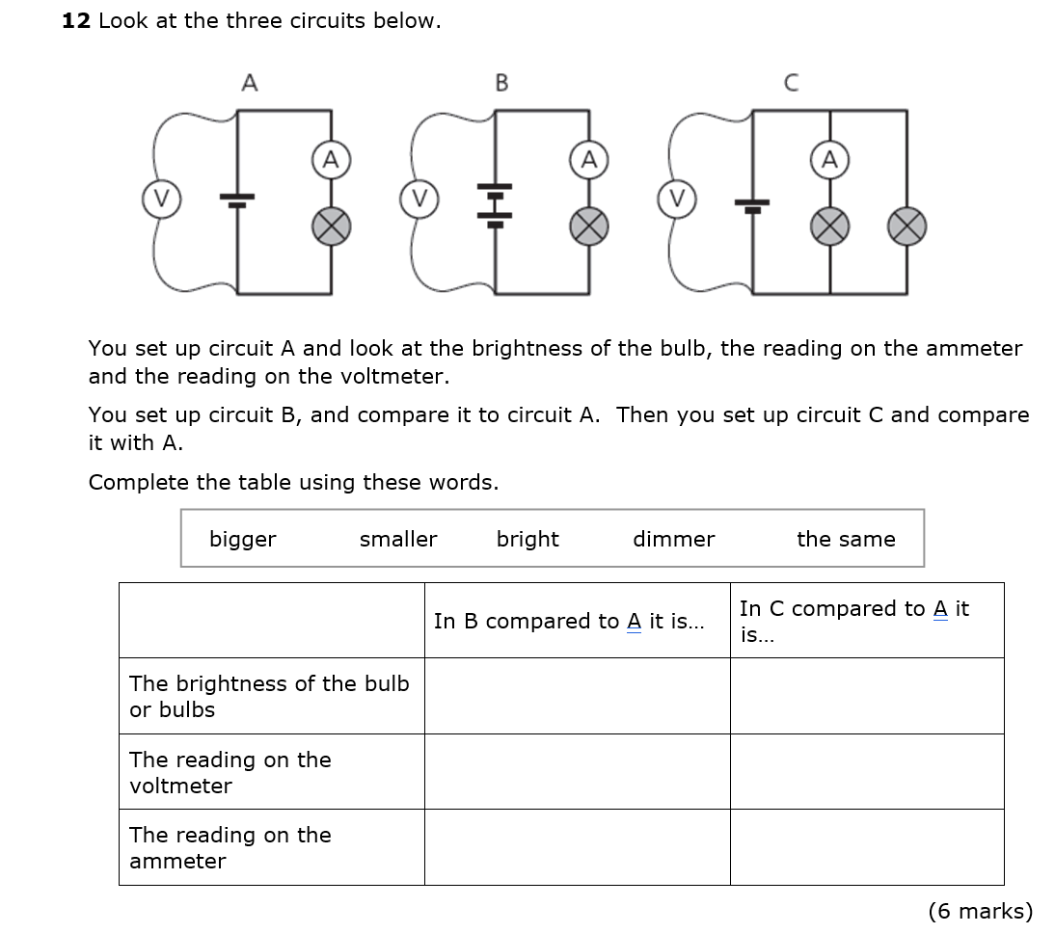
Mark scheme with Mr Toyne

