Slide 1
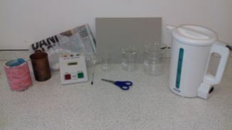
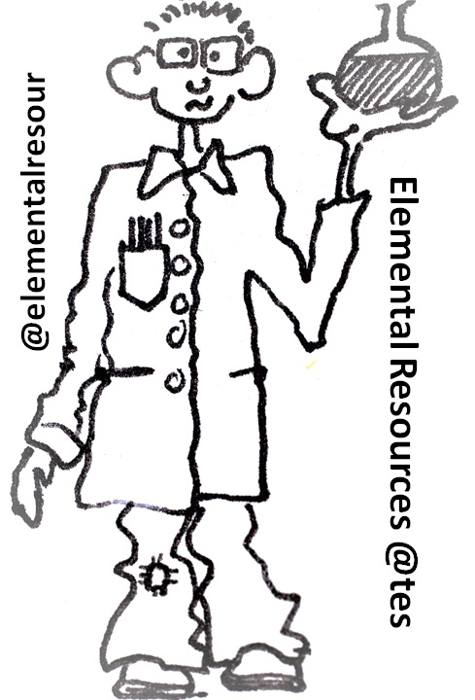
Thermal Insulation (Types of) Required Practical
Please ensure you have watched the video showing this Required Practical – link found via the Homestudy page

Slide 2
Learning Objectives
By the end of this practical you will be able to:
Devise and investigate testable questions
Recognise hazards and plan how to minimise risk
Identify and control variables
Describe how to use specialist equipment to take measurements
Handle and manipulate equipment with confidence and fluency
Analyse, interpret and evaluate data
Notes:
(37) Insulation - GCSE Science Required Practical - YouTube

Slide 3
1. Hypothesis-A proposal (suggestion) to explain certain facts or observations.
2. Prediction-A statement about what will happen in the future, based on experience, observation or hypothesis.
Planning
7. Fair Test-A test where only the independent variable has been allowed to affect the dependent variable.
4. Risk-an assessment of the likelihood that a hazard could cause harm.
5. Control-what needs to be done to minimize the risk in an experiment.
8b. Interval-the quantity between the readings, reducing this and taking more readings increase validity.
8c. Resolution-The smallest change of a quantity that can be measured by an instrument giving a perceptible change, changing the instrument can increase resolution.
3. Hazard-something that can cause harm.
6c. Continuous-Variables that can be discrete numbers or a measured value.
6b. Categoric-Variables that are types or labels.
6f. Control-Variables that can affect the outcome of the investigation. So need to be controlled or monitored.
6a. Variables-These are quantalities or characteristics that are changed in the experiment.
8a. Data-Information qualitative or quantitative that is collected.
6d. Independent-Values that are changed by the investigator (You).
6e. Dependent-Value measured when the independent variable is changed (it depends on the independent variable.
8d. Calibration-Marking a scale on an instrument where a relationship between the scale and standard or reference is established.
8e. Range-this is the maximum and minimum values of the independent and dependent variables.

Slide 4
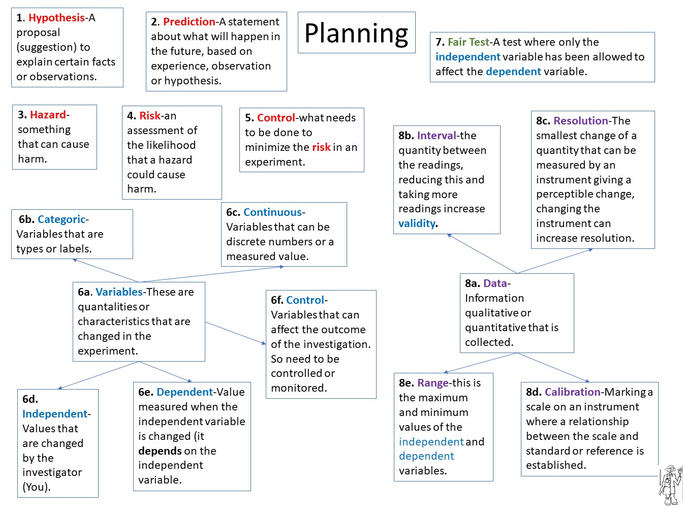
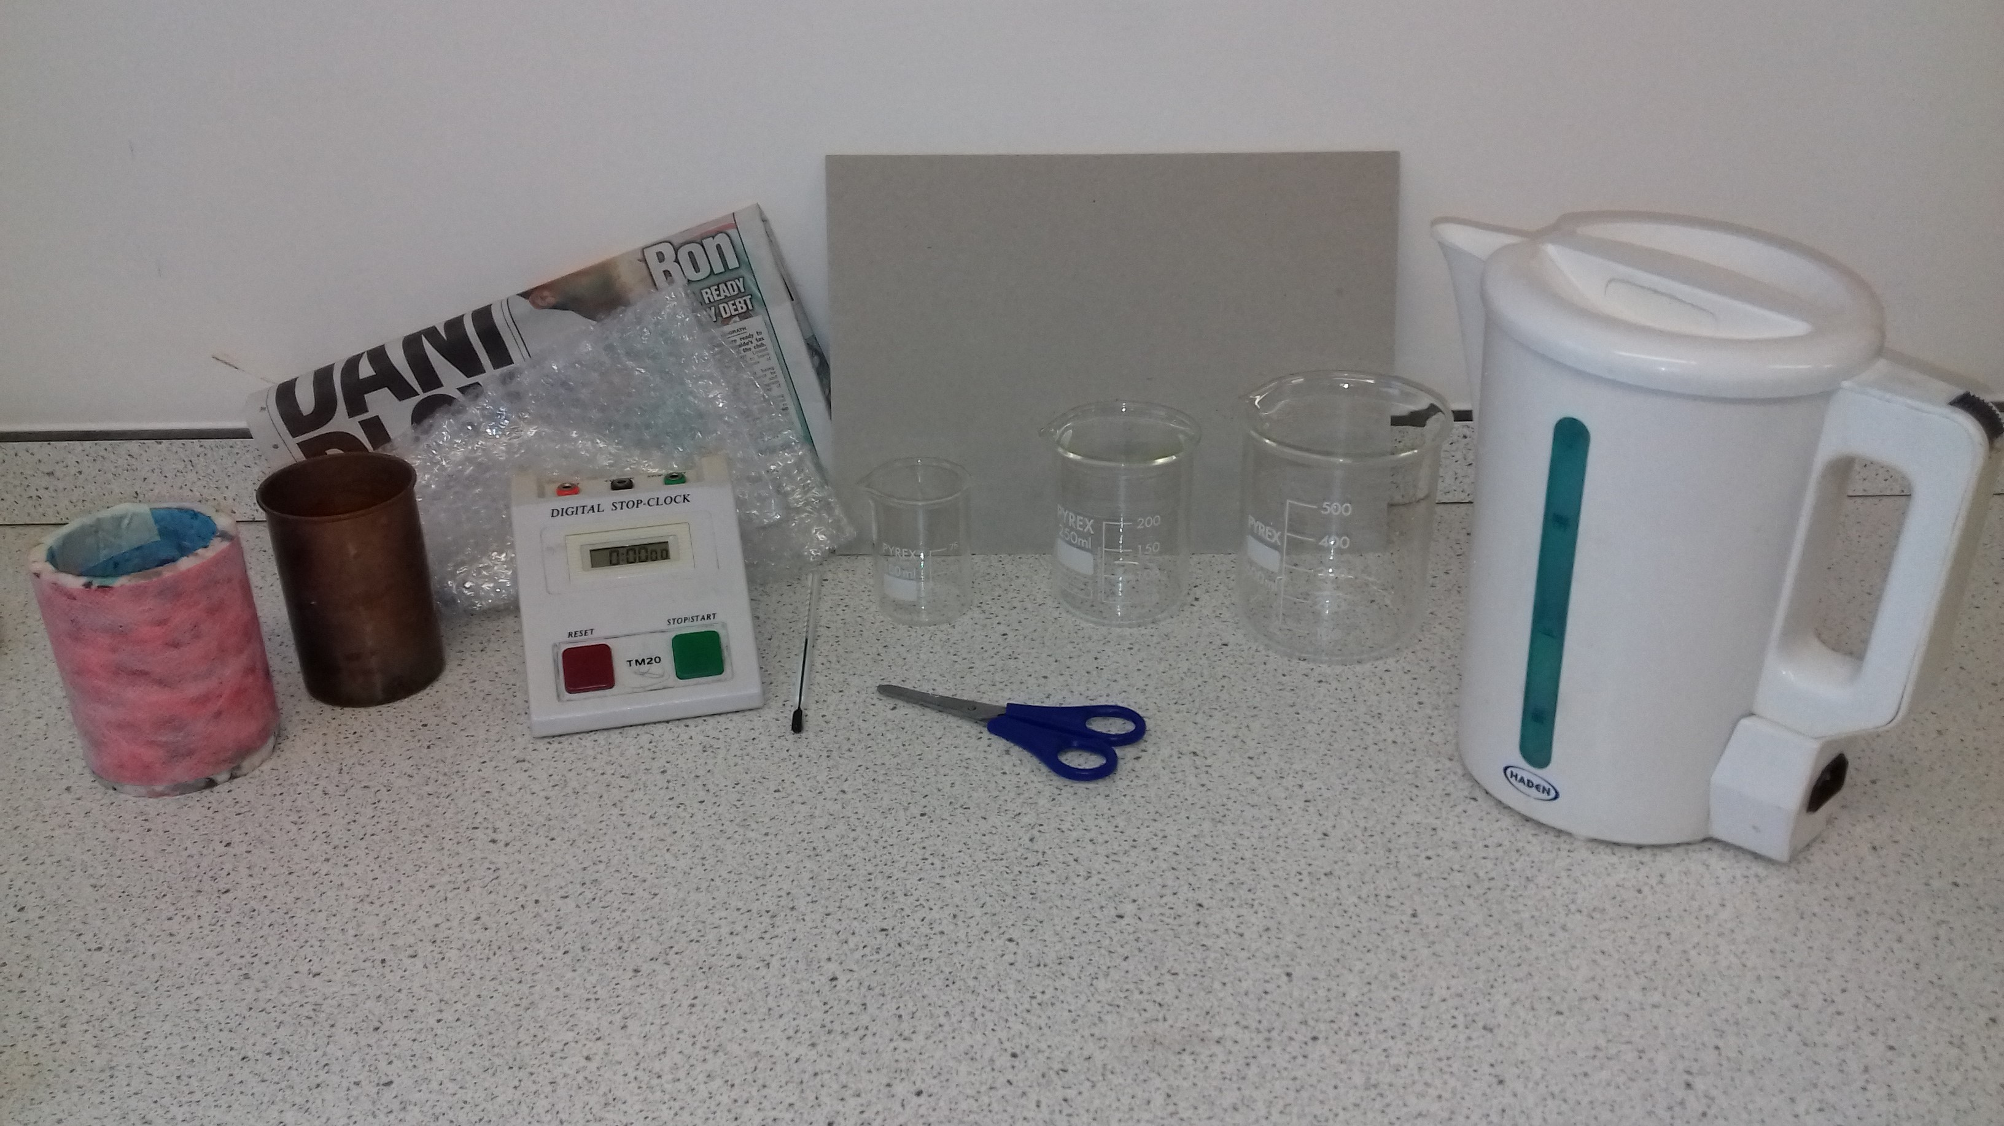
Hypothesis and Prediction
LO: To be able to devise and investigate testable questions.
Hypothesis-A proposal (suggestion) to explain certain facts or observations.
We are investigating factors affecting thermal insulation. What question could we ask?
Prediction-A statement about what will happen in the future, based on experience, observation or hypothesis.
What do you think will happen if change the type of insulation?

Slide 5
Hypothesis and Prediction
LO: To be able to devise and investigate testable questions.
Hypothesis-We are investigating factors affecting rate of cooling. What question could we ask?
What happens to the rate of cooling as we change the type of the insulation material?
Prediction- What do you think will happen if we change the type of insulation?
Changing the type of thermal insulation will affect the rate of cooling.

Slide 6
Hazard, Risk and Controls
LO: To be able to recognise hazards and plan how to minimise risk.
What are the hazards (something that can cause harm) in this practical?
What are the risks (assessment of the likelihood that a hazard could cause harm) in this practical?
What controls (things to be done to minimize the risk in an experiment) do we need in this practical?

Slide 7
Hazard, Risk and Controls
LO: To be able to recognise hazards and plan how to minimise risk.
What are the hazards (something that can cause harm) in this practical?
Hot water.
What are the risks (assessment of the likelihood that a hazard could cause harm) in this practical?
Scalding from hot water. Slipping on spilled water on the floor.
What controls (things to be done to minimize the risk in an experiment) do we need in this practical?
Perform the practical standing up and if scalded put the affected area under cold water for at least 10 minutes and inform the teacher. Be careful when pouring water. If water is spilled, tell the teacher and warn other students nearby.

Slide 8
Variables Independent, Dependent and Control
LO: To be able to identify and control variables.
Variables-These are quantalities or characteristics that are changed in the experiment.
What variables should you choose to answer the hypothesis: What happens to the rate of cooling as we change the type of the insulation material?
Independent-Values that are changed by the investigator (You)
Dependent-Value measured when the independent variable is changed (it depends on the independent variable)
Control-Variables that can affect the outcome of the investigation. So need to be controlled or monitored.

Slide 9
Variables Independent, Dependent and Control
LO: To be able to identify and control variables.
Hypothesis What happens to the rate of cooling as we change the type of the insulation material?
Independent?
I will change the type of insulation.
Dependent?
I will measure the rate of cooling.
Control?
I will keep the starting temperature of the water, thickness of the material, time the measurements are taken, volume of water and surface area of insulation the same.

Slide 10
Variables Independent, Dependent and Control Categoric or Continuous?
LO: To be able to identify and control variables.
Variables-They can be:
Categoric-Variables that are types or labels, e.g. type of insulation OR
Continuous-Variables that can be discrete numbers or a measured value, e.g. thickness of material
What type of variables are:
The rate of cooling is
The starting temperature is
The surface area of insulation is

Slide 11
Variables Independent, Dependent and Control Categoric or Continuous?
LO: To be able to identify and control variables.
Variables-They can be: Categoric OR Continuous
What type of variables are:
The rate of cooling is Continuous
The starting temperature is Continuous
The surface area of insulation is Continuous

Slide 12
How do we ensure a fair test?
LO: To be able to identify and control variables.
By making sure that the test we make is where only the independent variable has been allowed to affect the dependent variable, e.g. when all the control variables have been adequately controlled so only the independent variable is affecting the dependent variable.
Some values of control variables that could be kept the same:
Starting temperature will be 70 °C
Volume of water will be 200 ml
Time between measurements will be 5 mins

Slide 13
Collecting Data Calibration, Resolution, Interval, Range
LO: To be able to use specialist equipment to take measurements and handle and manipulate equipment with confidence and fluency
Resolution-The smallest change of a quantity that can be measured by an instrument giving a perceptible change, changing the instrument can increase resolution. What is the resolution of the thermometer?
Interval-the quantity between the readings, reducing this and taking more readings increase validity. What is the interval between our readings (insulation)?
Calibration-Marking a scale on an instrument where a relationship between the scale and standard or reference is established. Does the thermometer need calibrating?
Range-this is the maximum and minimum values of the independent and dependent variables. What is the range of the insulation?

Slide 14
Collecting Data Calibration, Resolution, Interval, Range
LO: To be able to use specialist equipment to take measurements and handle and manipulate equipment with confidence and fluency
Resolution-What is the resolution of the thermometer?
The thermometer has a resolution of 1°C
Interval-What is the interval between our readings (insulation)?
There are no intervals in this categoric variable.
Calibration- Does the thermometer need calibrating. How could we check?
To check we could put the thermometer in the ice water to see if it reads 0°C and boiling water to see if it reads 100°C.
Range- What is the range of the insulation?
There is no range for this categoric variable.

Slide 15
Suggested Method
LO: To be able to use specialist equipment to take measurements and handle and manipulate equipment with confidence and fluency
Put the small beaker inside the larger beaker.
Use the kettle to boil water and put 200 ml of this hot water into the small beaker.
Use a piece of cardboard as a lid for the large beaker. The cardboard must have a hole for the thermometer.
Insert the thermometer through the hole in the cardboard lid so that its bulb is in the hot water.
Record the temperature of the water and start the stopwatch.
Record the temperature of the water every 5 minutes for 20 minutes Add your results to a table.
Repeat steps 1‒6 using the different materials each time to fill the space between the small and large beaker.
Plot cooling curve graphs for each material.

Slide 16
Exemplar Results Table
LO: To be able to use specialist equipment to take measurements and handle and manipulate equipment with confidence and fluency
Type of Insulation | Temperature (°C)
 | 0 min | 5 min | 10 min | 15 min | 20 min
Newspaper | 70 | 56 | 47 | 38 | 32
Wool | 70 | 59 | 52 | 46 | 39
Bubble wrap | 70 | 63 | 55 | 49 | 42
polystyrene | 70 | 62 | 54 | 47 | 41
No insulation | 70 | 54 | 44 | 35 | 29

Slide 17
10. Sketch graph-Shows the general relationship between variables, no points, but axes are labelled and normally to scale.
9b. Reproducible-is where a different person, different technique or different apparatus produces the same result.
Analysing data
9c. True Value-Data obtained in an ideal measurement.
9d. Accuracy-Values close to the true value.
9a. Data Independent Variable | Dependent variable
 | Trial 1 | Trial 2 | Trial 3 | Average (Mean)
9e. Repeatable-To show repeatability, the results are similar for a repeated part of the experiment. To increase repeatability obtain more results that are similar.
12b. Evidence-Data that is shown to be valid.
9f. Precision-Data which has very little spread about the mean, precision can be increased by obtaining more results that are not spread much.
12a. Validity-Suitability of the investigation to answer the question, validity can be increased by obtaining more results which are similar and removing anomalous results.
11b. Random Error-Introduced in any measurement with a spread from the true value. They cannot be corrected only reduced by making more measurements and calculating a new mean.
11g. Anomalies-Values which are judged not to be a part of the variation caused by random uncertainty.
11a. Errors-Data that is not the same as the true value.
11f. Zero Error-False reading when the true value should be zero (0). It is a type of systematic error.
11c. Uncertainty-Interval within which the true value lies.
12c. Valid conclusion-Conclusion that is supported by valid data, from appropriate experiment design and sound reasoning.
11e. Systematic Error-Measurements that differ from the true value by a consistent amount each time. It cannot be fixed by repeating. A new technique or set of equipment should be tried and results compared.
11d. Measurement Error-measurements that are difference between our values and the true value.

Slide 18
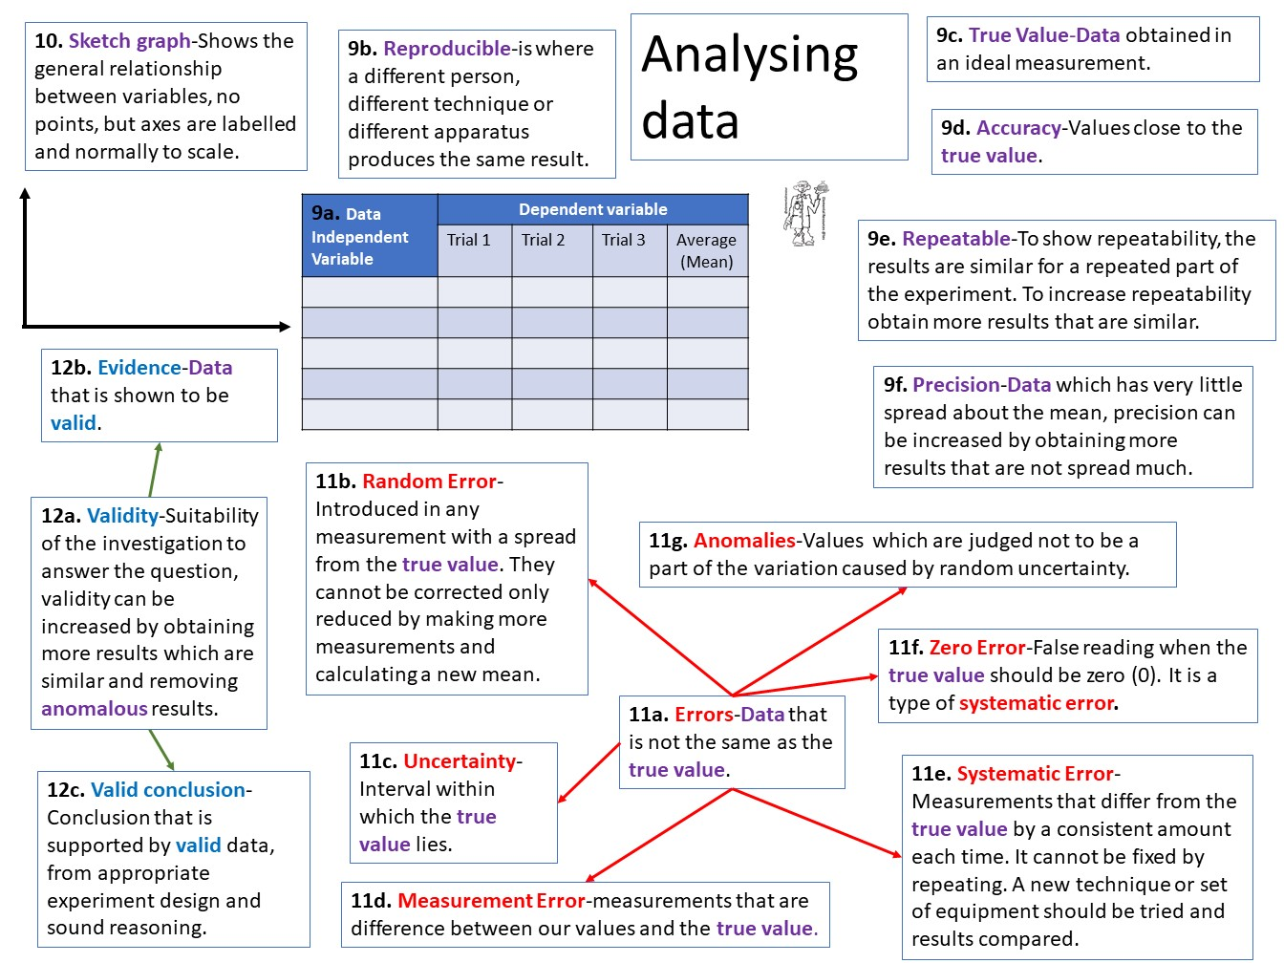
Results-Reproducible, Accurate, Repeatable, Precise
LO: To be able to analyse, interpret and evaluate data
Reproducible-is where a different person, different technique or different apparatus produces the same result. Has another member/group in your class obtained the same results as you/your group?
Accuracy-Values close to the true value. Describe how you kept your experiment a fair test.
Repeatable-To show repeatability, the results are similar for a repeated part of the experiment. To increase repeatability obtain more results that are similar. Are the results the same each time you repeated it?
Precision-Data which has very little spread about the mean, precision can be increased by obtaining more results that are not spread much. How close are your results to your mean?

Slide 19
Results-Reproducible, Accurate, Repeatable, Precise
LO: To be able to analyse, interpret and evaluate data
Reproducible -Has another member of your class obtained the same results?
If they have similar results, then the experiment is reproducible.
Accuracy -Describe how you kept your experiment a fair test.
It was kept a fair test by only changing the insulation and keeping the starting temperature at 80°C, the volume of water at 200 ml and taking measurements every 5 minutes.
Repeatable -Are the results the same each time you repeated it?
For Example: We did not repeat the experiment.
Precision -How close are your results to your mean?
For Example: We only obtained one set of results so we could not calculate a mean.

Slide 20
Drawing a Sketch Graph
LO: To be able to analyse, interpret and evaluate data
Sketch graph-Shows the general relationship between variables, no points, but axes are labelled and normally to scale. Draw one for your experiment

Slide 21
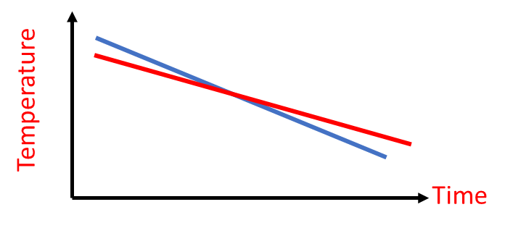
Drawing a Sketch Graph
LO: To be able to analyse, interpret and evaluate data
Sketch graph

Slide 22
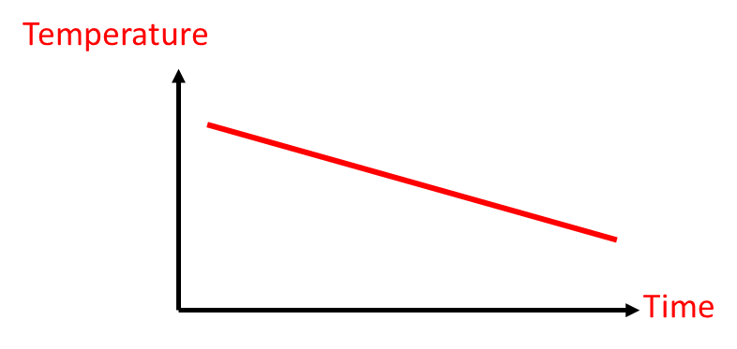
Calculating the Rate of Cooling
If your graph is a straight line, then you can calculate the rate of cooling by using this equation:
Rate of cooling = Change of Temperature (°C)
Change in Time (min)
Rate of
cooling =
10°C = 0.83 °C/min
12 min
10 °C
12 minutes

Slide 23
Calculating the Rate of Cooling
If your graph is a curve, then you will need to draw a tangent first, then calculate the rate of cooling by using this equation:
Rate of cooling = Change of Temperature (°C)
Change in Time (min)
Rate of
cooling =
8°C = 0.8 °C/min
10 min
8 °C
10 minutes

Slide 24
Errors-Zero, Systematic, Random
LO: To be able to analyse, interpret and evaluate data
Errors-Data that is not the same as the true value, e.g. if the true value is +0.15g and your measurement is +0.14g, then an error has occurred.
Zero Error-False reading when the true value should be zero (0). It is a type of systematic error.
Did the thermometer return to zero after measuring water temperature?
Systematic Error-Measurements that differ from the true value by a consistent amount each time. It cannot be fixed by repeating. A new technique or set of equipment should be tried and results compared.
How might trying to keep all the insulation the same thickness affect the results?
Random Error-Introduced in any measurement with a spread from the true value. They cannot be corrected only reduced by making more measurements and calculating a new mean.
Do any of your results show random errors-how can you tell?

Slide 25
Errors-Zero, Systematic, Random
LO: To be able to analyse, interpret and evaluate data
Zero Error-Did the thermometer return to zero after measuring the temperature of the water?
We did not check, as taking out the thermometer between readings would affect the results.
Systematic-How might trying to keep all the insulation the same thickness affect the results?
It was difficult to keep the same thickness, as doing this would involve increasing the layers of insulation.
Random-Do any of your results show random errors-how can you tell?
For example: We cannot tell, as we only obtained one set of results.

Slide 26
Errors-Measurement, Anomalies, Uncertainty
LO: To be able to analyse, interpret and evaluate data
Measurement Error-measurements that are difference between our values and the true value.
If the true value was the mean. Calculate the measurement error.
Anomalies-Values which are judged not to be a part of the variation caused by random uncertainty.
Do any of your results look like Anomalies-How do you know?
Uncertainty-Interval within which the true value lies. This is the number halfway between the values ± difference. E.g. between 10 and 16. Uncertainty is 13 ± 3.
If the true value lies between the highest and lowest measurements. Calculate it for your experiment.

Slide 27
Errors-Measurement, Anomalies, Uncertainty
LO: To be able to analyse, interpret and evaluate data
Measurement Error- If the true value was the mean. Calculate the measurement error.
For example: We did not calculate a mean, so we cannot calculate the measurement error.
Anomalies- Do any of your results look like Anomalies-How do you know?
For example: We only obtained one set of results, so we cannot spot anomalies easily.
Uncertainty- If the true value lies between the highest and lowest measurements. Calculate it for your experiment.
For example: We did not calculate a mean, so we cannot calculate the uncertainty this way.

Slide 28
Validity-Evidence and Conclusion
LO: To be able to analyse, interpret and evaluate data
Validity- Suitability of the investigation to answer the question, validity can be increased by obtaining more results which are similar and removing anomalous results.
Evidence- Data that is shown to be valid.
Valid conclusion- Conclusion that is supported by valid data, from appropriate experiment design and sound reasoning.
Describe how the method you used and the data you obtained made your experiment valid.

Slide 29
Validity-Evidence and Conclusion
LO: To be able to analyse, interpret and evaluate data
Validity- Describe how the method you used and the data you obtained made your experiment valid.
Our experiment only changed the insulation (independent variable) and measured the rate of cooling (dependent variable).
Most variables were controlled, for example, keeping the starting temperature at 80°C, the volume of water at 200 ml and taking measurements every 5 minutes.
The only variable that was hard to control was the thickness of the insulation. This will have affected our results, by reducing the rate of cooling for insulation that had to be made thicker.
The validity of our data can be increased by taking several measurements and producing a mean, and the
Data collected answers the hypothesis question- What happens to the rate of cooling as we change the type of the insulation material?

Slide 30
Exam Style Questions to Test Understanding

Slide 31
Learning Objective: To be able to remember variables, organize information and calculate resolution.
Thermal Insulation
Name: __________________
The section(s) I need to work on is/are : ____
Organise the method used to measure the effects of different insulations:
Plot cooling curve graphs for each material.
Use the kettle to boil water and put 80 ml of this hot water into the small beaker.
Insert the thermometer through the hole in the cardboard lid so that its bulb is in the hot water.
Record the temperature of the water and start the stopwatch.
Put the small beaker inside the larger beaker.
Repeat steps 1‒6 using the different materials each time to fill the space between the small and large beaker.
Use a piece of cardboard as a lid for the large beaker. The cardboard must have a hole for the thermometer.
Record the temperature of the water every 3 minutes for 20 minutes Add your results to a table.
Risk Assessment: Suggest what the risks are in this experiment. Describe what you should do to minimize the risks.
Grade 1/2
A
B
Grade 2/3
C
D
Resolution
What is the resolution of the Thermometer?
Which of these thermometers would have been used in this experiment? How do you know?
Variables:
Independent:
Dependent:
Control:
Grade 3
Time (min) | Temperature (°C)
0 | 75.2
3 | 72.4
6 | 68.5
Grade 3

Slide 32
Learning Objective: To be able to remember method, analyze information and recognize patterns in data.
E
Plan Without turning over (!) plan a method to obtain valid results for measuring the effects of different insulations.
Calculations
Draw a sketch graph of the above data
Which is the better insulator? Back up your answer with data.
F
Time (min) | Temperature (°C)
Time (min) | Newspaper | Bubble Wrap
0 | 75 | 80
3 | 72 | 78
6 | 68 | 76
9 | 64 | 75
12 | 62 | 73
15 | 60 | 71
18 | 58 | 70
Grade 4-7
Grade 4

Slide 33
Learning Objective: To be able to remember variables, organize information and calculate resolution.
Thermal Insulation
Name: __________________
The section(s) I need to work on is/are : ____
Organise the method used to measure the effects of different insulations:
8 Plot cooling curve graphs for each material.
2 Use the kettle to boil water and put 80 ml of this hot water into the small beaker.
4 Insert the thermometer through the hole in the cardboard lid so that its bulb is in the hot water.
5 Record the temperature of the water and start the stopwatch.
1 Put the small beaker inside the larger beaker.
7 Repeat steps 1‒6 using the different materials each time to fill the space between the small and large beaker.
3 Use a piece of cardboard as a lid for the large beaker. The cardboard must have a hole for the thermometer.
6 Record the temperature of the water every 3 minutes for 20 minutes Add your results to a table.
Risk Assessment: Suggest what the risks are in this experiment. Describe what you should do to minimize the risks.
Hot water can scald, so perform the practical standing up and if scalded put the affected area under cold water for at least 10 minutes and inform the teacher.
A
B
C
D
Resolution
What is the resolution of the Thermometer?
0.1 °C
Which of these thermometers would have been used in this experiment? How do you know?
The top one because there are 10 spaces between 30 and 29 (0.1). In the bottom one there are 10 spaces between 30 and 28 (0.2)
Variables:
Independent: Type of Insulation Material
Dependent: Rate of Cooling
Control: Size of Beakers, Thickness of Material, Starting Temperature.
Time (min) | Temperature (°C)
0 | 75.2
3 | 72.4
6 | 68.5

Slide 34
Learning Objective: To be able to remember method, analyze information and recognize patterns in data.
E
Plan Without turning over (!) plan a method to obtain valid results for measuring the effects of different insulations.
Put the small beaker inside the larger beaker.
Use the kettle to boil water and put 80 ml of this hot water into the small beaker.
Use a piece of cardboard as a lid for the large beaker. The cardboard must have a hole for the thermometer.
Insert the thermometer through the hole in the cardboard lid so that its bulb is in the hot water.
Record the temperature of the water and start the stopwatch.
Record the temperature of the water every 3 minutes for 20 minutes Add your results to a table.
Repeat steps 1‒6 using the different materials each time to fill the space between the small and large beaker.
Plot cooling curve graphs for each material.
Calculations
Draw a sketch graph of the above data
Which is the better insulator? Back up your answer with data.
Bubble wrap. It has a less steep gradient. It decreases 10°C over 18 minutes giving a cooling rate of 0.55°C/min rate. The Newspaper decreases 17°C over 18 minutes giving a cooling rate of 0.94°C/min rate.
F
Time (min) | Temperature (°C)
Time (min) | Newspaper | Bubble Wrap
0 | 75 | 80
3 | 72 | 78
6 | 68 | 76
9 | 64 | 75
12 | 62 | 73
15 | 60 | 71
18 | 58 | 70
Temperature
Time

