Slide 1

Relative formula mass
Success criteria
Use the periodic table to identify relative atomic masses (grade 3)
Calculate relative formula masses from data provided (grade 4)
Apply knowledge to complex exam questions (grade 5)
Starter: find the relative atomic mass of
O 2. Mg 3. N 4. Ca 5. Zn
6. C 7. K 8. Al 9. Ne 10. H
16
24
14
40
65
12
39
27
20
1

Slide 2
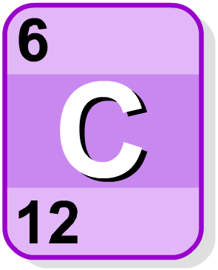
Where are r.a.m. values found?
The values of relative atomic mass (r.a.m.) will be on the periodic table you will given in the exam.
atomic number
symbol
relative atomic mass
When looking up relative atomic mass in the periodic table, remember that it always the larger of the two numbers given.
Mass number = ‘Mass’ive number

Slide 3
Relative formula mass
Atomic mass - A_{r}
Relative formula mass - M_{r}
Relative formula mass (M_{r}), of a substance is the sum of the relative atomic masses in the formula.

Slide 4
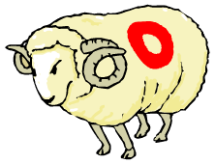


How is relative formula mass calculated?
To find the relative formula mass of a compound, add up the relative atomic masses of all the atoms in its formula.
Step 1: Write down the formula of the molecule.
Step 2: Find the r.a.m. of each type of atom in the molecule.
Step 3: Multiply each r.a.m. by the number of atoms of that
element and add these values together.
What is the relative formula mass of water?
Step 1: formula of water is H₂O
Step 2: Atomic mass values: hydrogen = 1, oxygen = 16
Step 3: Relative formula mass = (2 x 1) + (1 x 16) = 18

Slide 5
Relative formula mass
We have a go
Calculate the M_{r} of carbon dioxide
Step 1: Formula of carbon dioxide is: CO₂
Step 2: C = 12 – How many carbon’s do you have?
O = 16 – How many oxygen’s do you have?
Step 3:
(12 x 1) + (16 x 2)
12 + 32 = 44.
M_{r} of CO₂ = 44
Key point:
Little numbers next to letters – these mean that there are two of the element to its left!
Not two of everything!

Slide 6

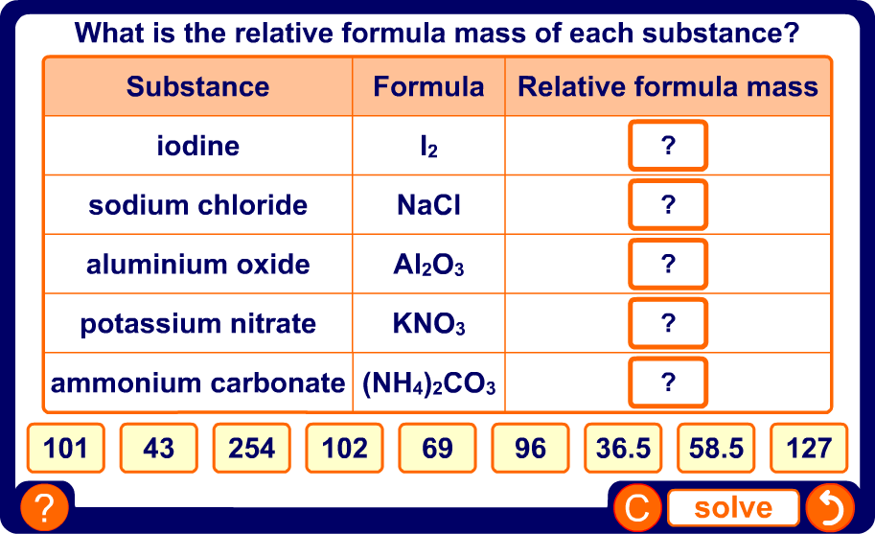
Match the relative formula mass
Calculate the relative formula mass of each substance.
The correct answers are in the selection below. If your answer doesn’t match one of those, you’ve gone wrong.
Key points:
Little numbers mean there are two of the element to the left of it.
Brackets – Work out the formula mass of what is inside the bracket first. Then multiple that by the number on the outside.
Notes:
Teacher notes
This drag and drop activity provides the opportunity for informal assessment of students’ understanding of calculating relative atomic mass.

Slide 7
Calculate the relative formula masses of:
N₂
2. CaCl2
3. NH₃
4. H₂SO₄
5. (NH₄)₂SO₄

Slide 8


“Moles (mol) is the measurement of chemical amounts.”
“One mole of a substance is equal to the A_{r} or M_{r}”
WORDS
MOLES

Slide 9
YOU need to
RECALL
&
APPLY
Number of moles = mass ÷ relative formula mass
n = m ÷ M^{r}

Slide 10
n = m ÷ M^{r}
Watch as we transfer the equation into the triangle
m
n
M^{r}

Slide 11
Questions involving Moles
These questions can ask you to do 1 of 2 possible calculations
Calculate the number of moles
Calculate the mass

Slide 12
Questions involving Moles
These questions can ask you to do 1 of 2 possible calculations
Calculate the number of moles in 235g of
K₂O
Calculate the mass of 10 moles of K₂O
M_{r} of K₂O = 94
M_{r} of K₂O = 94
n = m ÷ M_{r}
m = n x M_{r}
n = 235 ÷ 94
m = 10 x 94
n = 2.5
m = 940g

Slide 13
Calculate the mass of a sample using this equation:
0.5 moles of magnesium oxide, MgO
0.1 moles of calcium oxide, CaO
0.2 moles of water, H₂O
1.5 moles of sodium hydroxide, NaOH
0.75 moles of potassium hydroxide, KOH
Calculate the number of moles present in:
10g of magnesium oxide, MgO
5.6g of calcium oxide, CaO
3.6g of water, H₂O
0.4g of sodium hydroxide, NaOH
2.8g of potassium hydroxide, KOH

Slide 14
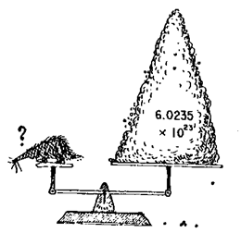
Avogadro’s Number
All you need to know is that 1 mole of a substance is the A_{r} or the M_{r} in grams.
The mole - Higher - Calculations in chemistry - Higher - AQA - GCSE Combined Science Revision - AQA Trilogy - BBC Bitesize

Slide 15
moles = molecules ÷ Avogadro’s number
molecules = moles x Avogadro’s number
molecules
moles
^{Avogadro’s number}

Slide 16
Calculate the percentage of an element in a compound
Write down the formula of the compund
Find relative atomic masses (A_{r}) of each element
Calculate the relative formula mass (M_{r}) of the compound
Write the mass of the element you are looking for as fraction of the total relative mass.
Find the percentage by multiplying your fraction by 100.

Slide 17
How to calculate a percentage
What percentage did you get in a test if you answered correctly 21 out of 28 questions?
21 x 100 = 75%
28

Slide 18
What percentage mass of white magnesium oxide is actually magnesium?
Step | What to do | Answer
1 | Write down formula | MgO
2 | A_{r} Mg | 24
3 | A_{r} O | 16
4 | M_{r} (total mass of compound) | 40
 | A_{r} of Mg 24 Total mass of compound 40
5 | (24 ÷ 40) x 100 = | 60 %

Slide 19
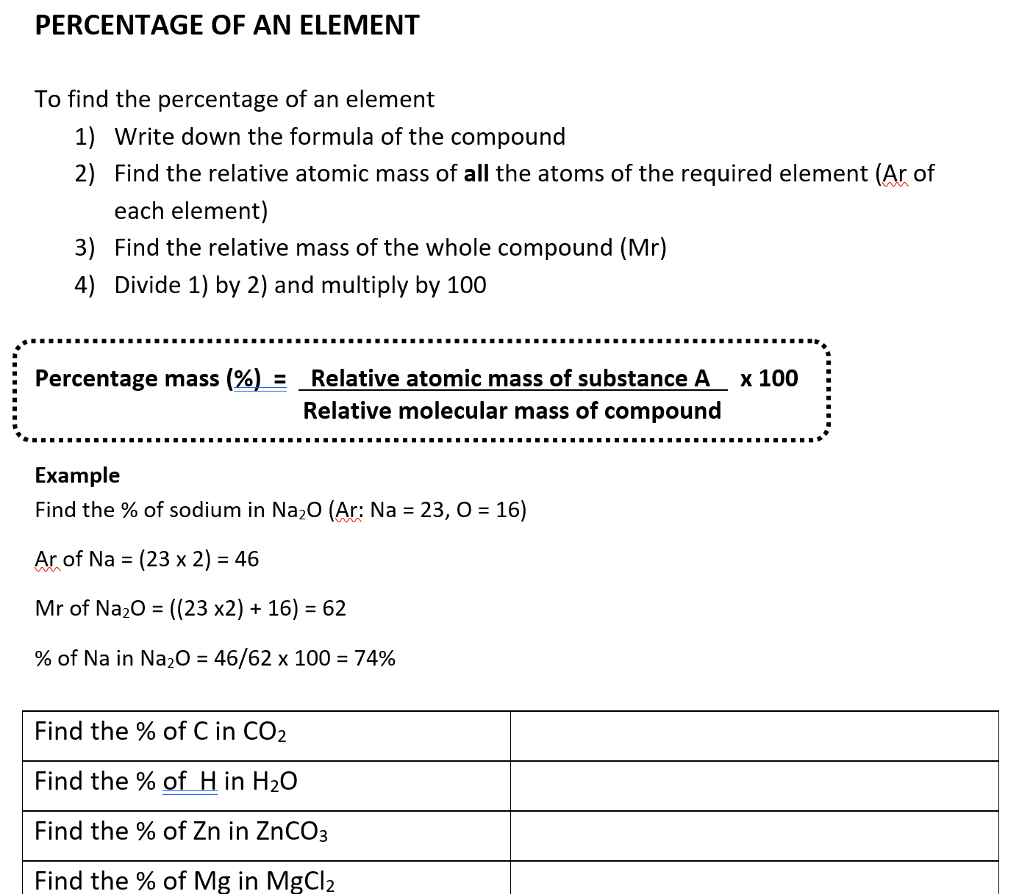

Slide 20
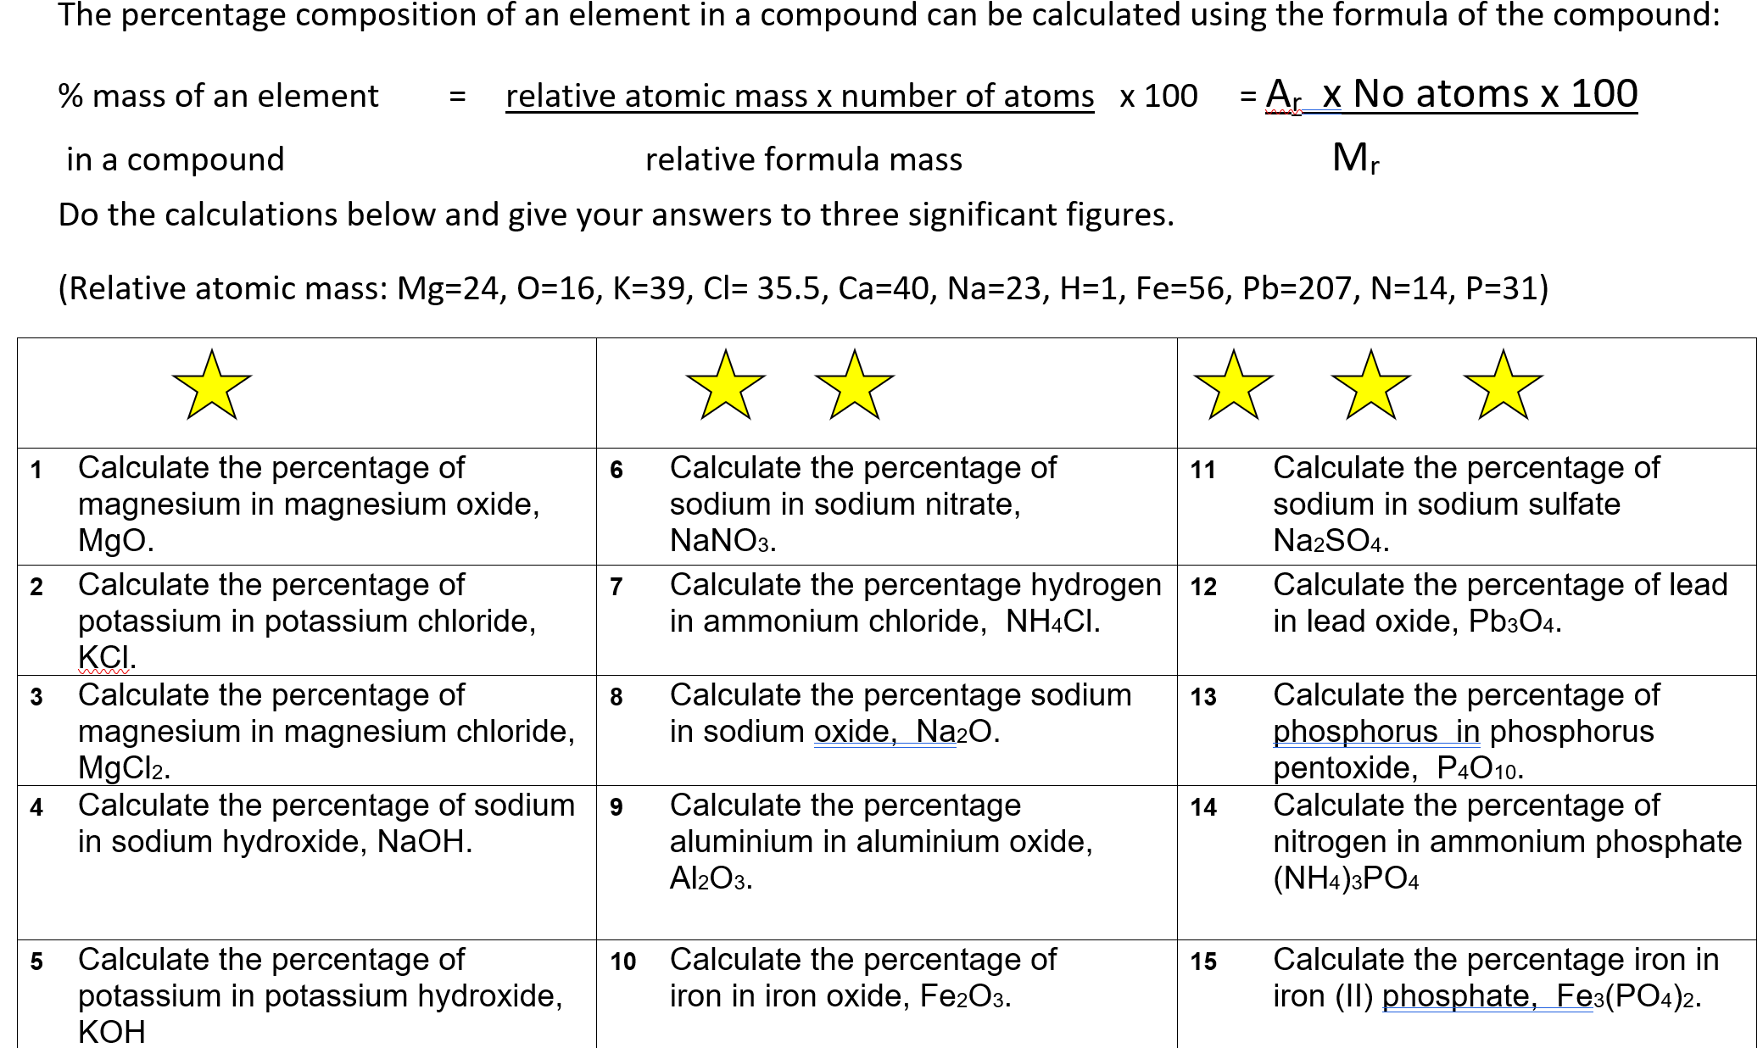

Slide 21
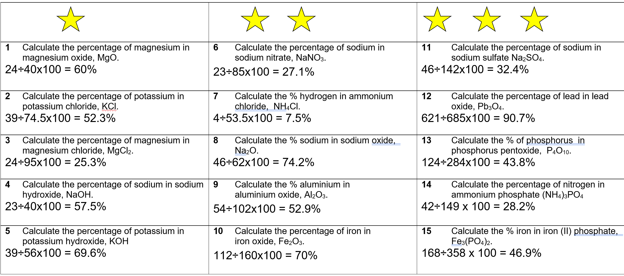

Slide 22
C3 Quantitative Chemistry
Relative Formula mass – Done
Moles – Done
Avogadro’s constant – Done
Percentage by mass of an element – Done
Concentration
Reacting masses

