Slide 1
The PiXL Club The PiXL Club The PiXL Club The PiXL Club The PiXL Club The PiXL Club The PiXL Club The PiXL Club The PiXL Club The PiXL Club The PiXL Club The PiXL Club The PiXL Club The PiXL Club The PiXL Club The PiXL Club The PiXL Club The PiXL Club The PiXL Club The PiXL Club The PiXL Club The PiXL Club The PiXL Club The PiXL Club The PiXL Club The PiXL Club The PiXL Club The PiXL Club The PiXL Club The PiXL Club The PiXL Club The PiXL Club The PiXL Club The PiXL Club The PiXL Club The PiXL Club The PiXL Club The PiXL Club The PiXL Club The PiXL Club The PiXL Club The PiXL Club The PiXL Club The PiXL Club The PiXL Club XL Club The PiXL Club The PiXL Club The PiXL Club The PiXL Club The PiXL Club The PiXL Club The PiXL Club The PiXL Club The PiXL Club The PiXL Club The PiXL Club The PiXL Club The PiXL Club The PiXL Club The PiXL Club The PiXL Club The PiXL Club The PiXL Club The PiXL Club The PiXL Club The PiXL Club The PiXL Club The PiXL Club The PiXL Club The PiXL Club The PiXL Club The PiXL Club The PiXL Club The PiXL Club The PiXL Club The PiXL Club The PiXL Club The PiXL Club The PiXL Club The PiXL Club The PiXL Club The PiXL Club The PiXL Club The PiXL Club The PiXL Club The PiXL Club The PiXL Club The PiXL Club The PiXL Club The PiXL Club The PiXL Club The PiXL Club The PiXL Club The PiXL Club The PiXL Club The PiXL Club The PiXL Club The PiXL Club The PiXL Club The PiXL Club The PiXL Club The PiXL Club The PiXL Club The PiXL Club The PiXL Club The PiXL Club The PiXL Club The PiXL Club The PiXL Club The PiXL Club The PiXL Club The PiXL Club The PiXL Club The PiXL Club The PiXL Club The PiXL Club The PiXL Club The PiXL Club The PiXL Club The PiXL Club The PiXL Club The PiXL Club The PiXL Club The PiXL Club The PiXL Club The PiXL Club The PiXL Club The PiXL Club The PiXL Club The PiXL Club The PiXL Club The PiXL Club The PiXL Club The PiXL Club The PiXL Club The PiXL Club The PiXL Club The PiXL Club The PiXL Club The PiXL Club The PiXL Club The PiXL Club The PiXL Club The PiXL Club The PiXL Club The PiXL Club The PiXL Club The PiXL Club The PiXL Club The PiXL Club The PiXL Club The PiXL Club The PiXL Club The PiXL Club The PiXL Club The PiXL Club The PiXL Club The PiXL Club The PiXL Club The PiXL Club The PiXL Club The PiXL Club The PiXL Club The PiXL Club The PiXL Club The PiXL Club The PiXL Club The PiXL Club The PiXL Club The PiXL Club The PiXL Club The PiXL Club The PiXL Club The PiXL Club The PiXL Club The PiXL Club The PiXL Club The PiXL Club The PiXL Club The PiXL Club The PiXL Club The PiXL Club The PiXL Club The PiXL Club The PiXL Club The PiXL Club The PiXL Club The PiXL Club The PiXL Club The PiXL Club The PiXL Club The PiXL Club The PiXL Club The PiXL Club The PiXL Club The PiXL Club The PiXL Club The PiXL Club The PiXL Club The PiXL Club The PiXL Club The PiXL Club The PiXL Club The PiXL Club The PiXL Club The PiXL Club The PiXL Club The PiXL Club The PiXL Club The PiXL Club The PiXL Club The PiXL Club The PiXL Club The PiXL Club The PiXL Club The PiXL Club The PiXL Club The PiXL Club The PiXL Club The PiXL Club The PiXL Club The PiXL Club The PiXL Club The PiXL Club The PiXL Club The PiXL Club The PiXL Club The PiXL Club The PiXL Club The PiXL Club The PiXL Club The PiXL Club The PiXL Club The PiXL Club The PiXL Club The PiXL Club The PiXL Club The PiXL Club The PiXL Club The PiXL Club The PiXL Club The PiXL Club The PiXL Club The PiXL Club The PiXL Club The PiXL Club The PiXL Club The PiXL Club The PiXL Club The PiXL Club The PiXL Club The PiXL Club The PiXL Club The PiXL Club The PiXL Club The PiXL Club The PiXL Club The PiXL Club The PiXL Club The PiXL Club The PiXL Club The PiXL Club The PiXL Club The PiXL Club The PiXL Club The PiXL Club The PiXL Club The PiXL Club The PiXL Club The PiXL Club The PiXL Club The PiXL Club The PiXL Club The PiXL Club The PiXL Club The PiXL Club The PiXL Club The PiXL Club The PiXL Club The PiXL Club The PiXL Club The PiXL Club The PiXL Club The PiXL Club The PiXL Club The PiXL Club The PiXL Club The PiXL Club The PiXL Club The PiXL Club The PiXL Club The PiXL Club The PiXL Club The PiXL Club The PiXL Club The PiXL Club The PiXL Club The PiXL Club The PiXL Club The PiXL Club The PiXL Club The PiXL Club The PiXL Club The PiXL Club The PiXL Club The PiXL Club The PiXL Club The PiXL Club The PiXL Club The PiXL Club The PiXL Club The PiXL Club The PiXL Club The PiXL Club The PiXL Club The PiXL Club The PiXL Club The PiXL Club The PiXL Club The PiXL Club The PiXL Club The PiXL Club The PiXL Club The PiXL Club The PiXL Club The PiXL Club The PiXL Club The PiXL Club The PiXL Club The PiXL Club The PiXL Club The PiXL Club The PiXL Club The PiXL Club The PiXL Club The PiXL Club The PiXL Club The PiXL Club The PiXL Club The PiXL Club The PiXL Club The PiXL Club The PiXL Club The PiXL Club The PiXL Club The PiXL Club The PiXL Club The PiXL Club The PiXL Club The PiXL Club The PiXL Club The PiXL Club The PiXL Club The PiXL Club The PiXL Club The PiXL Club The PiXL Club The PiXL Club The PiXL Club The PiXL Club The PiXL Club The PiXL Club The PiXL Club The PiXL Club The PiXL Club The PiXL Club The PiXL Club The PiXL Club The PiXL Club The PiXL Club The PiXL Club The PiXL Club The PiXL Club The PiXL Club The PiXL Club The PiXL Club The PiXL Club The PiXL Club The PiXL Club The PiXL Club The PiXL Club The PiXL Club The PiXL Club The PiXL Club The PiXL Club The PiXL Club The PiXL Club The PiXL Club The PiXL Club The PiXL Club The PiXL Club The PiXL Club The PiXL Club The PiXL Club The PiXL Club The PiXL Club The PiXL Club The PiXL Club The PiXL Club The PiXL Club The PiXL Club The PiXL Club The PiXL Club The PiXL Club The PiXL Club The PiXL Club The PiXL Club The PiXL Club The PiXL Club The PiXL Club The PiXL Club The PiXL Club The PiXL Club The PiXL Club The PiXL Club The PiXL Club The PiXL Club The PiXL Club The PiXL Club The PiXL Club The PiXL Club The PiXL Club The PiXL Club The PiXL Club The PiXL Club The PiXL Club The PiXL Club The PiXL Club The PiXL Club The PiXL Club The PiXL Club The PiXL Club The PiXL Club The PiXL Club The PiXL Club The PiXL Club The PiXL Club The PiXL Club The PiXL Club The PiXL Club The PiXL Club The PiXL Club The PiXL Club The PiXL Club The PiXL Club The PiXL Club The PiXL Club The PiXL Club The PiXL Club The PiXL Club The PiXL Club The PiXL Club The PiXL Club The PiXL Club The PiXL Club The PiXL Club The PiXL Club The PiXL Club The PiXL Club The PiXL Club The PiXL Club The PiXL Club The PiXL Club The PiXL Club The PiXL Club The PiXL Club The PiXL Club The PiXL Club The PiXL Club The PiXL Club The PiXL Club The PiXL Club The PiXL Club The PiXL Club The PiXL Club The PiXL Club The PiXL Club The PiXL Club The PiXL Club The PiXL Club The PiXL Club The PiXL Club The PiXL Club The PiXL Club The PiXL Club The PiXL Club The PiXL Club The PiXL Club The PiXL Club The PiXL Club The PiXL Club The PiXL Club The PiXL Club The PiXL Club The PiXL Club The PiXL Club The PiXL Club The PiXL Club The PiXL Club The PiXL Club The PiXL Club The PiXL Club The PiXL Club The PiXL Club The PiXL Club The PiXL Club The PiXL Club The PiXL Club The PiXL Club The PiXL Club The PiXL Club The PiXL Club The PiXL Club The PiXL Club The PiXL Club The PiXL Club The PiXL Club The PiXL Club The PiXL Club The PiXL Club The PiXL Club The PiXL Club The PiXL Club The PiXL Club The PiXL Club The PiXL Club The PiXL Club The PiXL Club The PiXL Club The PiXL Club The PiXL Club The PiXL Club The PiXL Club The PiXL Club The PiXL Club The PiXL Club The PiXL Club The PiXL Club The PiXL Club The PiXL Club The PiXL Club The PiXL Club The PiXL Club The PiXL Club The PiXL Club The PiXL Club The PiXL Club The PiXL Club The PiXL Club The PiXL Club The PiXL Club The PiXL Club The PiXL Club The PiXL Club The PiXL Club The PiXL Club The PiXL Club The PiXL Club The PiXL Club The PiXL Club The PiXL Club The PiXL Club The PiXL Club The PiXL Club The PiXL Club The PiXL Club The PiXL Club The PiXL Club The PiXL Club The PiXL Club The PiXL Club The PiXL Club The PiXL Club The PiXL Club The PiXL Club The PiXL Club The PiXL Club The PiXL Club The PiXL Club The PiXL Club The PiXL Club The PiXL Club The PiXL Club The PiXL Club The PiXL Club The PiXL Club The PiXL Club The PiXL Club The PiXL Club The PiXL Club The PiXL Club The PiXL Club The PiXL Club The PiXL Club The PiXL Club The PiXL Club The PiXL Club The PiXL Club The PiXL Club The PiXL Club The PiXL Club The PiXL Club The PiXL Club The PiXL Club The PiXL Club The PiXL Club The PiXL Club The PiXL Club The PiXL Club The PiXL Club The PiXL Club The PiXL Club The PiXL Club The PiXL Club The PiXL Club The PiXL Club The PiXL Club The PiXL Club The PiXL Club The PiXL Club The PiXL Club The PiXL Club The PiXL Club The PiXL Club The PiXL Club The PiXL Club The PiXL Club The PiXL Club The PiXL Club The PiXL Club The PiXL Club The PiXL Club The PiXL Club The PiXL Club The PiXL Club The PiXL Club The PiXL Club The PiXL Club The PiXL Club The PiXL Club The PiXL Club The PiXL Club The PiXL Club The PiXL Club The PiXL Club The PiXL Club The PiXL Club The PiXL Club The PiXL Club The PiXL Club The PiXL Club The PiXL Club The PiXL Club The PiXL Club The PiXL Club The PiXL Club The PiXL Club The PiXL Club The PiXL Club The PiXL Club The PiXL Club The PiXL Club The PiXL Club The PiXL Club The PiXL Club The PiXL Club The PiXL Club The PiXL Club The PiXL Club The PiXL Club The PiXL Club The PiXL Club The PiXL Club The PiXL Club The PiXL Club The PiXL Club The PiXL Club The PiXL Club The PiXL Club The PiXL Club The PiXL Club The PiXL Club The PiXL Club The PiXL Club The PiXL Club The PiXL Club The PiXL Club The PiXL Club The PiXL Club The PiXL Club The PiXL Club The PiXL Club The PiXL Club The PiXL Club The PiXL Club The PiXL Club The PiXL Club The PiXL Club The PiXL Club The PiXL Club The PiXL Club The PiXL Club The PiXL Club The PiXL Club The PiXL Club The PiXL Club The PiXL Club The PiXL Club The PiXL Club The PiXL Club The PiXL Club The PiXL Club The PiXL Club The PiXL Club The PiXL Club The PiXL Club The PiXL Club The PiXL Club The PiXL Club The PiXL Club The PiXL Club The PiXL Club The PiXL Club The PiXL Club The PiXL Club The PiXL Club The PiXL Club The PiXL Club The PiXL Club The PiXL Club The PiXL Club The PiXL Club The PiXL Club The PiXL Club The PiXL Club The PiXL Club The PiXL Club The PiXL Club The PiXL Club The PiXL Club The PiXL Club The PiXL Club The PiXL Club The PiXL Club The PiXL Club
PiXL KnowIT!
GCSE Physics
AQA Topic – P4 Atomic structure and Radiation
© Copyright The PiXL Club Ltd, 2017
This resource is strictly for the use of member schools for as long as they remain members of The PiXL Club. It may not be copied, sold nor transferred to a third party or used by the school after membership ceases. Until such time it may be freely used within the member school.
All opinions and contributions are those of the authors. The contents of this resource are not connected with nor endorsed by any other company, organisation or institution.
www.pixl.org.uk The PiXL Club Ltd, Company number 07321607

Slide 2
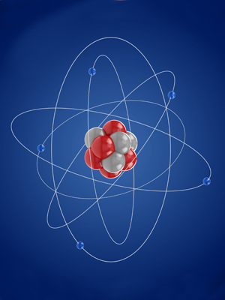
Overview Atomic structure
Atoms and isotopes
Structure of an atom
Mass number, atomic number and isotopes
Development of the atomic model
Atoms and nuclear radiation
Radioactive decay and nuclear radiation
Nuclear equations
Half lives and random nature of decay
Radioactive contamination

Slide 3
LearnIT!
KnowIT!
Atoms and isotopes
Structure of an atom
Mass number, atomic number
and isotopes
Development of the model of
the atom.

Slide 4
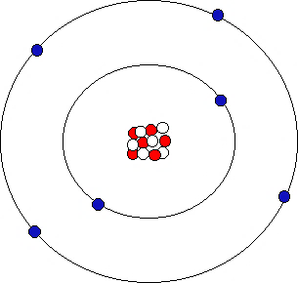
Structure of an atom
Atoms are made up of different numbers of protons, neutrons and electrons.
Atoms have the same number of + protons as – electrons so they are electrically neutral.
Electrons (-1 charge) arranged in orbits or energy levels around the nucleus.
Energy levels can hold a maximum of:
2 e⁻ in the first level
8 e⁻ in the second level
8 e⁻ in the third level
An atom of Carbon
. 9 x 10¹³ atoms
in this dot of ink
Nucleus made up of:
Protons: charge +1
Neutrons: charge 0
Nucleus of an atom has a positive charge
The radius of the nucleus is less than 1/10 000 the radius of the atom – the atom is 99.9999999% empty space!
Radius of an atom 1 x 10 ⁻¹⁰m
The nucleus holds 99% of the mass of the atom

Slide 5
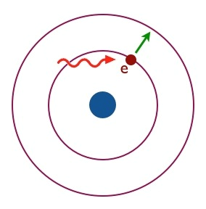
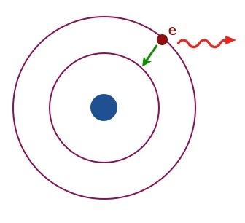
Structure of an atom
Electrons can absorb electromagnetic radiation. This excites the electron and can cause it to “jump” to a higher energy level.
It can then release this energy as an electromagnetic wave by falling back to its original energy level.
Electromagnetic radiation
absorbed by the electron causes it to move to a higher energy level.
The electron can emit this stored energy as electromagnetic radiation.
As it loses energy the electron returns to its original energy level.
A photon is the amount of energy needed to make an electron jump an energy level. This same amount of energy will be emitted as a photon of electromagnetic radiation as the electron drops back to its original ground state.

Slide 6
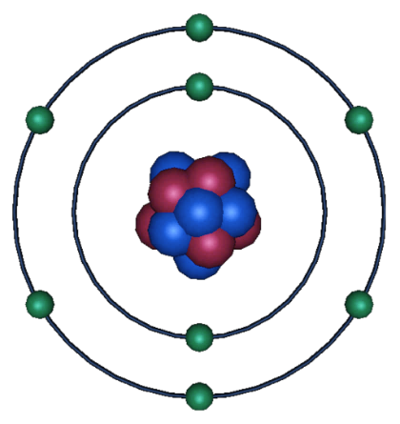
Mass number, atomic number and isotopes
All atoms of a particular element have the same number of protons. The number of protons in an element is called its atomic number.
Protons
Neutrons
Electrons
Neutrons
The total number of protons and neutrons in an atom is called its mass number. Oxygen has a mass number of 16. If it has 8 protons it must therefore have 8 neutrons to make a mass number of 16.
Protons
On the periodic table, oxygen is shown as having an atomic number of eight, therefore 8 protons.
Electrons
Atoms are electrically neutral so there must be the same number of electrons (-) as protons (+); 8 electrons.
Oxygen has: 8 protons, (16 – 8) = 8 neutrons, and 8 electrons

Slide 7
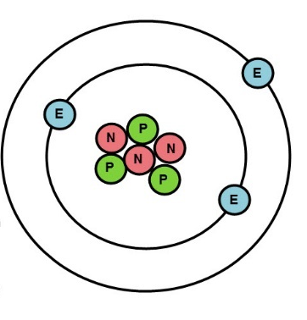
Mass number, atomic number and isotopes
Isotopes are elements with different atomic masses.
The number of protons can not change or it would not be the same element so an isotope is an element with different numbers of neutrons.
Lithium has two stable isotopes, Lithium 6 and Lithium 7
Lithium 6 has
3 protons
3 neutrons
Lithium 7 has
3 protons
4 neutrons
N
Both isotopes have the same number of protons and the same number of electrons.
Only the number of neutrons changes in an isotope.

Slide 8
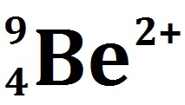
Mass number, atomic number and isotopes
Atoms can form ions if they gain or lose electrons. Atoms do this so they have full outer energy levels.
Beryllium can lose 2 electrons from its outer energy level to become an ion.
If Beryllium loses 2 e⁻
it now has:
4 protons 4+
2 electrons 2-
2+
Berylium ²⁺
Atoms can lose (-) electrons to become positive (+) ions
or gain (-) electrons to become negative (-) ions.

Slide 9
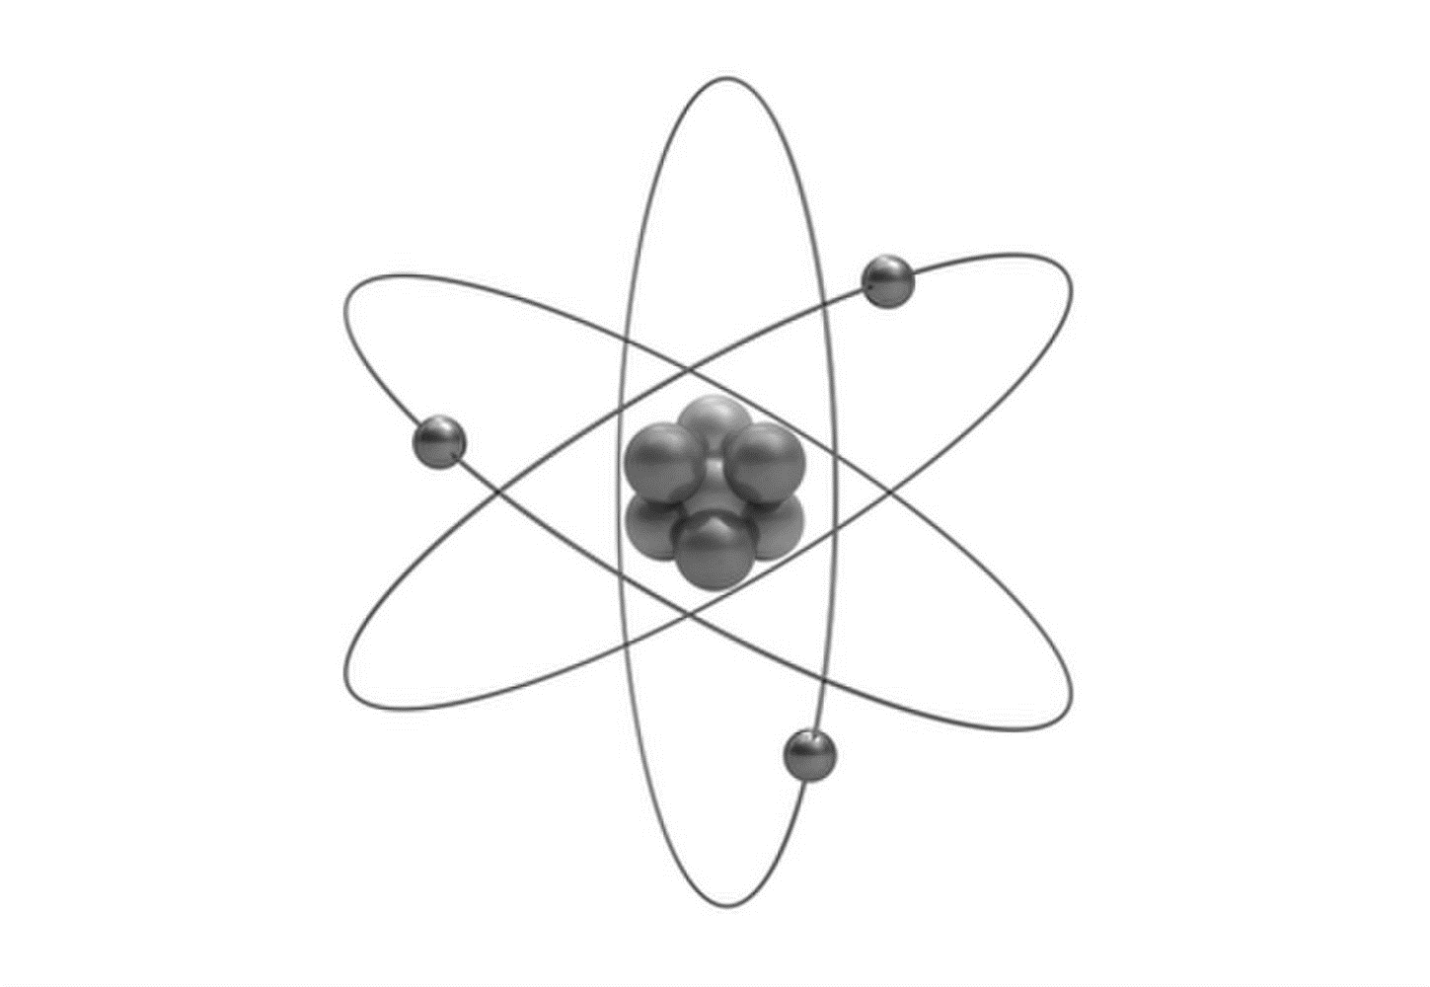
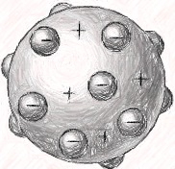
Development of the model of the atom
Pre 1900
Pre 1911
1911 to present
Sphere | Plum pudding model | Nuclear model
Before the discovery of the electron, atoms were thought to be tiny spheres that could not be divided. | The discovery of the electron led to the plum pudding model of the atom. The plum pudding model suggested the atom is a ball of positive charge with negative electrons embedded in it. | Alpha scattering experiment – mass of the atom is concentrated in the nucleus, which is charged. Niels Bohr – electrons orbit nucleus at different distances. Later experiments – positive charge in nucleus divided into whole number of smaller particles with positive charge. James Chadwick – 20 years after nucleus accepted – provided evidence for existence of neutrons in nucleus.

Slide 10
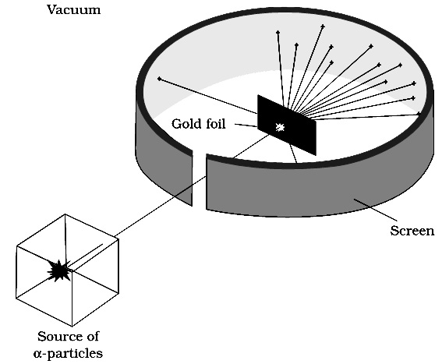
Atoms and isotopes – Development of the model of the atom
Rutherford’s alpha scattering experiment
A beam of alpha particles are directed at a very thin gold foil screen.
A few (+) alpha particles are deflected by a positive nucleus within the gold atoms.
Most (99.99%) of the alpha particles pass straight through the gold foil unaffected by its presence.
A tiny number of alpha particles are reflected because they collide with the nucleus of the gold atoms.
(α particles have a + charge)
Rutherford concluded that the gold atoms are mostly empty space with a positively charged nucleus that contains nearly all the mass of the atom.

Slide 11
QuestionIT!
Atoms and isotopes
Structure of an atom
Mass number, atomic number
and isotopes
Development of the model of
the atom.

Slide 12
Atoms and isotopes - QuestionIT
The diameter of an atom is about 0.000 000 000 2 m. What is this distance in standard form?
What is the nucleus of an atom composed of?
Describe what happens when an electron drops to a lower energy level in an atom.
An atom of sodium is represented by:
Use this information to determine the number of protons, neutrons and electrons in an atom of sodium.
What is the electrical charge attached to:
a neutron
an electron
a proton

Slide 13
Atoms and isotopes - QuestionIT
What is the mass number and the atomic number for fluorine?
Beryllium has the chemical symbol:
Use this information to draw a representation of an atom of beryllium.
A different isotope of beryllium has an extra neutron. Give the chemical symbol of this new isotope of beryllium.
9 | Be
4

Slide 14
Atoms and isotopes – AnswerIT
The radioactive element Uranium has two common isotopes.
Complete the table to show the number of protons, neutrons and electrons in each isotope.
Sodium can lose its outer electron to have a full outer energy level. What will the atom now become?
236 | U
92
and
238 | U
92
Isotope | Protons | Neutrons | Electrons
236 | U
92
238 | U
92

Slide 15
Atoms and isotopes – AnswerIT
Which scientific discovery resulted in the solid atom theory being adapted into the “plum pudding” model of the atom?
Rutherford carried out an experiment to show alpha particles either passing through gold leaf, being scattered by it. Summarise the conclusions he made from this experiment.
What contribution did Niels Bohr make to the arrangement of electrons in the atomic model?

Slide 16
AnswerIT!
Atoms and isotopes
Structure of an atom
Mass number, atomic number and isotopes
Development of the model
of the atom.

Slide 17
Atoms and isotopes - AnswerIT
The diameter of an atom is about 0.000 000 000 2 m. What is this distance in standard form?
2 x 10 ⁻¹⁰ m
What is the nucleus of an atom composed of?
Protons and neutrons (except Hydrogen which has no neutrons).
Describe what happens when an electron drops to a lower energy level in an atom.
It releases a photon of electromagnetic radiation.
An atom of sodium is represented by:
Use this information to determine the number of protons, neutrons and electrons in an atom of sodium.
Protons = 11 Neutrons = 12 Electrons = 11
What is the electrical charge attached to:
a neutron Neutral
an electron Negative
a proton Positive

Slide 18
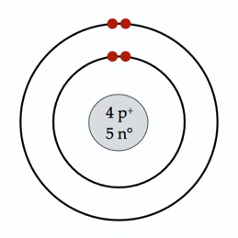
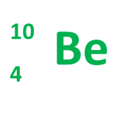
Atoms and isotopes - QuestionIT
What is the mass number and the atomic number for fluorine?
Mass number = 19; atomic number = 9
Beryllium has the chemical symbol:
Use this information to draw a representation of an atom of beryllium.
A different isotope of beryllium has an extra neutron. Give the chemical symbol of this new isotope of beryllium.
9 | Be
4

Slide 19
Atoms and isotopes – AnswerIT
The radioactive element Uranium has two common isotopes.
Complete the table to show the number of protons, neutrons and electrons in each isotope.
Sodium can lose its outer electron to have a full outer energy level. What will the atom now become?
An ion with a charge of 1+
236 | U
92
and
238 | U
92
Isotope | Protons | Neutrons | Electrons
 | 92 | 144 | 92
 | 92 | 146 | 92
236 | U
92
238 | U
92

Slide 20
Atoms and isotopes – AnswerIT
Which scientific discovery resulted in the solid atom theory being adapted into the “plum pudding” model of the atom?
Discovery of the electron (in 1897).
Rutherford carried out an experiment to show alpha particles either passing through gold leaf, being scattered off it. Summarise the conclusions he made from this experiment.
Most passing through suggests atoms are mostly empty space.
Some being deflected suggests the nucleus has the same charge as the alpha particle (positive).
A few reflected suggests the nucleus is where most of the mass of the atom is.
What contribution did Niels Bohr make to the arrangement of electrons in the atomic model?
He realised that electrons orbit the nucleus in clearly defined energy levels, at different distances from the nucleus.

Slide 21
LearnIT!
KnowIT!
Atoms and nuclear radiation
Radioactive decay and nuclear radiation
Nuclear equations
Half life and the random nature of radioactive decay
Radioactive contamination

Slide 22
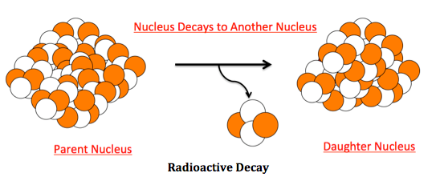
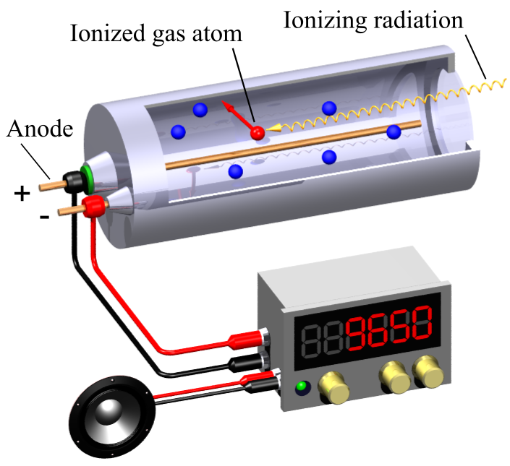
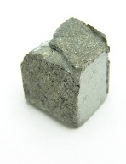
Radioactive decay and nuclear radiation
The nuclei of some atoms are unstable.
To become more stable these nuclei give out radiation.
This process is called radioactive decay.
Unstable atom
Stable atom
Activity = rate at which a source of unstable nuclei decays, measured in becquerels (Bq).
Radioactive decay
Count-rate = number of decays recorded each second by a detector (e.g. Geiger-Muller tube)
Radioactive rock
Different radioactive isotopes decay at different rates and emit different types of radiation.

Slide 23
Radioactive decay and nuclear radiation
There are three types of radioactive decay, alpha, beta and gamma. All come from the nucleus of the atom. In the examples below, only the nucleus is shown.
Alpha (symbol α or ) consist of 2 protons and 2 neutrons emitted from the nucleus. They have a positive charge as they contain 2 (+) protons.
Beta (symbol β or ) consist of an electron emitted from the nucleus. This results from a neutron splitting into a proton and an electron. Beta particles are negatively charged.
Gamma rays (symbol γ) are electromagnetic radiation emitted from the nucleus. Gamma radiation has no mass and no electrical charge.

Slide 24
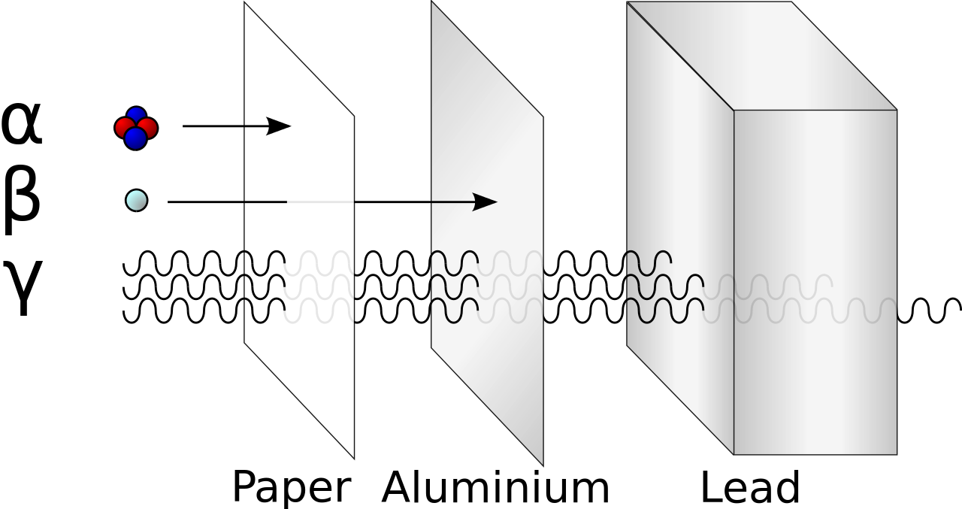
Radioactive decay and nuclear radiation
Properties of alpha, beta and gamma radiation.
Alpha, beta and gamma radiation can penetrate different materials due to their differing nature.
Alpha – easily stopped by a few
sheets of paper.
Beta – penetrates paper but stopped
by a thin sheet of aluminium.
Gamma – only stopped by thick lead
or several metres of concrete.
All three types of radiation cause ionisation of other atoms. If these atoms are in living cells it can cause damage which could lead to cancer.
Name | Symbol | Speed | Range in air | Ionising power
Alpha | α | Slowest | 6 - 8 cm | High
Beta | β | Medium | 1 – 2 m | Medium
Gamma | γ | Fastest | 300 -500 m | Low

Slide 25
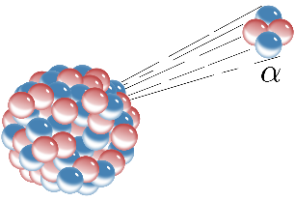
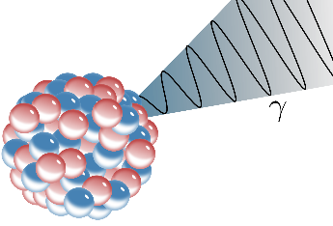
Nuclear equations
Nuclear equations show the changes to an atom when it emits radiation.
Alpha emission
Nucleus loses 2 protons and 2 neutrons.
Atomic number will reduce by 2 and atomic mass by 4.
Nucleus loses an electron which is produced when a neutron turns into a proton. So mass stays the same but atomic number of the product increases by one.
Beta emission
Gamma emission
No particles are emitted so there is no change to the nucleus. Atomic mass and atomic number stay the same.

Slide 26
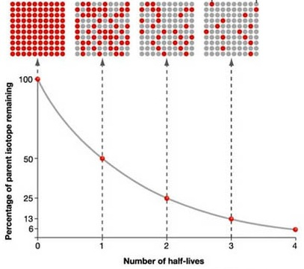
Half life and the random nature of radioactive decay
Radioactive decay is a random process so the likelihood of a decay taking place is a probability problem. For this reason, the half-life of an isotope is given rather than saying how long it will take to fully decay.
The half-life of a radioactive isotope is the time it takes for the number of nuclei of the isotope in the sample to halve, or the time it takes for the count rate from a sample containing the isotope to fall to half its initial level.
The net decline of the isotope is the fraction remaining after a number of half lives.
E.g. 100 50 25
After 2 half lives net decline is 75/100 = 3/4

Slide 27
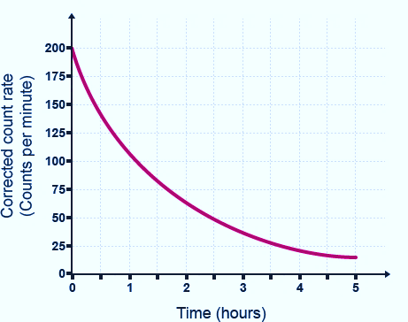
Half life and the random nature of radioactive decay
Calculating the half life of a radioactive isotope.
If you know the start and finish count rate and the time taken, you can calculate the half life.
Example:
The count rate of an isotope is 1008 Bq.
This falls to a count rate of 126 over a period of 21 days.
1 2 3
3 half lives for count rate to fall to 126.
These 3 half lives took 21 days so each half life took 7 days.
Half life if this isotope = 7 days
1
200 counts / min at the beginning.
100 counts/min occurred after 1.2 hours.
50 counts/min occurred after 2.4 hours.
It always takes 1.2 hours for the count rate to halve.
Half life of Fermium - 252 = 1.2 hours.
Radioactive sample of Fermium - 252
1008
504
252
126

Slide 28
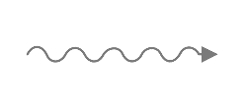
Radioactive contamination
Radioactive substances can be hazardous by contamination or irradiation.
Irradiation is when an object or person is exposed to
radiation. Protection from irradiation means stopping the radiation from reaching you.
Medical dressings are often irradiated but present no danger to the user.
Contamination is when a radioactive source is in contact with an object or person. The radioactive substance rather than the emissions are present.
The object remains radioactive until the contamination is removed or decays naturally.

Slide 29
QuestionIT!
Atoms and nuclear radiation
Radioactive decay and nuclear radiation
Nuclear equations
Half life and the random nature of radioactive decay
Radioactive contamination

Slide 30
Atoms and nuclear radiation – QuestionIT
Which part of an atom is involved with radioactive decay?
Explain the meaning of the term activity, as applied to
radioactive materials and state the units of activity.
3. What is meant by the term “count rate”?
Copy and complete the table to show the nature of alpha, beta
and gamma radiations.
Radiation | Symbol | Composition | Electrical charge
Beta | β
Gamma |  | Electromagnetic wave
Alpha |  |  | +2

Slide 31
Atoms and nuclear radiation – QuestionIT
A piece of radioactive rock shows a reading of 350 counts/min. When covered in aluminium foil, this drops down to 4 counts/min. Explain which type of radiation this rock is emitting.
Radioactive emissions are often described as ionising radiations. What does this mean?
Smoke detectors use americium-241 which is an alpha emitter. Explain why an alpha source is used in these detectors.
Why is an alpha particle often described as a helium nuclei?
Complete the nuclear equation for the beta decay of carbon.

Slide 32
Atoms and nuclear radiation – QuestionIT
Uranium-235 undergoes an alpha decay to produce thorium-231. (atomic number of uranium is 92). Complete the nuclear equation for this process.
When iodine 131 decays, there is no mass change in the nucleus and no new products formed. What type of radioactive emission is this?
Explain what is meant by the term “half life”.
A radioactive sample reduces its count rate from 240 counts/min to 30 counts/min over a period of 60 hours what is its half life?

Slide 33
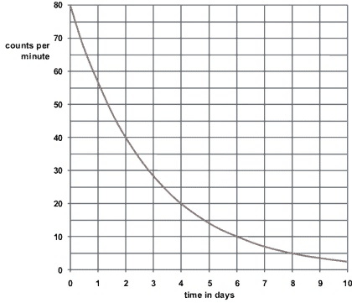
Atoms and nuclear radiation – QuestionIT
Use the decay curve below to work out the half-life of the isotope.

Slide 34
Atoms and nuclear radiation – QuestionIT
15. Explain the difference between radioactive irradiation and
radioactive contamination.
16. Copy and complete the table below to suggest one way of
preventing exposure to irradiation and contamination by
radioactive materials.
Type of exposure | Method of preventing exposure
Irradiation
Contamination

Slide 35
AnswerIT!
Atoms and nuclear radiation
Radioactive decay and nuclear radiation
Nuclear equations
Half life and the random nature of radioactive decay
Radioactive contamination

Slide 36
Atoms and nuclear radiation – AnswerIT
Which part of am atom is involved with radioactive decay?
The nucleus only.
Explain the meaning of the term activity as applied to
radioactive materials and state the units of activity.
The rate at which a source of unstable nuclei decays. Units Bq.
3. What is meant by the term “count rate”?
The number of radioactive decays recorded in a given time.
Copy and complete the table to show the nature of alpha, beta
and gamma radiations.
Radiation | Symbol | Composition | Electrical charge
Beta | β | an electron | -1
Gamma | γ | Electromagnetic wave | 0
Alpha | α | 2 protons and 2 neutrons | +2

Slide 37
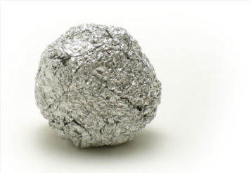
Atoms and nuclear radiation – AnswerIT
5. A piece of radioactive rock shows a reading of 350 counts/min.
When covered in aluminium foil, this drops down to 4 counts/min.
Explain which type of radiation this rock is emitting.
Could be alpha or beta as both would be stopped by the foil and
gamma would not be stopped by the foil.
6. Radioactive emissions are often described as ionising radiations. What does this mean?
The emissions knock off electrons from atoms which then become ions.
7. Smoke detectors use americium-241 which is an alpha emitter. Explain why an
alpha source is used in these detectors.
Alpha particles are easily stopped by smoke.
They do not travel far in air so are safe for the user.
8. Why is an alpha particle often described as a helium nuclei?
It contains 2 protons and 2 neutrons, the same as the nucleus of a helium atom.
9. Complete the nuclear equation for the beta decay of Carbon.
6

Slide 38
Atoms and nuclear radiation – AnswerIT
10.
11. When iodine 131 decays, there is no mass change in the
nucleus and no new products formed. What type of radioactive
emission is this?
Gamma emission
12. Explain what is meant by the term “half life”.
The time it takes a radioactive sample to lose half its
radioactivity (as measured by count rate).
13. A radioactive sample reduces its count rate from 240 counts/min to 30 counts/min over a period of 60 hours what is its half life?
1 2 3
Three half lives in 60 hours = 20 hour half life
Uranium-235 undergoes an alpha decay to produce thorium-231. (atomic number of Uranium is 92). Complete the nuclear equation for this process.
235 | U
92
231 | Th
90
240
120
60
30

Slide 39
Atoms and nuclear radiation – QuestionIT
Use the decay curve below to work out the half-life of the isotope.
80 = 0 day; 40 = 2 days. Difference = 2 days. Half-life = 2 days

Slide 40
Atoms and nuclear radiation – AnswerIT
15. Explain the difference between radioactive irradiation and
radioactive contamination.
Irradiation is exposure to emissions from radioactive materials
that are not in contact with an object. Contamination is when
radioactive materials are in contact with the object.
16. Copy and complete the table below to suggest one way of
preventing exposure to irradiation and contamination by
radioactive materials.
Type of exposure | Method of preventing exposure
Irradiation | Wear protective clothing, e.g., lead apron, to shield from radiation. Move away from the radiation. Shield the radiation with appropriate material.
Contamination | Avoid contact with radioactive materials. Prevent radioactive materials being released into the environment.

