Slide 1
Practical Skills Revision
Practicals 1-3

Slide 2
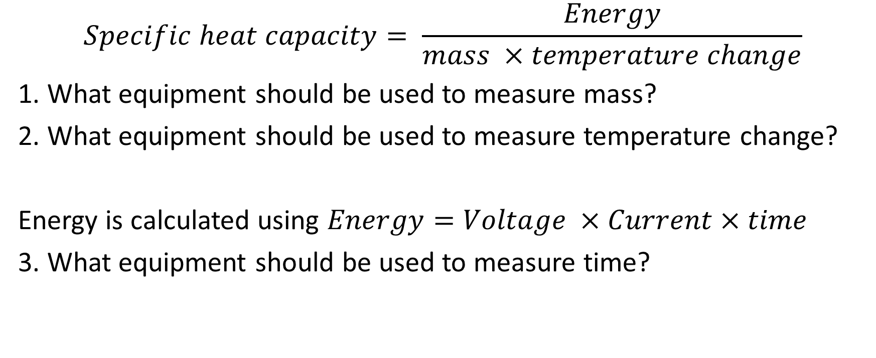
Practical 1: Determining the specific heat capacity of materials
$$Specific heat capacity= \frac{Energy}{mass ×temperature change}$$
1. What equipment should be used to measure mass?
2. What equipment should be used to measure temperature change?
Energy is calculated using $Energy=Voltage ×Current×time$
3. What equipment should be used to measure time?

Slide 3
Practical 1: Determining the specific heat capacity of materials
Jack is completing practical 1. He takes an empty calorimeter and measures the mass (506g) he then fills it up with water and measures the mass again (556g).
4. Why does he do this?
5. How much water does he have?
He measures the start temperature of the water. Then puts an electric heater into the water. He puts a lid on the water.
Why does he put a lid on?
What safety measures should Jack take?

Slide 4
Practical 1: Determining the specific heat capacity of materials
As the water heats up, Jack notes that the voltage of the heater is 1.5V and the current is 2A. Jack heats the water for 3 minutes. It heats from 21ºC to 25ºC.
8. How much energy has Jack put into the water?
9. What is the temperature change?
10. What specific heat capacity does Jack calculate?

Slide 5
Practical 1: Determining the specific heat capacity of materials
Jack looks in a textbook to find out how close his result is to the actual value. It is 2,400 J/kgºC.
11. What is the percentage difference between Jack’s value and the textbook answer?
12. Why is Jack’s value different from the textbook value?
13. What should Jack do to improve his answer?

Slide 6
Practical 1: Answers
A balance
A thermometer
A stopwatch
To find the mass of water
50g / 0.050kg
To reduce heat loss by convection/evaporation
Do not touch the heater while it is on.
1.5 x 2 x 180 = 540J
9. 4 ºC
10. 2,700 J/kgºC
11. (300/2400)* 100% = 12.5%
12. Because some energy has been lost to the surroundings
13. Increase the amount of insulation around the calorimeter

Slide 7
Practical 2 (triple only): Investigate the effectiveness of different materials as thermal insulators
Julie is completing practical 2. She is investigating the effectiveness of bubble wrap, cardboard, newspaper and aluminium foil as insulators. Julie thinks that bubble wrap will be the most effective.
Why does Julie think that bubble wrap will be the most effective.
Write a plan for Julie’s investigation.

Slide 8
Practical 2 (triple only): Investigate the effectiveness of different materials as thermal insulators
Material | Temperature Change 1 /ºC | Temperature Change 2 /ºC | Mean /ºC
Bubble Wrap | 7 | 6
Cardboard | 14 | 16
Newspaper | 12 | 15
Aluminium foil | 23 | 25
These are Julie’s results
3. Calculate the mean values
4. Draw a bar chart of the results
5. What conclusion can Julie draw.

Slide 9
Practical 2 (triple only): Investigate the effectiveness of different materials as thermal insulators
Julie then wants to investigate how the number of sheets of bubble wrap affect how good an insulator it is.
6. What will be her independent variable?
7. What will her dependent variable be?
8. What variables should she control?

Slide 10
Practical 2 (triple only): Investigate the effectiveness of different materials as thermal insulators
The graph shows Julie’s results.
9. What do we call the point at thickness 1.5cm?
10. What should Julie have done about it?
11. What conclusion should Julie draw from these results?

Slide 11
Practical 2: Answers
Because plastic is a good insulator, and it contains air pockets which prevent conduction and convection
Wrap a beaker in the insulating material. Fill with hot water and measure the start temperature with a thermometer. Time 5 minutes with a stopwatch then measure the end temperature. Repeat with each different material.
3. 6.5, 15, 13.5, 24
4. Bar chart
5. Bubble wrap is the best insulator. Aluminium foil is the worst insulator.
6. Number of layers of bubble wrap
7. Temperature change
8. Time, type of material, start temperature.
9. Anomalous
10. She should have repeated that measurement
11. The thicker the bubble wrap, the less the temperature change.

Slide 12
Practical 3: Investigate factors affecting the resistance of a circuit.
Bob is investigating how the length of a wire affects its resistance.
What is the independent variable?
What is the dependent variable?
What are the control variables?
What do you predict he will find?
What equipment should he use to measure the length of wire?
What risks does this experiment have?

Slide 13
Practical 3: Investigate factors affecting the resistance of a circuit.
Length of wire /cm | Resistance / Ω
10 | 1.3
20 | 2.5
30 | 4.0
40 | 5.2
50 | 6.5
60 | 7.7
70 | 9.0
80 | 10.1
These are Bob’s results.
7. Draw a graph of these results.
8. What conclusion can Bob draw from these results?

Slide 14
Practical 3: Investigate factors affecting the resistance of a circuit.
Bob wants to investigate what happens to the total resistance when you put resistors in series and parallel combinations.
9. What equipment does he need?
10. Draw a circuit diagram to show the circuit he should set up to find the resistance of 3 resistors in series.
11. Draw a circuit diagram to show the circuit he should set up to find the resistance of 3 resistors in parallel.

Slide 15
Practical 3: Answers
The length of wire
The resistance of the wire
Temperature, material of wire, thickness of wire
The longer the wire, the greater the resistance.
Ruler/ meter ruler
The wire will get hot and could cause burns
7. Graph
8. Resistance is directly proportional to length
9. Batteries/power supply, 4 identical resistors, voltmeter, ammeter, connecting leads

