Slide 1

3.1 Changes of State and the Particle Model

Slide 2
Particle theory revision
Particle theory is all about explaining the properties of solids, liquids and gases by looking at what the particles do.
SOLIDS
In a solid the particles ______ around a _____ position. There is a ______ force of attraction between each particle and they are very _____ together
Words – strong, close, vibrate, fixed

Slide 3
LIQUIDS
In a liquid the particles are _____ together but can move in any direction. They won’t keep a _____ shape like _____ do.
GASES
In a gas the particles are very far apart and move _____ in all directions. They often ______ with each other and because they are far apart they can be easily _______.
(zoomed out)
Words – fixed, collide, quickly, close, squashed, solids

Slide 4
Densities in Solids, Liquids and Gases
Which one is the most dense and why?
Solid
Gas
Liquid

Slide 5
Density
Mass
m
Density =
ρ =
Volume
V
What is the density of a piece of wood of volume 2m³ and mass 1200kg?
What is the density of aluminium if 0.5m³ has a mass of 1350kg?
600kg/m³
2700km/m³

Slide 6
Changes of State
Q. What are these changes of state called?
Note that these changes are “physical changes”, not “chemical changes”. What would happen if these were chemical changes?
1
3
2
4
5

Slide 7
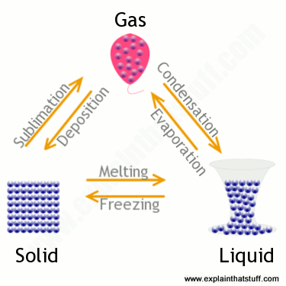
  Changes of state and the particle model – Changes of state
A change of state can be brought about by changing the temperature or pressure of a material.
If the solid shown has a mass of 1kg, then the liquid and gas will both have a mass of
1 kg.
Mass is conserved when a substance changes state, only the volume changes.
Changes of state are physical changes not chemical changes.
The change can be reversed in a physical change so the material recovers its original properties.
This does not happen with a chemical change.
The arrows show the direction in change of state.

Slide 8
Changes of Mass
Q. Does the mass of substance change during these changes of state?
What’s happened here?
1
3
2
4
5

Slide 9
Melting Ice
Ice at a temperature of below 0^{O}C:

Slide 10
Melting Ice
Ice turning into water and then a gas:

Slide 11
QuestionIT!
Changes of state and the particle model
Density of materials
Changes of state

Slide 12
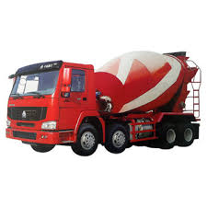
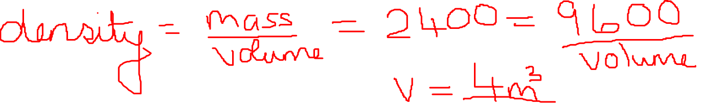
  Changes of state and the particle model – AnswerIT
Why is it incorrect to say iron is heavier than wood?
2. Water has a density of 1000 kg/m³. A piece of rubber has a density
of 1024 kg/m³. Explain what would happen if the rubber was put in
a pool of water?
3. This “ready-mix” concrete waggon contains
9600 kg of concrete. If the density of the
concrete is 2400 kg/m³, what volume of
concrete does the waggon contain?

Slide 13
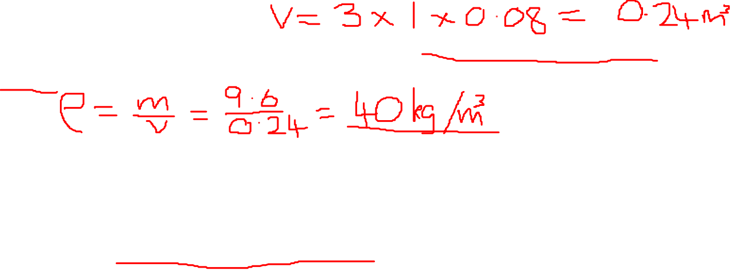
  Changes of state and the particle model – AnswerIT
4. a. A sheet of insulating foam measures 3 m x 1 m x 0.08 m. It has a
mass of 9.6 kg. Calculate the density of the insulating foam.
b. High density foam is made of the same material and can be used
to give better insulation for the same thickness of foam. Describe
how the arrangement of particles would differ in these two types
of foam (you may draw diagrams to help your answer).
5. When copper metal is heated to 1100 ºC it melts.
a. Is this a chemical or physical change? Explain your answer.
b. What will happen to the mass of the sample of copper after it has
melted? Explain your answer.

Slide 14
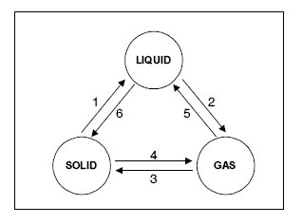


  Changes of state and the particle model – AnswerIT
6. Explain the difference between a physical and a chemical change.
7. Name the changes in state given in
the diagram by the arrows 1 to 6.
8. If you wanted to find the density of a brass key, you first need to
measure its volume. Describe how to determine the volume of a
brass key.

