Slide 1

3.2 Internal Energy and Energy Transfers

Slide 2
Motion of Gas Particles
Here are some gas particles doing what gas particles do:

Slide 3
Making a Gas Hotter
Consider increasing the temperature:
What changes did this hotter temperature make to the motion of the particles?
How did it affect their spacing?

Slide 4
Internal Energy
Which one of these boxes has got the most internal energy? Explain your answer:

Slide 5
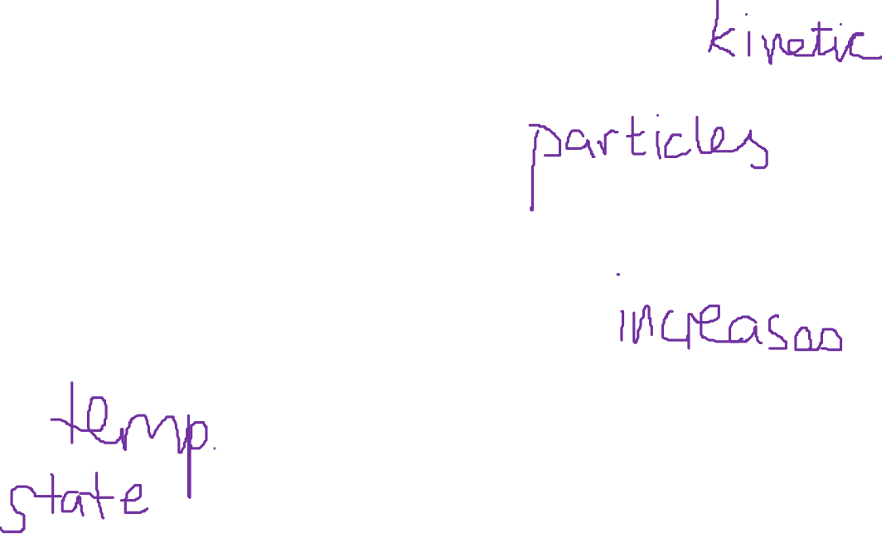
Internal Energy
Consider these particles again:
The “internal energy” of the gas is the total amount of ______ energy and potential energy of all of the gas _______ added together.
If a substance is heated up it’s internal energy _______. This will cause either:
An increase in _________
A change of ______
Words – state, temperature, molecules, increases, kinetic

Slide 6
Heating a Liquid up
If we heat this beaker up it’s fairly clear that the liquid will gain internal energy and get hotter.
Q. What three things does the increase in temperature depend on?
The amount of liquid (i.e. the mass)
The amount of heat energy going in to the liquid (i.e. how hot the Bunsen is and how long it’s on for)
The substance being heated – e.g. is it water or cooking oil?

Slide 7
Putting these into an equation…
Let’s put the factors from the last slide into an equation:
If the rise in temperature depends on the mass of liquid, how much energy it is given and the substance being heated then we can say:
You do NOT need to remember this equation!
ΔE = mcΔθ
Where:
ΔE = amount of heat energy being supplied (in Joules)
m = mass of liquid (in kg)
c = “specific heat capacity” (in J/Kg^{O}C)
Δθ = change in temperature (in ^{O}C)

Slide 8
Definition of Specific Heat Capacity
ΔE = mcΔθ
The specific heat capacity can be thought of as the “ability of an object to store heat energy”. It’s proper definition is:
Definition of SHC: The amount of energy needed to raise the temperature of 1kg of a substance by 1^{O}C.

Slide 9
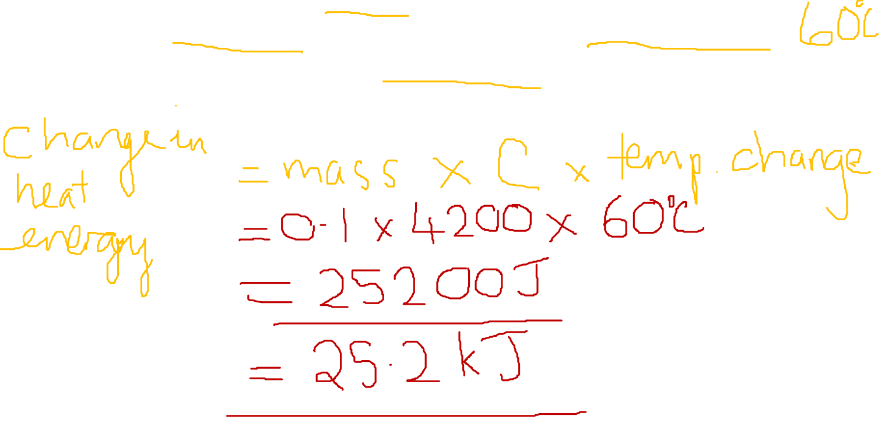
An example question
A beaker filled with 0.1kg of water with specific heat capacity 4200J/(kg.⁰C) is heated from 20⁰C to 80⁰C. Calculate the amount of heat energy gained by the water.
25.2 KJ

Slide 10
Heating ice
Temp/^{O}C
150
100
50
0
-50
This flat line shows where energy is being used to push the particles further apart for evaporation and NOT to increase the temperature.
Time/s
This flat line shows where energy is being used to break bonds (which has to be done during melting) and NOT increase the temperature.

Slide 11
Specific Latent Heat
The Specific Latent Heat of a substance is defined as “the amount of heat energy needed to change the state of one kilogram of the substance WITHOUT changing its temperature”. Therefore:
Energy = mass x specific latent heat of fusion
E = mL
E is heat energy supplied (in J)
m is mass (in kilograms)
L is specific latent heat (in J/kg)

Slide 12
Heating ice again
Temp/^{O}C
150
100
50
0
-50
This is a change in state from liquid to a gas – the energy needed is the “latent heat of vaporisation”
Time/s
This is a change in state from a solid to a liquid – the energy needed is the “latent heat of fusion”

Slide 13
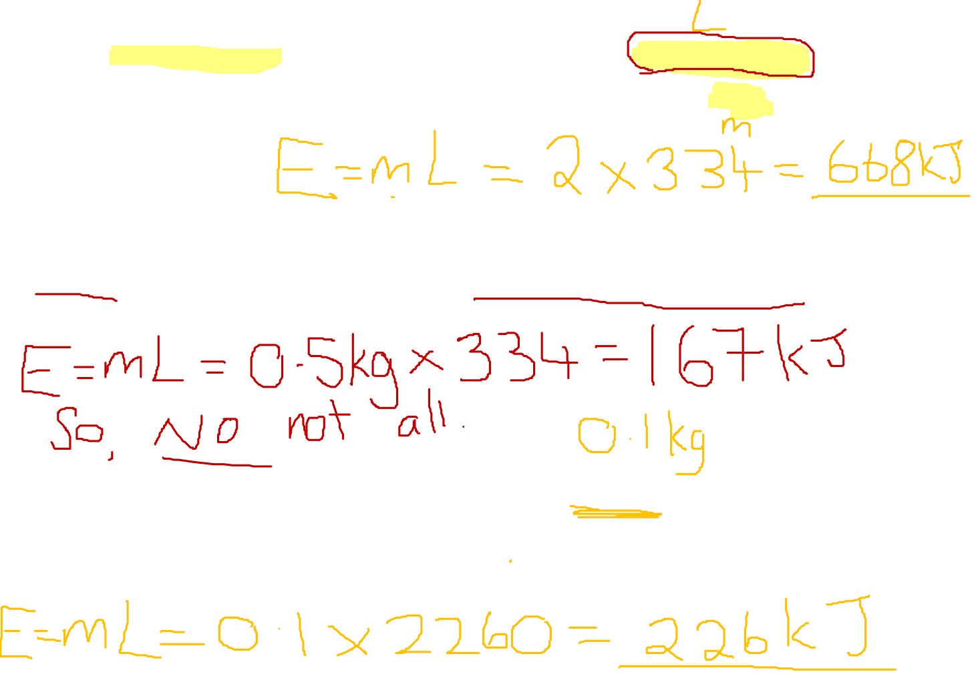
Some example questions
The latent heat of fusion for water is 334 KJ/kg. How much heat energy would be needed to melt 2kg of ice?
0.5kg of ice is supplied with 100KJ of heat energy. Will all of the ice melt?
Another heater is used to boil off 100g of water. The latent heat of vaporisation is 2260KJ/kg. How much heat energy was supplied to the water?
668KJ
No – not enough heat energy
226KJ

Slide 14
QuestionIT!
Internal energy and energy transfers
Internal energy
Temperature change in a system and specific heat capacity
Changes of heat and specific latent heat

Slide 15
  Internal energy and energy transfers – AnswerIT
Define internal energy.
2. Which of the following will change the internal energy of a stone?
A. Lifting it to the top of a building.
B. Heating it.
C. Firing it from a catapult.
3. Water and the chemical isooctane both boil at 100 ºC. When the
same mass of each substance is placed on a heater, the
isooctane boils first. Explain why this happens.

Slide 16
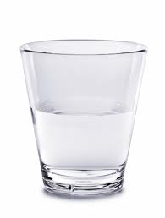

  Internal energy and energy transfers – AnswerIT
4. A hot stone is placed into a glass of water containing 200 g
of cold water. The stone transfers 25 200 J of energy to
the water. How much will the temperature of the water rise?
Specific heat capacity of water = 4200 J/kg ºC ΔE = m c Δθ
5. What is specific latent heat?
6. Explain the difference between latent heat of fusion and latent heat of
vaporisation.

Slide 17
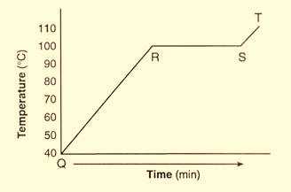
  Internal energy and energy transfers – AnswerIT
7. A boiler is being used to heat water. The graph shows the temperature of
the water every 5 minutes.
a. What state is the water in between points
Q and R?
b. At which point does the water begin
to boil?
c. What state is the water in at 110 ºC?
Candle wax has a latent heat of fusion of 200 000 J/kg. If the candle is at its melting temperature, how much heat energy is needed to melt a
250 g candle?
E = m L_{f}

Slide 18

AnswerIT!
Internal energy and energy transfers
Internal energy
Temperature change in a system and specific heat capacity
Changes of heat and specific latent heat

Slide 19
  Internal energy and energy transfers – AnswerIT
Define internal energy?
The total kinetic and potential energy of all the particles within a
system
2. Which of the following will change the internal energy of a stone?
A. Lifting it to the top of a building
B. Heating it
C. Firing it from a catapult
Heating it.
3. Water and the chemical isooctane both boil at 100 ºC. When the
same amount of each substance is placed on a heater, the
isooctane boils first. Explain why this happens.
Isooctane has a lower specific heat capacity than water so less heat energy is needed to raise its temperature to its
boiling point.

Slide 20
  Internal energy and energy transfers – AnswerIT
4. A hot stone is placed into a glass of water containing 200 g
of cold water. If the stone transfers 25 200 J of energy to
the water, what will the temperature rise of the water be?
specific heat capacity of water = 4200 J/kg ºC ΔE = m c Δθ
Δθ = ΔE = 25 200 = 30 ºC
m x c 0.2 x 4200
Temperature rise of the water = 30 ºC
5. What is latent heat?
The energy needed to change the state of a substance without
changing the temperature.
6. Explain the difference between latent heat of fusion and latent heat of
vaporisation.
Latent heat of fusion is the energy needed to change between
solid and liquid. Latent heat of vaporisation is the energy needed to change state between liquid and gas.

Slide 21

  Internal energy and energy transfers – AnswerIT
7. A boiler is being used to heat water. The graph shows the temperature of
the water every 5 minutes.
a. What state is the water in between points
Q and R?
Liquid
b. At which point does the water begin
to boil?
R
c. What state is the water in at 110 ºC?
Gas
Candle wax has a latent heat of fusion of 200 000 J/kg. If the candle is at its melting temperature, how much heat energy is needed to melt a
250 g candle?
E = m L_{f}
E = 0.25 x 200 000 = 50 000 J

