Slide 1
Independent learning activities

Slide 2
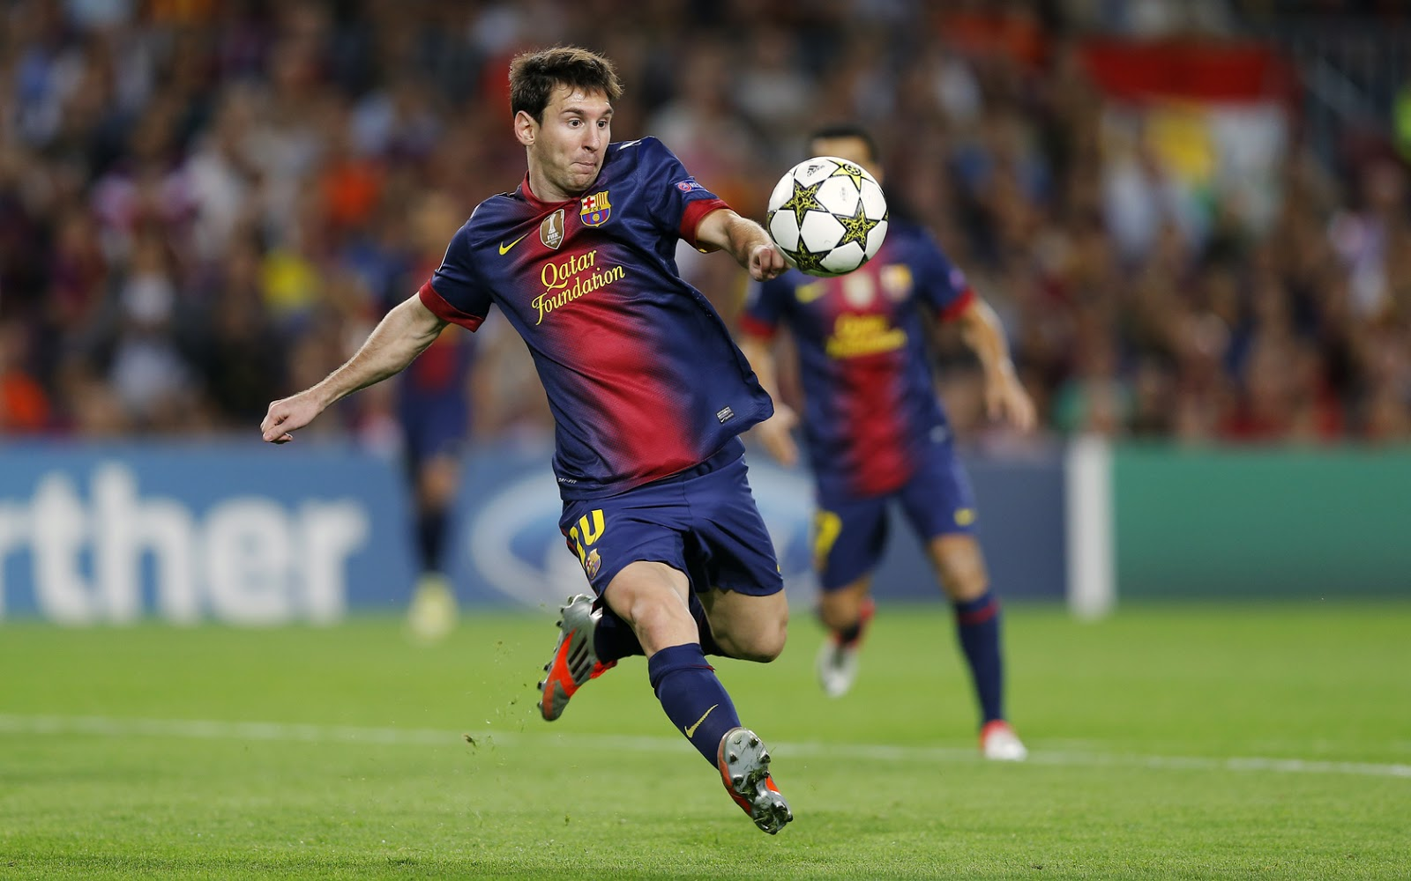
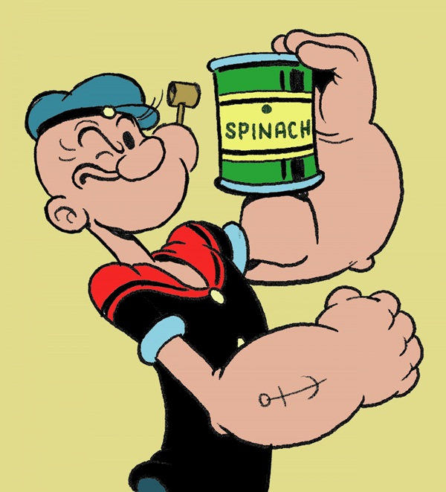
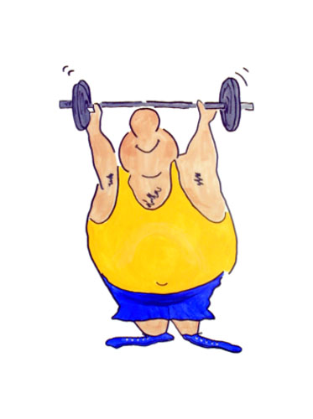
Biology- Keeping Healthy
CURRICULUM LINK: B1 1.1 -1.4
You are either an owner of a gym or a sports coach, your challenge is to design an exercise routine and diet plan that you can present to your Gym members or players.
You must include: your exercise workout, how muscles work, why you need to exercise, a meal plan explained,
what equipment/resources do you need?

Slide 3
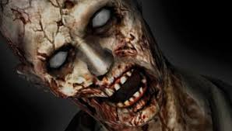
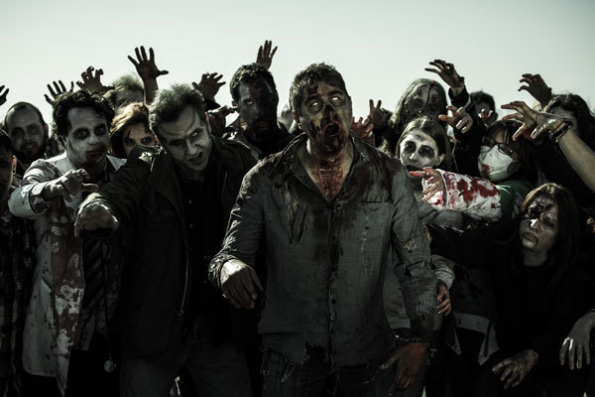
Biology- Keeping Healthy
CURRICULUM LINK: B1 1.4 -1.6, 1.9
There is a zombie out break and a deadly disease is spreading across Leicester. You must design an information poster on pathogens and disease. To try and prevent the whole of Braustone turning into flesh eating zombies!
You must include: the differences between bacteria and viruses, how pathogens cause disease, preventing microbes getting into your body, drugs that are used to treat disease(antibiotics) what vaccinations do

Slide 4
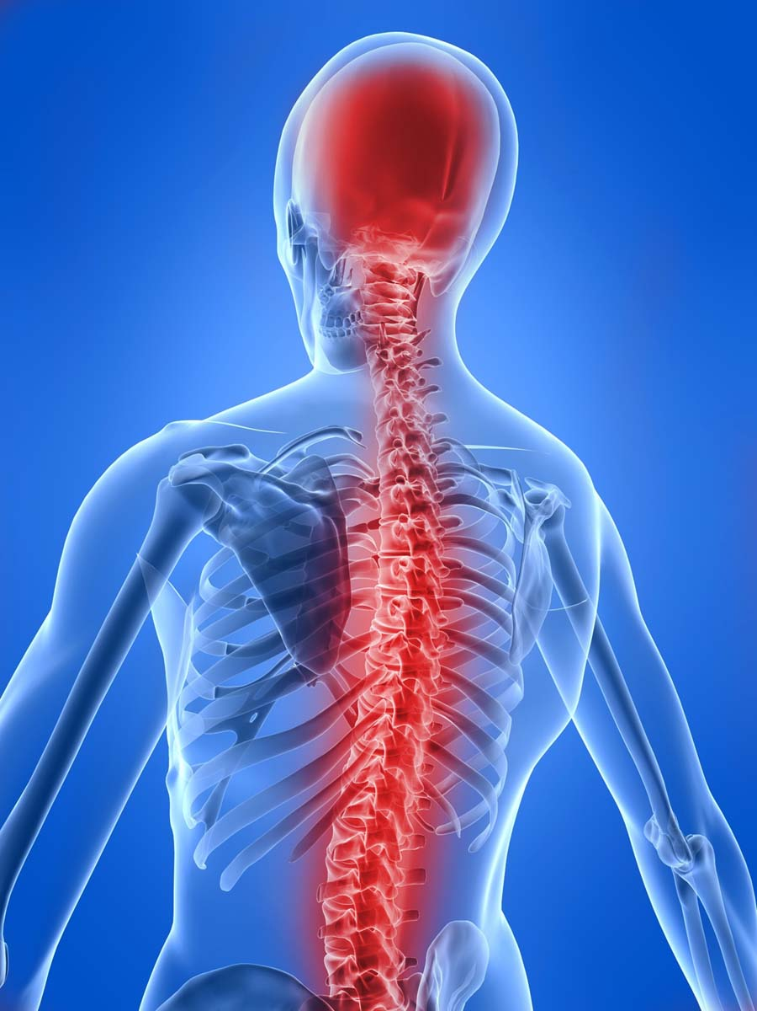
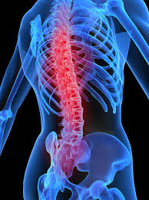
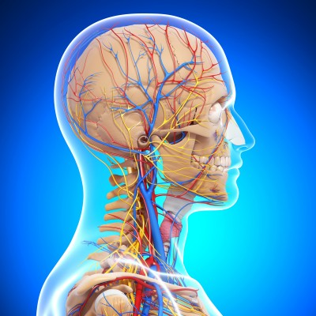
Biology- Coordination and control
CURRICULUM LINK: B1 2.1 -2.2
You have been set a task to create a revision poster on how your central nervous system works, the challenge is to work independently, this means you have to work by yourself to find information and complete the task!
You must include: information on responding to change, how your nervous system works, reflex actions.
What resources do you need?

Slide 5
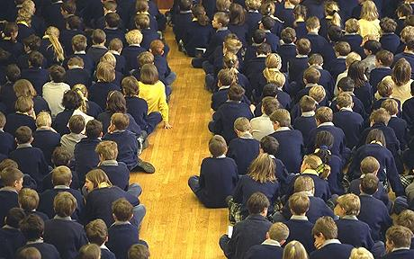
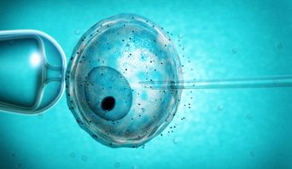
Biology- Coordination and control
CURRICULUM LINK: B1 2.3 -2.4, 2.7
you Challenge is to make a presentation that will be presented to a group of year 7s. You must explain to them how hormones and the menstrual cycle works, the artificial control of fertility and IVF
You must include: pictures, information and appropriate language for a year 7 to understand.
What resources do you need?

Slide 6
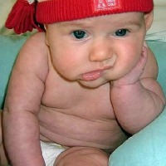
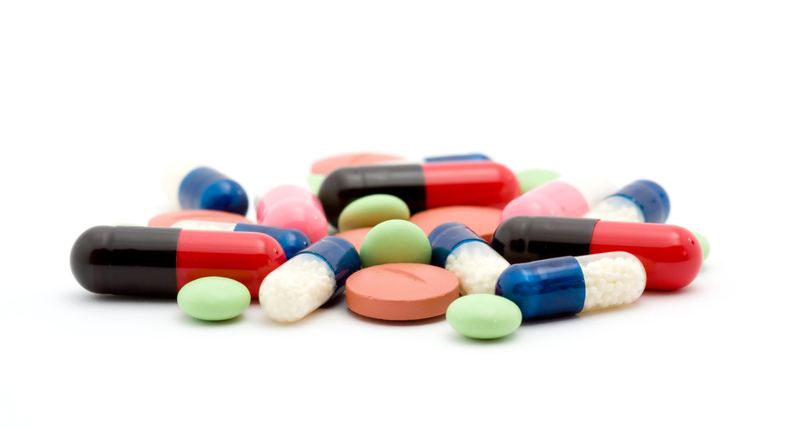
Biology- Medicine and drugs
CURRICULUM LINK: B1 3.1
After years and years of testing and probing there has been an amazing discovery, students everywhere will be saved from boring old teachers and lessons with the awesome break through in science of a new exciting drug that is being released that can cure boredom!!!
Your challenge is to design a web page that explains how new drugs are tested and why we need to test them thoroughly.
You must include: what stages there are in testing and trailing a new drug, information and pictures
What resources do you need?

Slide 7
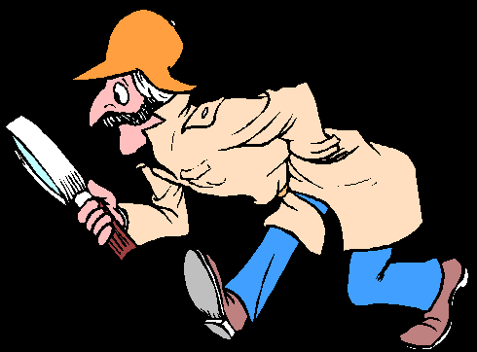
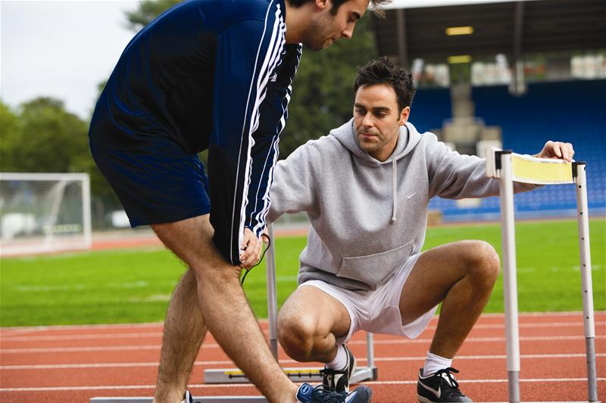
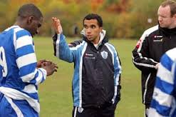
Biology- Medicine and drugs
CURRICULUM LINK: B1 3.3 -3.6
you are a sports coach and you have found out that one of your players has been taking drugs. You have been asked by your manager to follow the player and observe where the player goes and what they do. Write a report on the player explaining what drugs are and how to catch a cheat in sport.
You must include: what are legal and illegal drugs, the ethics of using drugs in sport.
What resources do you need?

Slide 8
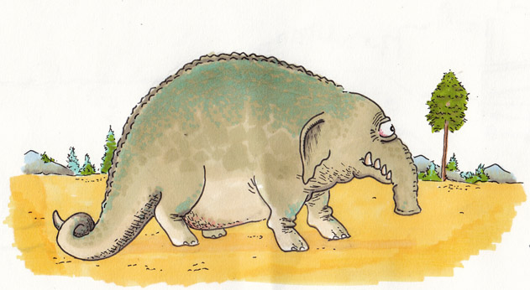
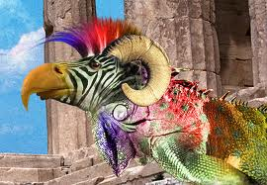
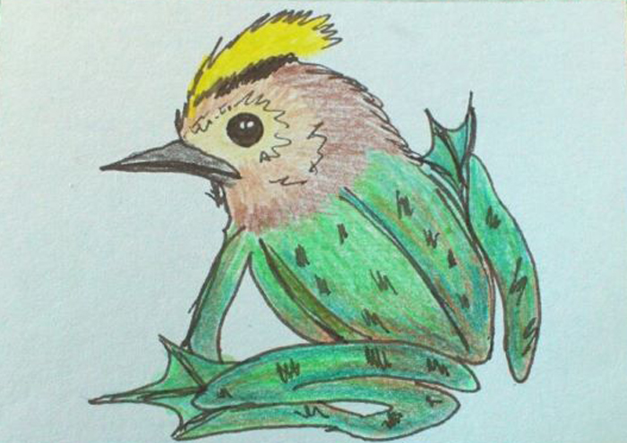
Biology- Adaptations for survival
CURRICULUM LINK: B1 4.1 -4.6
TASK: Design and draw a made up creature and explain what the creature needs to survive and why it has adapted the way it had to live. Eg a big warm coat was adapted because it lives in Antarctica.
(research and read pages 78-87 in AQA science books)
You must include: what it eats and drinks, why it has adapted the way it has, where is it in the food chain (who eats it?)
What resources do you need?

Slide 9
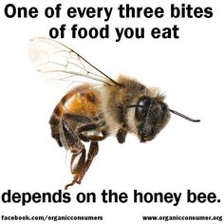
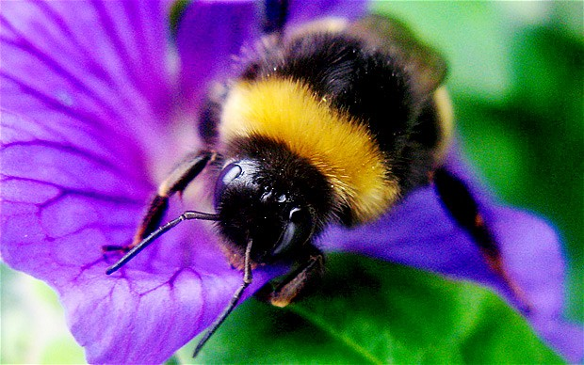
Biology- Adaptation for survival
CURRICULUM LINK: B1 4.7 -4.8
TASK: Research why all the honey bees are disappearing and produce a poster for save the bees explaining how we can help the bees.
You must include: what environmental changes could have happened e.g. temperature. How can we help the bees?
What resources do you need?

Slide 10
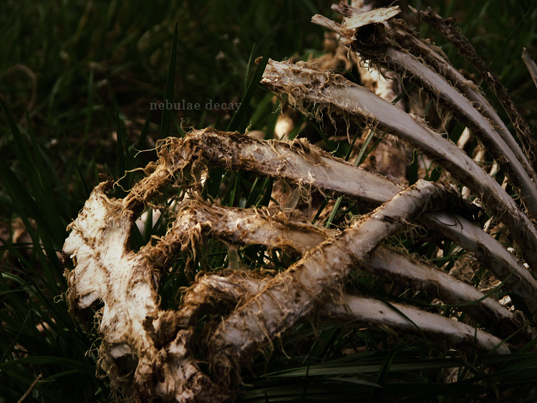
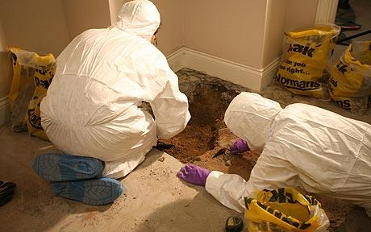
Biology- energy in biomass
CURRICULUM LINK: B1 5.3- 5.4
TASK: You are a CSI and have just been called out to a dead decaying body in a rubbish bin. Your supervisor has asked you to find out why things decay and what is the process of decay. This will help with the case and prosecution of the prime murder suspect.
➢ YOU MUST INCLUDE: the process of decay and the conditions in which it needs to be for decay. Diagram of the carbon cycle as well as a definition.
➢ what resources do you need?

Slide 11
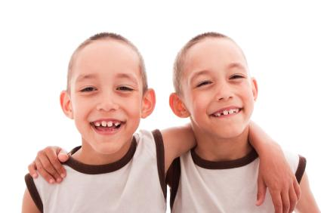
Biology- Variation, reproduction and new technology
CURRICULUM LINK: B1 6.1- 6.7
➢ TASK: you have been asked to research why we look like our family members and how cloning works. You have been challenged to produce a leaflet explaining this.
➢ YOU MUST INCLUDE: what are genes and chromosomes and how they affect the way we look. Types of reproduction. Genetic and environmental differences and cloning.
What resources do you need?

Slide 12
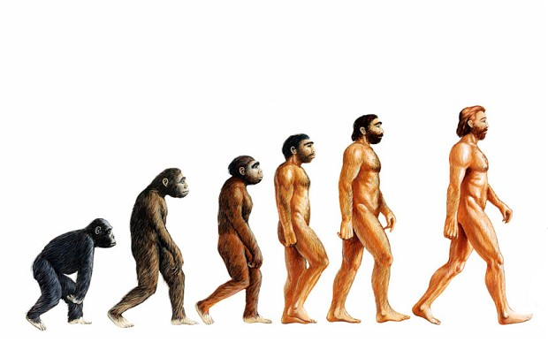
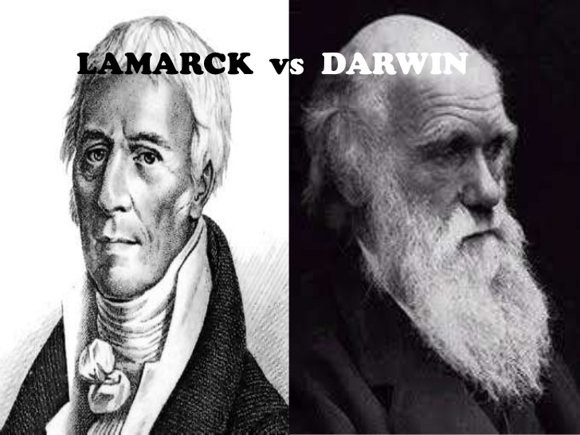
Biology- evolution
CURRICULUM LINK: B1 7.1- 7.4
➢ TASK: where did we come from? You have been challenged to make a fact file explaining the theories of evolution. You can use comic book style animations to help you explain the theories.
➢ YOU MUST INCLUDE: Lamarck’s theory of evolution, Charles Darwin’s ideas, the reasons why people object to these theories, and the process of natural selection.
What resources do you need?

Slide 13
Chemistry- Fundamental ideas
CURRICULUM LINK: C1 1.1
➢ TASK: you have been challenged to make a quiz about atoms, elements and compounds. E.g. What is H in the periodic table? Explain what the difference between elements and compounds. You will then test each other and see who can score the highest.
➢ YOU MUST INCLUDE: at least 15 questions, and produce an answer sheet.
What resources do you need?

Slide 14
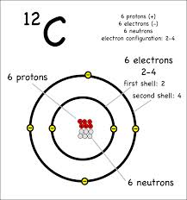
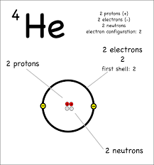
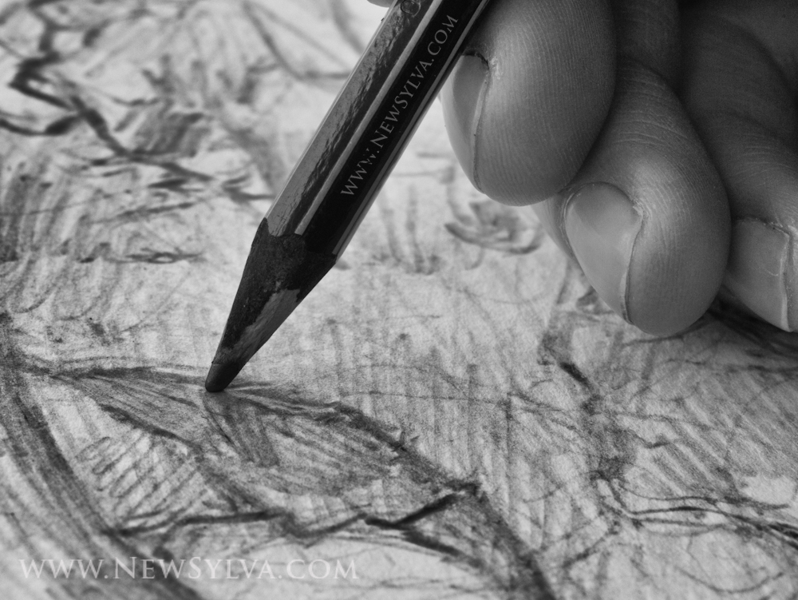
Chemistry- Fundamental ideas
CURRICULUM LINK: C1 1.2- 1.3
➢ TASK: you have been tasked to produce detailed drawings of the atomic structure that will be used to explain to year 7s, you must also draw the arrangement of electrons in atoms for Li, B, P, and Ar.
➢ YOU MUST INCLUDE: All drawings must be labelled and a sentence or two written underneath them explaining what it is.
What resources do you need?

Slide 15
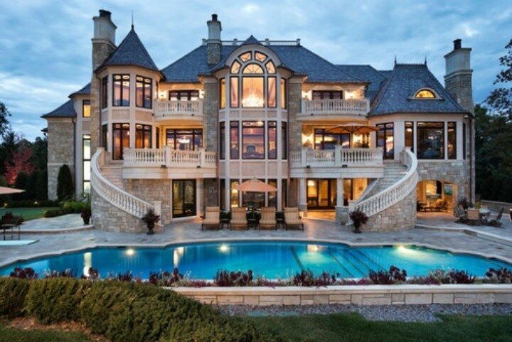
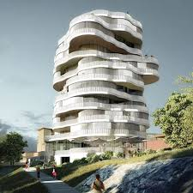
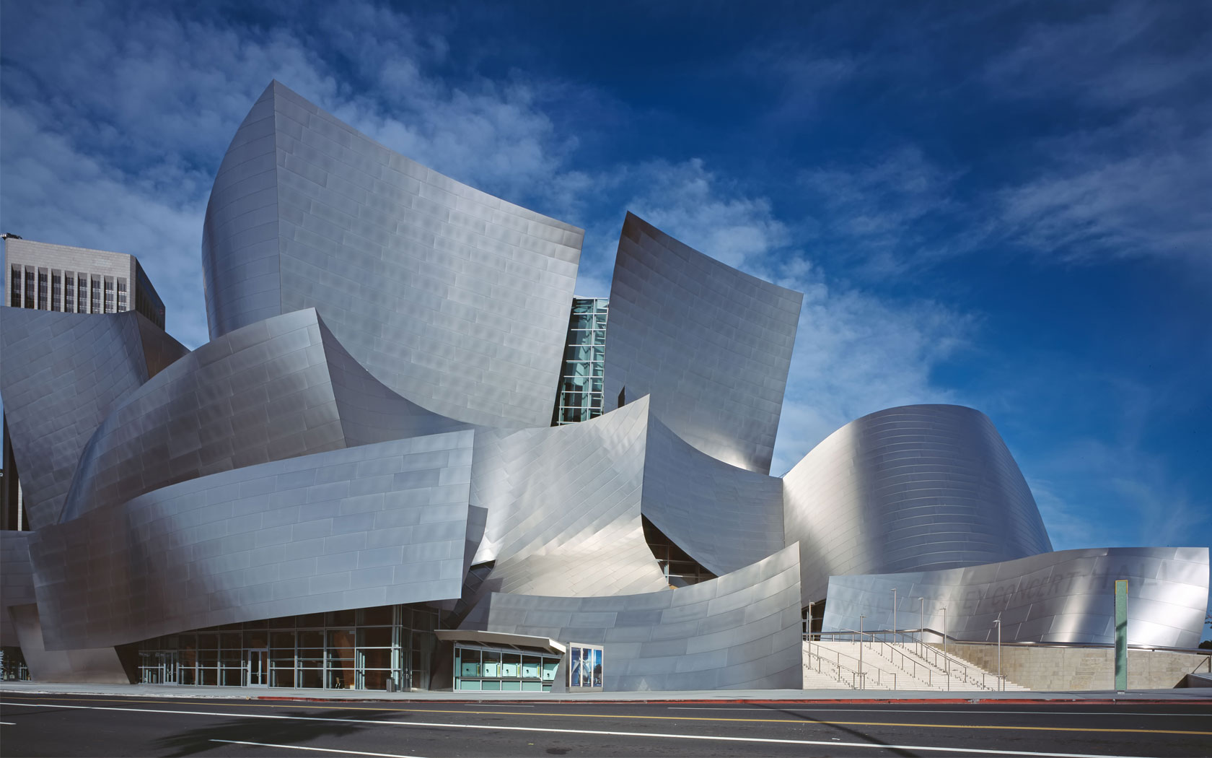
Chemistry- Rocks and Building Materials
CURRICULUM LINK: C1 2.1- 2.5
➢ TASK: you are an architect and have been asked to design a house for a celebrity. The celebrity would like limestone statues and would like you to use cement and concrete in the build. You must draw up a plan for the house with detailed labels. You then must make a presentation to explain what limestone, cement and concrete is.
➢ YOU MUST INCLUDE: detailed explanations of what limestone, cement and concrete is as well as its uses. (advantages and disadvantages of these building materials)
What resources do you need?

Slide 16
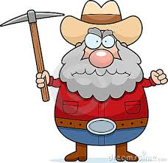
Chemistry- Metals and their uses
CURRICULUM LINK: C1 3.1- 3.4
TASK: you have been given the task to research and find out where metals come from. Present your research as either a poster or a leaflet
➢ YOU MUST INCLUDE: where metals come from and how can we extract metals from their ores
What resources do you need?

Slide 17
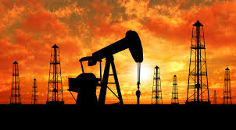
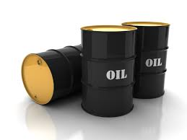
Chemistry- Crude oil and fuels
CURRICULUM LINK: C1 4.1
TASK: you need to find out why oil is so important. Use your skills to investigate why it is important, where is comes from and how we separate it. Present your findings as a newspaper article.
➢ YOU MUST INCLUDE: why we need oil, what do we use it for, what is crude oil and how do we separate it.
What resources do you need?

Slide 18
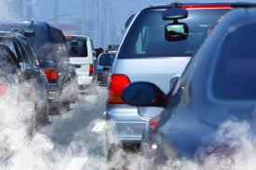
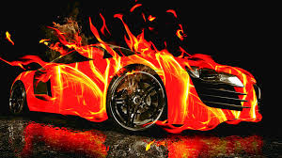
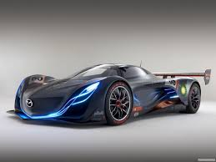
Chemistry- Crude oil and fuels
CURRICULUM LINK: C1 4.4- 4.5
TASK: You have been challenged to design a new car that uses only clean fuels. Then you must write a persuasive small speech/presentation as to how we can reduce the problem of pollution from cars.
➢ YOU MUST INCLUDE: what the consequences of burning fuels on our environment and how we can help to reduce it.
What resources do you need?

Slide 19
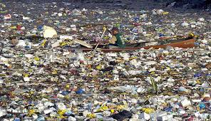
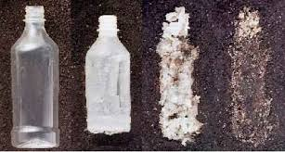
Chemistry- products from oil
CURRICULUM LINK: C1 5.4
TASK: one of the problems with plastics is what to do with them when we’ve finished with them. Your challenge is to produce an information sheet about biodegradable plastics and recycling.
➢ YOU MUST INCLUDE: what are the problems caused by disposing plastics. What does biodegradable mean and how can polymers be made biodegradable.
What resources do you need?

Slide 20
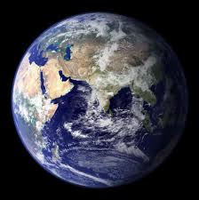
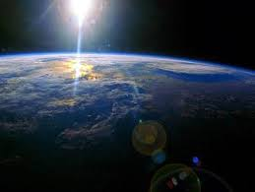
Chemistry- Our changing planet
CURRICULUM LINK: C1 7.1
TASK: your challenge is to make a 3D model of the structure of the earth.
➢ YOU MUST INCLUDE: A detailed plan of what the structure of the earth looks like and what are the each part is called and what it does.
What resources do you need?

Slide 21
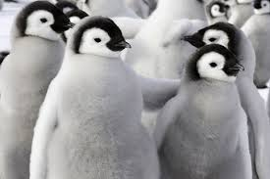
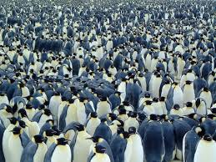
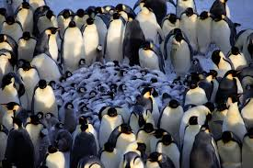
Physics- infrared radiation
CURRICULUM LINK: P1 1.1 -1.2
WHAT IS RADIATION? FIND OUT WHAT RADIATION IS AND EXAMPLES OF RADIATION. PRESENT YOUR RESEARCH AS A MIND MAP.
Task: A huddle test. Design an investigation to model the effects or penguins huddling together.
You could use beakers of hot water to represent the penguins and measure the temperatures of the water in each beaker or put cold water in the beakers on the out side and measure the temperature increase.
You must include: equipment list, method, results table

Slide 22
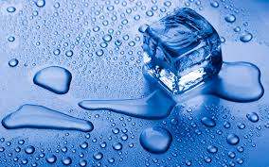
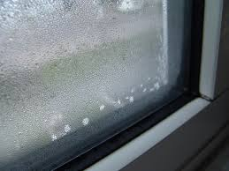
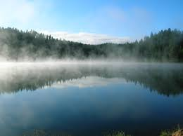
Physics- states of matter
CURRICULUM LINK: P1 1.3
Your challenge is to work In pairs to produce a fact sheet about two of these: melting, evaporation, freezing, condensation, sublimation. You must then teach your class mates about your fact sheet.
You must include: an explanation of what it is, examples, the arrangement of particles.
what equipment/resources do you need?

Slide 23
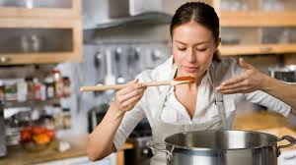
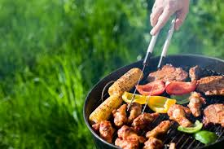
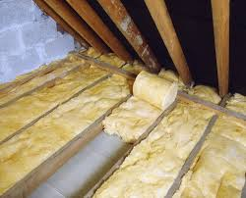
Physics- Conduction & Convection
CURRICULUM LINK: P1 1.4- 1.5
YOUR CHALLENGE IS TO RESEARCH AND MAKE A MULTIPLE CHOICE QUESTIONAIRE TO GIVE YOU TO YOUR CLASSMATES AT THE END OF THE LESSON.
You must include: 15 multiple choice questions and have a separate answer sheet,
what equipment/resources do you need?

Slide 24
Physics- Energy transfer by heating
CURRICULUM LINK: P1 1.9
Your task is to design a eco-friendly house which reduces the amount of energy lost
You must include: Drawing, labels and an explanation as to why it prevents/reduces energy transfer,
what equipment/resources do you need?

Slide 25
Physics-
CURRICULUM LINK: P1 1.1 -1.4
You are either an owner of a gym or a sports coach, your challenge is to design an exercise routine and diet plan that you can present to your Gym members or players.
You must include: your exercise workout, how muscles work, why you need to exercise, a meal plan explained,
what equipment/resources do you need?

