Slide 1
Give the definition of:
Element
Compound
Mixture
Ore
Metal oxide
Metal carbonate

Slide 2
Give the definition of:
Element – Chemicals made up of one type of atom only.
Compound – Chemicals made up of two or more element chemically combined.
Mixture – Made up of molecules of elements and/or compounds that are NOT chemically combined.
Ore – A naturally occurring solid material form which metal can be extracted profitably.
Metal oxide – A compound formed when a metal reacts with oxygen, e.g. magnesium oxide.
Metal carbonate – A metal compound made up of the metal, carbon and oxygen.

Slide 3
Metal Ores
Metal ores are
often compounds
of the metal with
oxygen ie
Copper oxide
Iron oxide
Magnesium oxide

Slide 4
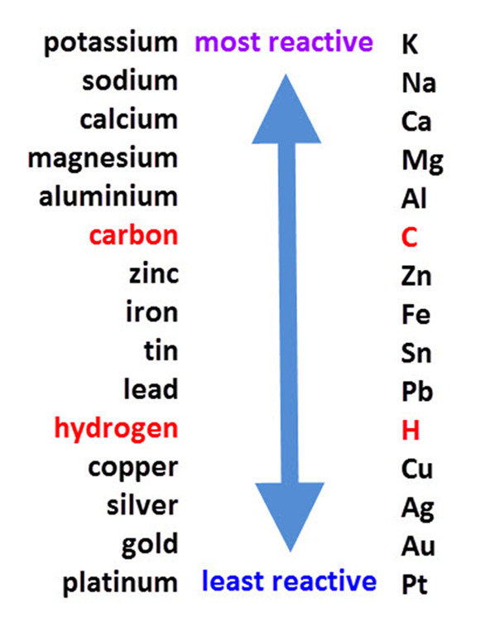
Metal Ores
We need to get the metals out of the metal ores ie we need to get the iron from the copper oxide.
HOW?
We DISPLACE the oxygen.
https://www.youtube.com/watch?v=MXTSels6e2Y

Slide 5
Reactivity series
Predict (using displacement):
Iron oxide + carbon
Copper oxide + iron
The iron oxide and copper oxide are
reduced they lose oxygen….
The carbon and iron are oxidised
they gain oxygen.

Slide 6
Thermite demo
https://www.youtube.com/watch?v=fcGkEtpMjw8

Slide 7
Questions
Are the following examples of Reduction or Oxidation. Explain your reasons.
1. Copper oxide + Hydrogen Copper + Water*
2. Magnesium + Oxygen Magnesium Oxide*
3. What type of ions to metals make when they react?*
4. How can you tell if a metal is reactive or not? Explain your answer.**
5. Explain what is the difference between reduction and oxidation? **
6. Where is reduction and oxidation used to extract pure metal?***

Slide 8
Questions
Are the following examples of Reduction or Oxidation. Explain your reasons.
1. Copper oxide + Hydrogen Copper + Water* copper reduced
2. Magnesium + Oxygen Magnesium Oxide* magnesium oxidized
3. What type of ions to metals make when they react?* positive
4. How can you tell if a metal is reactive or not? Explain your answer.** react it with water or acid and record your observations.
5. Explain what is the difference between reduction and oxidation? ** reduction loses oxygen. Oxidation gains oxygen
6. Where is reduction and oxidation used to extract pure metal?***

Slide 9
Questions
6. Where is reduction and oxidation used to extract pure metal?***
Iron oxide + carbon iron + carbon dioxide.
The idea that you can use a more reactive substance (remember carbon is not a metal but is more reactive that iron) to displace a less reactive substance.
This method is used to purify metals that are not very reactive.
Carbon is cheap and plentiful and so easy to use to extract iron from iron oxide. Why would it not work to extract magnesium from magnesium oxide?

Slide 10
Questions –
Why can we use carbon to extract iron from iron oxide but not use it to extract aluminium from aluminium oxide? (2)
Write out the displacement reaction for carbon and iron oxide. (2)
How can we test for the gas that is given off during the reaction? (1)
Mrs. C adds lead to water with no reaction. She then adds lead to steam and sees a reaction. Why did she need to react the lead with steam? (2)

Slide 11
Questions –
Why can we use carbon to extract iron from iron oxide but not use it to extract aluminium from aluminium oxide? (2)
Write out the displacement reaction for carbon and iron oxide. (2)
How can we test for the gas that is given off during the reaction? (1)
Mrs. C adds lead to water with no reaction. She then adds lead to steam and sees a reaction. Why did she need to react the lead with steam? (2)

Slide 12
Plenary
Write a short text message to your teacher outlining what you have learnt today.

