Slide 1
Tuesday, 05 January 2021
Reactivity Of Metals
Starter:
What is the chemical formula for Magnesium Oxide?
What is the chemical symbol for Magnesium?
When Magnesium is burnt in air, what happens to the mass?
What is the word equation for Magnesium reacting with oxygen?
What is the symbol equation for the reaction between magnesium and oxygen?

Slide 2
What is the chemical formula for Magnesium Oxide?
MgO
Starter:
What is the chemical symbol for Magnesium?
Mg
When Magnesium is burnt in air, what happens to the mass?
Increases
What is the word equation for Magnesium reacting with oxygen?
Magnesium + Oxygen ➔ Magnesium Oxide
What is the symbol equation for the reaction between magnesium and oxygen?
2Mg + O₂ ➔ 2MgO

Slide 3
Metals reacting with oxygen:
Metal + Oxygen ➔ Metal Oxide
This reaction is a ‘Oxidation’ reaction, where the metal gains oxygen.
The opposite of Oxidation is Reduction. This is were oxygen is lost.
Are all metals reactive with oxygen?

Slide 4
Metals reacting with oxygen:
Magnesium + Oxygen
Iron + oxygen
Iron oxide + magnesium Iron + magnesium oxide

Slide 5
But how do we know that zinc is more reactive than iron?
Miss Iron
Mr Sulphate
+
Miss Zinc
Miss Zinc
Mr Sulphate
Miss Iron
Iron sulphate
+
Zinc
Zinc Sulphate
+ Iron

Slide 6
Displacement
Input 1
A more reactive magnesium displaces a less reactive copper
Mr
Copper
Miss
Oxide
+
Mr Magnesium
Mr Magnesium
Miss
Oxide
Mr
Copper
Copper Oxide
Magnesium
Magnesium Oxide
+ Copper
+

Slide 7
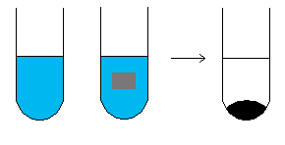
If a more reactive metal is placed into one of these metal solutions it will react and displace the other metal
For example the reaction between
copper sulphate and Magnesium
Would magnesium sulphate and copper react?
Copper sulphate
(blue)
Magnesium
Magnesium Sulphate
(clear)
Copper

Slide 8
Shoulder partner…
A reaction where a less reactive metal is displaced (removed) by a more reactive metal.

Slide 9
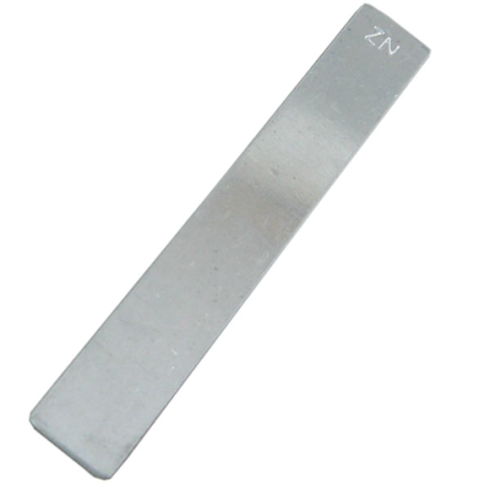
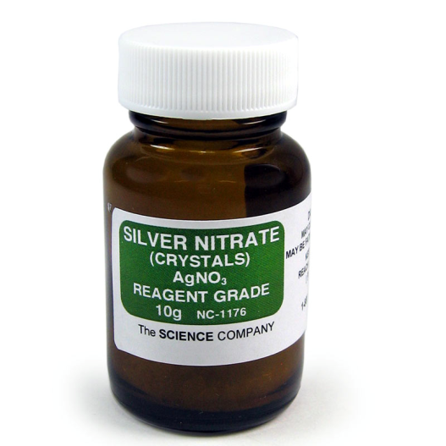
When silver nitrate and silver react will there be a displacement reaction?
+
Zinc
Silver nitrate

Slide 10
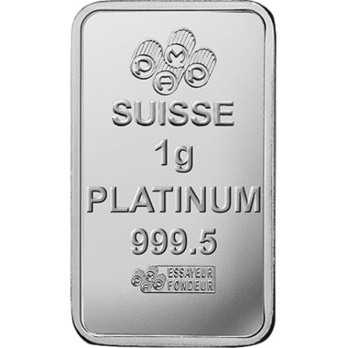
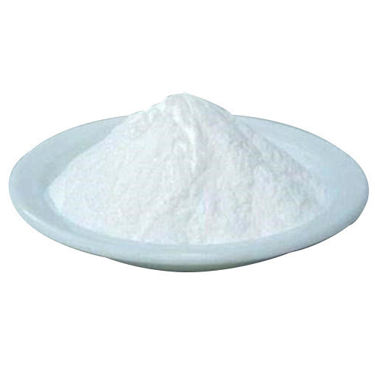
When calcium bromide and platinum react will there be a displacement reaction?
+
Platinum
Calcium bromide

Slide 11
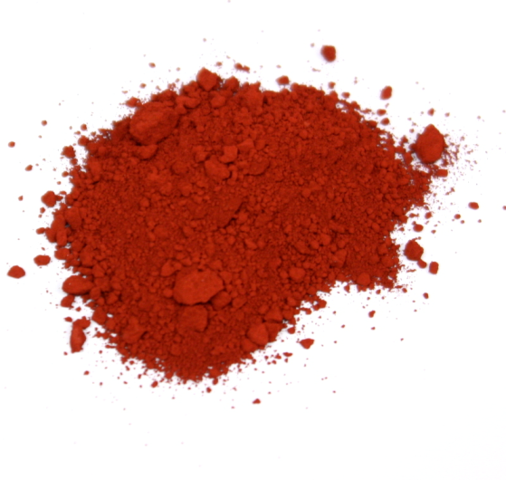
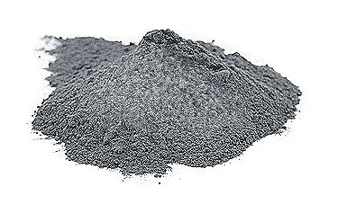
When aluminium and iron oxide react will there be a displacement reaction?
Input 1
+
Aluminium
Iron oxide

Slide 12
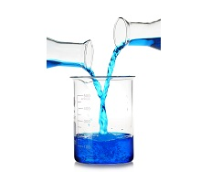
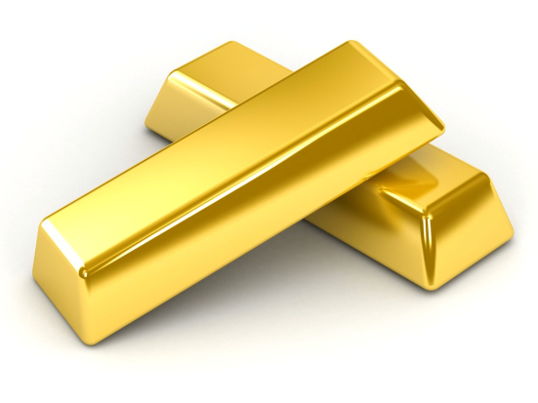
When gold and copper sulphate react will there be a displacement reaction?
Input 1
+
Gold
Copper sulphate

Slide 13
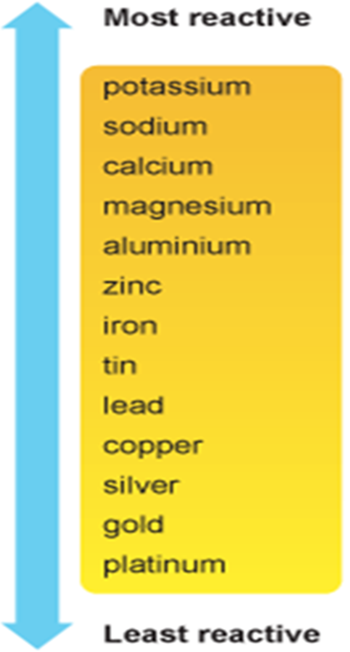
Shoulder partner…complete these displacement reactions.
magnesium + silver oxide →
platinum + calcium bromide →
aluminium + lead chloride →

Slide 14
Shoulder partner…complete these displacement reactions.
magnesium oxide + silver
magnesium + silver oxide →
platinum + calcium bromide →
aluminium + lead chloride →
Calcium bromide + platinum
aluminium chloride + lead

Slide 15
How can we test the reactivity of metals?
Reactivity of Metals with Water and Dilute Acids
When metals atoms react, they lose electrons to form positive ions.
The greater the tendency of a metal to lose electrons to form ions, the more reactive it is.
Potassium (K) easily loses electrons to form ions and is very reactive.
Gold (Au) does not tend to form ions and so is unreactive.

Slide 16
Metals Plus water….
https://www.youtube.com/watch?v=83eq5HyG-tI
Metal + WATER
Potassium - v reactive
Sodium - really reactive
Lithium - very reactive
Magnesium - reactive
Copper - not very reactive
Silver - no reaction
Gold - no reaction

Slide 17
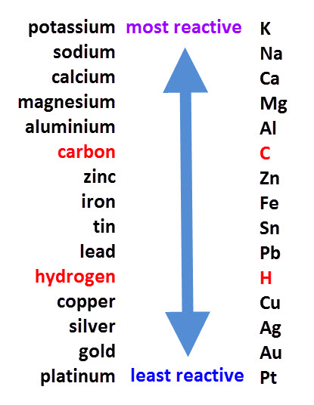
Reactivity series
Shows how reactive metals are.
The more easily they lose electrons,
the more reactive they are.
Some metals are very unreactive
ie gold and so their uses are linked
to the lack of reactivity.
Some are very reactive and so stored
under oil.

Slide 18
Reactivity series
1. Explain what this is showing.
2. Which metals will NOT react
with water?
3. Which metals must be stored
under oil because they are so
reactive?

Slide 19
Give the properties and uses of:
Gold
Tin
Copper
Aluminium

