Slide 1
04/01/2021
Chemical Analysis

Slide 2
Purity, Formulations and Chromatography

Slide 3
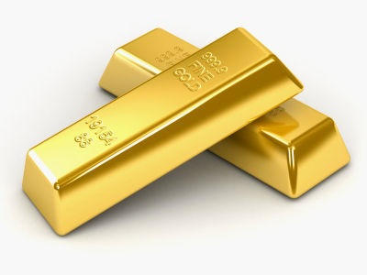
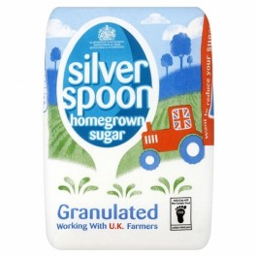
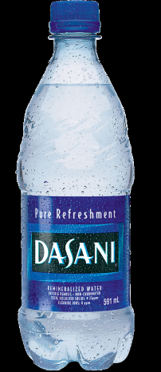
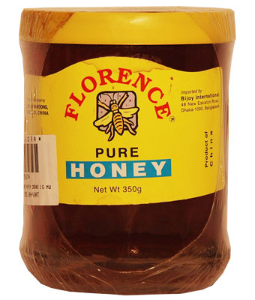
Pure Substances
A “pure” substance is defined as a substance that doesn’t contain any impurities (i.e. anything other than the substance it’s supposed to be).
Are the following pure or impure?

Slide 4
Boiling Points of Mixtures
Pure elements and compounds boil at specific temperatures (e.g pure water boils at 100^{O}C). However, what happens when you have a mixture?
% of ethanol | % of water | Boiling Point (^{O}C)
100 | 0 | 78
80 | 20 | 82
60 | 40 | 90
40 | 60 | 94
20 | 80 | 98
0 | 100 | 100
Some questions:
What temperature does pure ethanol boil at?
What effect does adding ethanol have to the boiling point?
What would be the boiling point of a 50/50 mix?

Slide 5
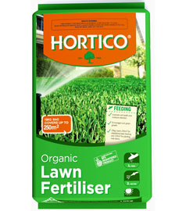
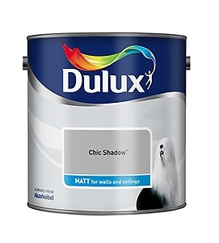
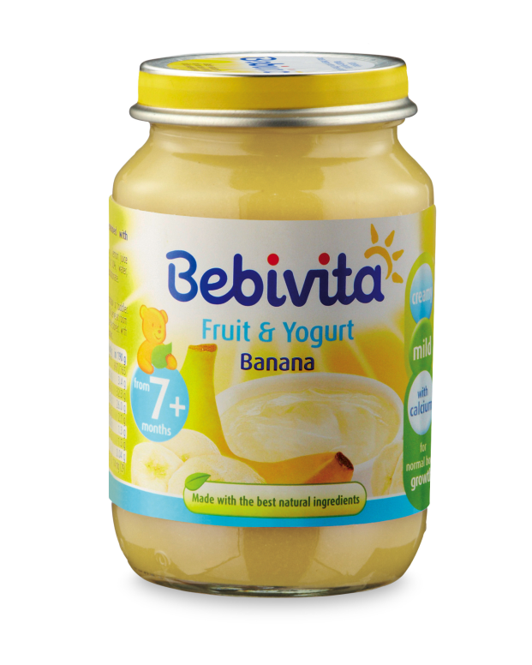
Formulations
Formulations are mixtures that have been made from specifically measured quantities in order to give the mixture a particular purpose. Some examples:

