Slide 1
The Kidneys
Key words: excretion, reabsorption, filtration
Starter:

Slide 2
The big picture: “Why are the kidneys so important?”
Learning outcomes:
Describe the organs within the excretory system and their function.
Explain the structure of the kidneys.
Analyse the stages in urine production.

Slide 3
Definitions
The kidneys are involved in homeostasis: the maintenance of a constant internal environment.
The removal of waste products from the body is called excretion.

Slide 4
Excretion
Describe 3 ways that water is lost from the body.
What process produces carbon dioxide? why is it dangerous if it wasn’t removed? And how does the body remove it?
Where does urea come from? How is the urea removed? Why is it dangerous if it not removed?

Slide 5
Excretion
Breathing, sweat and urine.
Respiration. Too much carbon dioxide creates an acidic solution in your body, this can affect the working of enzymes. Removed by breathing it out from your lungs.
Nitrogenous waste from the break down of excess amino acids. Passes from the liver into the blood and then removed from the blood by the kidneys. If it is not removed it is poisonous.

Slide 6
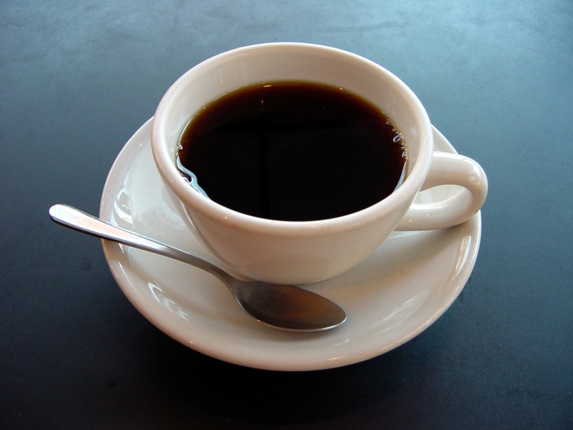
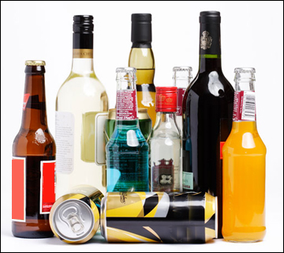
What’s the link?

Slide 7
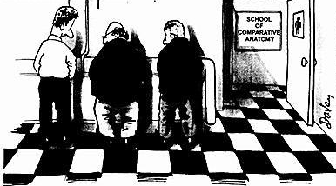
On average, how much urine does a person produce a day?
A: 0.5-1 litre
B: 1-1.5 litres
C: 1.5-2.5 litres
D: Over 2.5 litres

Slide 8
Where are your kidneys?

Slide 9
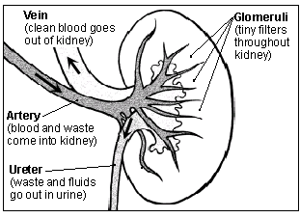
The kidney
The kidney is divided into two areas:
Cortex (outer area)
Medulla (inner area)
Notes:
Students label their kidneys on the worksheet (as homework). Your kidney’s clean blood and tissue fluid by removing excess water, urea and other wastes, which are excreted in urine. The amount of dissolved substances in the blood is controlled by osmoregulation.
Kidney’s filter blood 300 times a day. If they stopped absorbing water, you would be dead in less than 3 minutes as the body would become fatally dehydrated.
These are the answers, what are the questions?
Kidney
Pelvis
Bladder
Urine

Slide 10
The role of the kidneys
The kidneys help to maintain the internal environment by:
First filtering the blood;
Re-absorbing all the sugar (glucose);
Re-absorbing the dissolved ions needed by the body;
Re-absorbing as much water as the body needs;
Releasing urea, excess salts and excess water as urine.
kidneys

Slide 11
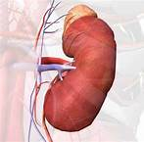
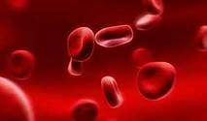
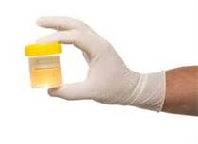
Kidneys clean blood & produce urine
The kidney sends the wastes to your bladder to be excreted as urine
The kidney removes the wastes from our blood.
It also adjusts the amount of salts and water in the blood

Slide 12
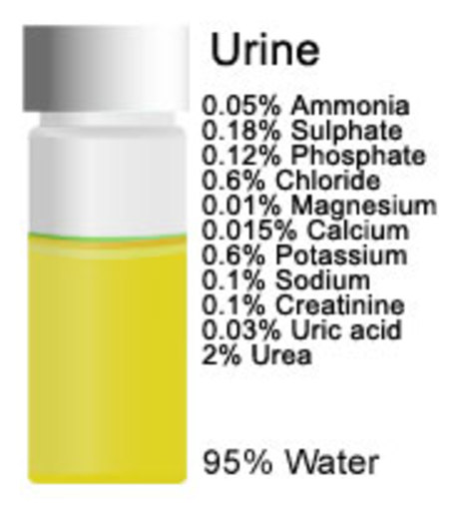
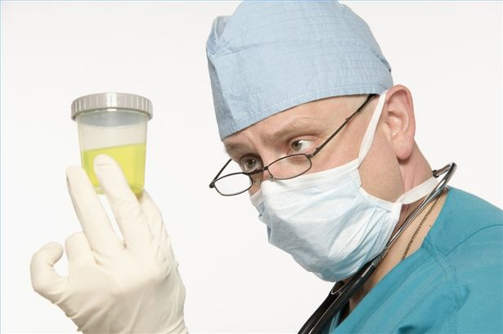
What is urine?
Water
Urea (nitrogenous wastes)
Salts

Slide 13
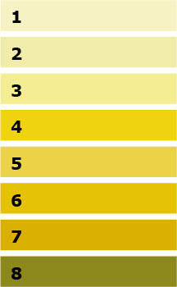
What colour will their urine be?
Sam has been playing lots of sports out in the sunshine
Reena has been working on her homework but also making copious glasses of squash in a bid to procrastinate
Sally has been playing sports in the sunshine but has made sure to drink lots of water
Ryan ate a salty burger and chips for lunch

Slide 14
Urine colour chart
You have been drinking enough water!
You need to drink more water

Slide 16
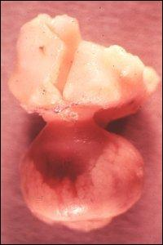
What is this?
The pituitary gland

Slide 17
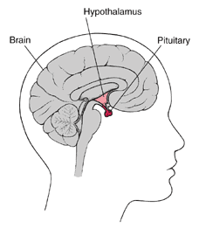

Slide 18
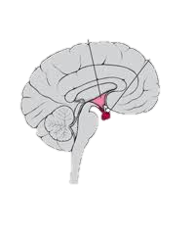
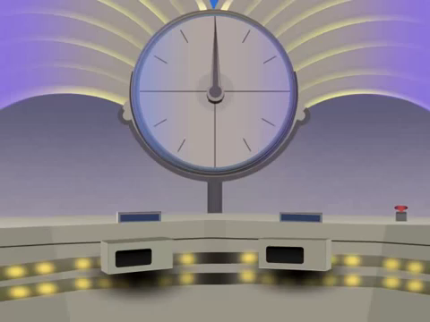
Receptor cells in the brain detect the water conc. in the blood.
Receptor cells in the brain detect the water conc. in the blood.
Water concentration = HIGH
Pituitary
Water concentration =LOW
↑ ADH
↓ ADH
Kidney tubules reabsorb less water (less permeable)
Kidney tubules reabsorb more water back into the blood (more permeable)
Red arrows = blood
Normal water concentration in the blood
Normal water concentration in the blood
Large volumes of dilute urine excreted
Small volume of concentrated urine

