Slide 1
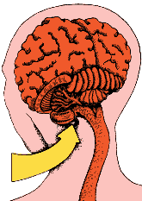
Dehydration
Decreased water potential of blood
Osmoreceptors cells in hypothalamus lose water (so shrink)
Stimulates nerve cells in the hypothalamus
Increased ADH (antidiuretic hormone) production by posterior pituitary gland
ADH carried in the blood
ADH arrives at the collecting duct

Slide 2
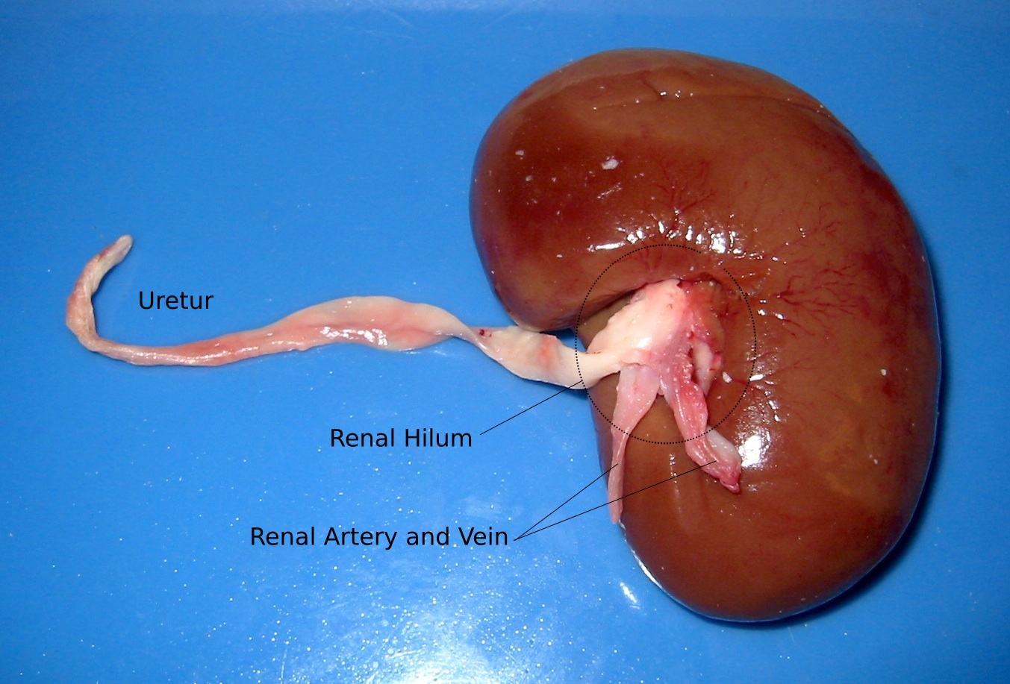

Slide 3
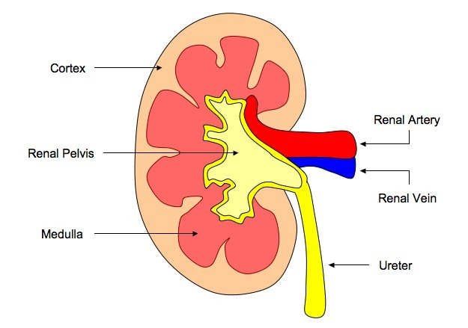
Anatomy of the kidney
Cortex - filters large molecules from the blood e.g. white blood cells
Renal artery - brings blood to kidney
Renal vein- takes blood away from kidney
Pelvis –
collects urine
Medulla - where water, salt and urea are removed from blood
Ureter - takes urine from kidney to bladder

Slide 4
How does the kidney control the amount of water in our body?
GCSE youtube video (4 mins)
http://www.youtube.com/watch?v=vB7tSHqR1eY&feature=endscreen&NR=1

Slide 5
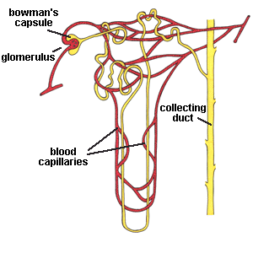
There are roughly one million nephrons in each kidney.
Cortex
Nephron
R. vein
Renal artery
Ureter
The unit of a kidney is the nephron – it carries out filtering and reabsorption.
Medulla

Slide 6
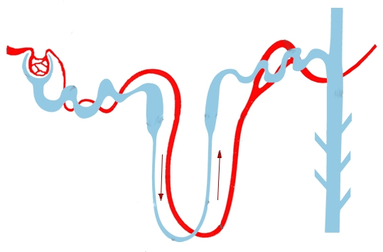
Blood is filtered in the renal capsule
Reabsorption of useful substances
Water levels of urine adjusted
To bladder

Slide 7
Renal artery
Glomerulus
Bowman’s capsule
Distal convoluted tubule
Capillaries off renal artery
Proximal convoluted tubule
Loop of Henle
Urine collecting duct
Blood arrives from the renal artery and enters a ball of capillaries
Small molecules leave the capillary and enter the capsule by diffusion – glucose, amino acids, salts, urea and water.

Slide 8
The filtered blood moves down the nephron.
In the convoluted tubule cells reabsorb the good stuff – glucose, amino acids, most salt and water.
The rest – water and urea – moves on through the nephron.
This is selective reabsorption
Renal artery
Glomerulus
Bowman’s capsule
Distal convoluted tubule
Capillaries off renal artery
Convoluted or kidney tubule
Urine collecting duct

Slide 9
The water & urea are now urine
As the urine moves on more water is saved in the loop of Henle and collecting duct
This adjusts water loss to suit the level of water in the body.
Glomerulus
Bowman’s capsule
Convoluted tubule
Loop of Henle
Urine collecting duct

Slide 10
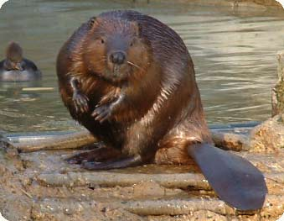
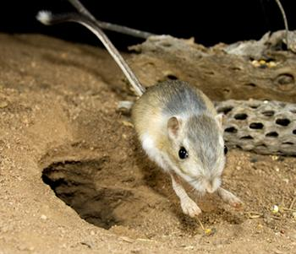
What is the relationship between dryness of habitat and length of Loop of Henle?

Slide 11
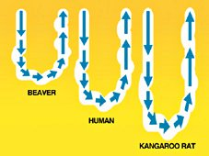

Slide 13
Tasks
1 : Explain the role of the kidneys.
2: Produce a flow chart to explain the events that occur in the kidneys.
3: Analyse how urine is produced (refer to a diagram in your answer).

Slide 14
EXAM PRACTICE
6 marks
Homeostasis keeps conditions in the body relatively constant.
The amount of water in the body is controlled by homeostasis.
Kidney function is controlled by a gland in the brain.
Describe how the water content of the blood is controlled.
Notes:
This bar timer, will start when anywhere on the slide is clicked. The bar will move from left to right and the word ‘End’ will appear at the end, accompanied by a ‘Deep Gong’ sound. It is possible to change the duration of this timer to any time, by entering the animation settings, and changing the timing for ‘rectangle 3’. Note the time has to be entered as a number of seconds – so if you want 2mins & 30secs – this is entered as 150 (60X2 + 30 = 150).

Slide 15
GP-P/A
WWW
EBI
0 marks No relevant content.
Level 1 (1 – 2 marks) There is a brief description of kidney function including a mention of pituitary gland or hormones but roles may be confused.
Level 2 (3 – 4 marks) There is a clear description of kidney function in relation to fluctuations in blood water levels and the roles of the pituitary gland or hormone is mentioned with correct role.
Level 3 (5 – 6 marks) There is a clear and detailed scientific description of kidney function in relation to fluctuations in blood water levels and of the roles of the pituitary gland and ADH.
• if water content too low, ADH released
• from pituitary gland
• into the blood
• (causing) kidney reabsorbs more water
• more concentrated / small volume urine produced
•if water content too high, ADH lowered / not produced
•less water reabsorbed by kidney
•more dilute / larger volume urine produced
full marks may be awarded for detailed description of either water loss or gain
[6]

Slide 16
HTTPS://WWW.YOUTUBE.COM/WATCH?V=9IMGFQMMUFS
Notes:
https://www.youtube.com/watch?v=9iMGFqMmUFs

Slide 17
HTTPS://WWW.YOUTUBE.COM/WATCH?V=Y52E551LU50
Notes:
https://www.youtube.com/watch?v=Y52e551lU50

