Slide 1
LearnIT!
KnowIT!
Internal energy and energy transfers
Internal energy
Temperature change in a system and specific heat capacity
Changes of heat and specific latent heat

Slide 2
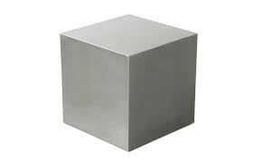
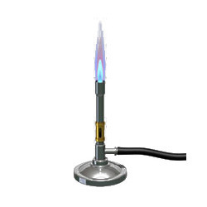
Internal energy and energy transfers – Temperature change in a system and specific heat capacity
The temperature increase of an object depends on what it is made of, the mass of the object and the amount of energy put into it.
Mass of system
(kg)
Type of material (specific heat capacity) (J/kg ºC)
To calculate the temperature change, the formula for specific heat capacity has to be re-arranged.
Remember, specific heat capacity (c) is the energy required to raise the temperature of 1 kg of a substance by 1ºC.
Energy input (thermal)
(J)
Temperature change (Δθ) = ___change in thermal energy (ΔE)__
mass (m) x specific heat capacity (C )

Slide 3
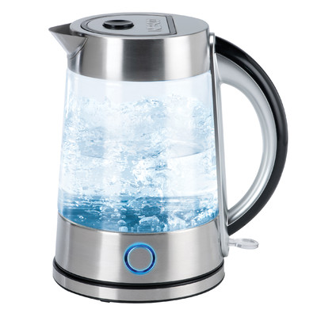
Internal energy and energy transfers – Temperature change in a system and specific heat capacity
Calculating temperature change
A kettle contains 1400 g of water at 12 ºC.
If 400 kJ of heat energy is supplied to the water, how much will the temperature rise?
Temperature change (Δθ) = change in thermal energy (ΔE) mass (m) x specific heat capacity (C)
Δθ = ΔE = 400 000 = 68 ºC
m x C 1.4 x 4200
The temperature rise will be 68 ºC.
The new temperature of the water will be 68 + 12 = 80 ºC.

Slide 4
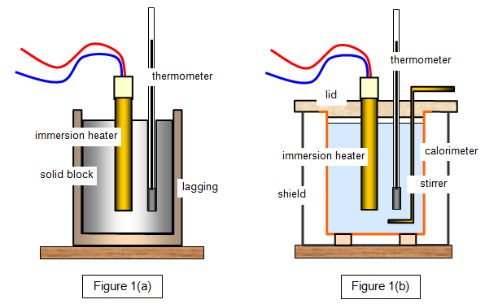
Practical procedure: Specific Heat Capacity
Video 1
Image from: http://www.schoolphysics.co.uk/age16-19/Thermal%20physics/Heat%20energy/text/Specific_heat_capacity_measurement/index.html
Notes:
Click on each of the tabs to take you to a YouTube clip. Please note these are external sites to PiXL, PiXL does not control the content of these sites.

Slide 5
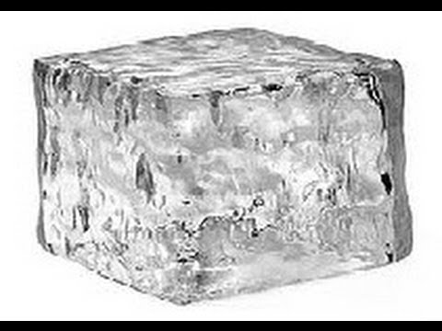
Internal energy and energy transfers – Changes of heat and specific latent heat
Latent heat is the energy needed to change the state of a substance without a change in temperature.
The energy supplied is used to change the internal energy store of the substance.
Latent heat for melting is called specific latent heat of fusion (L_{f})
Latent heat for evaporating is called specific latent heat of vaporisation (L_{v})
1kg of ice at 0ºC 1kg water at 0ºC
Specific latent heat of fusion for water = 336 000 J/kg
This means 336 000 J of energy are needed to turn 1 kg of ice into 1 kg of water with no temperature change.

Slide 6
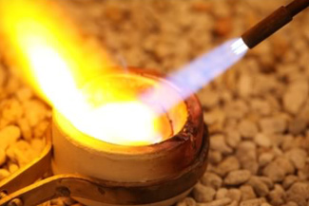
Internal energy and energy transfers – Changes of heat and specific latent heat
5 g of gold is being melted to make a ring.
Once the gold reaches its melting temperature, how much heat energy is needed to melt the gold?
Specific latent heat of fusion for gold = 64 400 J/kg
Energy to change state (J) = mass (kg) x specific latent heat (J/kg)
Remember there are two latent heats for each substance – fusion and vaporisation.
Fusion – melting and freezing Vaporisation – evaporating and condensing
Energy = 0.0005 kg x 64,400 J/kg = 322 J
322 J of heat energy is needed to melt 5 g of gold

Slide 7
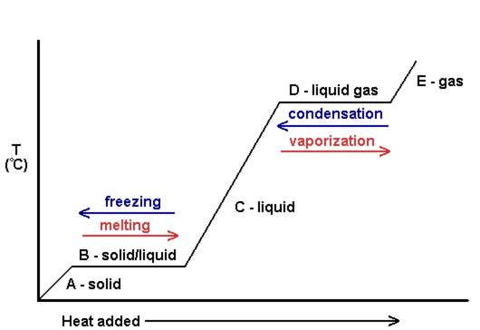
Internal energy and energy transfers – Changes of heat and specific latent heat
Heating and cooling graphs
As heat energy is added to a solid, the temperature rises until it reaches its melting point.
As the substance melts, all the heat energy added is used to change the state of the substance with no temperature change.
When all the substance is melted, the temperature will then rise until the boiling point is reached.
Again, heat energy is now required to change the state to a gas with no temperature change.

Slide 8
QuestionIT!
Internal energy and energy transfers
Internal energy
Temperature change in a system and specific heat capacity
Changes of heat and specific latent heat

Slide 9
Internal energy and energy transfers – AnswerIT
Define internal energy.
2. Which of the following will change the internal energy of a stone?
A. Lifting it to the top of a building.
B. Heating it.
C. Firing it from a catapult.
3. Water and the chemical isooctane both boil at 100 ºC. When the
same mass of each substance is placed on a heater, the
isooctane boils first. Explain why this happens.

Slide 10
Internal energy and energy transfers – AnswerIT
Define internal energy?
The total kinetic and potential energy of all the particles within a
system
2. Which of the following will change the internal energy of a stone?
A. Lifting it to the top of a building
B. Heating it
C. Firing it from a catapult
Heating it.
3. Water and the chemical isooctane both boil at 100 ºC. When the
same amount of each substance is placed on a heater, the
isooctane boils first. Explain why this happens.
Isooctane has a lower specific heat capacity than water so less heat energy is needed to raise its temperature to its
boiling point.

Slide 11
Internal energy and energy transfers – AnswerIT
4. A hot stone is placed into a glass of water containing 200 g
of cold water. The stone transfers 25 200 J of energy to
the water. How much will the temperature of the water rise?
Specific heat capacity of water = 4200 J/kg ºC ΔE = m c Δθ
5. What is specific latent heat?

Slide 12
Internal energy and energy transfers – AnswerIT
4. A hot stone is placed into a glass of water containing 200 g
of cold water. If the stone transfers 25 200 J of energy to
the water, what will the temperature rise of the water be?
specific heat capacity of water = 4200 J/kg ºC ΔE = m c Δθ
Δθ = ΔE = 25 200 = 30 ºC
m x c 0.2 x 4200
Temperature rise of the water = 30 ºC
5. What is latent heat?
The energy needed to change the state of a substance without
changing the temperature.

Slide 13
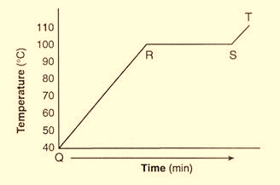
Internal energy and energy transfers – AnswerIT
6. A boiler is being used to heat water. The graph shows the temperature of
the water every 5 minutes.
a. What state is the water in between points
Q and R?
b. At which point does the water begin
to boil?
c. What state is the water in at 110 ºC?

Slide 14
Internal energy and energy transfers – AnswerIT
6. A boiler is being used to heat water. The graph shows the temperature of
the water every 5 minutes.
a. What state is the water in between points
Q and R?
Liquid
b. At which point does the water begin
to boil?
R
c. What state is the water in at 110 ºC?
Gas

