Slide 1
LearnIT!
KnowIT!
Changes of state and the particle model
Density of materials
Changes of state

Slide 2
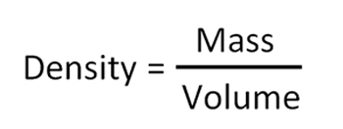
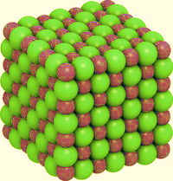
Changes of state and the particle model – Density of materials
Density is the mass of a given volume of a substance
The density of a substance is
determined by the mass of
the atoms it is made from and
how closely these atoms are mass in kg
packed together. volume in m³
What is the density of a bar of gold if its volume is 350 cm³ (0.00035 m³) and its mass is 6.76 kg?
Density ᵨ = mass (kg) = 6.76
volume (m³) 0.00035
Density of gold = 19 314 kg/m³
Substance | Density (kg/m³)
Water (l) | 1 000
Glass (s) | 3 140
Iron (s) | 7 700
Aluminium (s) | 2 800
Hydrogen (g) | 0.085

Slide 3
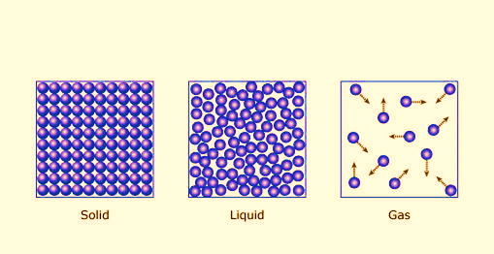
Changes of state and the particle model – Density of materials
Density also depends on the state of a substance.
In solids the particles are packed close together.
In liquids the particles are free to move so the same mass takes up more space.
In gases the particles take up a much greater volume than in liquids and solids.
Solid Liquid Gas
For any particular substance, a solid is usually denser than its liquid and the liquid is usually denser than the gas.
However, there are exceptions to this. Solid water (ice) is less dense than liquid water. This is why ice floats on water.

Slide 4
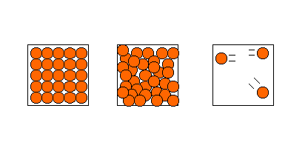
Internal energy and energy transfers – Internal energy
When heat is added to a system the internal energy of the particles increases. This can result in the material changing state.
In a solid, particles can only vibrate so they cannot move relative to each other. When the solid is heated the particles gain kinetic energy and vibrate faster and faster.
In a liquid, the particles are moving fast enough to break free from the solid. They are free to move relative to each other but are held within a container.
In a gas, the particles have sufficient energy to break free from their container. Gas particles can move away from their container and away from other gas particles.

Slide 5
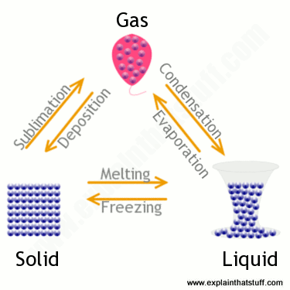
Changes of state and the particle model – Changes of state
A change of state can be brought about by changing the temperature or pressure of a material.
If the solid shown has a mass of 1kg, then the liquid and gas will both have a mass of
1 kg.
Mass is conserved when a substance changes state, only the volume changes.
Changes of state are physical changes not chemical changes.
The change can be reversed in a physical change so the material recovers its original properties.
This does not happen with a chemical change.
The arrows show the direction in change of state.

Slide 6
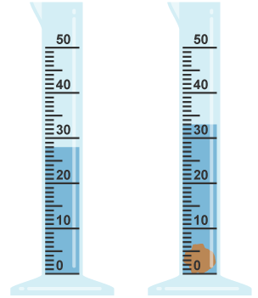
Changes of state and the particle model –Density of materials
Finding the density of an irregular object
To find the density of an irregular shaped object, you need to determine its volume.
To do this, it is placed in a known volume of water and the amount of water displaced equals the volume of the object.
Piece of granite stone with a mass of 13.5 g (0.0135 kg)
Volume = 0.000005 m³
Increase in water level = volume of granite
(5 cm³)
Density of granite = 0.0135 kg = 2 690 kg/m³
0.000005 m³

Slide 7
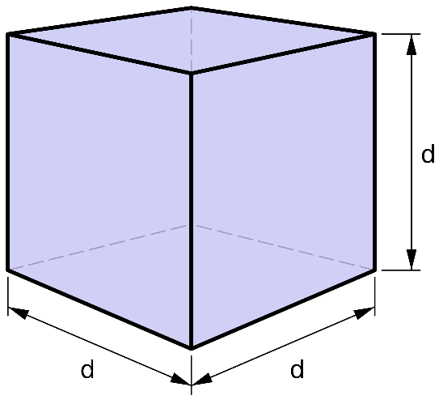
Practical procedure: Densities
Video 1
Video 2
Notes:
Click on each of the tabs to take you to a YouTube clip. Please note these are external sites to PiXL, PiXL does not control the content of these sites.

Slide 8
QuestionIT!
Changes of state and the particle model
Density of materials
Changes of state

Slide 9
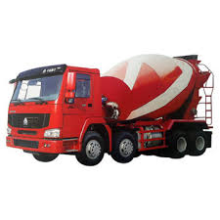
Changes of state and the particle model – AnswerIT
Why is it incorrect to say iron is heavier than wood?
2. Water has a density of 1000 kg/m³. A piece of rubber has a density
of 1024 kg/m³. Explain what would happen if the rubber was put in
a pool of water?
3. This “ready-mix” concrete waggon contains
9600 kg of concrete. If the density of the
concrete is 2400 kg/m³, what volume of
concrete does the waggon contain?

Slide 10
Changes of state and the particle model – AnswerIT
Why is it incorrect to say iron is heavier than wood?
It depends how much iron and wood you have. You should say iron
is denser than wood.
2. Water has a density of 1000 kg/m³. A piece of rubber has a density
of 1024 kg/m³. Explain what would happen if the rubber was put in
a pool of water?
Rubber has a higher density than water so the rubber would sink
in water.
3. This “ready-mix” concrete waggon contains
9600 kg of concrete. If the density of the
concrete is 2400 kg/m³, what volume of
concrete does the waggon contain?
Density = m v = mass = 9600 kg = 4
v density 2400 kg/m³
volume of concrete in the waggon = 4 m³

Slide 11
Changes of state and the particle model – AnswerIT
4. a. A sheet of insulating foam measures 3 m x 1 m x 0.08 m. It has a
mass of 9.6 kg. Calculate the density of the insulating foam.
b. High density foam is made of the same material and can be used
to give better insulation for the same thickness of foam. Describe
how the arrangement of particles would differ in these two types
of foam (you may draw diagrams to help your answer).
5. When copper metal is heated to 1100 ºC it melts.
a. Is this a chemical or physical change? Explain your answer.
b. What will happen to the mass of the sample of copper after it has
melted? Explain your answer.

Slide 12
Changes of state and the particle model – AnswerIT
4. a. A sheet of insulating foam measures 3 m x 1 m x 0.08 m. It has a
mass of 9.6 kg. Calculate the density of the insulating foam.
V = 3 x 1 x 0.08 = 0.24 m³ Density = 9.6 / 0.24 = 40 kg/m³
b. High density foam is made of the same material and can be used
to give better insulation for the same thickness of foam. Describe
how the arrangement of particles would differ in these two types
of foam (you may draw diagrams to help your answer).
Particles in the high density foam will be closer together so there
are more particles in a given volume, making it denser.
5. When copper metal is heated to 1100 ºC it melts.
a. Is this a chemical or physical change? Explain your answer.
Physical change. No new products have been formed.
b. What will happen to the mass of the sample of copper after it has
melted? Explain your answer.
It will stay the same. Mass is conserved when state changes.

