Slide 1
C4 – Chemical Changes

Slide 2
Neutralisation with Alkalis and pH
4.4.2.4
Monday, 04 January 2021
Starter: Use the formulae of common ions to write formulae for these salts.
Calcium chloride
Magnesium sulfate
Magnesium nitrate
CaCl₂
Sodium sulfate
Copper (II) sulfate
Copper (II) chloride
Na₂SO₄
Ca⁺ and Cl⁻
Na⁺ and SO₄²⁻
Ca²⁺
Cl⁻
Na⁺
+
-
SO₄²⁻
+
-
Na⁺
+
-
Cl⁻
+
-
MgSO₄
CuSO₄
Mg²⁺ and SO₄²⁻
Cu²⁺ and SO₄²⁻
Mg²⁺
+
-
SO₄²⁻
Cu²⁺
+
-
SO₄²⁻
+
-
+
-
Mg(NO₃)₂
CuCl₂
Mg²⁺ and NO₃⁻
Cu²⁺ and Cl⁻
Cu²⁺
+
-
Cl⁻
Mg²⁺
+
-
NO₃⁻
Cl⁻
NO₃⁻
+
-
+
-

Slide 3
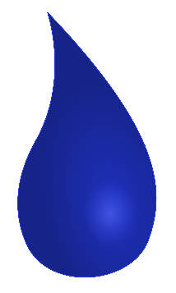
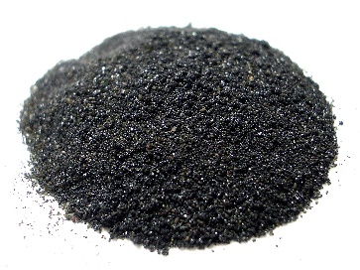
Alkalis
Recap: What is a base?
Bases are a group of compounds that are able to neutralise acids.
There are two key types of base:
Bases soluble in water
Bases insoluble in water
Alkalis
Insoluble bases
We use as solutions
Typically used as solid powders
Today we are going to look at alkalis.
Q: How can we recognise alkalis?

Slide 4
Alkalis
Q: How can we recognise alkalis?
Bases soluble in water
Alkalis
We use as solutions
Sodium hydroxide – NaOH
Lithium hydroxide – LiOH
Potassium hydroxide – KOH
Calcium hydroxide – Ca(OH)₂
Magnesium hydroxide – Mg(OH)₂
It’s the hydroxide anion OH⁻ that makes them alkalis!

Slide 5
Alkalis and pH
How the hydroxide ion makes them alkaline:
When dissolved in water, alkalis ionise into metal ions and hydroxide ions.
Na⁺
OH⁻
Na⁺
OH⁻
Na⁺
OH⁻
Na⁺
Na⁺
OH⁻
OH⁻
Na⁺
OH⁻
Na⁺
OH⁻
Na⁺
OH⁻
Na⁺
OH⁻
Na⁺
OH⁻
Na⁺
OH⁻
Na⁺
OH⁻
Na⁺
OH⁻
The presence of hydroxide OH⁻ ions in solution makes it alkaline.
The higher the concentration of OH⁻ the higher the pH
pH is a scale of how acidic or alkaline a solution is.
Alkalis pH ranges between 8-14.
pH 8 = Weak alkali low concentration of hydroxide
pH 14 = Strong alkali High concentration of hydroxide
The pH Scale:
0 1 2 3 4 5 6 7 8 9 10 11 12 13 14
pH 7 is neutral

Slide 6
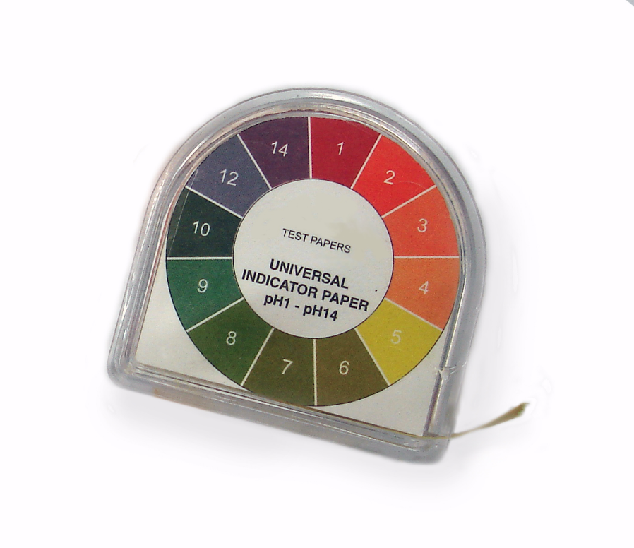
Alkalis and pH
Testing for alkalinity:
Universal indicator paper
Universal indicator solution
Universal indicator can be added to a solution to determine it’s pH.
The colours on this chart show that universal indicator turns blue in weak alkalis pH 8 , and purple in strong alkalis pH 14.
Green indicates a neutral solution (neither acidic nor alkaline).
0 1 2 3 4 5 6 7 8 9 10 11 12 13 14

Slide 7
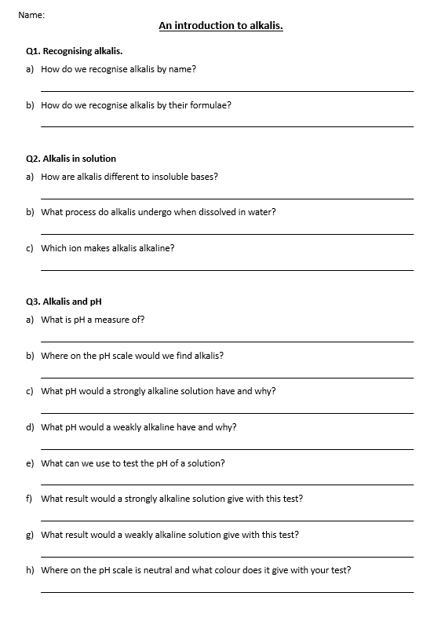
Task: Complete the questions on Alkalis
Q1. Recognising alkalis.
How do we recognise alkalis by name?
How do we recognise alkalis by their formulae?
Q2. Alkalis in solution
How are alkalis different to insoluble bases?
What process do alkalis undergo when dissolved in water?
Which ion makes alkalis alkaline?
Q3. Alkalis and pH
What is pH a measure of?
Where on the pH scale would we find alkalis?
What pH would a strongly alkaline solution have and why?
What pH would a weakly alkaline have and why?
What can we use to test the pH of a solution?
What result would a strongly alkaline solution give with this test?
What result would a weakly alkaline solution give with this test?
Where on the pH scale is neutral and what colour does it give with your test?

Slide 8
Self assessment & Corrections
Q1. Recognising alkalis.
How do we recognise alkalis by name?
How do we recognise alkalis by their formulae?
Q2. Alkalis in solution
How are alkalis different to insoluble bases?
What process do alkalis undergo when dissolved in water?
Which ion makes alkalis alkaline?
Q3. Alkalis and pH
What is pH a measure of?
Where on the pH scale would we find alkalis?
What pH would a strongly alkaline solution have and why?
What pH would a weakly alkaline have and why?
What can we use to test the pH of a solution?
What result would a strongly alkaline solution give with this test?
What result would a weakly alkaline solution give with this test?
Where on the pH scale is neutral and what colour does it give with your test?
M. 1a) They have “hydroxide in the name”
M. 1b) They have OH in the formula
M. 2a) Alkalis dissolve in water, insoluble bases do not
M. 2b) Ionisation
M. 2c) OH⁻ the hydroxide ion
M. 3a) Acidity or alkalinity
M. 3b) 8-14
M. 3c) High pH of 14, high concentration of hydroxide OH⁻
M. 3d) Lower pH of 8, low concentration of hydroxide OH⁻
M. 3e) Universal indicator paper or solution
M. 3f) Turns purple in colour.
M. 3g) Turns blue in colour.
M. 3h) pH 7, turns green in colour.

