Slide 1
Acids
Q: Do you know the formulae of the acids?
Q: What do they all have in common?
Hydrochloric Acid
Sulfuric Acid
Nitric Acid
HCl
H₂SO₄
HNO₃
H⁺
Cl⁻
H⁺
H⁺
SO₄²⁻
H⁺
NO₃⁻
They all contain hydrogen ions!
H⁺
When dissolved in water, these acids fully ionise to release their H⁺ ions into solution.

Slide 2
Acids
How the hydrogen ion makes them acidic:
When dissolved in water, acids ionise into non-metal ions and hydrogen ions.
H⁺
Cl⁻
H⁺
Cl⁻
H⁺
Cl⁻
H⁺
H⁺
Cl⁻
Cl⁻
H⁺
Cl⁻
H⁺
Cl⁻
H⁺
Cl⁻
H⁺
Cl⁻
H⁺
Cl⁻
H⁺
Cl⁻
H⁺
Cl⁻
H⁺
Cl⁻
The presence of hydrogen H⁺ ions in solution makes it acidic
The higher the concentration of H⁺ the lower the pH
pH is a scale of how acidic or alkaline a solution is.
Acids range from pH 0 to pH 6.
pH 6 = Weak acid low concentration of H⁺
The pH Scale:
0 1 2 3 4 5 6 7 8 9 10 11 12 13 14
pH 0 = Strong acid High concentration of H⁺
pH 7 is neutral

Slide 3
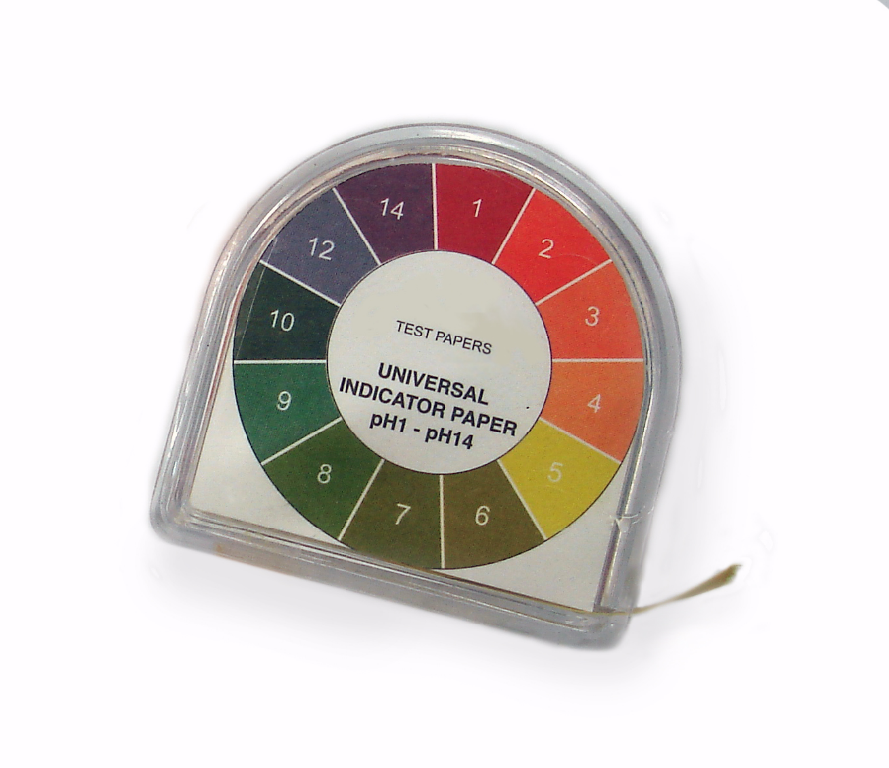
Acids and pH
Testing for acidity
Universal indicator paper
Universal indicator solution
Universal indicator can be added to a solution to determine it’s pH.
The colours on this chart show that universal indicator turns yellow in weak acids pH 6, and red in strong acids pH 0.
Green indicates a neutral solution (neither acidic nor alkaline).
0 1 2 3 4 5 6 7 8 9 10 11 12 13 14

Slide 4
Neutralisation
When an alkali reacts with an acid, it neutralises it.
This brings the pH to 7, which we could confirm with universal indicator as it turns green.
0 1 2 3 4 5 6 7 8 9 10 11 12 13 14
pH 7 is neutral
When an acid and alkali react the following word equation applies:
Acid + Alkali → soluble salt + water
Example 1:
Hydrochloric acid + sodium hydroxide → sodium chloride + water
HCl _{(aq)} + NaOH _{(aq)} → NaCl _{(aq)} + H₂O _{(l)}
Let’s look at why neutralisation takes place.

Slide 5
Neutralisation
In solution. The acid ionises to produce H⁺ ions.
In solution. The alkali ionises to produce OH⁻ ions.
The H⁺ and OH⁻ ions react to form water.
This means the solution now has a low concentration of both H⁺ and OH⁻ so the pH falls right in the middle!
The spectator ions remain in solution as the soluble salt, until they are removed by crystallisation.
Na⁺
OH⁻
H₂O
H⁺
Cl⁻
0 1 2 3 4 5 6 7 8 9 10 11 12 13 14
We show the neutralisation ionic equation as:
H⁺ + OH⁻ → H₂O

Slide 6
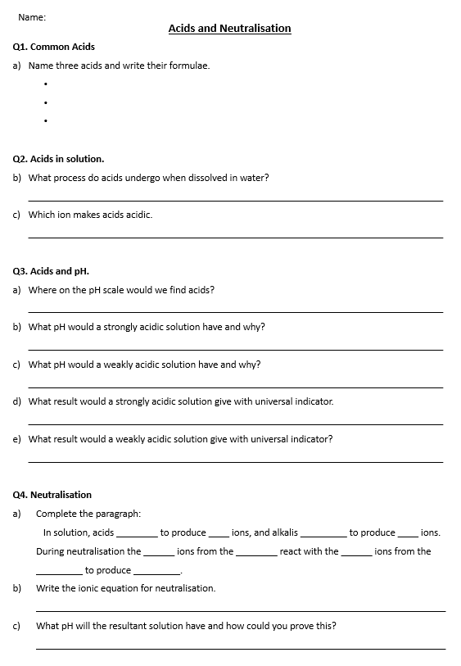
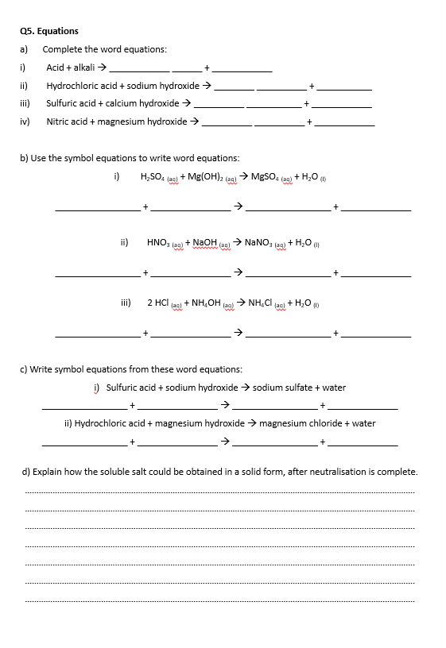
Task: Complete the questions on Acids & Neutralisation.

Slide 7
Self assessment & Corrections
Q1. Common Acids
Name three acids and write their formulae.
Q2. Acids in solution.
What process do acids undergo when dissolved in water? ________________________________________________________________________
Which ion makes acids acidic. ________________________________________________________________________
Hydrochloric acid
HCl
Sulfuric acid
H₂SO₄
Nitric acid
HNO₃
ionisation
H⁺ the Hydrogen ion!

Slide 8
Self assessment & Corrections
Q3. Acids and pH.
Where on the pH scale would we find acids? _____________________________________________________________________________
What pH would a strongly acidic solution have and why? _____________________________________________________________________________
What pH would a weakly acidic solution have and why? _____________________________________________________________________________
What result would a strongly acidic solution give with universal indicator. _____________________________________________________________________________
What result would a weakly acidic solution give with universal indicator? _____________________________________________________________________________
Low – between pH 0 and pH 6
pH 0 – as a high concentration of H⁺ ions.
pH 6 – as a low concentration of H⁺ ions.
Turns red in colour
Turns yellow in colour

Slide 9
Self assessment & Corrections
Q4. Neutralisation
Complete the paragraph: In solution, acids ________ to produce ____ ions, and alkalis _________ to produce ____ ions. During neutralisation the ______ ions from the ________ react with the ______ ions from the _________ to produce _________.
Write the ionic equation for neutralisation. ____________________________________________________________________________
What pH will the resultant solution have and how could you prove this? ____________________________________________________________________________
ionise
H⁺
ionise
OH⁻
H⁺
acid
OH⁻
alkali
water
H⁺ + OH⁻ → H₂O
pH 7 – Neutral – Will turn universal indicator green in colour.

Slide 10
Self assessment & Corrections
Q5. Equations
Complete the word equations:
Acid + alkali → ____________ ______ + ____________
Hydrochloric acid + sodium hydroxide → ________ __________ + ___________
Sulfuric acid + calcium hydroxide → __________ ___________ + ____________
Nitric acid + magnesium hydroxide → __________ __________ + ____________
soluble
salt
water
sodium
chloride
water
calcium
sulfate
water
magnesium
nitrate
water

Slide 11
Self assessment & Corrections
5b) Use the symbol equations to write word equations:
H₂SO₄ _{(aq)} + Mg(OH)₂ _{(aq)} → MgSO₄ _{(aq)} + H₂O _{(l)} _________________ + ________________ → _________________ + ______________
HNO₃ _{(aq)} + NaOH _{(aq)} → NaNO₃ _{(aq)} + H₂O _{(l)} _________________ + ________________ → _________________ + ______________
2 HCl _{(aq)} + NH₄OH _{(aq)} → NH₄Cl _{(aq)} + H₂O _{(l)} _________________ + ________________ → _________________ + ______________
magnesium hydroxide
magnesium sulfate
Sulfuric acid
water
sodium hydroxide
sodium nitrate
Nitric acid
water
ammonium hydroxide
ammonium chloride
Hydrochloric acid
water

Slide 12
Self assessment & Corrections
c) Write symbol equations from these word equations:
i) Sulfuric acid + sodium hydroxide → sodium sulfate + water
_________________ + ________________ → _________________ + ______________
ii) Hydrochloric acid + magnesium hydroxide → magnesium chloride + water
_________________ + ________________ → _________________ + ______________
H₂SO_{4 (aq)}
2 NaOH _{(aq)}
Na₂SO_{4 (aq)}
H₂O _{(l)}
2 HCl _{(aq)}
Mg(OH)₂ _{(aq)}
MgCl_{2 (aq)}
H₂O _{(l)}

Slide 13
Self assessment & Corrections
d) Explain how the soluble salt could be obtained in a solid form, after neutralisation is complete.
……………………………………………………………………………………………………………………………………………………. …………………………………………………………………………………………………………………………………………………….
…………………………………………………………………………………………………………………………………………………….
…………………………………………………………………………………………………………………………………………………….
…………………………………………………………………………………………………………………………………………………….
…………………………………………………………………………………………………………………………………………………….
…………………………………………………………………………………………………………………………………………………….
Crystallisation
Transfer the solution of soluble salt to an evaporating basin.
Heat the solution of soluble salt.
Until all of the water evaporates.
This will leave behind solid crystals.

