Slide 1
Learning objectives
1
Explain the effects of changing pressure on volume of a gas (and vice versa).
Use the equation ‘PV=constant’ (Boyle’s Law) to solve problems.
Correctly explain trends in terms of proportionality.
Explain the effects of quickly compressing a gas on temperature.
H
9
Keywords:
Mass, Volume & Density
Pressure.
Force.
Area.
Gas, Liquid & Solid.
Temperature
NOTICES: …Seneca Assignment due tonight at 9pm.
*H – Higher Tier
Notes:
Define the property of pressure and how it can be varied.
Relate states of matter to pressure of a gas.

Slide 2
Pressure and Volume
How do you think pressure and volume are related?
What would happen to the volume of fluid in a container if the pressure was increased?
What would happen to the pressure of fluid in a container if the volume was increased?
If the pressure is increased (there is less space in the container), the volume of fluid decreases
If the volume is increased (there is more space in the container), the pressure decreases. There will be fewer collisions with the walls of the container

Slide 3
Watch this video to recap gas pressure and factors that affect it
Notes:
https://youtu.be/9PwzPDJ7GYc

Slide 4
Exam question: Pressure and Volume
What would happen to the pressure of fluid in a container if the volume was increased? (3)
The pressure would decrease as the volume of the container increases.
This would be because of the larger volume providing larger spaces between molecules and the internal surface of the container.
This means
there would be fewer collisions on the internal surface and therefore less force exerted over this area (lower pressure).

Slide 5
Learning objectives
Explain the effects of changing pressure on volume of a gas (and vice versa).✓
Use the equation ‘PV=constant’ (Boyle’s Law) to solve problems.
Correctly explain trends in terms of proportionality.
Explain the effects of quickly compressing a gas on temperature.
1
H
9
Keywords:
Mass, Volume & Density
Pressure.
Force.
Area.
Gas, Liquid & Solid.
Temperature
NOTICES: …………….
*H – Higher Tier
Notes:
Define the property of pressure and how it can be varied.
Relate states of matter to pressure of a gas.

Slide 6
Boyle’s Law
For gas at constant temperature.
Pressure (Pa)
P x V = constant
Volume
(m³)
What does that mean?
‘= constant’ means that the sum of the pressure times the volume will remain the same even if the pressure and volume change.
V$= \frac{constant}{P}$
We can write the equation above like this
$$P_{1}V_{1}=P_{2}V_{2}$$
Pressure 1 (P₁) x Volume (V₁) is equal to Pressure 2 (P₂) x Volume (V₂)
Let me explain this simply, here is our honey jar at a constant temperature.
If we measure the pressure at the start (P₁), then we measure the volume of honey in there (V₁), and multiply those numbers together to give us an answer.
Then we change the pressure (P₂) and change the volume (V₂) inside the jar and we measure them. We then multiple those new numbers together; the answer you get will be the same as before. Let’s look at an example on the next slide.
$$P= \frac{constant}{V}$$

Slide 7
Boyle’s Law
For gas at constant temperature.
Pressure (Pa)
P x V = constant
Volume
(m³)
What does that mean?
‘= constant’ means that the sum of the pressure times the volume will remain the same even if the pressure and volume change.
V$= \frac{constant}{P}$
We can write the equation above like this
$$P_{1}V_{1}=P_{2}V_{2}$$
EXAMPLE
200 kPa x 1m³ = 400 kPa x 0.5 m³
$$P= \frac{constant}{V}$$
= 200
= 200
P₁ = 200 kPa
P₂ = 400 kPa
V₁ = 1 m³
1
V₂ = 0.5 m³
2

Slide 8
Watch the following video and take notes. This explains what we have just been through with pressure and volume…. But, now you have to calculate and prove it mathematically.
Notes:
https://youtu.be/-TjKWzZrDGk

Slide 9
Boyle’s Law
Method – In this method we remove the constant as it is the same for both and we simply say that Pressure 1 x Volume 1 is the same as Pressure 2 x Volume 2. This is my preferred method and I think it is easier.
You need to be able to rearrange this to make any of these letters the ‘subject’.
Making ‘P₁’ the subject
$$P_{1}V_{1}=P_{2}V_{2}$$
Now you try. Make ‘P₂’ the subject
$$P_{1 }x V_{1}=P_{2} x V_{2}$$
$$P_{1 }x V_{1}=P_{2} x V_{2}$$
$$P_{1}=P_{2}V_{2}$$
$V1$
$$P_{1 }x V_{1}=P_{2}$$
V₂
As we have moved V₂ from one side of the equation to the other, we have to perform the opposite calculation.
So it changes from multiply to divide.
This is the same if you are make V₁ or V₂ the subject.
As we have moved V₁ from one side of the equation to the other, we have to perform the opposite calculation.
So it changes from multiply to divide

Slide 10
Method 2 continues. Now we can rearrange the equation lets look at a question… Lets do the same one as before and you should get the same answer.
Q1. 3.5m³ of a gas is at a pressure of 520 Pa. It is compressed to a volume of 1m³ at a constant temperature. What is the new pressure of the gas?
$$P_{1}V_{1}=P_{2}V_{2}$$
P₁ = 520
V₁ = 3.5
P₂ = ?
V₂ = 1
$$P_{1}V_{1}=P_{2}V_{2}$$
Substitute the numbers into the equation
520 x 3.5 = P₂ x 1
Rearrange this to make P₂ the subject
520 x 3.5 = P₂
1
P₂ = 1820 Pa

Slide 11
Practice Questions
Q1. A sealed syringe contains 10 × 10⁻⁶ m³ of air at 1 × 10⁵ Pa. The plunger is pushed until the volume of trapped air is 4 × 10⁻⁶ m³. If there is no change in temperature what is the new pressure of the gas?
$$P_{1}V_{1}=P_{2}V_{2}$$
P₁ = 1 × 10⁵ or (100,000)
V₁ = 10 × 10⁻⁶ or (0.00001)
P₂ = ?
V₂ = 4 × 10⁻⁶ or (0.000004)
$$P_{1}V_{1}=P_{2}V_{2}$$
Substitute the numbers into the equation
(1 × 10⁵⁾ x (10 × 10⁻⁶) = P₂ x (4 × 10⁻⁶)
Rearrange this to make P₂ the subject
1 × 10⁵ x 10 × 10⁻⁶ = P₂
4 × 10⁻⁶
P₂ = 2500000 Pa

Slide 12
Exam Questions
Q1. A gas occupies a volume of 0.50 m³ at a pressure of 100 Pa. Calculate the pressure exerted by the gas if it is compressed to a volume of 0.25 m³. Assume that the temperature and mass of the gas stay the same.
Q2. If a gas has a pressure of 200,000 Pa when it is in a volume of 10 m³, what will its pressure be if the volume is reduced to 2.5 m³? Assume that the temperature and mass of the gas stay the same.

Slide 13
Exam Questions
Q1. A gas occupies a volume of 0.50 m³ at a pressure of 100 Pa. Calculate the pressure exerted by the gas if it is compressed to a volume of 0.25 m³. Assume that the temperature and mass of the gas stay the same.
P₁ = 100 P₂ = ?
V₁ = 0.50 V₂ = 0.25
Substitute the numbers into the equation
100 x 0.50 = P₂ x 0.25
Rearrange this to make P₂ the subject
P₂ = 100 x 0.50
0.25
New pressure or P₂ = 200 Pa

Slide 14
Exam Questions
Q2. If a gas has a pressure of 200,000 Pa when it is in a volume of 10 m³, what will its pressure be if the volume is reduced to 2.5 m³? Assume that the temperature and mass of the gas stay the same.
P₁ = 200,000 P₂ = ?
V₁ = 10 V₂ = 2.5
Substitute the numbers into the equation
200,000 x 10 = P₂ x 2.5
Rearrange this to make P₂ the subject
P₂ = 200,000 x 10
2.5
New pressure or P₂ = 800,000 Pa or 800 kPa

Slide 15
Exam Questions
1) If I have 5.6m³ of gas in a piston at a pressure of 1.5 Pa and compress the gas until its volume is 4.8m³, what will the new pressure inside the piston be?
2) I have added 15m³ of air to a balloon at sea level (1.0 Pa). If I take the balloon with me to Denver, where the air pressure is 0.85 Pa, what will the new volume of the balloon be?
3) I’ve got a car with an internal volume of 12,000m³. If I drive my car into the river and it implodes, what will be the volume of the gas when the pressure goes from 1.0 Pa to 1.4 Pa?

Slide 16
Exam Questions
1) If I have 5.6m³ of gas in a piston at a pressure of 1.5 Pa and compress the gas until its volume is 4.8m³, what will the new pressure inside the piston be?
2) I have added 15m³ of air to a balloon at sea level (1.0 Pa). If I take the balloon with me to Denver, where the air pressure is 0.85 Pa, what will the new volume of the balloon be?
3) I’ve got a car with an internal volume of 12,000m³. If I drive my car into the river and it implodes, what will be the volume of the gas when the pressure goes from 1.0 Pa to 1.4 Pa?
P₁V₁ = P₂V₂
1.5 x 5.6 = P₂ x 4.8
(1.5 x 5.6) / 4.8 = P₂
= 1.8 Pa
P₁V₁ = P₂V₂
1.0 x 15 = 0.85 x V₂
(1.0 x 15) / 0.85 = V₂
= 18m³
P₁V₁ = P₂V₂
1.0 x 12,000 = 1.4 x V₂
(1.0 x 12,000) / 1.4 = V₂
= 8600m³

Slide 17
Learning objectives
Explain the effects of changing pressure on volume of a gas (and vice versa).✓
Use the equation ‘PV=constant’ (Boyle’s Law) to solve problems. ✓
Correctly explain trends in terms of proportionality.
Explain the effects of quickly compressing a gas on temperature.
1
H
9
Keywords:
Mass, Volume & Density
Pressure.
Force.
Area.
Gas, Liquid & Solid.
Temperature
*H – Higher Tier
Notes:
Define the property of pressure and how it can be varied.
Relate states of matter to pressure of a gas.

Slide 18
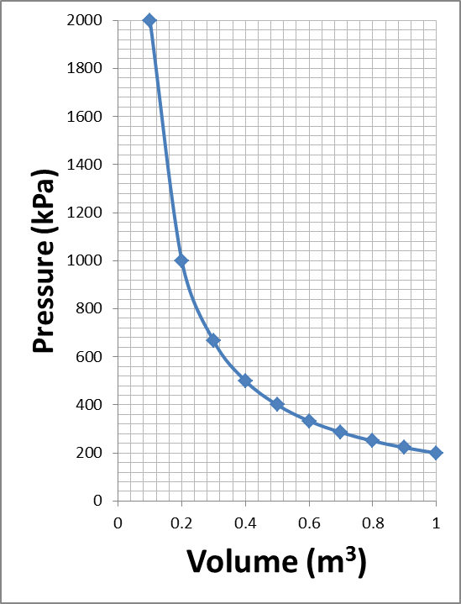
Boyle’s Law
What does Boyle’s Law mean in words not just maths.
We just found this in the previous exercise.
Boyle’s Law states that for a fixed amount of (ideal) gas at a fixed temperature pressure is inversely proportional to volume.
As we can see in the graph, as pressure increases the volume decreases in an inversely proportional manner.

Slide 19
Relationships - Boyle’s Law
P x V = constant
There is an inversely proportional relationship between pressure and volume
$$P= \frac{constant}{V}$$
As the pressure increases the volume decreases.
As the volume increases the pressure decreases

Slide 20
Learning objectives
1
Explain the effects of changing pressure on volume of a gas (and vice versa).✓
Use the equation ‘PV=constant’ (Boyle’s Law) to solve problems. ✓
Correctly explain trends in terms of proportionality. ✓
Explain the effects of quickly compressing a gas on temperature.
9
H
*H – Higher Tier
Notes:
Define the property of pressure and how it can be varied.
Relate states of matter to pressure of a gas.

Slide 21
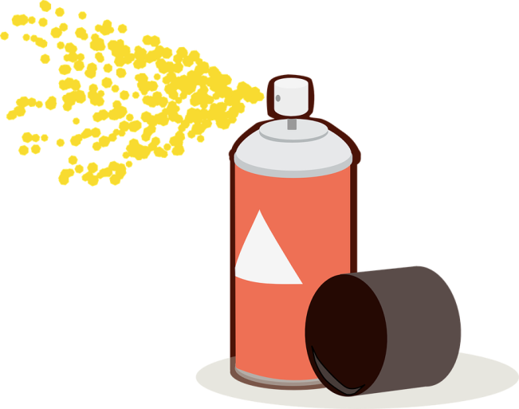
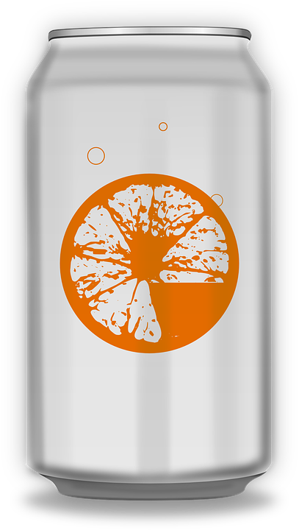
What do these have in common?
All of these make use of Boyle’s Law.
We will look at a few.
We will come back to some of these later in the course.
Notes:
https://owlcation.com/stem/Examples-of-Boyles-Law
Scuba diver - https://upload.wikimedia.org/wikipedia/commons/thumb/a/a5/PEO-scuba_diver.svg/200px-PEO-scuba_diver.svg.png
Spray paint - https://pixabay.com/en/aerosol-can-can-spray-brush-160053/
Tyre - https://pixabay.com/en/tire-rubber-tyre-car-wheels-1135376/
Syringe - https://pixabay.com/en/photos/syringe/
Soda can - https://pixabay.com/p-161093/?no_redirect

Slide 22
Challenge Question
How does a syringe sucks in a fluid like blood?
Plunger
As the plunger is pulled outwards from the syringe, it cause the volume within the chamber to increase.
What happens to pressure when the volume increases?
The pressure in the chamber decreases which creates a vacuum effect.
Since the only fluid available on the other side of the needle tends to be a liquid such as blood, this gets sucked into the chamber.
This then reduces the volume and increases the pressure back to where it wants to be.
Chamber

Slide 23
Cartesian Divers
The bottle is filled with water and inside is a small packet of sauce which also has some air sealed in the packet. As the bottle is squeezed the sauce packet sinks
Why?
When you squeeze the bottle inward, you are reducing the volume of the bottle.
This reduction in volume increases the pressure of all of the gas, including air in the sauce packet.
The increased pressure of the air and therefore decreased volume will make it slightly more dense reducing its ‘buoyancy’ causing it to sink lower.
Notes:
Can carry this out as class demonstration or mini classroom activity provided enough resources are prepared.
https://www.youtube.com/watch?v=xFT-n6bdy8Q

Slide 24
Pressure, Volume & Temperature
If a container of gas was compressed very quickly what would happen to the temperature of the gas?
The temperature of the gas would increase
Why?
H
This happens when you use a bicycle pump
Notes:
https://youtu.be/m19-8Vtewkw
Work is the transfer of energy by a force.
Doing work on a gas increases the internal energy of the gas and can
cause an increase in the temperature of the gas.
Students should be able to explain how, in a given situation eg a bicycle
pump, doing work on an enclosed gas leads to an increase in the
temperature of the gas.

Slide 25
Pressure, Volume & Temperature
If a container of gas was compressed very quickly what would happen to the temperature of the gas?
The temperature of the gas would increase
Why?
In order to compress the gas, work is done on the gas.
Work done is energy transferred, and this is transferred to the particles increasing their kinetic energy.
The particles therefore collide more frequently and with more energy due to their now greater internal energy in a smaller volume.
This increases the temperature of the gas.
H
This happens when you use a bicycle pump
Notes:
Work is the transfer of energy by a force.
Doing work on a gas increases the internal energy of the gas and can
cause an increase in the temperature of the gas.
Students should be able to explain how, in a given situation eg a bicycle
pump, doing work on an enclosed gas leads to an increase in the
temperature of the gas.

Slide 26
Notes:
https://www.youtube.com/watch?v=AxROqW1QDqE

Slide 27
P, V & T – Bicycle Pump
Why does a bicycle pump get hot?
In part it is because there is friction in the pipe which generates heat whilst using it.
When the pump is used the plunger as well as reducing the volume in the chamber work is done on the gas molecules providing them with kinetic energy.
With the overall internal energy of the gas increased and in a smaller volume the gas molecules collide with the surface of the pump which not only increases the pressure but also transfer energy to the wall of the pump, resulting in its temperature increasing, feeling hot.
‘VIDEO LINK’
Notes:
Bicylce tyre image - https://pixabay.com/en/bicycle-wheel-bike-cycle-tyre-rim-32293/

Slide 28
Learning objectives
1
Explain the effects of changing pressure on volume of a gas (and vice versa).✓
Use the equation ‘PV=constant’ (Boyle’s Law) to solve problems. ✓
Correctly explain trends in terms of proportionality. ✓
Explain the effects of quickly compressing a gas on temperature. ✓
9
H
*H – Higher Tier
Notes:
Define the property of pressure and how it can be varied.
Relate states of matter to pressure of a gas.

