Slide 1
Feeding relationships

Slide 2
Starter: Exam question
Fruits contain seeds. Most plants produce fruits that are adapted for dispersing seeds. Seeds are dispersed so that young plants do not grow near their parents.
(a) Explain the advantage to plants of dispersing their seeds.

Slide 3
Exam Question
Plants and animals have become adapted in many different ways to reduce the risk of being eaten by predators.
Describe these adaptations.
Give examples of animals and plants adapted in the ways you describe.

Slide 4
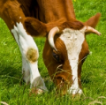
Outcomes
Draw & label a food chain, identifying all trophic levels
Interpret a food web & predict population changes
Describe & explain a prey/predator graph

Slide 5
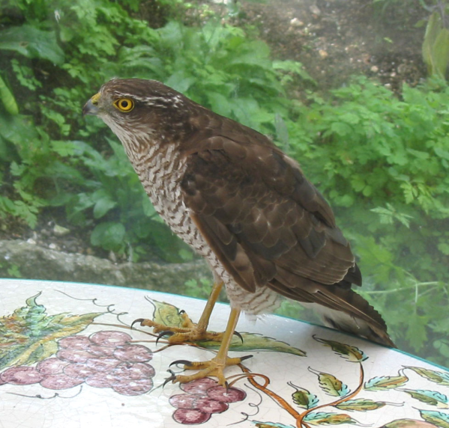
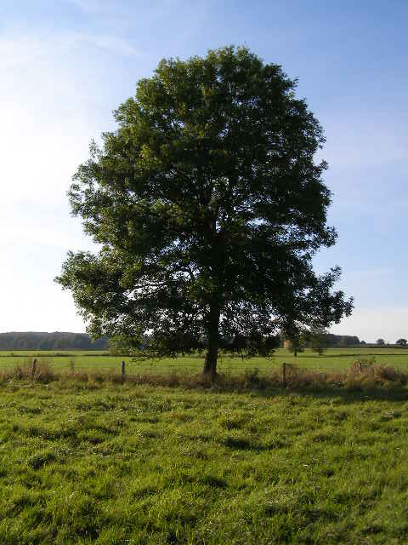
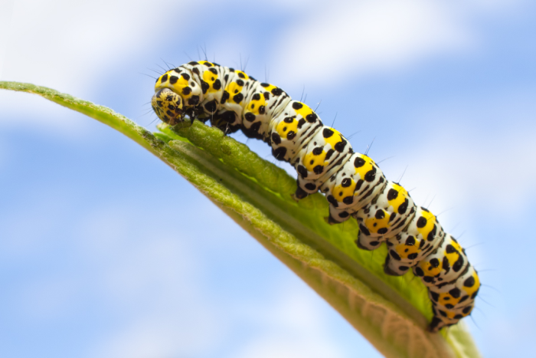
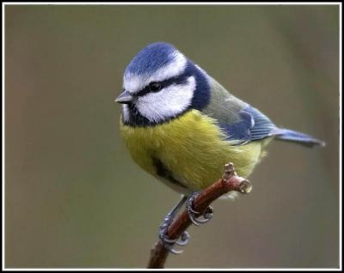
Can you draw a food chain?
On your whiteboards, in pairs, draw a food chain using these organisms.
Label the:
Producer Tertiary consumer
Herbivore Primary consumer
Omnivore Secondary consumer
Carnivore
Sparrowhawk
Caterpillar
Tree
Extension:
What do you think is a disadvantage of using a food chain? How could you overcome this?
Bluetit

Slide 6
A quick reminder…….

Slide 7
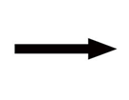
Food chains & webs
Tree
Caterpillar
Bluetit
Sparrowhawk
Producer
Herbivore
Omnivore
Carnivore
Primary consumer
Secondary consumer
Tertiary consumer

Slide 8
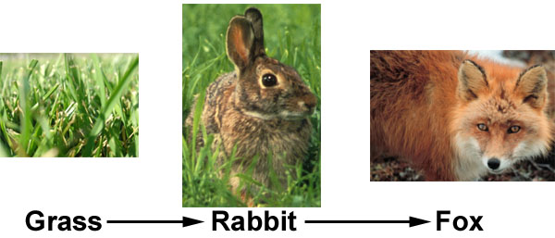
Food Chains
Food chains show which organisms eat other organisms
The arrows show the transfer of energy from one organism to the next.

Slide 9
make a food chain!
Read the following story about who eats whom in the Antarctic. After you have read the story draw a food chain that shows the feeding relationships in this habitat.
Don’t forget that your food chain must start with a producer!
Killer whales or orca’s range around Antarctica hunting for their food. One of the species that they eat are the Weddell Seal. Weddell seals are large mammals that stay in Antarctica all year round. One of the many things that they eat are squid. Squid are very fast hunters who often poison their prey. They feed on many different organisms including shrimp. Shrimp are small animals that live on the ocean floor. There are over 2,000 different species of shrimp all over the world. They are omnivores but phytoplankton makes up a large part of their diet.
Notes:
This activity is based on learning objective 1

Slide 10
Phytoplankton → shrimp→ squid→ seal → killer whale

Slide 11
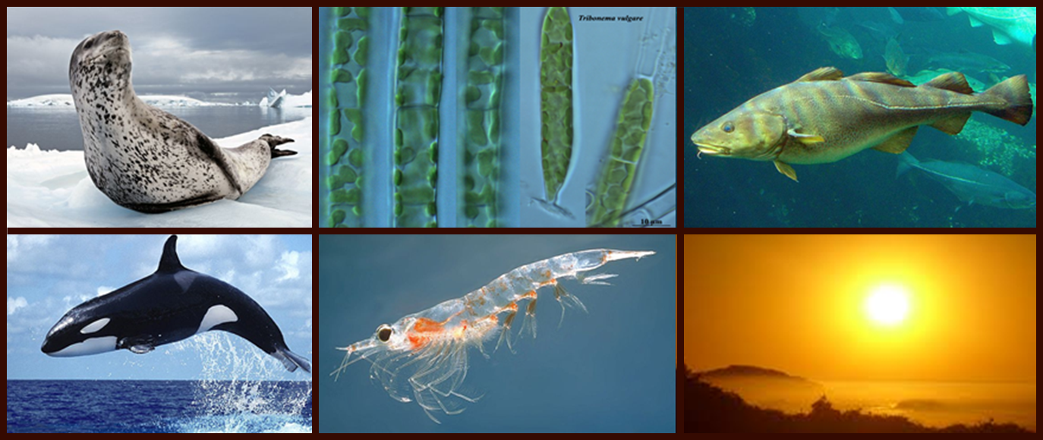
Securing Knowledge
On whiteboards, construct a food chain for these organisms.
•Label the organisms as either a producer, a herbivore, a carnivore or a primary energy source.
•Label the organisms as a primary consumer, secondary consumer, tertiary consumer or quaternary consumer.
Leopard seal
Algae
Cod
Killer whale
Krill
The Sun

Slide 12
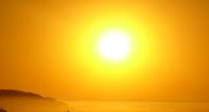
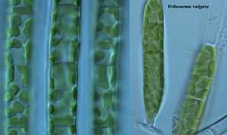
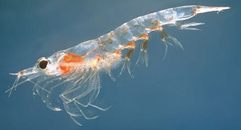
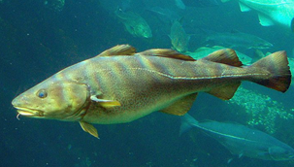
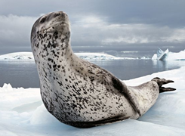
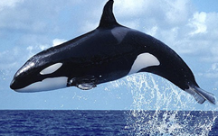
• The Sun
•Primary energy source
• Algae
•Producer
• Krill
•Herbivore
• Primary consumer
• Cod
• Carnivore
• Secondary consumer
• Leopard seal
• Carnivore
• Tertiary Consumer
• Killer whale
• Carnivore
• Quaternary Consumer

Slide 13
Trophic Levels
Each level of a food chain is known as a trophic level
Barn owl
Tertiary consumer
Fourth trophic level
Wood mouse
Secondary consumer
Third trophic level
Bark beetle
Primary consumer
Second trophic level
Oak Tree
Producer
Trophic level 1

Slide 14
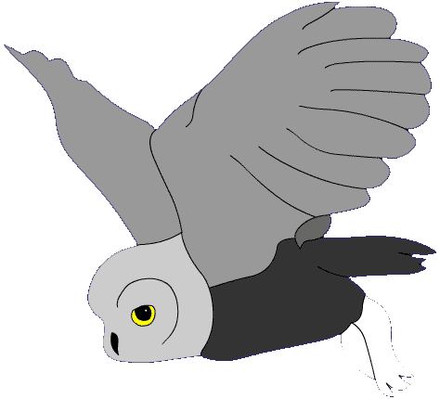
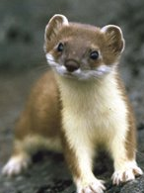
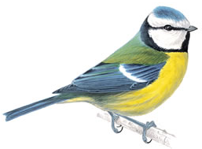
analyse a food web
Which of these are not herbivores? Moth larvae, stoat, aphid.
Which secondary consumers are also top carnivores?
Name two species that are eaten by owls.
If the ladybirds were removed, what would happen to the population of aphids and spiders?
Aphids ________________________________
__________________________________________________________________________________________________________________________
Spiders ________________________________
___________________________________________________________________________________________________________________________
owl
stoat
blue tit
chiffchaff
vole
spider
ladybird
moth larva
aphid
plants
Notes:
This activity is based on learning objective 2

Slide 15
analyse a food web
Which of these are not herbivores? Moth larvae, stoat, aphid.
stoat
Which secondary consumers are also top carnivores?
Owl & stoat
Name two species that are eaten by owls.
Blue tit, chiffchaff, vole
If the ladybirds were removed, what would happen to the population of aphids and spiders?
Aphids: increase because they don’t get eaten by the ladybirds
Spiders: decrease because the blue tit would have to eat the moth larvae, so spiders would have less food (moth larvae)
owl
stoat
blue tit
chiffchaff
vole
spider
ladybird
moth larva
aphid
plants
Notes:
This activity is based on learning objective2

Slide 16
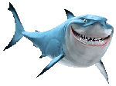
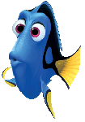
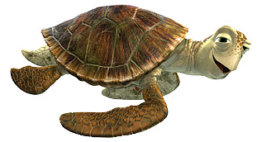
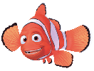
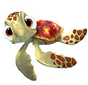
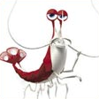
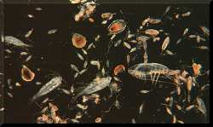
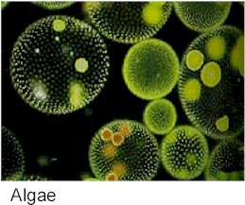
Great white shark
Sea Turtle
Clown Fish
Blue regal
Small invertebrates
Zoo Plankton
Algae

Slide 17
Analysing Food Webs
1. Explain (in a paragraph) what would happen to the number of clown fish if the sharks became vegetarian?
2. What effect will this have on the number of zooplankton?
3. Explain what would happen to the Blue Regal fish if a disease wiped out the small invertebrates.
4. If the small invertebrates became extinct due to a disease, what would happen to the number of clown fish and why?
5. In your own words, explain how an entire food web could be wiped out if one species became extinct?

Slide 18
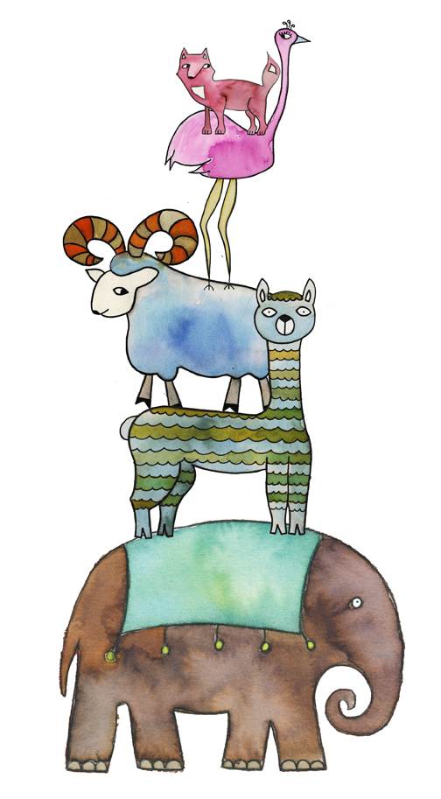

Slide 19
Food Webs
Write down at least one food chain from this food web.
Label the producers, consumers, herbivores and carnivores

Slide 20
What does a food chain always start with?
Producer

Slide 21
What do we call animals that eat producers?
Primary consumers or herbivores

Slide 23
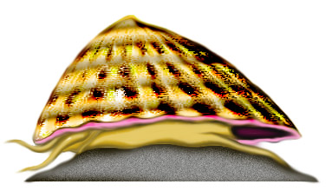
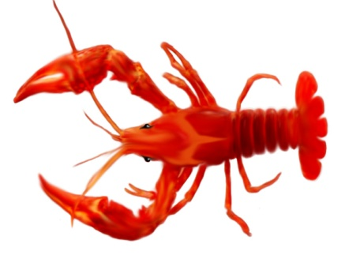

Slide 25
What is happening in this feeding relationship?
Describe & explain what is happening to the population of predators and prey.

Slide 26
Sort these features into predators / prey / both
Eyes at front Sharp claws
Horns Good hearing
live in herds
eyes at side of head
fast runners stings Sharp teeth
Camouflage

Slide 27
Sort these features into predators / prey / both
Predator Both Prey
Eyes at front fast runners Horns
Sharp claws sting Good hearing
Sharp teeth Camouflage live in herds
eyes at side of head

Slide 28
Predator or Prey

Slide 29
Predator or Prey

Slide 30
Predator or Prey

Slide 31
Predator or Prey

Slide 32
Predator or Prey

Slide 33
Predator or Prey

Slide 34
Predator or Prey

Slide 35
Predator or Prey

Slide 36
Predator or Prey

Slide 37
Exam questions

