Slide 1

Concentration Of Solution
Starter
What is a mole?
2 moles of Sodium weighs…………
200g of CuO contains …………………… moles
0.5 moles of Calcium Carbonate weighs………………..
110g of Carbon Dioxide contains ………………… moles
46g
2.5
50g
2.5

Slide 2

1-9 (F) | State the unit of concentration .
4-9 (F/H) | Calculate concentration using a known mass of solute and volume of solution.
5-9 (H) | Calculate mass of a solute in a solution of known concentration.
8-9 (H*) | Explain how concentration of solution is related to mass and volume.
Learning Outcomes

Slide 3
Concentration
What is concentration?
It is the mass of substance (solute) dissolved in a known volume of solution.
It is measured in g/dm³
1dm³ = 1000cm³ = 1000ml = 1 litre

Slide 4
Expressing Concentration
A solution is made when a solute is ………………… in a ………………… For example, dissolving sugar in water gives a …………………
The concentration of a solution tells you how much ………………… is dissolved in 1dm³ of solution (1dm³ = 1000cm³ = 1litre).
A ………………… concentrated solution has more solute in the same ………………… of solution than a less concentrated solution.
dissolved
solvent
solution
solute
more
volume

Slide 5
Expressing Concentration
Concentration (g/dm³) = Mass of solute (g)
Volume of solution (dm³)
A concentrated solution contains a ……………… mass of solute and / or a ……………… volume of solvent.
A dilute solution contains a ……………… mass of solute and / or a ……………… volume of solvent.
large
small
small
large

Slide 6
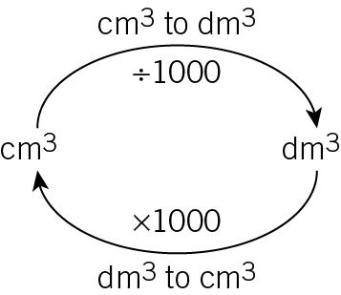
Converting between cm³ and dm³
To convert cm³ to dm³ divide by 1000
E.g. 34cm³ is 0.0034 dm³
To convert dm³ to cm³ times by 1000
E.g. 120dm³ is 120 000 cm³

Slide 7
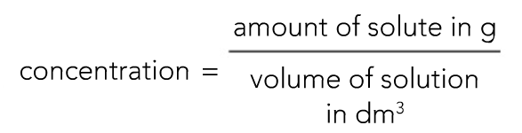
Concentration
You can work out the concentration of a solution by using the following equation.
(solute is the solid)

Slide 8
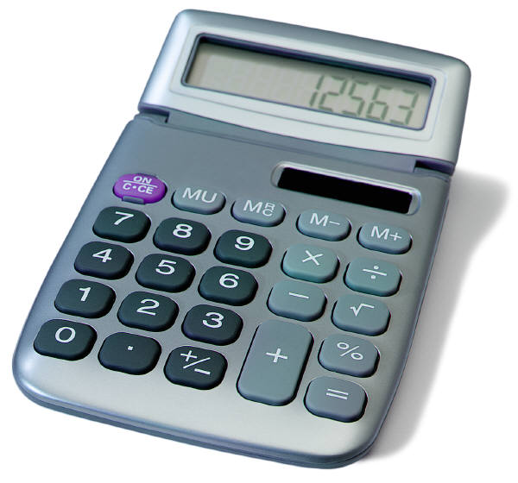
Worked Example
A 1dm³ solution of water contains 0.5g of solute. What is its concentration?
Concentration = 0.5 = 0.5 g/dm³
1

Slide 9
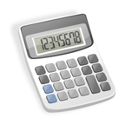
Questions
Work out the concentration of the following:
A 2dm³ solution containing 0.7g of solute.
A 0.5dm³ solution containing 1.5g of solute.
A 15dm³ solution containing 20g of solute.
0.35g/dm³
3g/dm³
1.33g/dm³

Slide 10
Equation Triangle
mass
Concentration
Volume

Slide 11
Task
Fill in the gaps
Mass of Solute (g) | Volume of Solution (dm³) | Concentration (g/dm³)
6 | 2 | 3
5 | 2 | 2.5
2.4 | 3 | 0.8
3.6 | 0.9 | 4

Slide 12
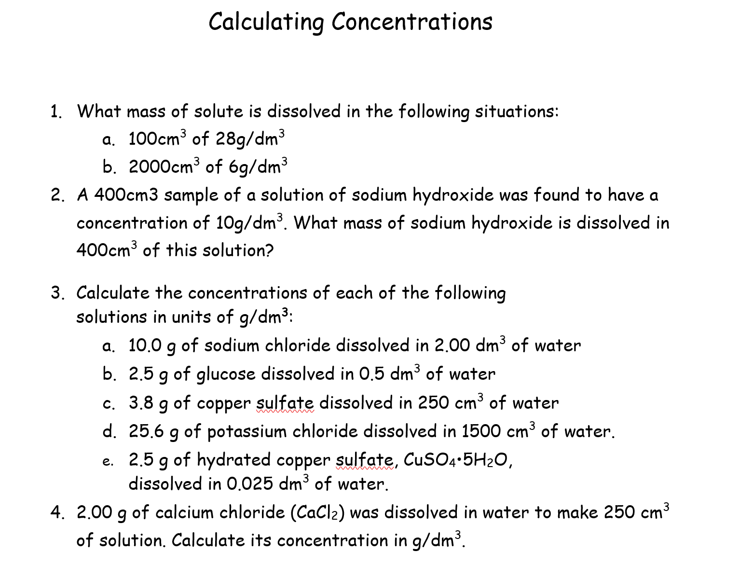

Slide 13
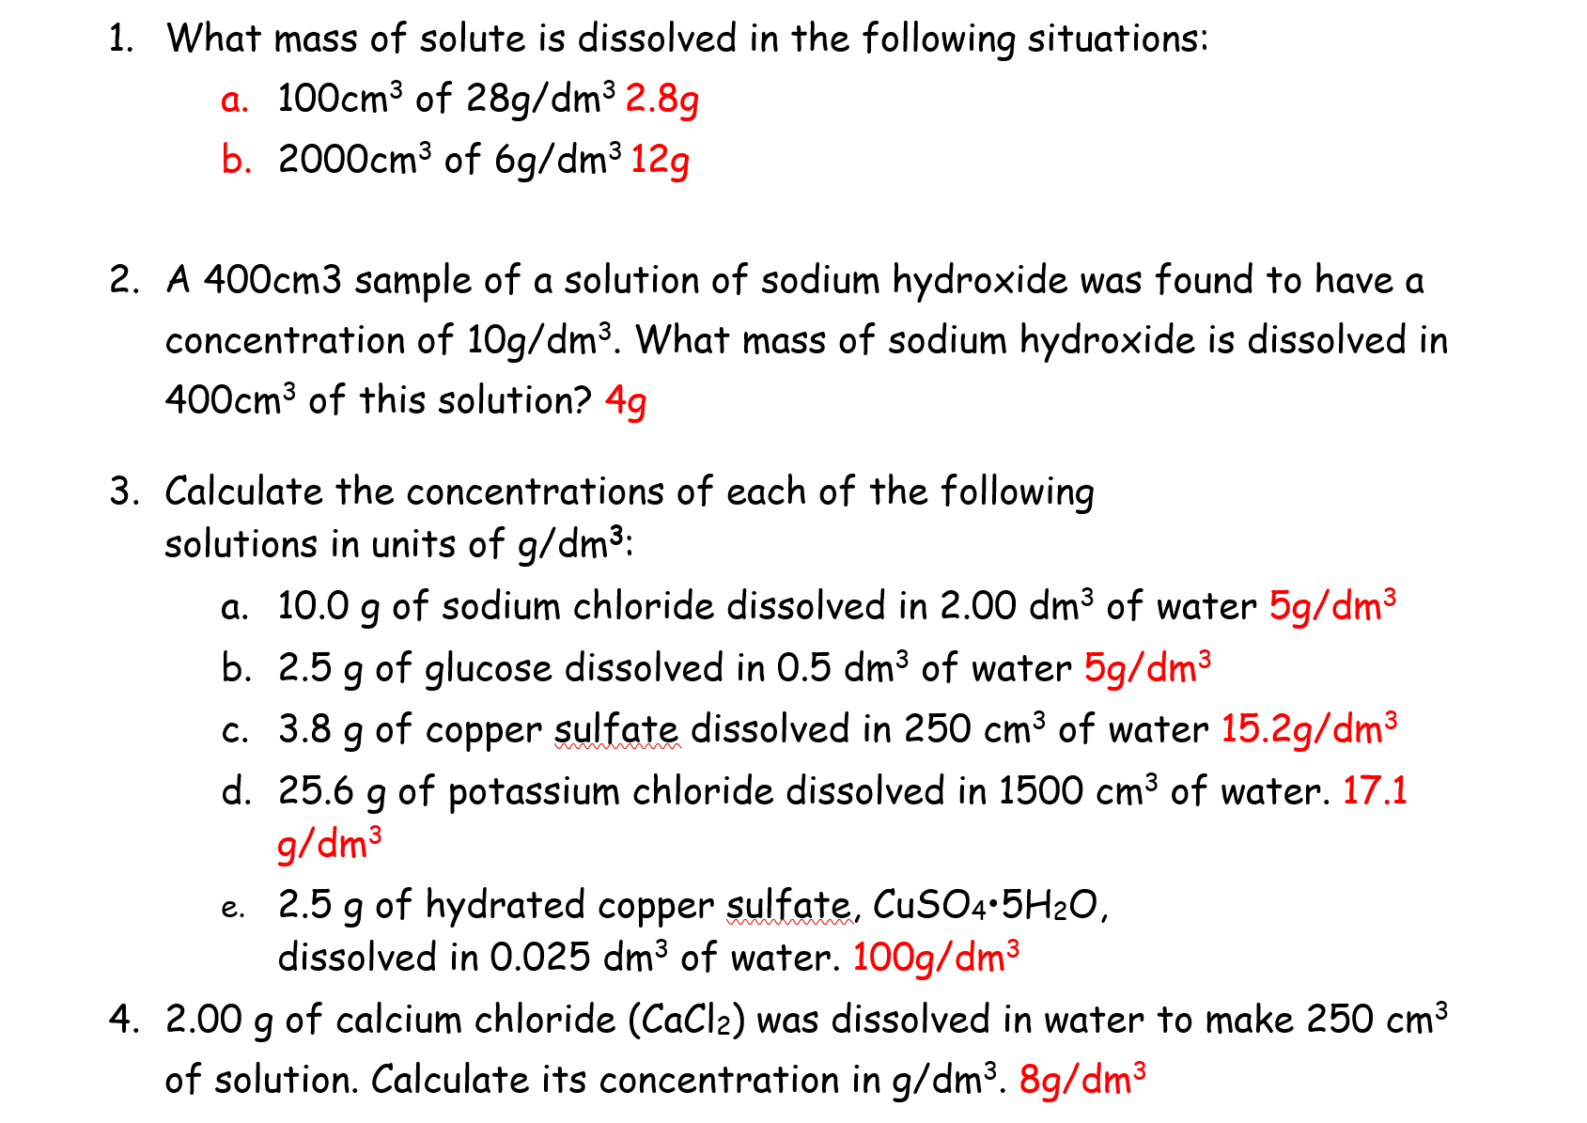

Slide 14
