Slide 1
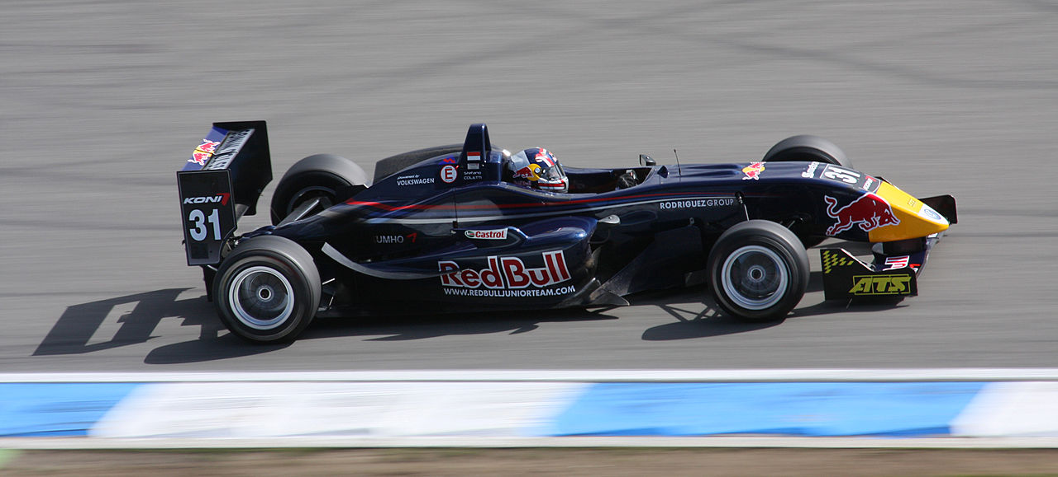
Tuesday, 05 January 2021
Centre of mass
Date and title in books. What do you need? Pen? Pencil? Ruler?
Starter Activity
What are the important design features of this car that allows it to go fast?

Slide 2
1-9 (F) | Recall the weight equation
4-9 (F/H) | Define the term ’centre of mass’
5-9 (H) | Calculate weight using the equation W=mg
8-9 (H*) | Rearrange the weight equation to calculate mass and gravity.
Learning Outcomes

Slide 3
Learning Objective
To be able to: to know the relationship between mass, weight and gravity
Key Words: Gravity, Mass, Weight, Vector, Contact, Non-Contact, Gravitational Field

Slide 4
Context
Forces
Centre of mass
Resultant force
Work done
Springs
Compression
Speed and distance
Velocity
Acceleration
Using graphs
Falling objects
Effects of forces
F=MA
Stopping distance 1
Stopping distance 2
Momentum 1
Momentum 2

Slide 5
Mass and Weight
What is the difference between the terms mass and weight?
What are some of the important effects of gravity?
Keywords: Gravity, Mass, Weight, Vector, Contact, Non-Contact, Gravitational Field

Slide 6
Mass and Weight
Mass – the amount of material. Measured in Kilograms (kg). This is the same anywhere in the universe.
Weight – the force that acts on an object due to gravity. Measured in Newtons by a Newton meter (N). This is caused by the pull of gravity.
Therefore, 1kg bag of sugar has the same mass on Earth and the moon, but a different weight (10N on Earth, 1N on the moon) as the gravity on the moon is less.
Weight is directly proportional to the mass of an object.
Keywords: Gravity, Mass, Weight, Vector, Contact, Non-Contact, Gravitational Field

Slide 7
Gravity
Gravity has three important effects:
On the surface of a planet, it makes all things accelerate towards the ground (on Earth it is about 10m/s²)
It gives everything a weight.
It keeps planets, moons and satellites in their orbit.
Keywords: Gravity, Mass, Weight, Vector, Contact, Non-Contact, Gravitational Field

Slide 8
Very important formula
Remember, mass is measured in kilograms (kg) and weight is measured in Newtons (N).
So, you can work out the weight of an object using:
W = m x g (W = weight, m = mass, g = gravity strength)
Keywords: Gravity, Mass, Weight, Vector, Contact, Non-Contact, Gravitational Field

Slide 9
Very important formula
W = m x g (W = weight, m = mass, g = gravity strength)
Q: What is the weight, in Newtons, of a 5kg mass, both on Earth and on the moon?
(‘g’ on moon is 1.6N/kg, ‘g’ on Earth is 10N/kg)
A: W = m x g.
Earth = 5 x 10 = 50N, Moon = 5 x 1.6 = 8N.
Keywords: Gravity, Mass, Weight, Vector, Contact, Non-Contact, Gravitational Field

Slide 10
Convert your mass if it is 50kg to a weight for each planet by using the equation:
Weight = mass x gravitational field strength
Planet | Gravitational Field Strength (N/kg)
Mercury | 3.8
Venus | 8.8
Earth | 9.8
Mars | 3.8
Jupiter | 25
Saturn | 10.4
Uranus | 10.4
Neptune | 13.8
Keywords: Gravity, Mass, Weight, Vector, Contact, Non-Contact, Gravitational Field

Slide 11
Centre of Mass
Is the point at which the mass may be thought to be concentrated.
Keywords: Gravity, Mass, Weight, Vector, Contact, Non-Contact, Gravitational Field

Slide 12
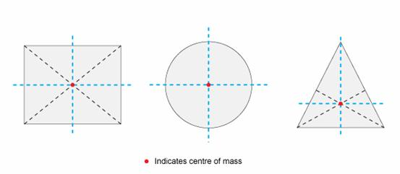
Symmetrical Objects
Keywords: Gravity, Mass, Weight, Vector, Contact, Non-Contact, Gravitational Field

Slide 13
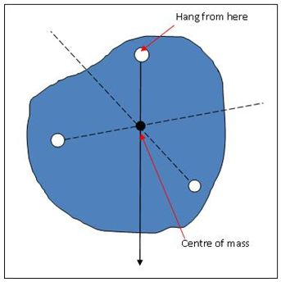
Irregular Shape
Practical Task
Keywords: Gravity, Mass, Weight, Vector, Contact, Non-Contact, Gravitational Field

Slide 14
Method (6 marks)
Write out the method used to work out the centre of mass of an irregular shape.
Keywords: Gravity, Mass, Weight, Vector, Contact, Non-Contact, Gravitational Field

Slide 15
Mark Scheme - (6 marks)
Two holes are made in the card with each hole near the edge of the card.
A pin is put through one of the holes in the card and held by the boss.
The weight is tied to a piece of string (plumb line) and then hung from the pin.
A line is drawn to show the position of the string on the card.
Repeat the process for the second hole.
The centre of mass is where the two lines cross.
Keywords: Gravity, Mass, Weight, Vector, Contact, Non-Contact, Gravitational Field

