Slide 1
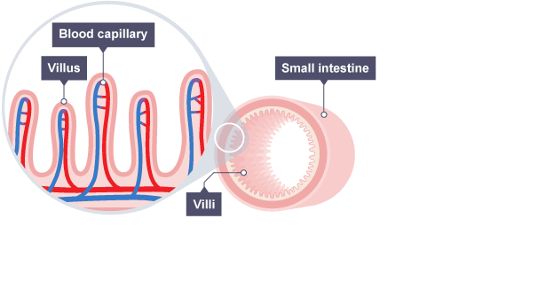
B3 Organisation and the Digestive System | Describe how you would test for starch in a food sample: (p13) | Describe how you would test for sugar in a food sample: (p13) | Describe how you would test for lipids in a food sample: (p13) | Describe how you would test for protein in a food sample: (p14)
Explain how the villi in the small intestine are adapted to the function (p5) |  | Draw and label the structure of the following foods (p12&13): Starch: Lipids: Protein: | Explain what is meant by the ‘lock and key hypothesis’: (p22) | Draw a picture below of how an enzyme and substrate fit together (p22)
Define the following terms (p4) Tissue: Organ: Organ System: Organism: | State the role of these organs in the digestive system (p5): Mouth Stomach Gall bladder Small intestine Large intestine |  | State what happens to an enzyme if it becomes too hot: (p30) State what happens to an enzyme if it becomes too cold: (p30) | What is the optimum temperature for enzymes in the human body? (p30) State the optimum pH for enzymes in the stomach: (p31)
 |  | State the enzyme which breaks down protein (p37): State the enzyme which breaks down lipids (p37): | State the enzyme which breaks down starch (p37): State the name of the organ which is responsible for making enzymes (p36) | Explain how bile helps digestion (p37) Where is bile made? (p37) Where is bile stored? (p37)

Slide 2
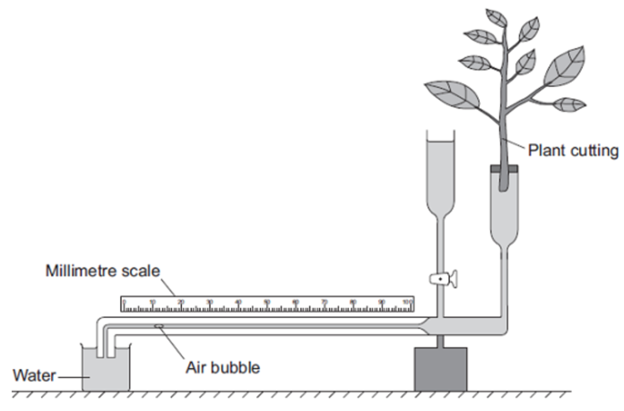
Label the diagram of the heart (p17) Draw arrows to show the direction of blood flow (p17) Circle a valve Draw a cross where the pacemaker is located (p18) |  | Explain the effect of CHD on the heart. (p22&23) | State the difference between transpiration and the transpiration stream. (p43&44) | What is translocation? (p44) Why is this process important to plants?
 |  | What is a stent? (p22&23) State an advantage of a stent. State a disadvantage of a stent. | Explain how the following effect the rate of transpiration: (p52): Temperature Wind Light Humidity | State the role of the xylem and how it’s adapted to its function: (p38) State the role of the phloem and how it’s adapted to its function:
Describe the route blood takes through the heart (p17) | Why is the human circulatory system called a double pump? (p18) | State the four components of the blood and their role (p5&6) |  | Explain why the stomata are only found on the underside of the leaf
Explain how the structure of the capillary is adapted to its function (p12) | Explain how the structure of the artery is adapted to its function (p11) | Explain how the structure of the vein is adapted to its function (p12) | Describe how a potometer measures the rate of transpiration. (p52)

Slide 3
B5 Communicable Diseases | State what ‘transmission’ means. (L1) Explain what a vector is. (L1) | Explain why TMV and Rose Black Spot causes stunted growth in plants. (L3 and L5) | Which pathogen do antibiotics effect? (L4) Which part of the cell do antibiotics attack? (L4) Why do they not attack our own cells? (L4) | Explain why the stomach and skin are called general defenses but white blood cells are called specific defenses: (L6)
How do bacteria make us ill? (L1) | List five ways that diseases can be transmitted. (L1) | Malaria (L5) Pathogen: Symptoms: Transmission: Treatment: | Describe how the following are adapted to defend the body against pathogens: (L6) Stomach: Nose: Trachea: Skin: | State the name of the protein markers found on the surface of all pathogens: (L6)
How do viruses make us ill? (L1) | Gonorrhoea (L4) Pathogen: Symptoms: Transmission: Treatment: | Tobacco Mosaic Virus (L3) Pathogen: Symptoms: Transmission: Treatment: |  | Explain how antitoxins help to fight pathogens. (L6)
State the difference between a communicable and a non-communicable disease. (L1) | Rose Black Spot (L5) Pathogen: Symptoms: Transmission: Treatment: | Explain how lymphocytes help to fight pathogens. (L6) | Explain how phagocytes help to fight pathogens. (L6) | Prior knowledge: Bacteria are prokaryotes; describe the structure of a prokaryote. (B1)

Slide 4
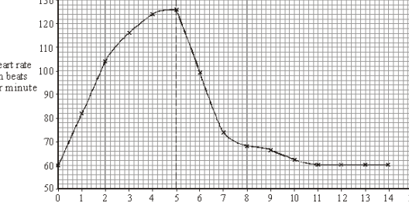
B9 Respiration | State what animals use the energy from respiration for: | Why can’t animals store excess glucose? What do animals convert glucose into for storage? Where do animals store this? | Write the word equation for anaerobic respiration in yeast: What is the name of this process? State the importance of the process named above for the economy:
State the word equation for aerobic respiration: State the balanced symbol equation for aerobic respiration: State the word equation for anaerobic respiration: | Define metabolism: State some examples of metabolic reactions: | Where in the cell does aerobic respiration occur? Where in the cell does anaerobic respiration occur? Which type of respiration produces more energy? | A student pedaled an exercise cycle at constant speed for 5 minutes. The student’s heart rate was recorded at one-minute intervals during the exercise and also during recovery. Describe the effect exercise has on the heart:
 | Explain the different roles which the liver plays in the human body. | What is anaerobic respiration and when do we use it? How does it cause muscle fatigue? What is oxygen debt?
State the role of the following organelles in respiration: Mitochondria Ribosomes Cytoplasm | Why does heart rate and breathing rate increase during exercise? (link your answer to respiration) |  | State the top ten keywords for this unit:

Slide 5
B10 Human Nervous System | CNS stands for: The two organs which make up the CNS are: PNS stands for: |  | State the impact of caffeine on reaction time: State the equipment used in the reaction time practical: | Independent variables are the one you change. Dependent variables are the ones you measure Control variables are what you keep the same. State the independent, dependent and control variables for the ruler drop practical:
Define Homeostasis: State three conditions which the body needs to keep the same: | Complete the table: |  | Define diffusion: State the name of the chemical which crosses the synapse: Give two examples of an effector:
 | Sense Organ | Stimuli
 | Eyes
 |  | Chemicals
 | Tongue
 | Ears
 |  | Touch
Label the diagram below: |  |  | Explain (in detail) how an electrical impulse crosses a synapse: | Write a step-by-step method for the ruler drop practical:

Slide 6
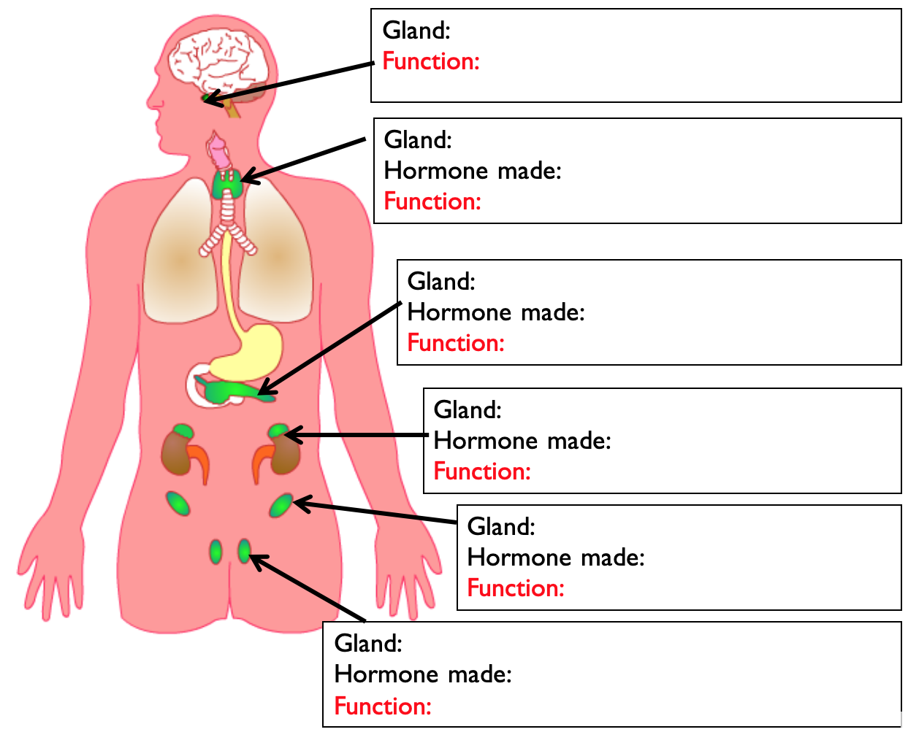
B11 Hormonal Co-ordination | State the differences in how Type 1 and Type 2 diabetes impact the body: | Explain the treatment for Type 1 diabetes: Explain the treatment for Type 2 diabetes: | The menstrual cycle lasts ____ days. Ovulation occurs on day _____ . Describe the role of the following hormones in the menstrual cycle: FSH LH Oestrogen Progesterone | Describe the 5 main stages of IVF:
State how hormones travel round the body: State the organ system which is responsible for producing hormones: State how hormones know where to act: | Explain the process which occurs within the body when your blood glucose level is too high [4-marks]: Key words: Pancreas, insulin, glucose, glycogen, liver. | Explain why people with iodine deficiency have thyroid issues: Describe the negative feedback loop which controls the levels of thyroxine in the blood: Explain the impact of adrenaline on the body:
 |  |  | Hormonal contraception include the pill, the implant and the patch. Explain how these work: Keywords: Oestrogen, FSH, LH | State two advantages of IVF: State two disadvantages of IVF:
 |  | State the secondary sexual characteristics in: Males Females | State 5 examples of non-hormonal based contraception: | There are ethical concerns about IVF; outline them below:

Slide 7
B12 Homeostasis (Triple) | Define homeostasis: State the area of the brain which monitors temperature: | Explain the role of ADH in the kidney if… You have too much water: You have too little water: | Which components within the blood can pass through the ppm and into the kidney? Which components within the blood are too large to fit through the ppm and into the kidney?
State the roles of the kidney in maintaining homeostasis: | What are the consequences for animal cells if osmoregulation is not regulated? | Explain how a dialysis machine works: | Explain what selective reabsorption is: How much glucose is reabsorbed into the blood after it had left the kidney?
What is the optimum human body temperature? Explain why it’s important that this is maintained: | HIGHER TIER: State how to body excretes excess amino acids: | Dialysis: Advantages | Disadvantages
List all of the changes your body does if you are too cold | List all of the changes your body does if you are too hot | Transplant Advantages | Disadvantages

Slide 8
B13 Reproduction (Trilogy) | Mitosis and meiosis are two types of cell division. Explain the stages in meiosis and the role it has in the body: (L3) | Define the following words (L7) Genotype Phenotype Allele Homozygous | Cystic fibrosis (L8): Which part of the cell does CF effect? Is it a dominant or recessive disease? What is a carrier?
Explain what asexual reproduction involves (L1) Explain what sexual reproduction involves (L1) |  | Heterozygous Dominant Recessive | Polydactyly (L8): What is polydactylyl? Is it a dominant or recessive disease? Why can you not be a carrier?
Give some advantages of the following (L1) Sexual Asexual | Describe the structure of DNA (L5): | Complete the following Punnett Square (L7) | If the A = Tall and a = short, circle all the offspring that would be tall. What percentage of the offspring in this Punnett square would be short?
What are the gametes in animals? (L1) What are the gametes in plants? (L1) | What is the human genome? (L5): Why do scientists want to study the human genome? (L5) | Complete the following Punnett Square (L7) | If the H = Hairy ears and h = No hair on ears, circle all the offspring that would have no hair on their ears. What percentage of the offspring in this Punnett square would have hairy ears?
 | A | a
A
A
 | H | h
H
h

Slide 9
B13 Reproduction (Triple) | Mitosis and meiosis are two types of cell division. Explain the stages in meiosis and the role it has in the body: (L3) | Define the following words (L7) Genotype Phenotype Allele Homozygous | Cystic fibrosis (L8): Which part of the cell does CF effect? Is it a dominant or recessive disease? What is a carrier?
Explain what asexual reproduction involves (L1) Explain what sexual reproduction involves (L1) |  | Heterozygous Dominant Recessive | Polydactyly (L8): What is polydactylyl? Is it a dominant or recessive disease? Why can you not be a carrier?
Give some advantages of the following (L1) Sexual Asexual | Describe the structure of DNA (L5): | Complete the following Punnett Square (L7) | If the A = Tall and a = short, circle all the offspring that would be tall. What percentage of the offspring in this Punnett square would be short?
What are the gametes in animals? (L1) What are the gametes in plants? (L1) | What is the human genome? (L5): Why do scientists want to study the human genome? (L5) | Where in the cell does protein synthesis take lace? Describe the process of transcription: | Label: Describe the process of translation:
 | A | a
A
A

Slide 10
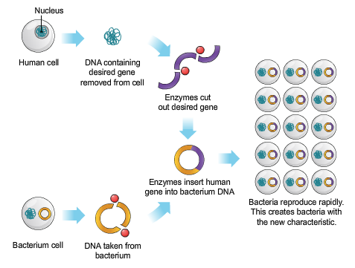
B14 Variation and Evolution (Trilogy) | Which scientist discovered the theory of natural selection? Outline natural selection, with an example (L2) | Outline the steps in genetic engineering (L4) | How do we know when two organisms are no longer the same species?
Explain the two causes of variation (L1) |  |  | What does ‘GM’ stand for in GM crops? Why is it beneficial to farmers to use GM crops?
Of the two types of variation mentioned above, say which one caused each of these: Accent Height Eye colour Hair style Religion Scar Weight Blood type | Outline the steps in selective breeding (L3) | List all of the reasons why humans would genetic engineering (L4) | Give some advantages and disadvantages of GM crops:
Define the following words (L2) Mutation: Phenotype: Natural selection: |  | List all of the reasons why humans would selectively breed (L3)

Slide 11
B14 Variation and Evolution (Triple) | Outline natural selection, with an example (L2) | List all of the reasons why humans would genetic engineering (L4) | Read the article on designer babies on p24 and write the key points from the articles below:
Explain the two causes of variation (L1) | Outline the steps in selective breeding (L3) | Explain how to clone a plant (L5)
Of the two types of variation mentioned above, say which one caused each of these: Accent Height Eye colour Hair style Religion Scar Weight Blood type | List all of the reasons why humans would selectively breed (L3) | Explain how to clone a sheep (L6)
Define the following words (L2) Mutation: Phenotype: Natural selection: | Outline the steps in genetic engineering (L4) | Evaluate the use of adult cell cloning (L6) – remember to include a conclusion

Slide 12
B15 Genetics and Evolution (Triple) | Explain what Darwin discovered on his trip on HMS Beagle (L2). | Explain how different fossils are formed (L5) | Which scientist came up with the original classification system? (L9) Name each group in this scientists classification system:
Who was Mendel? (L1) What did he discover and how? | Explain the evidence we have to support Drawin’s theory (L3) | Explain the problems with the fossil record (L5) | Which scientist updated the above system (L10) Which additional group was added? Why was an extra group added?
What does DNA stand for? (L1) Describe the structure of DNA. | Explain the work of Wallace (L4) Define speciation. | Define extinction (L6) Describe some of the causes of extinction (L6) | Explain how binomial naming works (L9)
Explain Lamarck’s theory of evolution. (L2) | Explain how animals become new species (L4) | Summarise how bacteria become resistant to antibiotics (L8) | Outline the three different domains (L10).

Slide 13
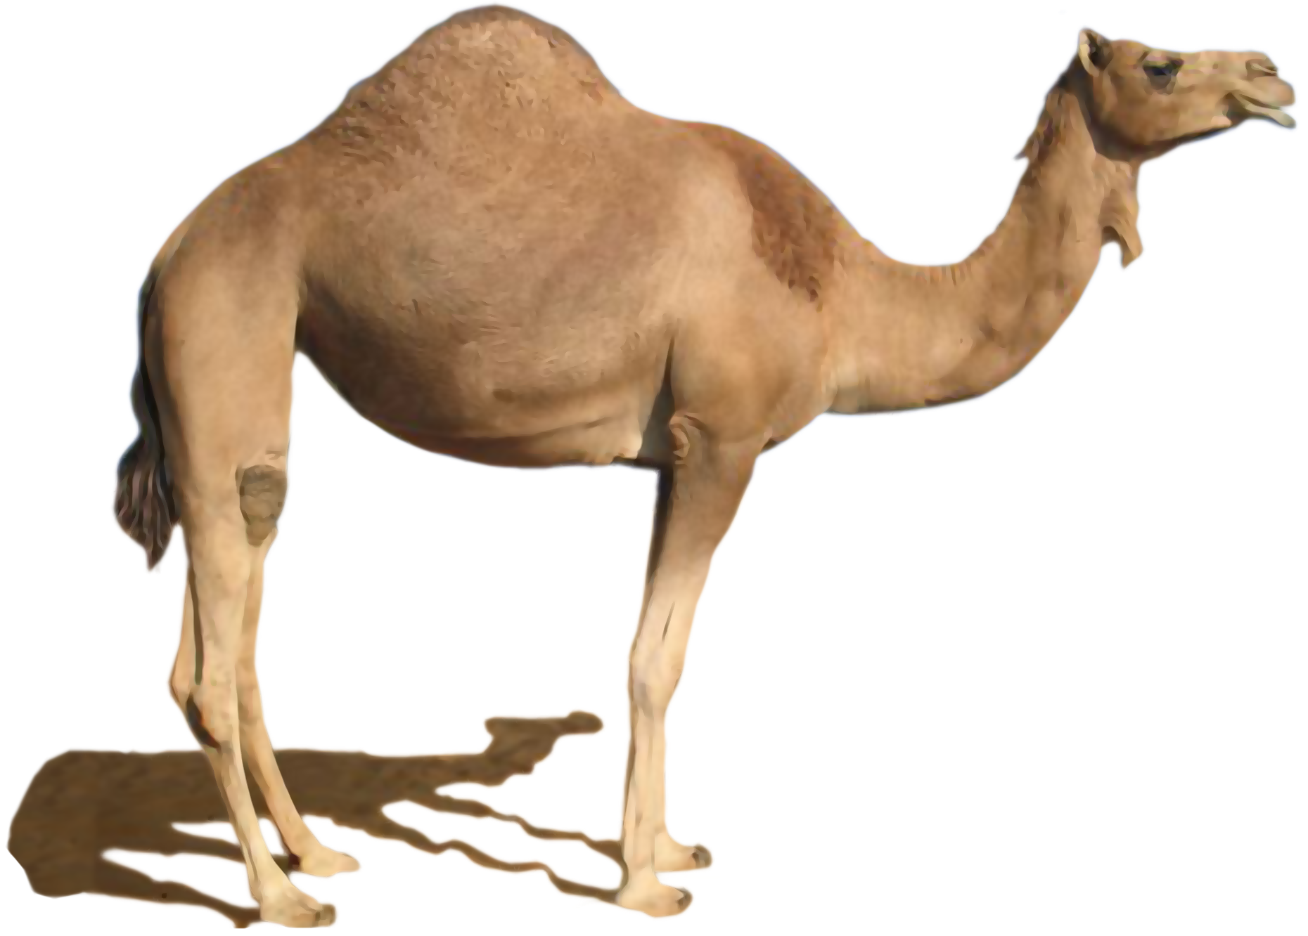
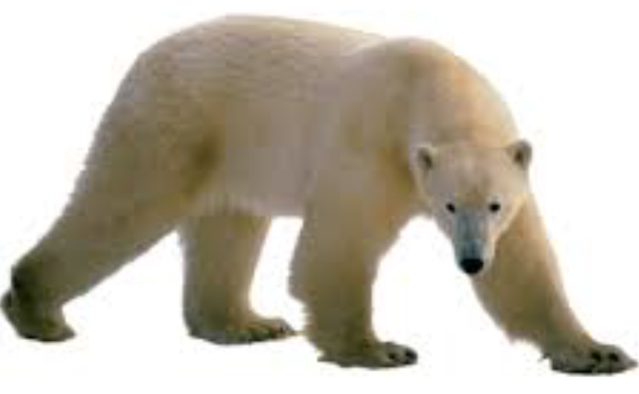
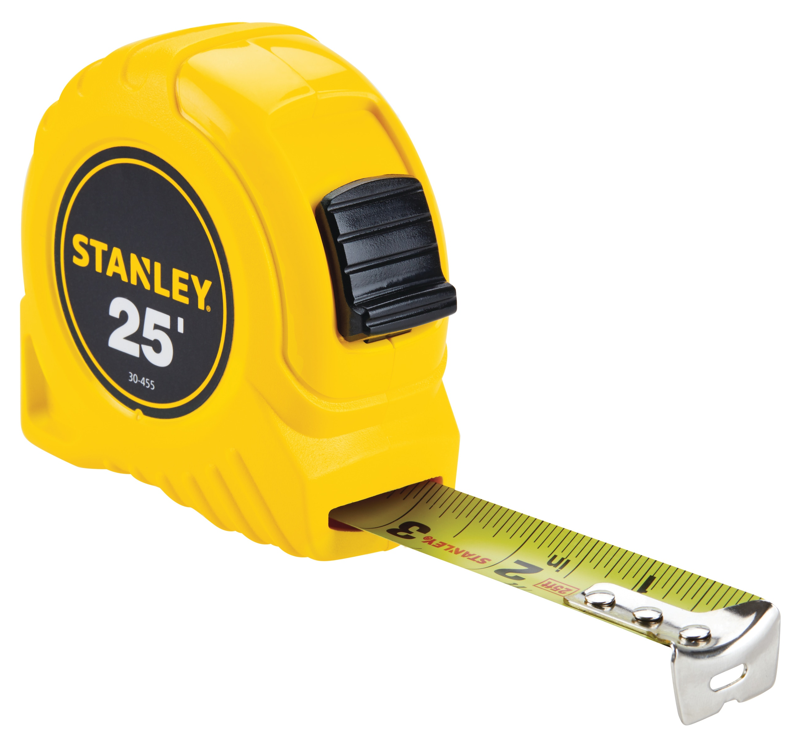
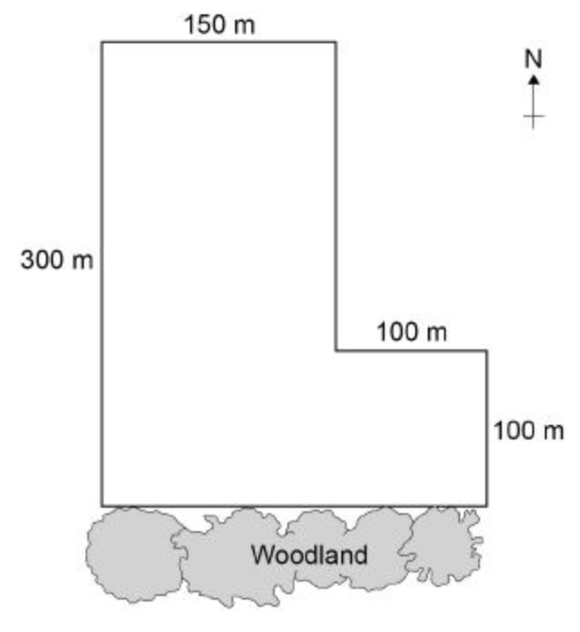
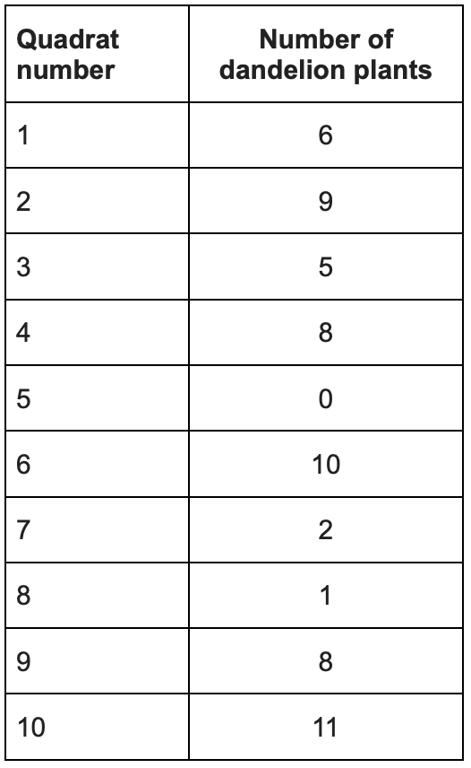
B16 Adaptations and Interdependence (Trilogy) | What is a biotic factor? What is an abiotic factor? Give examples of biotic and abiotic factors which effect animals in the wild: Biotic Abtioc | Explain how this camel is adapted to its function: | Define distribution: Define abundance: Describe how you could find the abundance of a species in a habitat: Describe how you could find the distribution of a species in a habitat:
Define the following words: Community: Ecosystem: Population: |  | Explain how this polar bear is adapted to its function:
What do the following organisms compete for? Animals Plants | What is the difference between the following types of adaptations: Structural: Behavioural: Functional.: | Explain how this axolotl is adapted to its function: | The student placed a 1 m × 1 m square quadrat at 10 random positions in the field: Estimate the total number of dandelion plants in the field. Give your answer in standard form.
What is interdependence? Why is interdependence important for a stable ecosystem? | What is an extremophile? Give some examples of extremeophiles: | Explain how this cactus is adapted to its function:

Slide 14
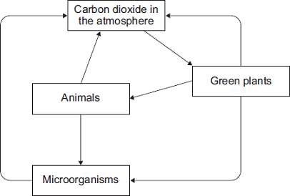
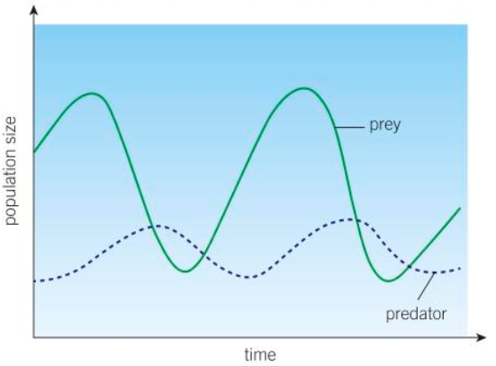
B17 Organising an Ecosystem (Triple) | Describe how living things are involved in the constant cycling of carbon [6 marks] |  | Describe a method of how you could investigate the effect of temperature on the rate of decay of fresh milk.
Explain how to calculate the following: Mean: Median: Mode: Range: | Explain the predator-prey relationship in regard to population: | Explain how the following affect the rate of decay: Temperature: Water: Availability of oxygen:
Define biomass: Which organisms create biomass and how do they do this? |  | State the equation to calculate the rate of decay is a set of results: Explain how you would find the rate of decay from a graph: | Which gas do anaerobic decay produce? Explain the use of this as a biogas:
Add the following labels to the food chain below: producer, primary consumer, secondary consumer, tertiary consumer, apex predator. |  | Gardeners and farmers try to provide optimum conditions for rapid decay of waste biological material to create compost. How do they create these conditions? What is compost used for? | Explain why gardeners use compost and manure on plants/crops,

Slide 15
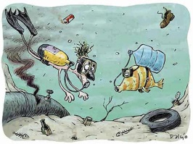
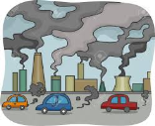
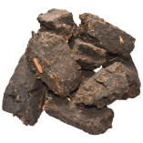
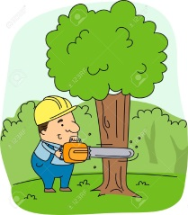
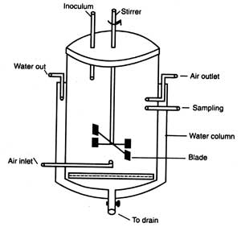
B18 Ecosystem and Biodiversity (Triple) | State all the ways humans are currently causing land pollution: | How can pollution occur in water | How can pollution occur in the air
Define biodiversity: Explain why biodiversity is important: | Why have humans destroyed peat and what is a problem associated with burning peat? | What do pyramids of biomass show? | State some factors which are threatening our food security:
State how the following will help to maintain biodiversity: Breeding programs: Regeneration of rare habitats: Reintroduction of field margins: Reducing deforestation: Recycling: | What are humans causing large scale deforestation? | Why is over fishing a problem? Suggest ways we can fish more sustainably. | How can we increase the efficiency of food production?
 | Describe some of the biological consequences of global warming Name the two gases that contribute to global warming | Explain the role of bio technology in sustainable food production:

