Slide 1
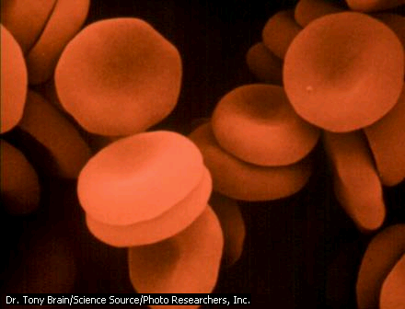
18/07/2017
Cell Biology
AQA 2016 Biology topic 1
W Richards
The Weald School

Slide 2
1.1 Cell Structure

Slide 3

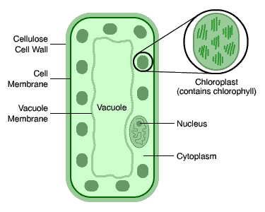
Plant and Animal cells (eukaryotic cells)
Eukaryotic cells have these features:
Cytoplasm
1)
Genetic material within a nucleus
2)
Cell Membrane
3)
Typical size of animal cell = 10-30μm
Typical size of plant cell = 10-100μm

Slide 4
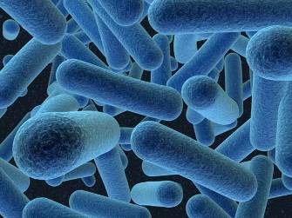
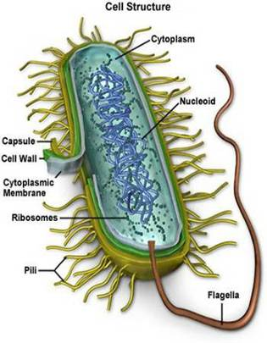
Bacteria (prokaryotic) cells
Consider a bacteria cell in more detail:
Bacteria contain cytoplasm and a ______ surrounded by a cell wall. The ______ are NOT in a distinct _____ and bacterial cells do not have mitochondria or chloroplasts. They may have one or more small rings of DNA called _______.
Words – nucleus, membrane, plasmids, genes
Typical size of bacterial cell = 2μm

Slide 5
A Typical Animal Cell
Ribosomes – protein synthesis happens here
4)
Cytoplasm - this is where the reactions happen and these are controlled by enzymes
1)
Nucleus – controls the cell’s activities
2)
Mitochondria - energy is released here during aerobic respiration
5)
Cell Membrane – controls what comes in and out
3)

Slide 6
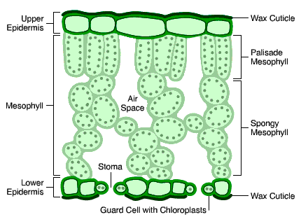
A Typical Plant Cell:
Cell wall – made of cellulose which strengthens the cell
Cell membrane – controls what comes in and out
Chloroplasts (containing chlorophyll) – this is needed for photosynthesis
Nucleus – controls what the cell does and stores information
Large vacuole – contains sap and helps support the cell
Cytoplasm – Chemical reactions happen here

Slide 7
Plant and Animal Cells compared
Things in
plant cells
Things in
animal cells

Slide 8
Summary
 | Plant cells | Animal cells | Bacteria
Nucleus?
Cell membrane?
Mitochondria?
Chloroplasts?
Ribosomes?
Vacuole?

Slide 9
Specialised animal cells
I.D:
Red Blood Cell
Carries oxygen around the body
No nucleus and large surface area
Function:
Features:
Can you complete a similar description for these cells?
White blood cell
Ciliated epithelial cell
Nerve cell (neurone)
Egg cell (ovum)

Slide 10
Design the following cells…
A cell that would carry out a large number of chemical reactions
A cell that would be capable of absorbing large amounts of water
A cell that could line the windpipe and catch dust/germs
A cell that would be good at photosynthesis

Slide 11
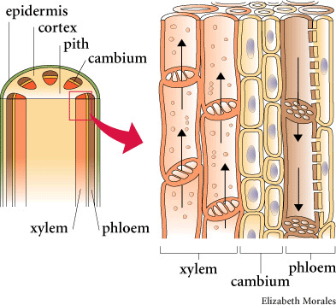
Xylem and Phloem
Xylem and phloem are specialised plant cells:
Xylem are used by the plant to transport water and soluble mineral salts from the roots to the stem and the leaves.
Phloem are tubes used by the plant to transport dissolved food to the whole plant for respiration and storage.

Slide 12
Cell differentiation
During the development of a multi-celled organism cells differentiate to form specialised cells. They do this by acquiring different sub-cellular structures:
Animal cells differentiate at an early stage whereas plant cells retain the ability to specialise throughout their life.
White blood cell
Ciliated epithelial cell
Nerve cell (neurone)
Egg cell (ovum)

Slide 13
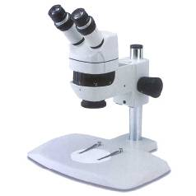
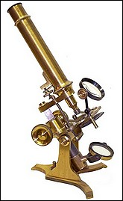
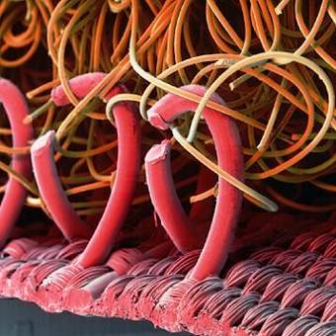
Microscopy
These microscopes have different powers of magnification. Consider this image of velcro:
A “stereo” microscope
An old microscope!
If the “loop” on this image is measured to be 20cm tall at a magnification of 100x how big is it really?
2mm

Slide 14
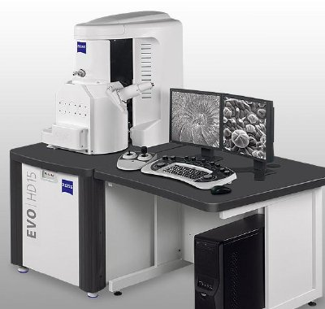
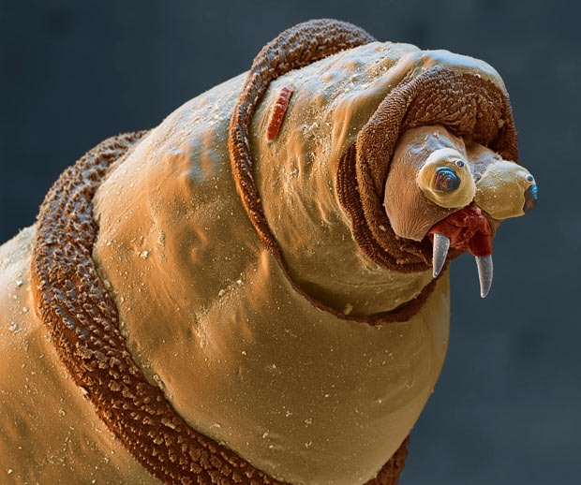
Scanning Electron Microscopes
Scanning Electron Microscopes have much higher magnification powers than light microscopes. This has led to a much greater understanding of cell structure.
An electron microscope image of a maggot…
Notice the resolution of this image of me. The high levels of resolution also make electron microscopes very useful. Now I’m going to eat you.

Slide 15
Growing Bacteria (Biology only)
Bacteria can grow and multiply at very quick rates, especially inside the human body where the conditions are right. They grow through an asexual process called “binary fission”.
Imagine bacteria could double every 20 minutes. Draw a graph of how many you would have at the following times:
Time | No. of bacteria
0 20 40 60 80 100 120 140 160 180 | 1 2
No of bacteria
The “right conditions” mentioned here are the right temperature and the presence of nutrients
Time

Slide 16
Growing Bacteria (Biology only)
1) Sterilise the inoculating loop
2) Dip the loop in the bacteria and spread it across the agar
3) Secure (but don’t seal) the lid with tape and store upside down.
Questions:
Why are you sterilising the petri dish and the loop?
What does the agar do?
Why is the lid not sealed all the way around?
Why is the dish stored upside down?
Why would you not want to culture your bacteria at 37^{O}C?

Slide 17
1.2 Cell Division

Slide 18
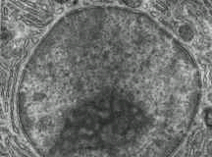
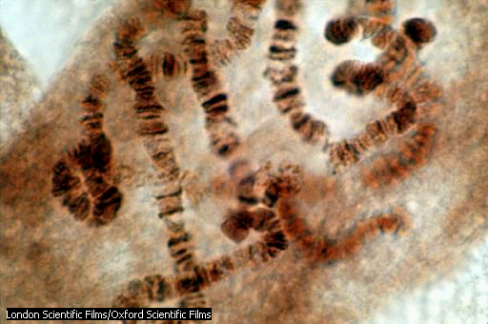
Cells, Genes and Chromosomes
The nucleus of a cell contains chromosomes made of DNA molecules. Each chromosome carries a large number of genes and chromosomes are often found in pairs.

Slide 19
Cell Growth - Mitosis
Mitosis is basically: 1) Copy the DNA, 2) Divide it into two:
Each daughter cell has the same number of chromosomes and genetic information as the parent – in other words, we’ve “grown” a new cell.
Before this division the cell would need to increase the number of sub-cellular structures such as ribosomes.

Slide 20
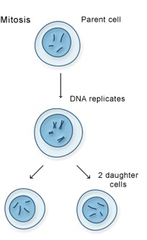
Facts about Mitosis
Mitosis:
Used for _____ and _____ of cells
Used in _______ reproduction
Cells with identical number of _______ and genetic information are produced (“________”)
Words – clones, asexual, growth, chromosomes, repair

Slide 21
Stem Cells
A while ago we considered examples of specialised cells:
White blood cell
Ciliated epithelial cell
Nerve cell (neurone)
Egg cell (ovum)
A “stem cell” is a cell that hasn’t yet become specialised and can be found in embryos or bone marrow. These cells can be used to treat certain conditions but the use of these cells is very controversial.

Slide 22
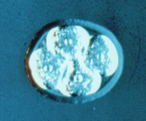
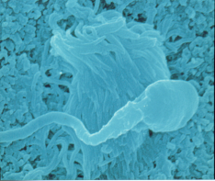
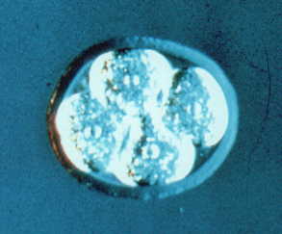
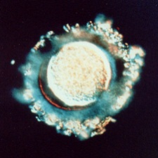

Stem cell research
Stem cells are cells that have not yet specialised:
These stem cells have the potential to develop into any kind of cell. In grown adults they can be taken from bone marrow or they can come from embryos from unused IVF treatments. They can be used to treat conditions such as diabetes and paralysis.
Embryo
Egg and sperm
Cloned embryos
The ethical issue:
Should these embryos be treated as humans?

Slide 23
Making decisions
Some questions cannot be answered by science and need to be considered on ethical grounds.
Factors that might influence a decision:
Beliefs/religion
What does “the right thing” mean?
“Playing God”
Risks – acceptable or unacceptable?
Social and economic contexts

Slide 24
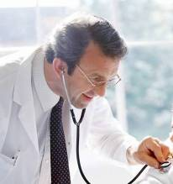
More about Stem Cell Research
I could benefit from stem cell research but doctors are worried that my body will reject the treatment. What’s a possible solution?
“Therapeutic cloning” may be the answer. We’ll produce an embryo with the same genes as you.
Not sure how I feel about that…
Stem cell research does also carry the risk of transmitting viral infections.

Slide 25

Stem Cells in Plants - Meristems
Plant growth occurs in areas called meristems. Stem cells can come from meristems.
e.g. this meristem causes the plant to grow upwards.
Cells from the meristem behave like stem cells – they can develop into any kind of cell. Cloned plants can be produced from these cells. What are the advantages of this?
Food production?
Rare plants?

Slide 26
1.3 Transport in Cells

Slide 27
Diffusion
Diffusion is when something travels from an area of high concentration to an area of low concentration. For example, consider the scent from a hamburger…
The “scent particles” from this hamburger are in high concentration here:
Eventually they will “diffuse” out into this area of low concentration:
Substances can move across a cell membrane by diffusion.

Slide 28
Diffusion Summary
Diffusion is when particles spread from an area of high concentration to an area of ___ concentration. The particles move along a “concentration _____”. Diffusion can be accelerated by increasing the _______ of the particles, which makes them move _______, or by making the surface area of the membrane _______.
Words – faster, low, gradient, temperature, bigger

Slide 29
An example of Diffusion: the lungs
O₂
Oxygen diffuses in and carbon dioxide diffuses out of blood in the lungs:
CO₂
Diffusion also occurs in cells – urea diffuses out of cells into blood plasma for excretion in the kidney.

Slide 30
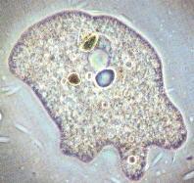
Single celled organisms
Here’s a picture of an amoeba, a single-celled organism.
The amoeba has a large surface area to volume ratio. How does this help diffusion?
What about a larger organism that doesn’t have such a high surface area to volume ratio? Let’s consider a fish…

Slide 31
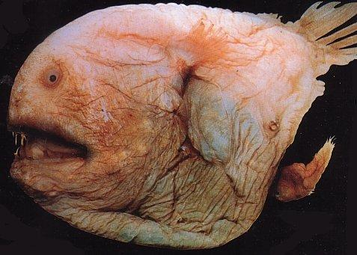
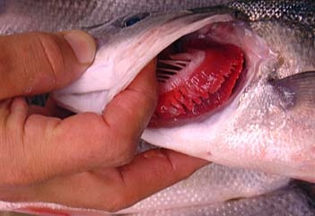
Gas Exchange in Fish
1) The fish gulps water through its mouth and then pushes it out of the gill flap
2) The oxygen is absorbed by the fine filaments (which increase surface area) in the gills
Notice the large surface area and good blood supply in the gills!
3) The oxygen is transported away from the gill filaments by the blood supply.

Slide 32
Diffusion in the lungs
O₂
As we’ve said before, oxygen diffuses in and carbon dioxide diffuses out of blood in the lungs:
CO₂
Alveoli have four things that help them to do this job:
A massive surface area
A lining that is only one cell thick
A very good blood supply
Ventilation.

Slide 33
Osmosis
Osmosis is a “special kind of ___________”. It’s when water diffuses from a __________ area to a less concentrated area through a partially permeable _________ (i.e. one that allows water to move through but not anything else):
Water
Sugar solution
In this example the water molecules will move from left to right (along the concentration ______) and gradually _____ the sugar solution.
Words – membrane, concentrated, dilute, diffusion, gradient

Slide 34
Strong sugar solution
Medium sugar solution
Potato cells
Weak sugar solution

Slide 35
Active Transport
In diffusion substances moved along a concentration gradient. In active transport, substances move against this gradient:
Outside cell
Inside cell
This process takes ______ and this comes from ___________. It enables cells to take in substances even though they are in very small __________. Root hair cells take in ______ using active transport.
Words – concentration, energy, respiration, nutrients
Cell membrane

Slide 36


Root hair cells
Plant roots are made of specialised “root hair cells” which have two features that help them to take in water and nutrients:
Root hair cells
Large surface area
Thin cell membrane

Slide 37
Active Transport in plants and humans
Mineral
Less concentrated
More concentrated
Plant nutrients are taken in by root hair cells using active transport.
Sugar molecules are absorbed from the gut into blood by active transport.

Slide 38
Comparing Diffusion, Osmosis and Active Transport
Diffusion
Osmosis
Active transport

