Slide 1
Transpiration revision
https://www.youtube.com/watch?v=nQ5UdAlgSVc

Slide 2
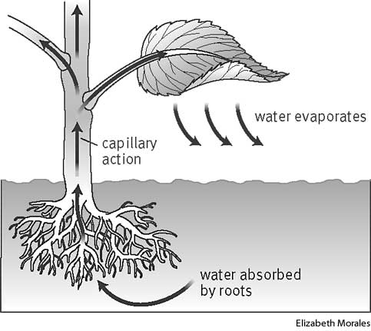
B4 REVISION Transpiration
Use the diagram to describe Transpiration
Name the vessels in a plant and what they carry.
1.
2.
Label the diagram
What is translocation?
Why does sugar need to move around the plant?
How does sugar move from phloem vessel to phloem vessel?
Draw a picture of two guard cells surrounding a stomata.
Why are stomata necessary for transpiration?
How does temperature affect transpiration and why?
How does humidity affect transpiration and why?
How does air movement(wind) affect transpiration and why?
There are lots of tissues in a plant. For each one say where it is and what it does.
Tissue | What is does | Where it is
Epidermal tissue Palisade mesophyll Spongy mesophyll Meristem
KEY WORDS:
Stomata
Phloem
Xylem
Humidity
Transpiration
Evaporation
Meristem
Mesophyll
Epidermal
Palisade
Translocation

Slide 3
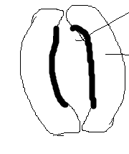
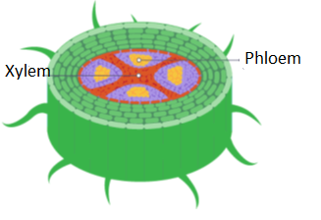
B4 REVISION Transpiration
Use the diagram to describe Transpiration
Water evaporates from the stomata on the underside of leaves.
This creates a negative pressure/sucking
Water is therefore absorbed through the roots
Name the vessels in a plant and what they carry.
1.Xylem - water and ions
2. Phloem – glucose/fructose mainly
Label the diagram
What is translocation?
Movement of dissolved sugars
Why does sugar need to move around the plant?
Leaves make sugar, roots are underground so can’t photosynthesise and need the sugar for respiration so sugar needs to move from leaves to roots.
Sugar is also loaded into fruits and tubers.
How does sugar move from phloem vessel to phloem vessel?
Cell sap can move from one phloem cell to the next through pores in the end walls.
Draw a picture of two guard cells surrounding a stomata.
Why are stomata necessary for transpiration?
They open to allow gas exchange, but water vapour evaporates
How does temperature affect transpiration and why?
Higher temperatures mean particles move more/kinetic energy which means there is more evaporation
How does humidity affect transpiration and why?
High humidity reduces transpiration because there will be a reduced concentration gradient between inside the leaf and outside the leaf (the air is wet)
How does air movement(wind) affect transpiration and why?
Wind removes the evaporated water vapour, increase concentration gradient so transpiration increased.
There are lots of tissues in a plant. For each one say where it is and what it does.
Tissue | What is does | Where it is
Epidermal tissue Palisade mesophyll Spongy mesophyll Meristem | Surrounding cells – impermeable to water. See through. Contains chloroplasts so does most photosynthesis. Vertical so more likely that light hits a chloroplast Air spaces to allow diffusion of O2 out and CO2 in during the day Can produce stem cells | Surface of the leaf Under the epidermis Under the palisade mesophyll Tips of growing shoots and roots
KEY WORDS:
Stomata
Phloem
Xylem
Humidity
Transpiration
Evaporation
Meristem
Mesophyll
Epidermal
Palisade
Translocation

