Slide 1
Revision – blood, heart & blood vessels
https://www.youtube.com/watch?v=Kf_IxTS2S8E

Slide 2
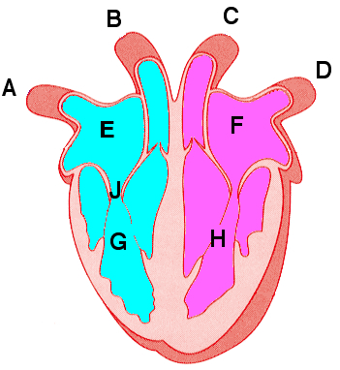
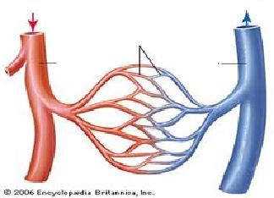
B4 REVISION Circulatory System
Label the heart and draw an arrow to show the direction of blood through it;
Name the three type of blood vessels and what makes each one different;
1.
2.
3.
Label the diagram
What is the purpose of the circulatory system?
Mammals have a double circulatory system. What does this mean?
What is a stent? Draw a picture.
What arteries are they used in and why?
What are the issues with using blood products?
What are the functions of the following components of blood and draw a picture:
Red blood cells White Blood cells Platelet
What does blood plasma carry?
How do you calculate rate of blood flow?
What is coronary heart disease?
Treatment description | Advantages | Disadvantages
Statins Replacement valves Transplants
KEY WORDS:
Circulation
Atrium
Ventricle
Valve
Capillary
Artery
Vein
Stent
Statins
Transplants
Plasma
Coronary arteries

