Slide 1
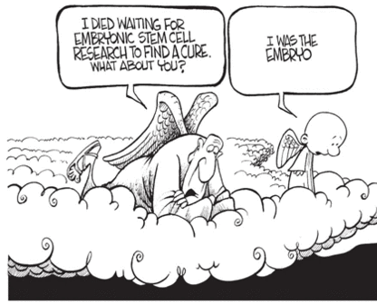
BIG QUESTION
Title: Stem cell dilemmas
In one sentence sum up the message portrayed by the picture.
DEEPER THINKING:
Suggest the ethical implications if stem cells were used in medical research and treatments.

Slide 2
Keywords:
Embryonic stem cell
Therapeutic cloning.
Immunosuppressant's
B2.4 Stem cell dilemmas
Learning outcomes
Evaluate the use of stem cells in medicine.
Describe what therapeutic cloning can be used for.
List some arguments for and against the use of stem cells.

Slide 3
Link to specification
Notes:
NO NEED TO READ THROUGH THIS TEACHER REFERENCE ONLY

Slide 4
SILENT STARTER
1. Research has been carried out into the use of embryonic stem cells to repair damaged tissues in adults.
State two properties of stem cells. [2 marks]
(b)Following an investigation it was discovered that injections of embryonic stem cells improved the function of hearts damaged by heart attacks.
Suggest how stem cells helped to repair the damaged heart muscle. [2 marks]
DEEPER THINKING:
Research has been carried out into the use of embryonic stem cells to repair damaged tissues in adults.
Describe two ethical issues in using stem cells to treat damaged tissues in humans. [2 marks]
End
5 mins

Slide 5
1. Research has been carried out into the use of embryonic stem cells to repair damaged tissues in adults.
State two properties of stem cells. [2 marks]
(b)Following an investigation it was discovered that injections of embryonic stem cells improved the function of hearts damaged by heart attacks.
Suggest how stem cells helped to repair the damaged heart muscle. [2 marks]
not specialised / undifferentiated; able to keep dividing [1]
arge nuclear / cytoplasmic ratio; can develop into specialised cells [1]
develop into heart / cardiac muscle cells
to replace damaged cells;
stem cells differentiate; divide / multiply; by mitosis;
heart muscle cells don’t normally divide
Self-assess
Score __/4
DEEPER THINKING:
Research has been carried out into the use of embryonic stem cells to repair damaged tissues in adults.
Describe two ethical issues in using stem cells to treat damaged tissues in humans. [2 marks]
may give false hope
may transmit infection;
fate of embryo / blastocyst;
religious / cultural reasons;
may cause an immune response in patient
Self-assess
Score __/2

Slide 6
Task:
Subheading: Use of embryonic stem cells in medical research.
Complete the table.
(You may use previous lesson notes)
For | Against
Page 30-32
DEEPER THINKING:
Scientists are now also looking into therapeutic cloning.
Describe therapeutic cloning.
End
10mins

Slide 7
Use of embryonic stem cells in medical research.
For | Against
potential to cure many currently untreatable diseases/ injuries e.g. diabetes/paralysis, macular degeneration
use of human embryos problematic for some (ethics)
risk of side effects (e.g., cancer, viral infection)
grow new organs for transplant
patients may need immunosuppressant drugs
prevent organ rejection
development of treatments slow and expensive
difficult to control stem cells.

Slide 8
The future of stem cell research
Scientists have found embryonic stem cells in;
the umbilical cord blood of newborns
Amniotic fluid that surrounds the fetus
Scientists also found ways of using adult stems cells
Currently only develop into a limited range of cell types.
Successfully treated some heart diseases
grow organs e.g. trachea.
Both the above overcome ethical issues with using spare embryos

Slide 9
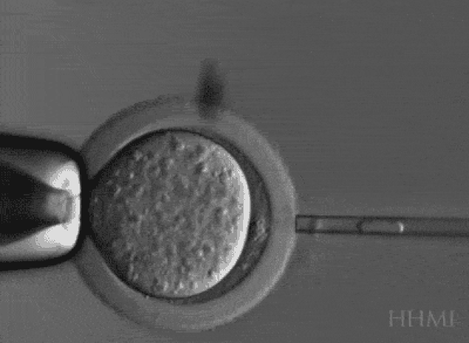
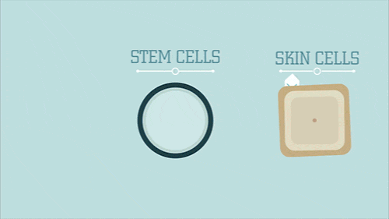
Therapeutic cloning
If you were to receive medical treatment with cells grown from stem cells, your body’s immune system would recognise the cells as foreign, and they would be rejected and die.
But this would not happen if you received cells with the same genes as you.
This could be done by cloning one of your cells to produce an embryo, then taking stem cells from this.
This is called therapeutic cloning.
Therapeutic cloning-Using cells from an adult to produce a cloned early embryo of themselves.

Slide 10
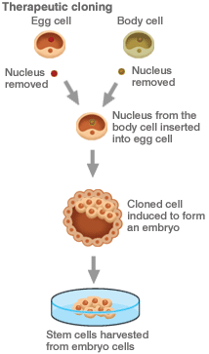
Re-arrange the steps involved in therapeutic cloning.
USE THE NUMBERS ONLY
(Hint: Use the image for guidance)
Nucleus taken out of a human egg cell
Stem cells treated to develop into required cell types
Egg cell stimulated to develop into an embryo
Stem cells taken from the embryo
Nucleus from a patient's cell put into the egg cell
Stem cells grown in a container of warm nutrients
Egg cell stimulated to develop into an embryo
End
5 mins

Slide 11
Therapeutic cloning-process
1, 5, 7, 4, 6, 2
Nucleus taken out of a human egg cell
Nucleus from a patient's cell put into the egg cell
Egg cell stimulated to develop into an embryo
Stem cells taken from the embryo
Stem cells grown in a container of warm nutrients
Stem cells treated to develop into required cell types

Slide 12
Stem cell research-UK
http://www.ukscf.org/
Stem cell research is being carried out into potential therapies to treat:
Spinal cord injuries
Diabetes
Heart after damage in a heart attack
Eyesight in the blind
Damaged bone and cartilage

Slide 13
Classroom scientist
Convince your group as to whether or not stem cell research should go ahead in 1 minute.
1 minute
End

