Slide 1
BIG QUESTION
Title: Stem cells (introduction)
Using the picture on the right; what can stem cells do?
DEEPER THINKING:
Suggest why this is important for humans.

Slide 2
Keywords:
Stem cells
Embryonic stem cell
undifferentiated
B2.3 Stem cells
Learning outcomes
Explain how stem cells can be used to treat medical conditions.
Describe differences between embryonic and adult stem cells.
State that a stem cell is a cell that is not differentiated.

Slide 3
Link to specification
Notes:
NO NEED TO READ THROUGH THIS TEACHER REFERENCE ONLY

Slide 4
How do stem cells work? – bang goes the theory
Notes:
https://youtu.be/cEB8656TCIE

Slide 5
Use your current knowledge to complete the passage below.
SILENT STARTER
Keywords: undifferentiated, single, zygote, sperm, stem
An egg and _____ cell fuse to form a _______.
A zygote is made up of a _____ cell. The cells divide and become a ball of cells.
The inner cells of this ball are called embryonic ______ cells.
A stem cell is an __________ cell of an organism which can differentiate into many different specialised cells.
Deeper Thinking:
Suggest why scientists are interested in stem cell therapy.
End
5 mins

Slide 6
You may not need all words
Keywords: Undifferentiated, zygote, single, stem ,sperm
An egg and _____ cell fuse to form a _______.
A zygote is made up of a _____ cell. The cells divide and become a ball of cells.
The inner cells of this ball are called embryonic ______ cells.
A stem cell is an __________ cell of an organism which can differentiate into many different specialised cells.
sperm
zygote
single
stem
undifferentiated
Self-assess
Score __/5

Slide 7
Stem cells can be found in;
Embryo’s
Adult animals
Plants
The function of the stem cells slightly varies depending on where it is found.

Slide 8
Type of stem cell | Where is it found? | Describe its function | Can it be used to produce plant clones?
Embryonic stem cell
Adult stem cell
Meristem tissue
Task:
Complete the table.
Page 30-31
DEEPER THINKING:
Suggest how might stem cells enable us to save rare species of plants from extinction.
End
5 mins

Slide 9
Type of stem cell | Where is it found? | Describe its function | Can it be used to produce plant clones?
Embryonic stem cell
Adult stem cell
Meristem tissue

Slide 10
Where do I look?
Page 30-31

Slide 11
Type of stem cell | Where is it found? | Describe its function | Can it be used to produce plant clones?
Embryonic stem cell
Adult (somatic) stem cell
Meristem tissue
Human embryos-inner cells in the hollow ball of cells.
Can differentiate to form all of the specialised cells in the human body.
NO
Found among differentiated cells in a tissue or organ.
e.g. Bone marrow
As well as; brain, blood, blood vessels, skeletal muscle, skin, teeth, heart, gut, liver.
Can renew itself and can differentiate to form some or all of the major specialised cell types of the tissue or organ. e.g. Bone marrow can form all the specialised blood cells (rbc/wbc)
NO
Plant meristem-
Can differentiate into any type of plant cell, throughout the life of the plant.
YES
Green pen review
Score ___/9
marks

Slide 12
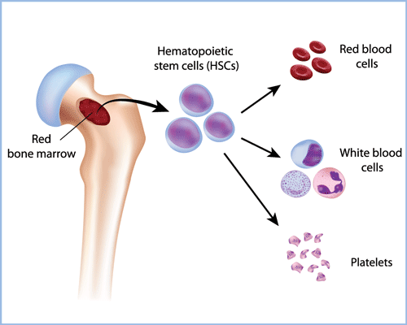

Slide 13
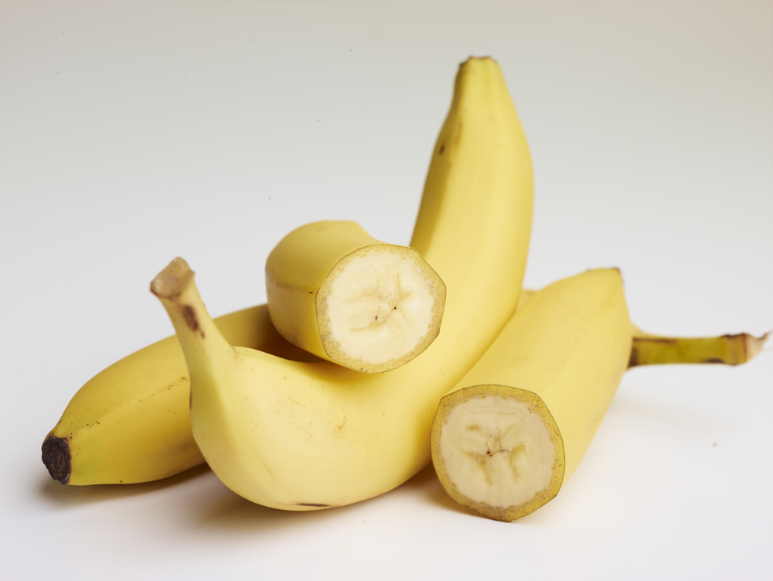
Stem cells from the meristem can be used to make clones-identical to parent plant.
Benefits of cloning plants
Very quick and economical
Produce large numbers of rare plants which can save them from extinction
Horticulture-fruits, vegetables, flowers
Agriculture-large scale farming
DEEPER THINKING:
Suggest possible disadvantages of cloning plants

Slide 14
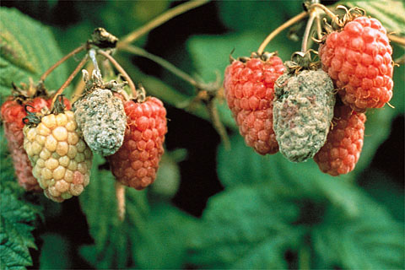
DEEPER THINKING:
Suggest possible disadvantages of cloning plants
Plant clones-All the plants are genetically identical, the lack of genetic variation means that if the plants become exposed to disease or to changes in environmental conditions, all of them will be affected.

Slide 15
History of Human Embryonic Stem Cell Research
1998- Scientific breakthrough
Thomson and Gearhart cultured embryonic stem cells
Culture-growing and maintaining living matter in a specially prepared nutrient medium under specific conditions.

Slide 16
Using embryonic stem cells
Spinal injuries → paralysis (spinal nerves cannot repair themselves)
Type 1 diabetes → Cells in pancreas destroyed → no insulin → high blood sugar levels → inject insulin daily.
Treatment with stem cells may be able to help conditions such as
diabetes and paralysis.

Slide 17
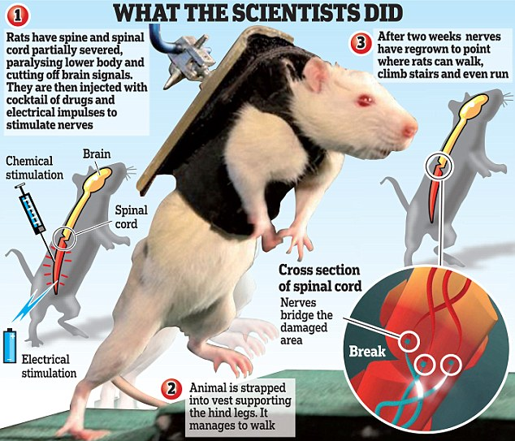
Using embryonic stem cells-paralysis
Nerve cells grown from embryonic stem cells used to restore partial movement to the legs of paralysed rats.
2012-1st time, people with broken spines have recovered feeling in previously paralysed areas after receiving injections of neural stem cells.
Not long before stem cells can be used to cure paralysis

Slide 18
Using embryonic stem cells-Macular degeneration
www.bbc.co.uk/news/health-11517680
Notes:
www.bbc.co.uk/news/health-11517680

Slide 19
Match each word with the most appropriate statement

