Slide 1
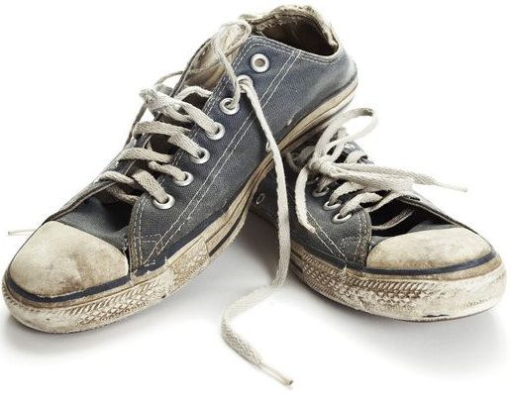
BIG QUESTION
Title: Cell division
When your shoes get old and worn, what do you do?
What might happen to cells when they get old?
DEEPER THINKING:
Suggest why new cells must have the same genetic information as the originals.

Slide 2
Keywords:
Mitosis
DNA
chromosomes
gene
B2.1 Cell division
*New topic*
Learning outcomes
Explain in detail what happens at each stage of the cell cycle.
Use the key words to describe the process of mitosis.
State the meaning of most of the key words.

Slide 3
Link to specification
Notes:
NO NEED TO READ THROUGH THIS TEACHER REFERENCE ONLY

Slide 4
Your body is constantly making new cells.
Why do organisms need new cells?
To grow
To replace cells that become worn out
Repair damaged tissue
New cells must contain the same genetic information as the original so they can do the same job.

Slide 5
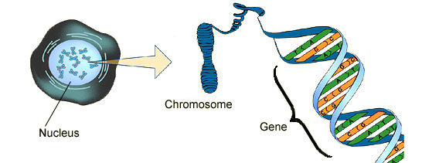
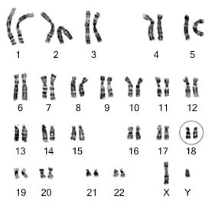
In pairs describe the pictures below
SILENT STARTER
The nucleus is packed full of chromosomes.
Each nucleus contains 46 chromosomes arranged in 23 pairs.
Chromosomes contain genes.
Genes are made up of DNA.
End
2mins

Slide 6
Copy and complete the sentences using the keywords
Keywords: 46, DNA, Nucleus, Genes, 23
Deeper Thinking:
What happens if you’ve got too may chromosomes?
The ________ of a cell contains chromosomes made of ______ molecules.
You have ____ chromosomes in the nucleus of your body cells. They are arranged in ____ pairs.
Each chromosome carries a large number of ________.
End
5 mins

Slide 7
Keywords: 46, DNA, Nucleus, Genes, 23
The ________ of a cell contains chromosomes made of ______ molecules.
You have ____ chromosomes in the nucleus of your body cells. They are arranged in ____ pairs.
Each chromosome carries a large number of ________.
Nucleus
DNA
46
23
Genes
Self-assess
Score __/5

Slide 8
Notes:
https://www.youtube.com/watch?v=aeAL6xThfL8

Slide 9
How does your body make new cells?
Cell cycle & mitosis
In order to produce new cells your body cells need to divide.
Your body cells divide in a series of stages known as the ‘cell cycle’.
The stage where the cell divides is called mitosis.

Slide 10
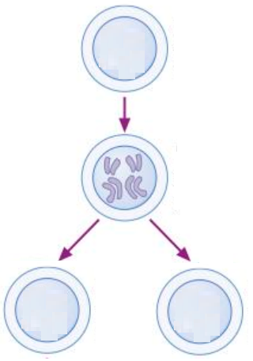
Name:…………………
Stage 1: ………………………………………………………………………………………………………………………………………………………………………………………………………………………………
Task:
Complete the cell cycle diagram (use a pencil)
Describe what’s happening at each stage.
Stage 2: ……………………………………………………………………………………………………………………………………………………………….
Page 27
Stage 3: ……………………………………………………………………………………………………………………………………………………
DEEPER THINKING:
Explain how and why you would expect the length of the cell cycle to vary between a 13-year-old student and a 70-year-old adult.
End
10mins

Slide 11
Green pen review
Stage 1:
Longest stage in cell cycle. Cells grow bigger, increased mass.
Replicate DNA to form two copies of each chromosome.
Increase number of mitochondria, ribosomes, chloroplasts (in plants) getting ready for cell division.
Stage 2
Mitosis; one set of chromosomes is pulled to each end of the cell.
Nucleus divides

Slide 12
Green pen review
Stage 3:
Cytoplasm and cell membrane splits/divides
Forms two identical daughter cells.

Slide 13
DEEPER THINKING:
Explain how and why you would expect the length of the cell cycle to varies between a 13-year-old student and a 70-year-old adult.
Firstly, the length of the cycle is shortest in an embryo. An embryo needs to grow thus, it needs quicker cell replication to build up tissue which can form organs.
The length of the cell cycle slightly increases at 13 years old but it is still relatively short compared to an adult. This is because at that age the body is going through puberty as a result cells are being replaced.
As you get older the cell cycle would further increase in length. As you approach 70 the body begins to deteriorate and cells die.

Slide 14
Assessment books only
Describe what happens during the three stages of the cell cycle. [6 marks]
End
6 mins

Slide 15
Describe what happens during the three stages of the cell cycle. [6 marks]
Self-assess
Score __/6

Slide 16
True or false
F
T
F
T

