Slide 1


The PiXL Club The PiXL Club The PiXL Club The PiXL Club The PiXL Club The PiXL Club The PiXL Club The PiXL Club The PiXL Club The PiXL Club The PiXL Club The PiXL Club The PiXL Club The PiXL Club The PiXL Club The PiXL Club The PiXL Club The PiXL Club The PiXL Club The PiXL Club The PiXL Club The PiXL Club The PiXL Club The PiXL Club The PiXL Club The PiXL Club The PiXL Club The PiXL Club The PiXL Club The PiXL Club The PiXL Club The PiXL Club The PiXL Club The PiXL Club The PiXL Club The PiXL Club The PiXL Club The PiXL Club The PiXL Club The PiXL Club The PiXL Club The PiXL Club The PiXL Club The PiXL Club The PiXL Club XL Club The PiXL Club The PiXL Club The PiXL Club The PiXL Club The PiXL Club The PiXL Club The PiXL Club The PiXL Club The PiXL Club The PiXL Club The PiXL Club The PiXL Club The PiXL Club The PiXL Club The PiXL Club The PiXL Club The PiXL Club The PiXL Club The PiXL Club The PiXL Club The PiXL Club The PiXL Club The PiXL Club The PiXL Club The PiXL Club The PiXL Club The PiXL Club The PiXL Club The PiXL Club The PiXL Club The PiXL Club The PiXL Club The PiXL Club The PiXL Club The PiXL Club The PiXL Club The PiXL Club The PiXL Club The PiXL Club The PiXL Club The PiXL Club The PiXL Club The PiXL Club The PiXL Club The PiXL Club The PiXL Club The PiXL Club The PiXL Club The PiXL Club The PiXL Club The PiXL Club The PiXL Club The PiXL Club The PiXL Club The PiXL Club The PiXL Club The PiXL Club The PiXL Club The PiXL Club The PiXL Club The PiXL Club The PiXL Club The PiXL Club The PiXL Club The PiXL Club The PiXL Club The PiXL Club The PiXL Club The PiXL Club The PiXL Club The PiXL Club The PiXL Club The PiXL Club The PiXL Club The PiXL Club The PiXL Club The PiXL Club The PiXL Club The PiXL Club The PiXL Club The PiXL Club The PiXL Club The PiXL Club The PiXL Club The PiXL Club The PiXL Club The PiXL Club The PiXL Club The PiXL Club The PiXL Club The PiXL Club The PiXL Club The PiXL Club The PiXL Club The PiXL Club The PiXL Club The PiXL Club The PiXL Club The PiXL Club The PiXL Club The PiXL Club The PiXL Club The PiXL Club The PiXL Club The PiXL Club The PiXL Club The PiXL Club The PiXL Club The PiXL Club The PiXL Club The PiXL Club The PiXL Club The PiXL Club The PiXL Club The PiXL Club The PiXL Club The PiXL Club The PiXL Club The PiXL Club The PiXL Club The PiXL Club The PiXL Club The PiXL Club The PiXL Club The PiXL Club The PiXL Club The PiXL Club The PiXL Club The PiXL Club The PiXL Club The PiXL Club The PiXL Club The PiXL Club The PiXL Club The PiXL Club The PiXL Club The PiXL Club The PiXL Club The PiXL Club The PiXL Club The PiXL Club The PiXL Club The PiXL Club The PiXL Club The PiXL Club The PiXL Club The PiXL Club The PiXL Club The PiXL Club The PiXL Club The PiXL Club The PiXL Club The PiXL Club The PiXL Club The PiXL Club The PiXL Club The PiXL Club The PiXL Club The PiXL Club The PiXL Club The PiXL Club The PiXL Club The PiXL Club The PiXL Club The PiXL Club The PiXL Club The PiXL Club The PiXL Club The PiXL Club The PiXL Club The PiXL Club The PiXL Club The PiXL Club The PiXL Club The PiXL Club The PiXL Club The PiXL Club The PiXL Club The PiXL Club The PiXL Club The PiXL Club The PiXL Club The PiXL Club The PiXL Club The PiXL Club The PiXL Club The PiXL Club The PiXL Club The PiXL Club The PiXL Club The PiXL Club The PiXL Club The PiXL Club The PiXL Club The PiXL Club The PiXL Club The PiXL Club The PiXL Club The PiXL Club The PiXL Club The PiXL Club The PiXL Club The PiXL Club The PiXL Club The PiXL Club The PiXL Club The PiXL Club The PiXL Club The PiXL Club The PiXL Club The PiXL Club The PiXL Club The PiXL Club The PiXL Club The PiXL Club The PiXL Club The PiXL Club The PiXL Club The PiXL Club The PiXL Club The PiXL Club The PiXL Club The PiXL Club The PiXL Club The PiXL Club The PiXL Club The PiXL Club The PiXL Club The PiXL Club The PiXL Club The PiXL Club The PiXL Club The PiXL Club The PiXL Club The PiXL Club The PiXL Club The PiXL Club The PiXL Club The PiXL Club The PiXL Club The PiXL Club The PiXL Club The PiXL Club The PiXL Club The PiXL Club The PiXL Club The PiXL Club The PiXL Club The PiXL Club The PiXL Club The PiXL Club The PiXL Club The PiXL Club The PiXL Club The PiXL Club The PiXL Club The PiXL Club The PiXL Club The PiXL Club The PiXL Club The PiXL Club The PiXL Club The PiXL Club The PiXL Club The PiXL Club The PiXL Club The PiXL Club The PiXL Club The PiXL Club The PiXL Club The PiXL Club The PiXL Club The PiXL Club The PiXL Club The PiXL Club The PiXL Club The PiXL Club The PiXL Club The PiXL Club The PiXL Club The PiXL Club The PiXL Club The PiXL Club The PiXL Club The PiXL Club The PiXL Club The PiXL Club The PiXL Club The PiXL Club The PiXL Club The PiXL Club The PiXL Club The PiXL Club The PiXL Club The PiXL Club The PiXL Club The PiXL Club The PiXL Club The PiXL Club The PiXL Club The PiXL Club The PiXL Club The PiXL Club The PiXL Club The PiXL Club The PiXL Club The PiXL Club The PiXL Club The PiXL Club The PiXL Club The PiXL Club The PiXL Club The PiXL Club The PiXL Club The PiXL Club The PiXL Club The PiXL Club The PiXL Club The PiXL Club The PiXL Club The PiXL Club The PiXL Club The PiXL Club The PiXL Club The PiXL Club The PiXL Club The PiXL Club The PiXL Club The PiXL Club The PiXL Club The PiXL Club The PiXL Club The PiXL Club The PiXL Club The PiXL Club The PiXL Club The PiXL Club The PiXL Club The PiXL Club The PiXL Club The PiXL Club The PiXL Club The PiXL Club The PiXL Club The PiXL Club The PiXL Club The PiXL Club The PiXL Club The PiXL Club The PiXL Club The PiXL Club The PiXL Club The PiXL Club The PiXL Club The PiXL Club The PiXL Club The PiXL Club The PiXL Club The PiXL Club The PiXL Club The PiXL Club The PiXL Club The PiXL Club The PiXL Club The PiXL Club The PiXL Club The PiXL Club The PiXL Club The PiXL Club The PiXL Club The PiXL Club The PiXL Club The PiXL Club The PiXL Club The PiXL Club The PiXL Club The PiXL Club The PiXL Club The PiXL Club The PiXL Club The PiXL Club The PiXL Club The PiXL Club The PiXL Club The PiXL Club The PiXL Club The PiXL Club The PiXL Club The PiXL Club The PiXL Club The PiXL Club The PiXL Club The PiXL Club The PiXL Club The PiXL Club The PiXL Club The PiXL Club The PiXL Club The PiXL Club The PiXL Club The PiXL Club The PiXL Club The PiXL Club The PiXL Club The PiXL Club The PiXL Club The PiXL Club The PiXL Club The PiXL Club The PiXL Club The PiXL Club The PiXL Club The PiXL Club The PiXL Club The PiXL Club The PiXL Club The PiXL Club The PiXL Club The PiXL Club The PiXL Club The PiXL Club The PiXL Club The PiXL Club The PiXL Club The PiXL Club The PiXL Club The PiXL Club The PiXL Club The PiXL Club The PiXL Club The PiXL Club The PiXL Club The PiXL Club The PiXL Club The PiXL Club The PiXL Club The PiXL Club The PiXL Club The PiXL Club The PiXL Club The PiXL Club The PiXL Club The PiXL Club The PiXL Club The PiXL Club The PiXL Club The PiXL Club The PiXL Club The PiXL Club The PiXL Club The PiXL Club The PiXL Club The PiXL Club The PiXL Club The PiXL Club The PiXL Club The PiXL Club The PiXL Club The PiXL Club The PiXL Club The PiXL Club The PiXL Club The PiXL Club The PiXL Club The PiXL Club The PiXL Club The PiXL Club The PiXL Club The PiXL Club The PiXL Club The PiXL Club The PiXL Club The PiXL Club The PiXL Club The PiXL Club The PiXL Club The PiXL Club The PiXL Club The PiXL Club The PiXL Club The PiXL Club The PiXL Club The PiXL Club The PiXL Club The PiXL Club The PiXL Club The PiXL Club The PiXL Club The PiXL Club The PiXL Club The PiXL Club The PiXL Club The PiXL Club The PiXL Club The PiXL Club The PiXL Club The PiXL Club The PiXL Club The PiXL Club The PiXL Club The PiXL Club The PiXL Club The PiXL Club The PiXL Club The PiXL Club The PiXL Club The PiXL Club The PiXL Club The PiXL Club The PiXL Club The PiXL Club The PiXL Club The PiXL Club The PiXL Club The PiXL Club The PiXL Club The PiXL Club The PiXL Club The PiXL Club The PiXL Club The PiXL Club The PiXL Club The PiXL Club The PiXL Club The PiXL Club The PiXL Club The PiXL Club The PiXL Club The PiXL Club The PiXL Club The PiXL Club The PiXL Club The PiXL Club The PiXL Club The PiXL Club The PiXL Club The PiXL Club The PiXL Club The PiXL Club The PiXL Club The PiXL Club The PiXL Club The PiXL Club The PiXL Club The PiXL Club The PiXL Club The PiXL Club The PiXL Club The PiXL Club The PiXL Club The PiXL Club The PiXL Club The PiXL Club The PiXL Club The PiXL Club The PiXL Club The PiXL Club The PiXL Club The PiXL Club The PiXL Club The PiXL Club The PiXL Club The PiXL Club The PiXL Club The PiXL Club The PiXL Club The PiXL Club The PiXL Club The PiXL Club The PiXL Club The PiXL Club The PiXL Club The PiXL Club The PiXL Club The PiXL Club The PiXL Club The PiXL Club The PiXL Club The PiXL Club The PiXL Club The PiXL Club The PiXL Club The PiXL Club The PiXL Club The PiXL Club The PiXL Club The PiXL Club The PiXL Club The PiXL Club The PiXL Club The PiXL Club The PiXL Club The PiXL Club The PiXL Club The PiXL Club The PiXL Club The PiXL Club The PiXL Club The PiXL Club The PiXL Club The PiXL Club The PiXL Club The PiXL Club The PiXL Club The PiXL Club The PiXL Club The PiXL Club The PiXL Club The PiXL Club The PiXL Club The PiXL Club The PiXL Club The PiXL Club The PiXL Club The PiXL Club The PiXL Club The PiXL Club The PiXL Club The PiXL Club The PiXL Club The PiXL Club The PiXL Club The PiXL Club The PiXL Club The PiXL Club The PiXL Club The PiXL Club The PiXL Club The PiXL Club The PiXL Club The PiXL Club The PiXL Club The PiXL Club The PiXL Club The PiXL Club The PiXL Club The PiXL Club The PiXL Club The PiXL Club The PiXL Club The PiXL Club The PiXL Club The PiXL Club The PiXL Club The PiXL Club The PiXL Club The PiXL Club The PiXL Club The PiXL Club The PiXL Club The PiXL Club The PiXL Club The PiXL Club The PiXL Club The PiXL Club The PiXL Club The PiXL Club The PiXL Club The PiXL Club The PiXL Club The PiXL Club The PiXL Club The PiXL Club The PiXL Club The PiXL Club The PiXL Club The PiXL Club The PiXL Club The PiXL Club The PiXL Club The PiXL Club The PiXL Club The PiXL Club The PiXL Club The PiXL Club The PiXL Club The PiXL Club The PiXL Club The PiXL Club The PiXL Club The PiXL Club The PiXL Club The PiXL Club The PiXL Club The PiXL Club The PiXL Club The PiXL Club The PiXL Club The PiXL Club The PiXL Club The PiXL Club The PiXL Club The PiXL Club The PiXL Club The PiXL Club The PiXL Club The PiXL Club The PiXL Club The PiXL Club The PiXL Club
PiXL KnowIT!
GCSE Biology
AQA Topic – Cell Biology
© Copyright The PiXL Club Ltd, 2017
This resource is strictly for the use of member schools for as long as they remain members of The PiXL Club. It may not be copied, sold nor transferred to a third party or used by the school after membership ceases. Until such time it may be freely used within the member school.
All opinions and contributions are those of the authors. The contents of this resource are not connected with nor endorsed by any other company, organisation or institution.
www.pixl.org.uk The PiXL Club Ltd, Company number 07321607

Slide 2
Overview
Cell Biology
Cell structure
  Eukaryotes and prokaryotes
  Animal and plant cells
  Cell specialisation
  Cell differentiation
  Microscopy
  Culturing microorganisms (biology only)
Cell division
  Chromosomes
  Mitosis and the cell cycle
  Stem cells
Transport in cells
  Diffusion
  Osmosis
  Active transport

Slide 3
LearnIT!
KnowIT!
Cell structure
Part 1
Eukaryotes and prokaryotes
Animal and plant cells

Slide 4
  Cell structure part 1 - Eukaryotes and prokaryotes
All living things are made of cells, they are the basic unit of all life.
Eukaryotic cells
Have a cell membrane,
cytoplasm and genetic material (DNA) enclosed in a nucleus.
Animal and plant cells are eukaryotic cells
Prokaryotic cells
These are smaller than eukaryotic cells. The genetic material is not enclosed in a nucleus. The DNA is a single loop and there may be one or more rings of DNA called plasmids.
Bacterial cells are prokaryotic cells
Prefixes are used in science to make very small numbers more manageable. You need to learn the ones in the table and be able to convert to and from standard form.
Prefix | Multiple | Standard form
centi (cm) | 1 cm = 0.01 m | x 10 ⁻²
milli (mm) | 1 mm = 0.001 m | x 10 ⁻³
micro (𝛍m) | 1 𝛍m = 0.000 001 m | x 10 ⁻⁶
nano (nm) | 1 nm = 0.000 000 001 m | x 10 ⁻⁹

Slide 5
  Cell structure part 1 - Animal, plant cells and bacterial cells
You will need to know the differences between plant, animal and bacterial cells.
Bacterial cells are much smaller than plant and animal cells.

Slide 6
  Cell structure part 1 - Animal, plant cells and bacterial cells
Cell part | Function | Animal | Plant | Bacteria
Nucleus | Contains genetic material, which controls the activities of the cell | ✔ | ✔
Cytoplasm | Most chemical processes take place here, controlled by enzymes | ✔ | ✔ | ✔
Cell membrane | Controls the movement of substances into and out of the cell | ✔ | ✔ | ✔
Mitochondria | Most energy is released by respiration here | ✔ | ✔
Ribosomes | Protein synthesis happens here | ✔ | ✔
Cell wall | Strengthens the cell – made of cellulose (not bacteria) (algal cells also have a cell wall) |  | ✔ | ✔
Chloroplasts | Contain chlorophyll, absorbs light energy for photosynthesis |  | ✔
Permanent vacuole | Filled with cell sap to help keep the cell turgid |  | ✔
Bacterial DNA | Loop of DNA NOT found in a nucleus |  |  | ✔
Plasmid (DNA) | Small ring of DNA often used as a vector in genetic modification |  |  | ✔

Slide 7
QuestionIT!
Cell structure
Part 1
Eukaryotes and prokaryotes
Animal and plant cells

Slide 8
  Cell structure part 1 – QuestionIT
1. Where is the genetic material in a prokaryotic cell?
2. Where is the genetic material in a eukaryotic cell?
3. Copy and complete the table.
4. Why do scientists use prefixes?
Prefix | Multiple | Standard form
centi (cm) |  | x 10 ⁻²
 | 1 mm = 0.001 m | x 10 ⁻³
micro (𝛍m) | 1 𝛍m = 0.000 001 m
nano (nm) |  | x 10 ⁻⁹

Slide 9
  Cell structure part 1 – QuestionIT
5. Name the structures A to L on the diagrams below and label cells 1, 2 and 3.

Slide 10
  Cell structure part 1 – QuestionIT
6. Copy and complete the table and tick the correct column for each one.
Cell part | Function | Animal | Plant | Bacteria
 | Contains genetic material, which controls the activities of the cell
Cytoplasm
 | Controls the movement of substances into and out of the cell
 | Most energy is released by respiration here
Ribosomes | Protein synthesis happens here
 | Strengthens the cell – made of cellulose
Chloroplasts
 | Filled with cell sap to help keep the cell turgid
 | Loop of DNA NOT found in a nucleus
Plasmid (DNA)

Slide 11

AnswerIT!
Cell structure
Part 1
Eukaryotes and prokaryotes
Animal and plant cells

Slide 12
  Cell structure – AnswerIT
Where is the genetic material in a prokaryotic cell?
In a bacterial DNA loop and there may be one or more plasmid rings.
2. Where is the genetic material in a eukaryotic cell?
The DNA is in chromosomes enclosed in a nucleus.
3. Copy and complete the table.
4. Why do scientists use prefixes?
To make very small numbers more manageable
Prefix | Multiple | Standard form
centi (cm) | 1 cm = 0.01 m | x 10 ⁻²
milli (mm) | 1 mm = 0.001 m | x 10 ⁻³
micro (𝛍m) | 1 𝛍m = 0.000 001 m | x 10 ⁻⁶
nano (nm) | 1 nm = 0.000 000 001 m | x 10 ⁻⁹

Slide 13
  Cell structure – AnswerIT
5. Name the structures A to L on the diagrams below and label cells 1, 2 and 3.

Slide 14
  Cell structure – AnswerIT
6. Copy and complete the table and tick the correct column for each one.
Cell part | Function | Animal | Plant | Bacteria
Nucleus | Contains genetic material, which controls the activities of the cell | ✔ | ✔
Cytoplasm | Most chemical processes take place here, controlled by enzymes | ✔ | ✔ | ✔
Cell membrane | Controls the movement of substances into and out of the cell | ✔ | ✔ | ✔
Mitochondria | Most energy is released by respiration here | ✔ | ✔
Ribosomes | Protein synthesis happens here | ✔ | ✔
Cell wall | Strengthens the cell – made of cellulose |  | ✔ | ✔
Chloroplasts | Contain chlorophyll, absorbs light energy for photosynthesis |  | ✔
Permanent vacuole | Filled with cell sap to help keep the cell turgid |  | ✔
Bacterial DNA | Loop of DNA NOT found in a nucleus |  |  | ✔
Plasmid (DNA) | Small ring of DNA often used as a vector in genetic modification |  |  | ✔

Slide 15
LearnIT!
KnowIT!
Cell structure
Part 2
Cell specialisation
Cell differentiation

Slide 16
  Cell structure part 2 - Animal cell specialisation
The structure of different cells helps them to carry out a particular function within the organism. These cells are called specialised cells.
Name of animal cell | Diagram | Structure and function
Sperm |  | Function is to fertilise an egg. Streamlined with a long tail to swim to the egg. Acrosome in the head containing enzymes to digest the egg cell membrane. Large number of mitochondria in the mid section to release energy for movement.
Nerve |  | Function is to carry electrical signals. Long to carry signals long distances. Branched connections to connect to other nerve cells and form a network around the body. Insulating sheath to enhance transmission of electrical signals.
Muscle |  | Function is . Contain a large number of mitochondria to release energy from respiration for movement. Long so that there is enough space to contract.

Slide 17
  Cell structure part 2 - Plant cell specialisation
Name of plant cell | Diagram | Structure and function
Root hair |  | Function is to absorb water and minerals from the soil. Hair like projections to increase the surface area. (Note that root hair cells have no chloroplasts this is because they do not need them as they are in the soil)
Xylem |  | Function is to carry water and minerals in plants. Form hollow xylem tubes made of dead tissue. Long cells with walls toughened by lignin. Water and minerals flow from the roots towards the leaves only in one direction in a process called TRANSPIRATION.
Phloem |  | Function is to carry glucose around the plant. Form phloem tubes made of living tissue. Cells have end plates with holes in them. Glucose in solution moves from the leaves to growth and storage tissues in a process called TRANSLOCATION.

Slide 18
  Cell structure part 2 - Cell differentiation
Cell differentiation occurs as organisms develop, the cell changes and becomes specialised. As the cell differentiates, it forms different sub-cellular structures, e.g. the tail on a sperm cell or the hairs on a root hair cell.
Most types of ANIMAL cells differentiate in the early stage of development.
Most types of PLANT cells can differentiate throughout their life cycle.

Slide 19
QuestionIT!
Cell structure
Part 2
Cell specialisation
Cell differentiation

Slide 20
  Cell structure part 2 – QuestionIT
1. Name animal cells A, B and C and describe their structure and function.
Name of animal cell | Diagram | Structure and function
A.
B.
C.

Slide 21
  Cell structure – QuestionIT
2. Name plant cells A, B and C and describe their structure and function.
Name of plant cell | Diagram | Structure and function
A.
B.
C.

Slide 22
  Cell structure – QuestionIT
3. What does cell differentiation mean?
4. In what stage of an animal’s life cycle do most cells differentiate?
5. In mature animals when do cells still need to differentiate?
6. In what stage of their life cycle do plant cells differentiate?

Slide 23
AnswerIT!
Cell structure
Part 2
Cell specialisation
Cell differentiation

Slide 24
  Cell structure – AnswerIT
1. Name animal cells A, B and C and describe their structure and function.
Name of animal cell | Diagram | Structure and function
A. Sperm |  | Function is to fertilise an egg. Streamlined with a long tail to swim to the egg. Acrosome in the head containing enzymes to digest the egg cell membrane. Large number of mitochondria in the mid section to release energy for movement.
B. Nerve |  | Function is to carry electrical signals. Long to carry signals long distances. Branched connections to connect to other nerve cells and form a network around the body. Insulating sheath to enhance transmission of electrical signals.
C. Muscle |  | Function is to contract to allow movement. Contain a large number of mitochondria to release energy from respiration for movement. Long so that there is enough space to contract.

Slide 25
  Cell structure – AnswerIT
2. Name plant cells A,B and C and describe their structure and function.
Name of plant cell | Diagram | Structure and function
A. Root hair |  | Function is to absorb water and minerals from the soil. Hair like projections to increase the surface area. (Note that root hair cells have no chloroplasts this is because they do not need them as they are in the soil)
B. Xylem |  | Function is to carry water and minerals in plants. Form hollow xylem tubes made of dead tissue. Long cells with walls toughened by lignin. Water and minerals flow from the roots towards the leaves only in one direction in a process called TRANSPIRATION.
C. Phloem |  | Function is to carry glucose around the plant. Form phloem tubes made of living tissue. Cells have end plates with holes in them. Glucose in solution moves from the leaves to growth and storage tissues in a process called TRANSLOCATION.

Slide 26
  Cell structure – AnswerIT
3. What does cell differentiation mean?
When a cell changes to become specialised.
4. In what stage of an animal’s life cycle do most cells differentiate?
In the early stages.
5. In mature animals when do cells still need to differentiate?
For repair and replacement of cells.
6. In what stage of their life cycle do plant cells differentiate?
They differentiate throughout their lifecycle.

Slide 27
LearnIT!
KnowIT!
Cell structure
Part 3
Microscopy
Culturing microorganisms (biology only)

Slide 28
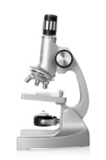
  Cell structure - Microscopy
light microscope
First ones used in 1590’s
electron microscope
First ones used in 1960’s
Feature | Light (optical) microscope | Electron microscope
Radiation used | Light rays | Electron beams
Max magnification | ~ 1500 times | ~ 2 000 000 times
Resolution | 200nm | 0.2nm
Size of microscope | Small and portable | Very large and not portable
Cost | ~£100 for a school one | Several £100,000 to £1 million plus
Resolution: The shortest distance between two objects that can be seen clearly.
Video - Types of microscopes

Slide 29
  Cell structure - Microscopy
Electron microscopes have a higher magnification and resolution than light microscopes. This means that scientists can see more sub- cellular structures (structures within the cells).
nucleus
mitochondria
mitochondrion
Light microscopes image
can let us see structures like nuclei and mitochondria.
Electron microscopes image
can let us see the internal structures of a chloroplast and mitochondrion.

Slide 30
  Cell structure - Microscopy
You can calculate the magnification of an image by using the equation:
MAGNIFICATION: the number of times bigger the image looks compared to the object
IMAGE: what is viewed through the microscope lenses
OBJECT: the ACTUAL specimen under the microscope
magnification M = size of image I
real size of the object A
WORKED EXAMPLE 1:
A magnified animal cell structure has a diameter of 6 mm.
The actual diameter of the structure is 0.15mm.
Calculate how many times the structure has been magnified.
IMAGE
OBJECT
M = I
M = 6
M = 40
You may need to to write your answers in standard form.
A
0.15
You may need to be able rearrange to change the subject of the equation.

Slide 31
  Cell structure - Microscopy
magnification M = size of image I
real size of the object A
WORKED EXAMPLE 2:
The actual length of a cell structure is 30𝛍m.
It is magnified 40 times.
Calculate the length of the magnified cell structure in mm.
Rearrange the equation to make I the subject
OBJECT (A)
OBJECT (A)
MAGNIFICATION (M)
You may need to to write your answers in standard form.
A x
x A
M = I
Multiply both sides by A
A
Cancel out the As
To convert to mm you need to divide by 1000
I = M x A
Put I on the left of the equation
I = 40 x 30
I = 1200 𝛍m
I = 1.2mm

Slide 32
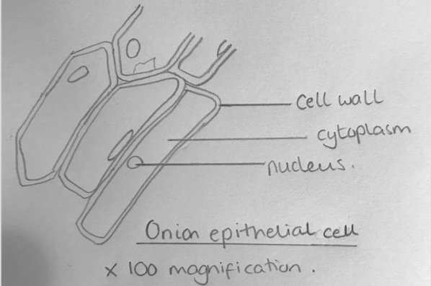
  Cell structure – Microscopy
Making a wet mount slide e.g. onion cells
Place a thin section of the specimen onto slide.
Place a drop of water in the middle of the slide or stain the specimen.
Gently lower cover slip onto the specimen without trapping air bubbles.
Soak up any excess liquid with a paper towel.
Switch on the light source and place your slide on the stage.
Use the lowest objective lens and turn the focusing wheel to move the lens close to the slide.
Slowly adjust the focusing wheel until you can see a clear image.
Increase the magnification by changing the objective lens and re-focus.
Drawing what you see
Clear line drawing – no shading
Label main cell structures
Add a title and the magnification.
See GCSE Practical Guide - Biology – Microscopy on Huddle - Microscopy Practical guide

Slide 33
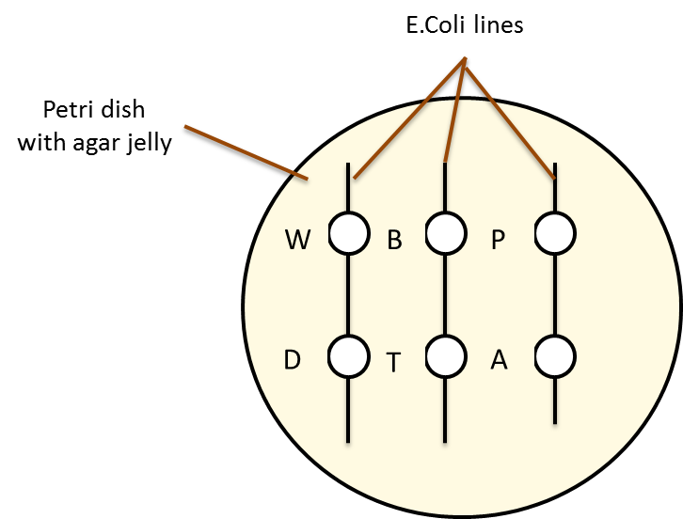
  Cell structure - Culturing microorganisms (biology only)
Effectiveness of disinfectants and antibiotics on bacteria experiment
Agar inoculated with BACTERIA.
Paper discs containing antiseptics and antibiotics placed on bacteria and left to grow.
Water disc used as a CONTROL.
If bacteria don’t grow around the disc then the chemical is effective at killing bacteria.
Area where bacteria don’t grow is called ZONE OF INHIBITION.
See GCSE Practical Guide - Practical guide - Microbiology
Bacteria multiply by binary fission (a cell division where two identical cells are formed). In the right conditions cells can divide as often as every 20 minutes.
Bacteria can be grown in the lab
A culture medium (agar) used containing an energy source (carbohydrate) and minerals.
Petri dishes and agar must be sterilised before use to kill microorganisms.
Inoculating loops used to transfer bacteria after being heated in a Bunsen flame.
The lid of the Petri dish should be sealed with tape to stop other microorganisms getting in (must not be fully sealed so oxygen can get in)
In school, Petri dishes are incubated at 25°C to reduce risk of growth of pathogens that might be harmful to humans.
Bacteria lines

Slide 34
QuestionIT!
Cell structure
Part 3
Microscopy
Culturing microorganisms (biology only)

Slide 35
  Cell structure part 3 – QuestionIT
1. Define the term ‘resolution’.
2. Copy and complete the table below.
3. What are the advantages of the electron microscope?
4. Name the smallest cell structures that can be seen by the light microscope?
5. What are the smallest cell structures that can be seen by the electron microscope?
Feature | Light (optical) microscope | Electron microscope
Radiation used
Max magnification
Resolution
Size of microscope
Cost

Slide 36
  Cell structure part 3 – QuestionIT
6. Write down the magnification equation.
7. Rearrange the equation to change the subject for the two other factors.
8. A magnified cell structure has a diameter of 375𝛍m.
  The actual diameter of the structure is 2.5𝛍m.
  Calculate how many times the structure has been magnified.
9. The actual length of a cell structure is 3𝛍m.
  It is magnified 1,500 times.
  Calculate the length of the magnified cell structure in mm.

Slide 37
  Cell structure part 3 – QuestionIT
10. Name the parts of the light microscope in the diagram below.
11. How would you make an onion cell slide?
12. How would you use the light microscope to view onion cells?

Slide 38
  Cell structure part 3 – QuestionIT (Biology ONLY)
13. What is ‘binary fission’?
14. Why do you need to sterilise Petri dishes and culture mediums before use?
15. What would you use an inoculating loop for?
16. How do you sterilise an inoculating loop?
17. How would you secure the lid of the Petri dish?
18. What temperature would you incubate the samples at in a school and why should you use this temperature?
19. How can you test the effectiveness of antibiotics and disinfectants on bacteria?
20. What is the zone of inhibition?

Slide 39
AnswerIT!
Cell structure
Part 3
Microscopy
Culturing microorganisms (biology only)

Slide 40
  Cell structure part 3 – QuestionIT
Define the term resolution.
The shortest distance between two objects that can be seen clearly.
2. Copy and complete the table below.
3. What are the advantages of the electron microscope? Electron microscopes have a higher magnification and resolution than light microscopes; scientists can see more sub-cellular structures.
4. Name the smallest cell structures that can be seen by the light microscope?
Nuclei and mitochondria
5. What are the smallest cell structures that can be seen by the electron microscope? Internal structures of mitochondria and chloroplasts.
Feature | Light (optical) microscope | Electron microscope
Radiation used | Light rays | Electron beams
Max magnification | ~ 1500 times | ~ 2 000 000 times
Resolution | 200nm | 0.2nm
Size of microscope | Small and portable | Very large and not portable
Cost | ~£100 for a school one | Several £100,000 to £1 million plus

Slide 41
  Cell structure part 3 – AnswerIT
6. Write down the magnification equation.
7. Rearrange the equation to change the subject for the two other factors.
8. A magnified cell structure has a diameter of 375𝛍m.
The actual diameter of the structure is 2.5𝛍m.
Calculate how many times the structure has been magnified.
M = I/A M = 375/2.5 = 150 M = 150 times
9. The actual length of a cell structure is 3𝛍m.
It is magnified 1,500 times.
Calculate the length of the magnified cell structure in mm.
I = M x A I = 1500 x 3 I = 4500 𝛍m 4500 / 1000 = 4.5mm
magnification (M) = size of image (I)
real size of the object (A)
size of image (I) = magnification (M) x real size of the object (A)
real size of the object (A) = size of image (I)
magnification (M)

Slide 42
  Cell structure part 3 – QuestionIT
10. Name the parts of the light microscope in the diagram below.

Slide 43
  Cell structure part 3 – QuestionIT
11. Describe how you would make an onion cell slide.
Place thin section of onion epidermis onto slide.
Place a drop of iodine in the middle of the slide to stain the onion.
Gently lower cover slip onto the onion without trapping air bubbles.
Soak up any excess liquid with a paper towel.
12. Describe how you would use the light microscope to view onion cells.
Switch on the light source and place your slide on the stage.
Use the lowest objective lens and turn the focusing wheel to move the lens close to the slide.
Slowly adjust the focusing wheel until you can see a clear image.
Increase the magnification by changing the objective lens and re-focus.

Slide 44
  Cell structure part 3 – QuestionIT (Biology ONLY)
13. What is ‘binary fission’? Cell division where two identical cells to the parent cell are formed.
14. Why do you need to sterilise Petri dishes and culture mediums before use? To kill any unwanted microorganisms.
15. What would you use an inoculating loop for? To transfer bacteria onto the agar.
16. How do you sterilise an inoculating loop? By heating in a Bunsen flame.
17. How would you secure the lid of the Petri dish? With tape but not sealed all the way around.
18. What temperature would you incubate the samples at in a school and why should you use this temperature? 25ºC, to prevent the growth of pathogens harmful to humans.
19. How can you test the effectiveness of antibiotics and disinfectants on bacteria? Inoculate agar with bacteria, place discs soaked in the solutions (water as a control) and place the discs on the agar containing bacteria. Incubate at 25ºC.
20. What is the zone of inhibition? An area where bacteria doesn’t grow.

Slide 45
LearnIT!
KnowIT!
Cell division
  Chromosomes
  Mitosis and the cell cycle
  Stem cells

Slide 46
  Cell division - Chromosomes
In human body cells the chromosomes are normally found in pairs. The karyotype diagram below shows the 23 chromosome pairs for a female human.
The nucleus of a cell contains the instructions for making proteins and new cells. In the nucleus there are structures called chromosomes. The chromosomes are made of coiled strands of DNA molecules. A section of DNA that codes for a specific protein or characteristic is called a gene.
Human have are around 24,000 genes and there are up to 2,000 genes in one human chromosome.

Slide 47
  Cell division - Mitosis and the cell cycle
In the cell cycle, cells divide in a series of stages. The genetic material is doubled and then divided into two identical cells.
Stage 1 – Growth: Before a cell can divide it needs to grow and increase the number of sub-cellular structures such as ribosomes and mitochondria.
Stage 2 - DNA synthesis: The DNA replicates to form two copies of each chromosome.
Stage 3 – Mitosis: One set of chromosomes is pulled to each end of the cell and the nucleus divides. Then the cytoplasm and cell membranes divide to form two cells that are identical to the parent cell.
Mitosis occurs during growth and to repair or replace damaged cells.
Asexual reproduction occurs by mitosis in both plants and simple animals.

Slide 48
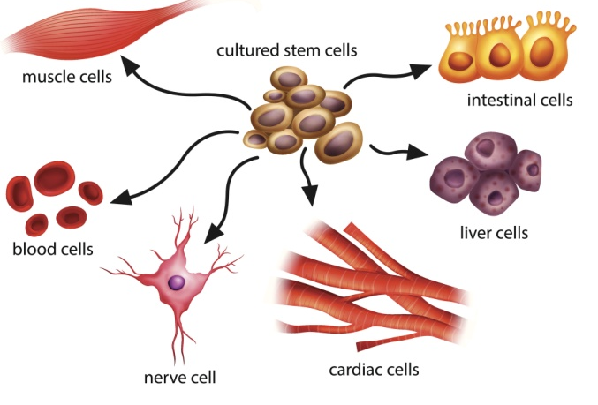
  Cell division - Stem Cells - animals
Stem cells are undifferentiated cells within an organism. They can produce other stem cells that can then differentiate into many different types of cells.
Human embryo stem cells: can be cloned and made to differentiate into most different types of human cells.
Human adult stem cells: can form many (but not all) types of cells including blood cells.
Human stem cells can be used to help treat diseases like diabetes and paralysis.
Embryos produced by therapeutic cloning have the same genes as the patient. This means stem cells from the embryo are not rejected by the patient’s body. This is why they can be used for medical treatments.
The risks of using stem cells risks such as transfer of viral infections.
Some people have objections to stem cell use for ethical and religious reasons. During Fertility treatment doctors usually fertilise many more eggs than are going to be used. The embryos then formed are used to obtain stem cells. In the UK scientists can use these embryos for research but only under very strict guidelines.

Slide 49
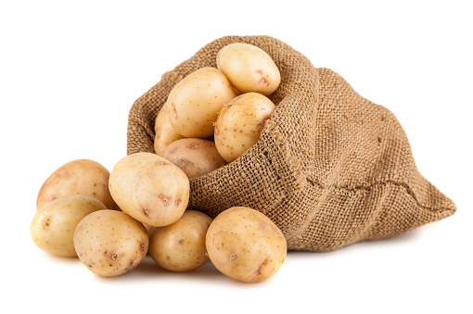
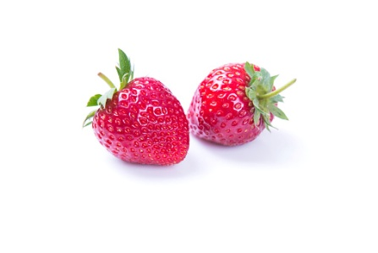
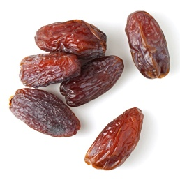
  Cell division- Stem Cells - plants
Most types of PLANT cells can differentiate throughout their life cycle.
Undifferentiated stem cells in plants are grouped together in structures called meristems. The undifferentiated cells can then specialise e.g. root hair cell, xylem or phloem cells.
Stem cells from meristems in plants can be used to produce clones of plants quickly and economically.
• Rare species:
can be cloned to protect from extinction.
• Crop plants:
with special features such as disease resistance can be cloned to produce large numbers of identical plants for farmers.
e.g. potatoes, strawberries and dates

Slide 50
QuestionIT!
Cell division
  Chromosomes
  Mitosis and the cell cycle
  Stem cells

Slide 51
  Cell Division– QuestionIT
1. What are chromosomes?
2. What is a gene?
3. What is DNA?
4. Where in a cell do you find chromosomes?
5. How many chromosome pairs do you find in a human body cell?
6. What are the three stages of the cell cycle?
7. What is mitosis and what is it used for in animals and plants?
8. What is a stem cell?
9. Which type of human stem cell can differentiate into any human cell?

Slide 52
  Cell Division– QuestionIT
10. What is therapeutic cloning?
11. What are the risks of therapeutic cloning?
12. State two reasons why people may object to the use of stem cells in therapeutic cloning.
13. What are meristems?
14. State two reasons that plants are cloned.

Slide 53
AnswerIT!
Cell division
  Chromosomes
  Mitosis and the cell cycle
  Stem cells

Slide 54
  Cell Division– AnswerIT
1. What are chromosomes? Coiled strands of DNA molecules.
2. What is a gene? A section of DNA that codes for a protein.
3. What is DNA?
A genetic material found in the nucleus that codes for proteins.
4. Where in a cell do you find chromosomes?
In the nucleus of cells.
5. How many chromosome pairs do you find in a human body cell?
23 pairs
6. What are the three stages of the cell cycle? Growth, DNA synthesis and mitosis.
7. What is mitosis and what is it used for in animals and plants? Growth, repair and asexual reproduction.
8. What is a stem cell? An undifferentiated cell.
9. Which type of human stem cell can differentiate into any human cell?
Embryo stem cells.

Slide 55
  Cell Division– AnswerIT
10. What is therapeutic cloning? Where patients are given stem cells containing the same genes as theirs.
11. What are the risks of therapeutic cloning? Viral infections.
12. State two reasons why people may object to the use of stem cells in therapeutic cloning.
Ethical and religious reasons.
13. What are meristems? Structures in plants that contain stem cells.
14. State two reasons that plants are cloned? To clone rare species of plants and to clone crop plants with useful characteristics.

Slide 56
LearnIT!
KnowIT!
Transport in cells
  Diffusion
  Osmosis
  Active transport

Slide 57
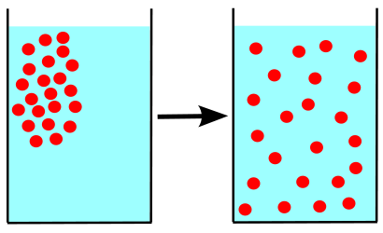
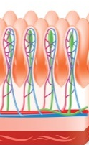
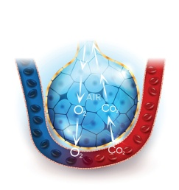
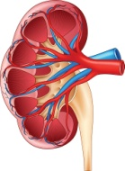
  Transport in cells - Diffusion
Diffusion is the spreading of the particles of a gas or substances in solution, resulting in a net movement of particles from a region where they are of a higher concentration to an area of lower concentration.
Diffusion can occur in: Air – smells from perfume etc.
Solution – tea from a tea bag, dye in water etc.
Through membranes – small intestines, blood cells etc.
Substances that are transported in and out of cells in humans
Location | Particles move | From | To
Small Intestine | Digested food e.g. glucose, amino acids | Small intestine | Blood in capillary of villus
Lungs | Oxygen | Alveolar air space | Blood circulating around the lungs
Kidneys | Urea | Cells | Blood plasma

Slide 58
  Transport in cells - Diffusion
The larger the difference in concentration the faster the rate of diffusion.
Factors which affect the rate of diffusion:
The concentration gradient:
A difference in concentration between
two areas next to each other. Particles
will move down the concentration
gradient from high to low.
The temperature:
As the temperature increases the particles
in a gas or liquid gain more energy
so they move faster. The hotter it is the
faster the rate of diffusion.
The surface area of the membrane:
A single-celled organism has a
large surface area compared to its
volume. This allows sufficient transport of
molecules into and out of the cell
to meet the needs of the organism.
Beetroot in different temperatures of water

Slide 59

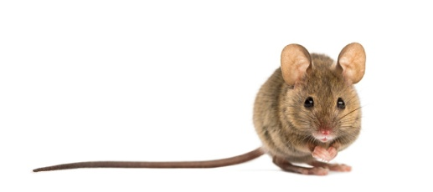
  Transport in cells – Surface area to volume ratio
The surface area to volume ratio can be calculated by dividing an object’s surface area (SA) by its volume
B
Cube A represents a small animal
like a mouse the sides are 1 cm
each and there are 6 sides.
To calculate the volume:
volume A = length x width x height
volume A = 1 x 1 x 1
volume A = 1cm ³
To calculate the area of one surface:
area = height x width
area = 1 x 1 = 1cm²
To calculate the SA of A:
area of one surface x the number of surfaces
surface area = 1 x 6 = 6cm²
SA:V ratio = 6/1 = 6
Cube B represents a larger
animal like a dog the sides are
6cm each and there are 6 sides.
To calculate the volume:
volume B = length x width x height
volume B = 6 x 6 x 6
volume A = 216cm ³
To calculate the area of one surface:
area = height x width
area = 6 x 6 = 36cm²
To calculate the surface area of B:
area of one surface x the number of surfaces
surface area = 36 x 6 = 216cm²
SA:V ratio = 216/216 = 1
A
So as you can see the mouse has a much larger surface area compared to its volume.

Slide 60
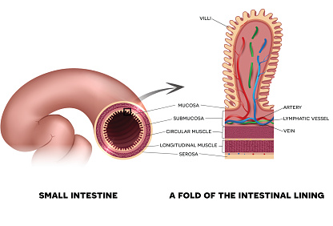
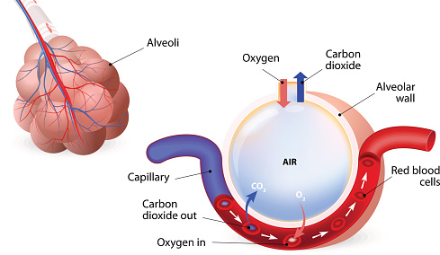
  Transport in cells – Adaptations in animals
Adaptations of the small intestines:
Internal surface is covered in millions of folds called villi.
Villi increase the surface area.
Villi have a very good blood supply. This maintains the concentration gradient.
Membranes of the villi are very thin to allow for a short diffusion distance.
Adaptations of the lungs:
Lungs contain millions of tiny air sacs called alveoli.
Alveoli increase the surface area.
Alveoli have a very good blood supply. This maintains the concentration gradient.
Membranes of the alveoli are very thin to allow for a short diffusion distance.

Slide 61
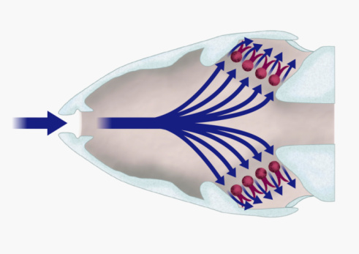
  Transport in cells – Adaptations in animals
Adaptations of gills in fish:
Each gill is made of lots of thin plates called
gill filaments, water with low oxygen flows over
them (however, the oxygen in the blood surrounding
the gills is lower) .
Gill filaments increase the surface area.
Gill filaments are covered with lamella
that increase the surface area more.
Lamella have a very good blood supply. This maintains
the concentration gradient as water flows in the opposite direction.
Membranes of the lamellae are very thin to allow for a short diffusion distance.
http://kids.britannica.com/kids/assembly/view/87782

Slide 62
  Transport in cells – Adaptations in plants
Adaptations of the roots:
The root surface is covered in millions of root hair cells.
Root hair cells increase the surface area.
Present on the mature parts of the roots.
Absorb water and minerals from the soil.
Adaptations of the leaves:
Large surface area to absorb more light.
Thin so short distance for carbon dioxide to diffuse into leaf cells.
Chlorophyll absorbs sunlight for photosynthesis.
Xylem and phloem to support the leaf and transport water and glucose.
Stomata on the lower side of the leaf to allow gases to diffuse into and out of the leaf.

Slide 63
  Transport in cells - Osmosis
Osmosis in plant and animal cells:
Osmosis is the diffusion of water from a dilute solution to a concentrated solution through a partially permeable membrane.
The rate of osmosis changes depending on the concentration gradient and temperature.
Partially permeable membrane – a membrane that lets some but not all substances through.
Hypertonic – more concentrated solution than in the cells.
Isotonic – same concentration as the solution in the cell.
Hypotonic – more dilute than the solution in the cells.

Slide 64
  Transport in cells – Active transport
Active transport occurs in root hair cells.
Active transport moves substances from a more dilute solution to a more concentrated solution (against a concentration gradient). The energy is provided by respiration.
The minerals are at a higher concentration in the root hair cell than in the soil. So the minerals move into the cell against the concentration gradient.
Active transport also occurs in the gut (small intestines) sugar (glucose) molecules are absorbed from lower concentrations in the gut into the blood which has a higher sugar concentration.
The glucose is used for respiration.

Slide 65
QuestionIT!
Transport in cells
  Diffusion
  Osmosis
  Active transport

Slide 66
  Transport in cells – QuestionIT
1. Define ‘diffusion’.
2. State three places where diffusion occurs in the body.
3. What is a concentration gradient?
4. What three factors affect the concentration gradient?
5. What is surface area to volume ratio?
6. Which has the largest surface area to volume ratio, an elephant or a meerkat?
7. State how the following are adapted for diffusion:
  a. The small intestines
  b. The lungs
  c. Gills in fish
  d. Root
  e. Leaves

Slide 67
  Transport in cells – QuestionIT
8. Define ‘osmosis’.
9. What is a ‘partially permeable membrane’?
10. What happens to an animal cell in a hypertonic solution?
11. What happens to an animal cell in a hypotonic solution?
12. Define ‘active transport’.
13. Why does active transport need to occur in root hair cells?
14. Why does active transport need to occur in the gut?

Slide 68
AnswerIT!
Transport in cells
  Diffusion
  Osmosis
  Active transport

Slide 69
  Transport in cells – QuestionIT
Define ‘diffusion’?
The spreading of the particles from a region where they are of a higher concentration to an area of lower concentration.
2. State three places where diffusion occurs in the body. Small intestines, lungs, kidneys
3. What is a concentration gradient? The difference in concentration between two areas next to each other.
4. What three factors affect rate of diffusion? Concentration gradient, temperature, surface area.
5. What is surface area to volume ratio? The size of a surface compared to its volume.
6. Which has the largest surface area to volume ratio an elephant or a meerkat? The meerkat.

Slide 70
  Transport in cells – QuestionIT
7. State how the following are adapted for diffusion:
  a. The small intestines. Have villi to increase surface area, good blood supply, thin membranes.
  b. The lungs. Have alveoli to increase surface area, good blood supply, thin membranes, they are ventilated.
  c. Gills in fish. Have gill filaments and lamella to increase surface area, good blood supply, thin membranes.
  d. Roots. Have root hair cells to increase surface area.
  e. Leaves. Large surface area, thin and stomata.
8. Define osmosis? Osmosis is the diffusion of water from a dilute solution to a concentrated solution through a partially permeable membrane.
9. What is a partially permeable membrane? A membrane that lets some but not all substances through.

Slide 71
  Transport in cells – QuestionIT
10. What happens to an animal cell in a hypertonic solution? It will lose water by osmosis and shrivel.
11. What happens to an animal cell in a hypotonic solution? It will absorb water by osmosis and get bigger/burst.
12. Define active transport. Active transport moves substances from a more dilute solution to a more concentrated solution (against a concentration gradient) using energy from respiration.
13. Why does active transport need to occur in root hair cells? Because the minerals are at a higher concentration in the roots than in the soil.
14. Why does active transport need to occur in the gut? Because the glucose in the blood is at a higher concentration than in the gut.

