Slide 1
Adaptations

Slide 2
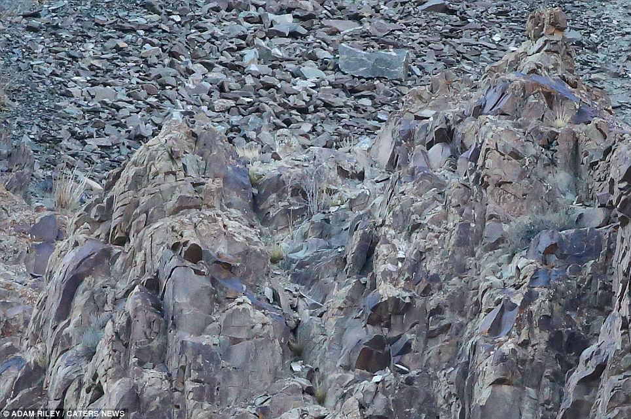
Starter: Spot the snow leopard

Slide 3
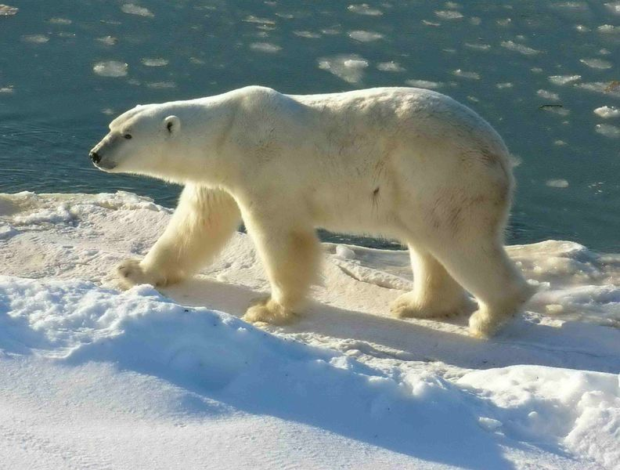
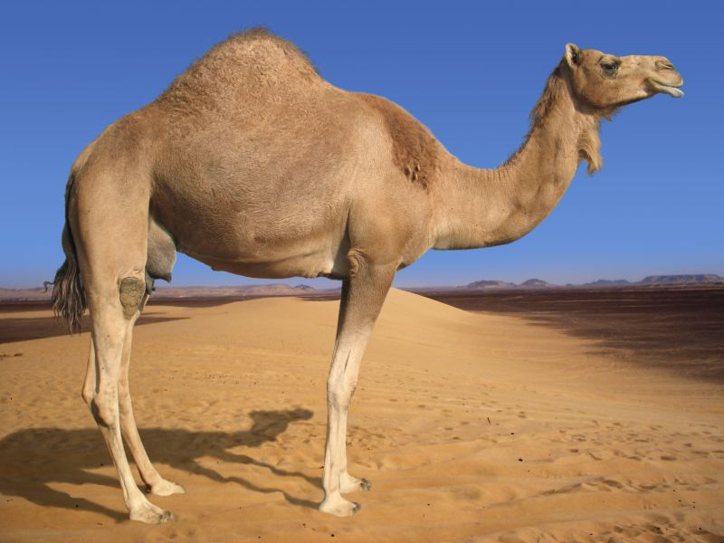
Look at the following animals:
Why are the way they are?

Slide 4
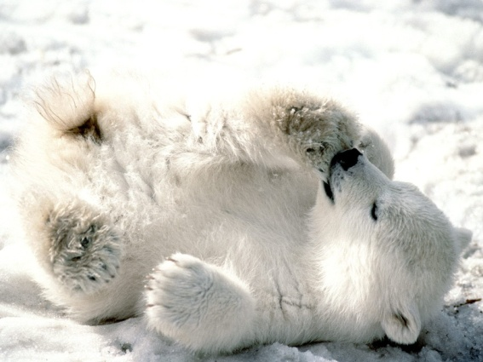
Adaptations
Polar bear –
Thick fur (warmth),
White in colour (camouflage),
Blubber (for warmth and food),
Can close nostrils under water,

Slide 5
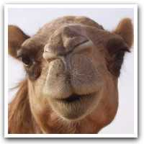
Adaptations
Camel –
Hump made of fat (for food),
Long eye lashes (keep sand out of eyes),
Thick leathery patches on knees (protect from hot sand when kneeling),
Can close nostrils (keep out blowing sand)

Slide 6
Learning Objective
To be able to: to know how organisms are adapted to suit their environment.
Key Words: Ecosystem, independence, competition, community, habitat

Slide 7
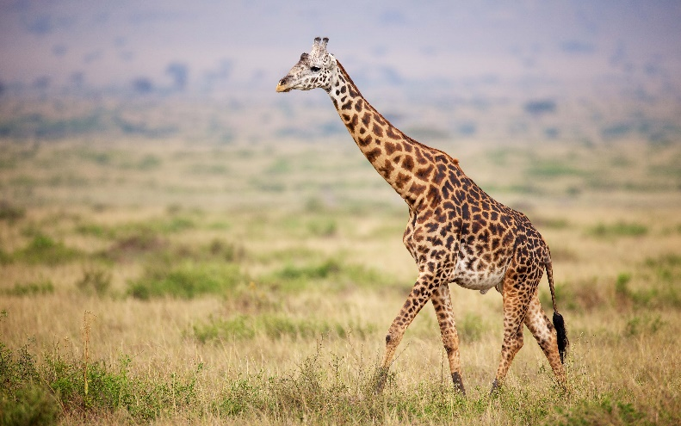
Adaptations
Animals (and plants) have features and characteristics that help them survive – these are called ‘Adaptations’.
Adaptations can be structural, behavioural or functional.
Some organisms live in environments that are very extreme – these are called extremophiles, e.g. bacteria living in deep sea vents.
Keywords: Ecosystem, independence, competition, community, habitat

Slide 8
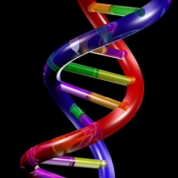
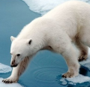
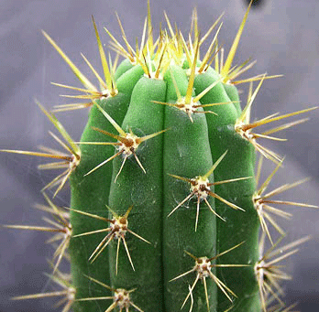
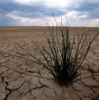
Adaptation for survival
Animal adaptation and competition
Plant adaptation and competition
Biology
Environmental change

Slide 9
Desert fox

Slide 10
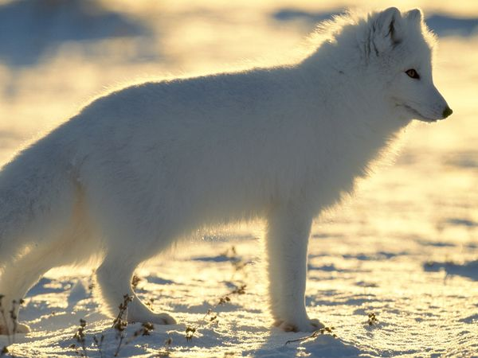
Arctic fox

Slide 11
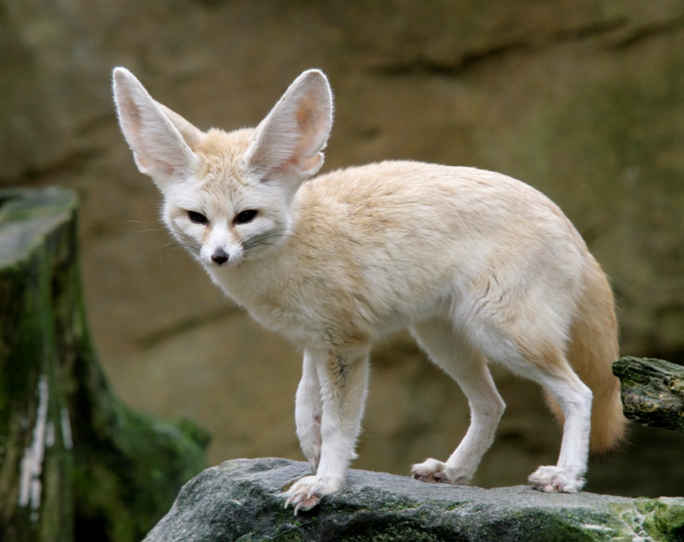
What are the differences between these two foxes that help them survive?
Arctic fox
Desert fox

Slide 12
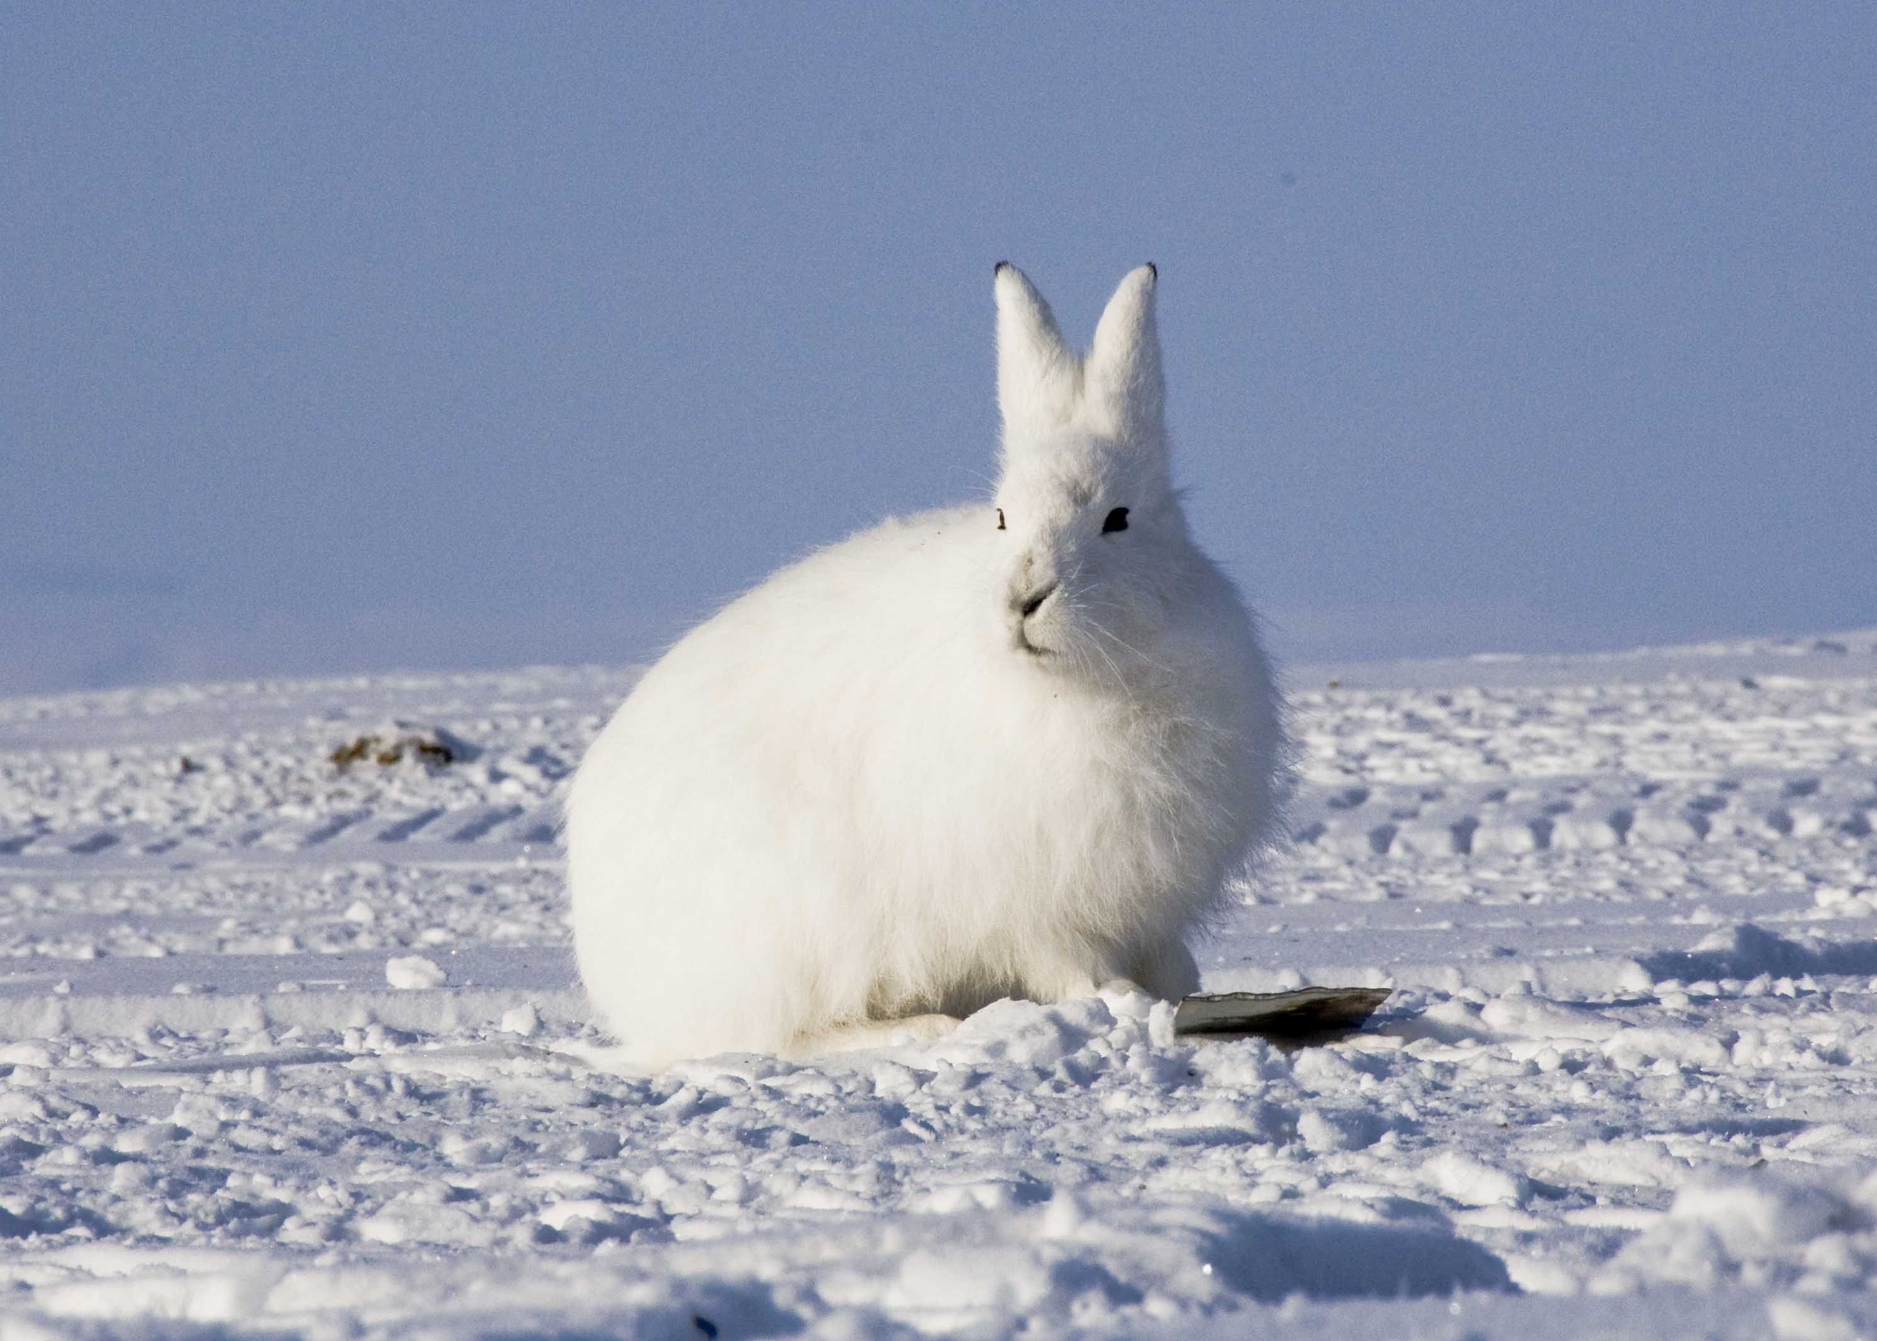
Arctic hare

Slide 13
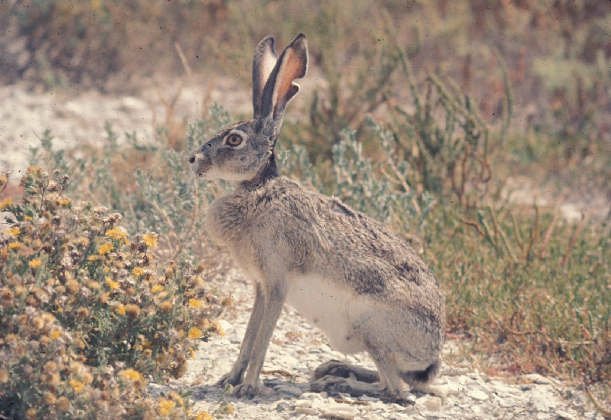
American desert hare

Slide 14
What are the differences between these two hares that help them survive?
Arctic hare
Desert hare

Slide 15
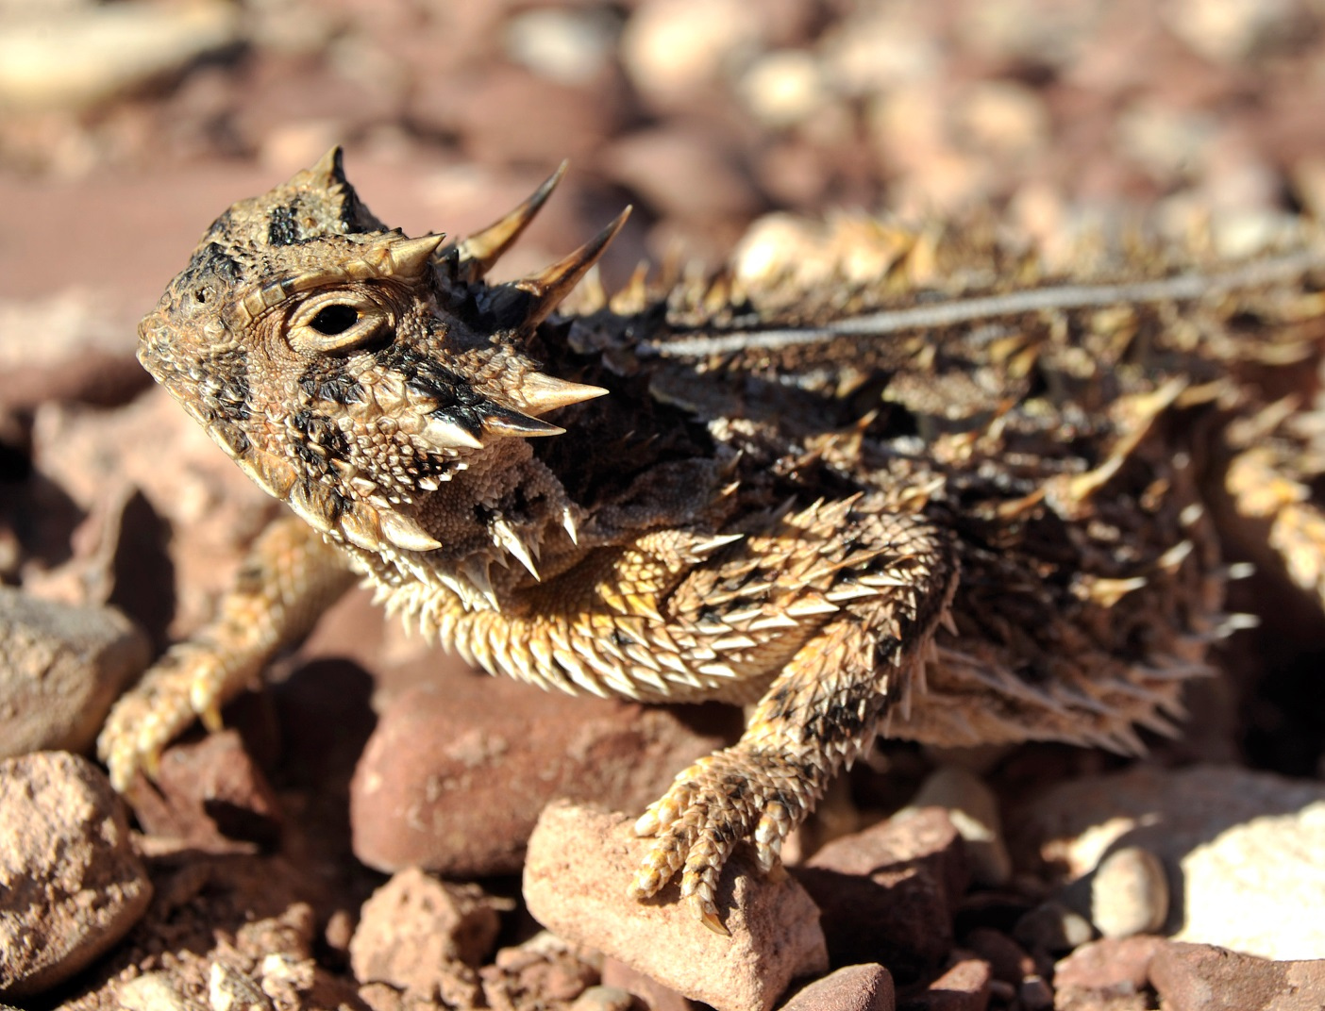
Horned lizard

Slide 16
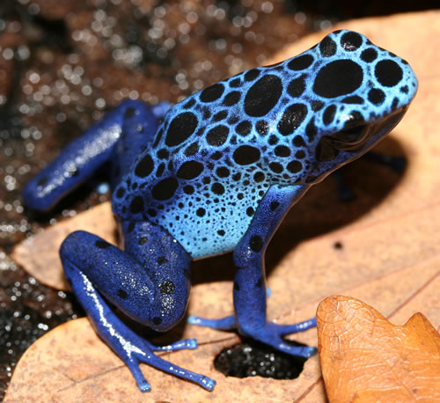
Poison dart frog

Slide 17
Write the adaptation under the correct heading:
Adaptations to the cold climate
Adaptations to the warm climate
They often are only active at night
May change colour in the summer - camouflage
Small – large SA:vol ratio
Thick oily fur coats
Large thin ears
Layers of blubber under the skin
Little body fat
Long limbs to help spread the heat
Small ears
large rounded body shape – SA:vol ratio

Slide 18
Adaptations to the cold climate:
Thick oily fur coats
Layers of blubber under the skin
May change colour in the summer - camouflage
Small ears
Large furry feet
Often longer snout
large rounded body shape – SA:vol ratio

Slide 19
Adaptations to the warm climate:
Large thin ears
Little body fat
Thin silky fur
Long limbs to help spread the heat
They often are only active at night
More elongated body shape
Kidneys can produce concentrated urine – do not need drink
Shade during day
Small – large SA:vol ratio

Slide 20
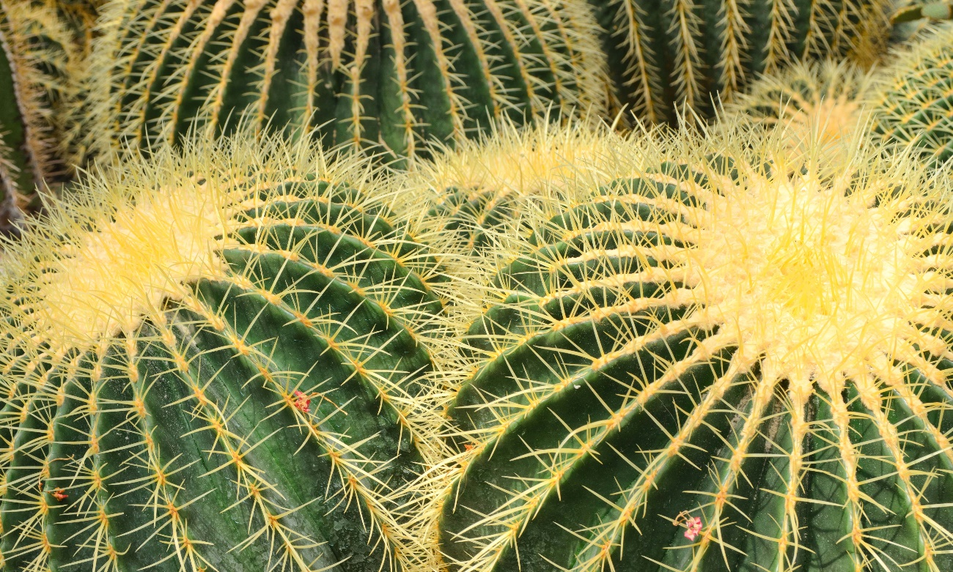
How are plants adapted?
How are these plants adapted?
Keywords: Ecosystem, independence, competition, community, habitat

Slide 21
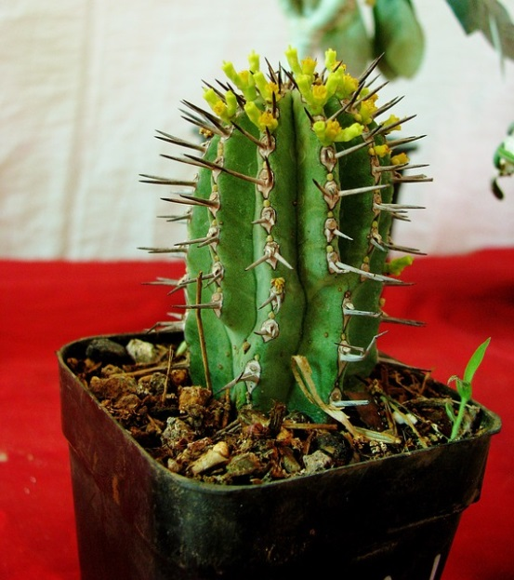
How are plants adapted?
How are these plants adapted?
This plant has a waxy coating on its leaves.
Keywords: Ecosystem, independence, competition, community, habitat

Slide 22
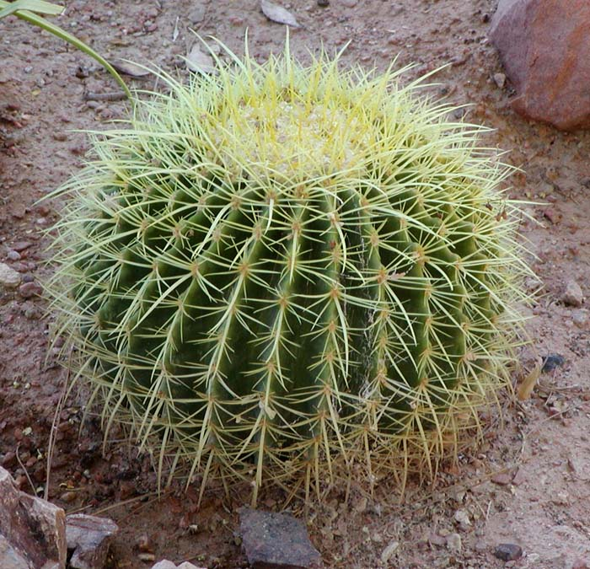
How are plants adapted?
How are these plants adapted?
This plant has spines rather than leaves and it stores water in its stem.
Spines (plus unpleasant taste and smell) offer protection against predators searching for water.
Keywords: Ecosystem, independence, competition, community, habitat

Slide 23
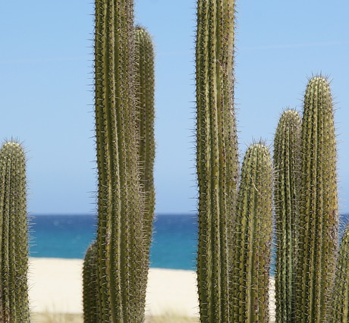
How are plants adapted?
How are these plants adapted?
Look at the colour of the spines – which colour reflects the heat the most?
White!
Keywords: Ecosystem, independence, competition, community, habitat

Slide 24
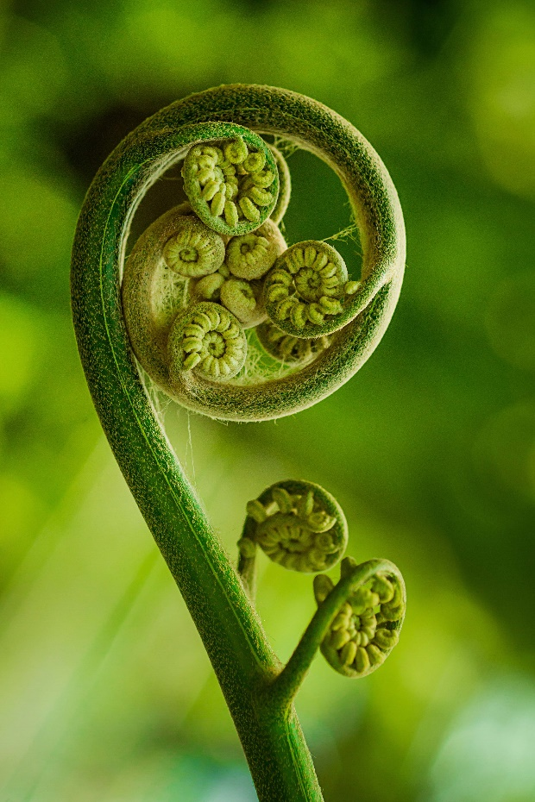
How are plants adapted?
Leaves curl up.
Keywords: Ecosystem, independence, competition, community, habitat

Slide 25
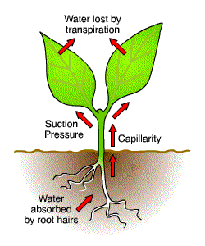
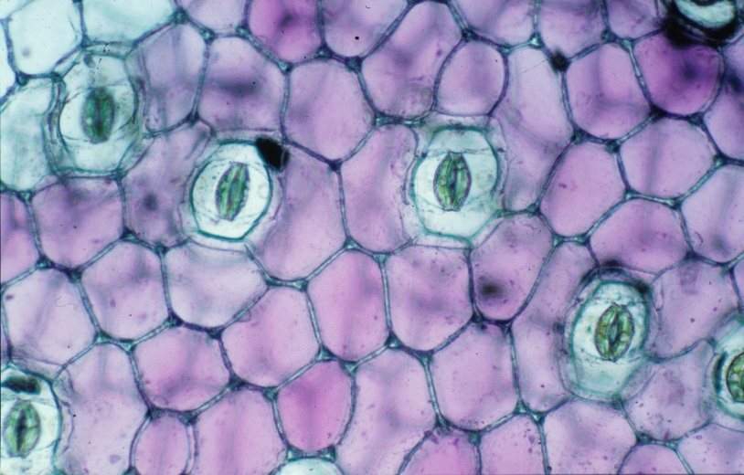
Adaptation in plants
Water travels up through a plant from the soil through its roots, then its stem and into the leaves.
It is lost thought tiny openings in the leaves called stomata.
This is called transpiration.

Slide 26
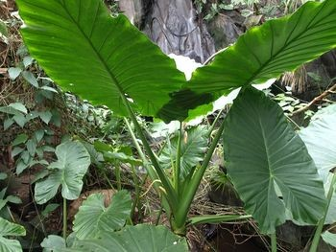
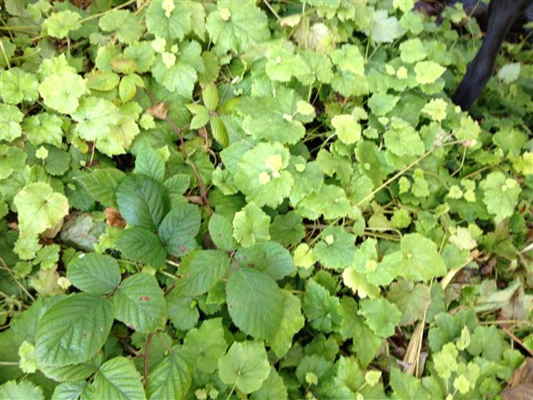
Adaptation in plants
Two plants are the same size.
Under the same conditions which one will lose water the fastest?
The plant with large leaves
The plant with small leaves

Slide 27
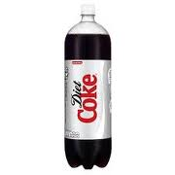
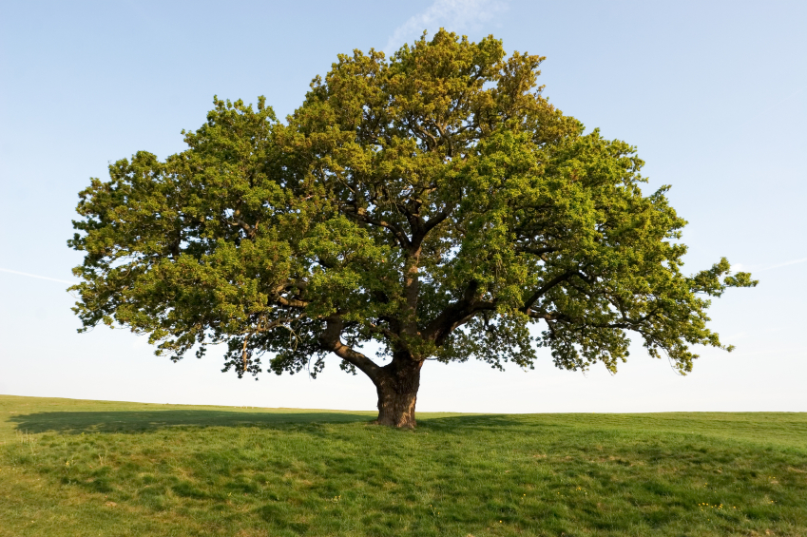
Adaptation in plants
A large bottle of soft drink is 2 litres.
How many bottles of soft drink do you think an oak tree transpires in a year?
Source: http://ga.water.usgs.gov/edu/watercycletranspiration.html

Slide 28
Adaptation in plants
A large bottle of soft drink is 2 litres.
How many bottles of soft drink do you think an oak tree transpires in a year?
It transpires 151,000 litres (75,500 bottles of soft drink)
Source: http://ga.water.usgs.gov/edu/watercycletranspiration.html

Slide 29
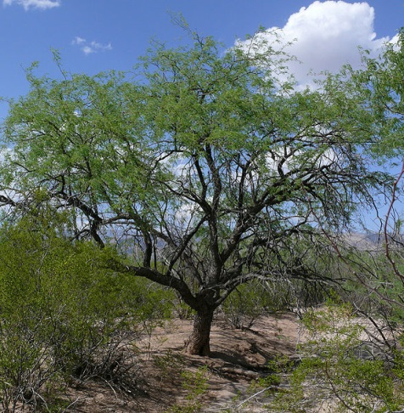
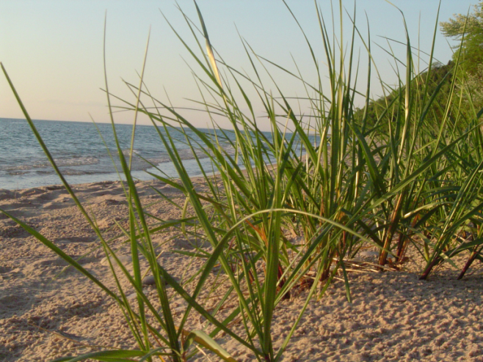
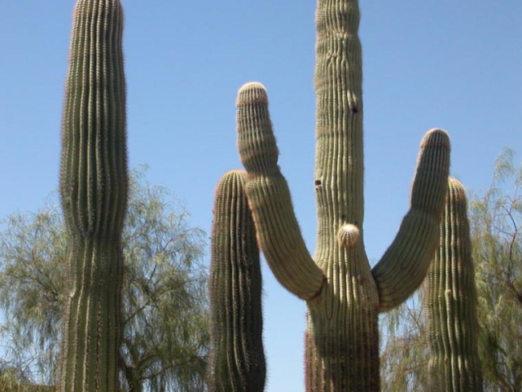
Adaptation in plants
Saguaro cactus
Mesquite tree
Marram
grass
There are 6 stations of information around the room. You need to send one person to each station to find out one adaptation at a time about each of these plants. You have 10 mins to find out 3 adaptations of each plant.

Slide 30
Name of plant | Marram grass | Mesquite tree | Saguaro cactus
Where is this plant found?
What adaptations does this plant have that help it survive in its environment? | 1) Adaptation Rolled leaves How it helps it survive? Prevents airflow over the leaf. Reduces surface area. 2) Adaptation 2 Waxy leaf to prevent water loss. How it helps it survive? 3) Adaptation 3 Stiff hairs on inside leaf How it helps it survive? Traps humid air against the leaf. | Adaptation Long roots How it helps it survive? Allows roots to get to groundwater 2) Adaptation 2 Sheds leaves when water is scarce How it helps it survive? Conserve water 3) Adaptation 3 Waxy leaves How it helps it survive? Minimise transpiration | 1) Adaptation Spines How it helps it survive? Reduce surface area. Protection form animals 2) Adaptation 2 Water storage in the ribs How it helps it survive? 3) Adaptation 3 Large root system How it helps it survive? Deeper roots help it find water

Slide 31
http://www.youtube.com/watch?v=ZV8cO70fz7o&feature=related

Slide 32
Question 1-
A feature that enables an animal to survive in its environment is called a ………….?
a) Evolution
Adaptation
Skill

Slide 33
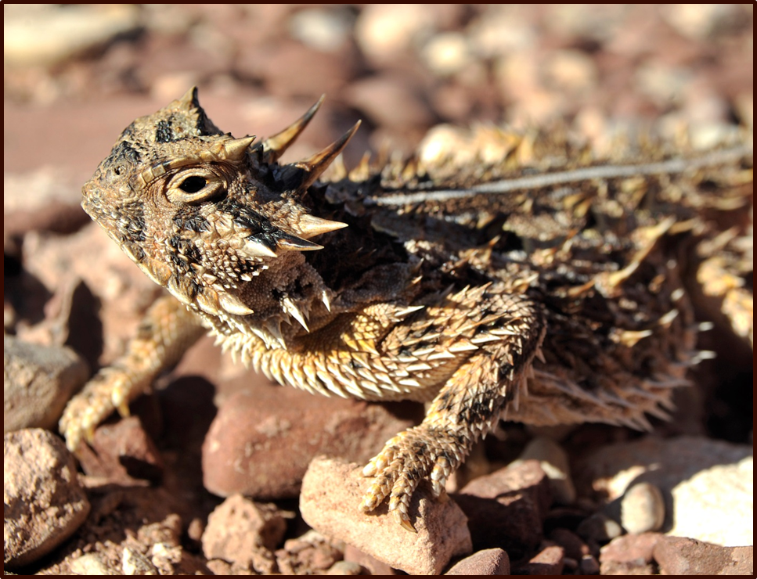
Question 2 –
What adaptation allows this animal to avoid being eaten by predators?

Slide 34
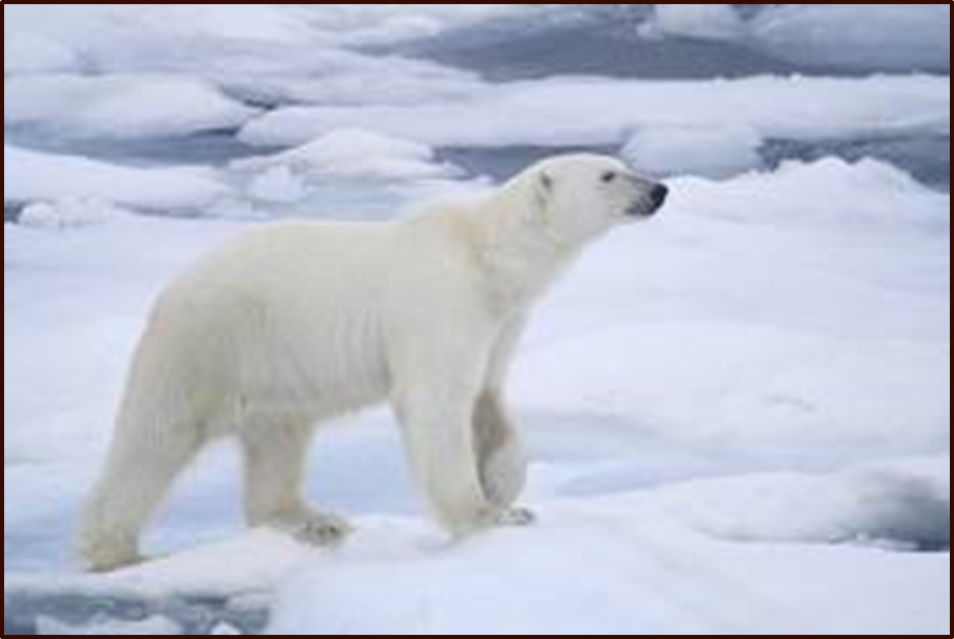
Question 3-
What adaptation does this animal have that allows it to catch prey?

Slide 35
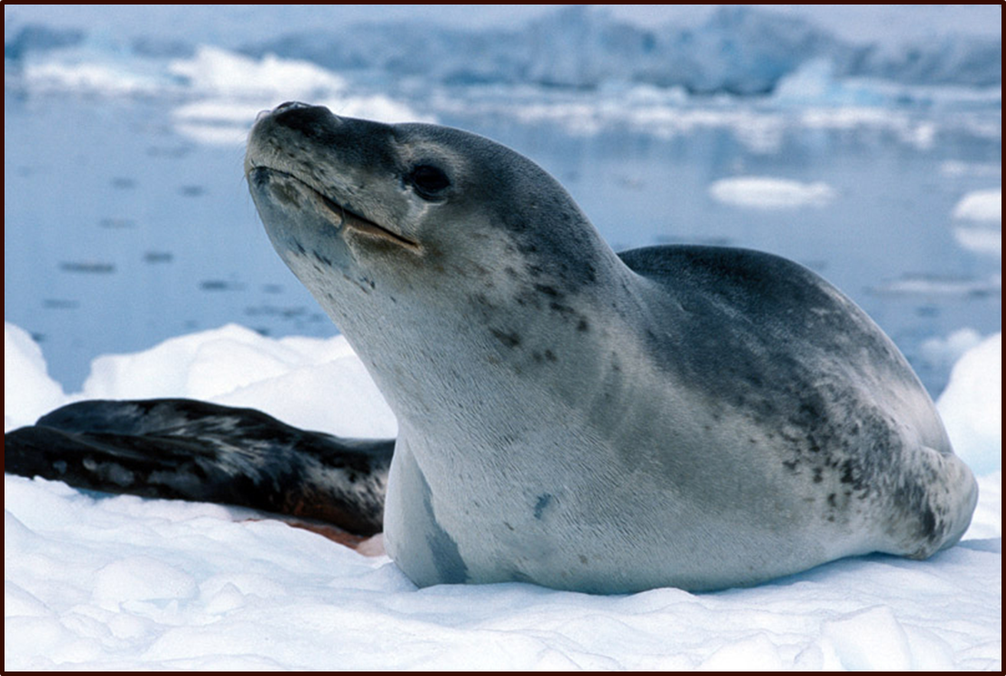
Question 4-
Name two adaptations this animal has that allows it to keep warm?

Slide 36
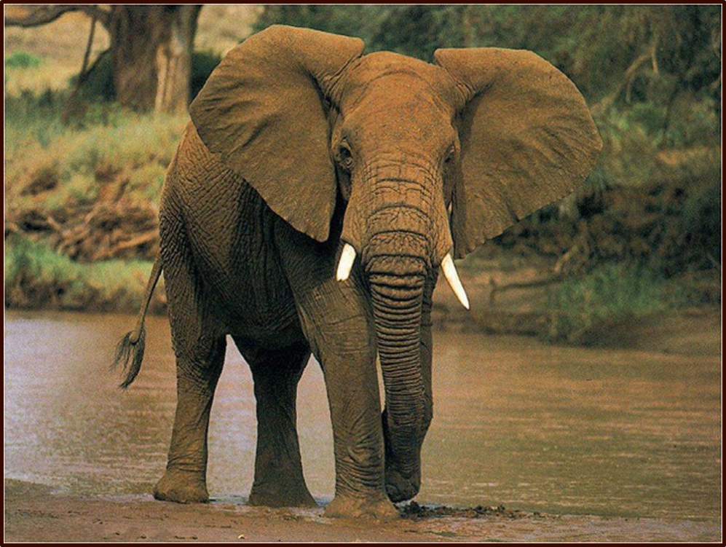
Question 5 -
Why is this animal well adapted for cooling down by losing heat through it’s ears?

Slide 37
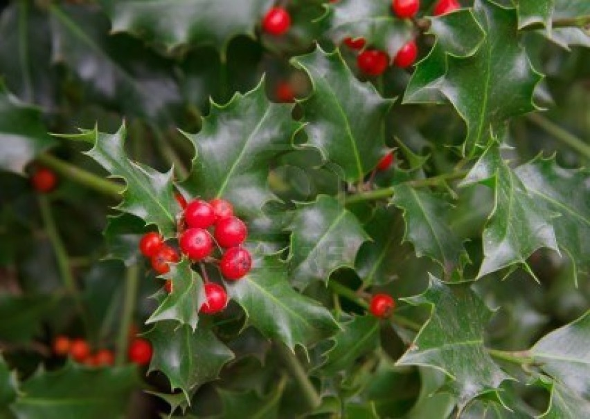
Question 1
Give an adaptation that helps this plant survive.

Slide 38
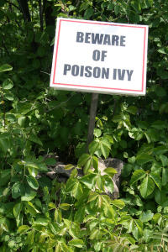
Question 2
Give an adaptation that helps this plant survive.

Slide 39
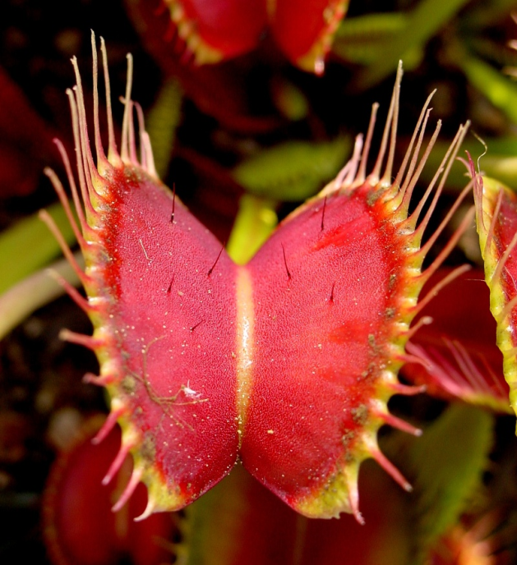
Question 3
Give an adaptation that helps this plant survive.

Slide 40
Tasks
1. Explain how a camel is adapted to live in the desert.
2. Explain how a polar bear is adapted to live in the artic.
3. Compare & contrast the adaptations of plants that are found in the desert and the rainforests.
Keywords: Ecosystem, independence, competition, community, habitat

