Slide 1
The PiXL Club The PiXL Club The PiXL Club The PiXL Club The PiXL Club The PiXL Club The PiXL Club The PiXL Club The PiXL Club The PiXL Club The PiXL Club The PiXL Club The PiXL Club The PiXL Club The PiXL Club The PiXL Club The PiXL Club The PiXL Club The PiXL Club The PiXL Club The PiXL Club The PiXL Club The PiXL Club The PiXL Club The PiXL Club The PiXL Club The PiXL Club The PiXL Club The PiXL Club The PiXL Club The PiXL Club The PiXL Club The PiXL Club The PiXL Club The PiXL Club The PiXL Club The PiXL Club The PiXL Club The PiXL Club The PiXL Club The PiXL Club The PiXL Club The PiXL Club The PiXL Club The PiXL Club The PiXL Club The PiXL Club The PiXL Club The PiXL Club The PiXL Club The PiXL Club The PiXL Club The PiXL Club The PiXL Club The PiXL Club The PiXL Club The PiXL Club The PiXL Club The PiXL Club The PiXL Club The PiXL Club The PiXL Club The PiXL Club The PiXL Club The PiXL Club The PiXL Club The PiXL Club The PiXL Club The PiXL Club The PiXL Club The PiXL Club The PiXL Club The PiXL Club The PiXL Club The PiXL Club The PiXL Club The PiXL Club The PiXL Club The PiXL Club The PiXL Club The PiXL Club The PiXL Club The PiXL Club The PiXL Club The PiXL Club The PiXL Club The PiXL Club The PiXL Club The PiXL Club The PiXL Club The PiXL Club The PiXL Club The PiXL Club The PiXL Club The PiXL Club The PiXL Club The PiXL Club The PiXL Club The PiXL Club The PiXL Club The PiXL Club The PiXL Club The PiXL Club The PiXL Club The PiXL Club The PiXL Club The PiXL Club The PiXL Club The PiXL Club The PiXL Club The PiXL Club The PiXL Club The PiXL Club The PiXL Club The PiXL Club The PiXL Club The PiXL Club The PiXL Club The PiXL Club The PiXL Club The PiXL Club The PiXL Club The PiXL Club The PiXL Club The PiXL Club The PiXL Club The PiXL Club The PiXL Club The PiXL Club The PiXL Club The PiXL Club The PiXL Club The PiXL Club The PiXL Club The PiXL Club The PiXL Club The PiXL Club The PiXL Club The PiXL Club The PiXL Club The PiXL Club The PiXL Club The PiXL Club The PiXL Club The PiXL Club The PiXL Club The PiXL Club The PiXL Club The PiXL Club The PiXL Club The PiXL Club The PiXL Club The PiXL Club The PiXL Club The PiXL Club The PiXL Club The PiXL Club The PiXL Club The PiXL Club The PiXL Club The PiXL Club The PiXL Club The PiXL Club The PiXL Club The PiXL Club The PiXL Club The PiXL Club The PiXL Club The PiXL Club The PiXL Club The PiXL Club The PiXL Club The PiXL Club The PiXL Club The PiXL Club The PiXL Club The PiXL Club The PiXL Club The PiXL Club The PiXL Club The PiXL Club The PiXL Club The PiXL Club The PiXL Club The PiXL Club The PiXL Club The PiXL Club The PiXL Club The PiXL Club The PiXL Club The PiXL Club The PiXL Club The PiXL Club The PiXL Club The PiXL Club The PiXL Club The PiXL Club The PiXL Club The PiXL Club The PiXL Club The PiXL Club The PiXL Club The PiXL Club The PiXL Club The PiXL Club The PiXL Club The PiXL Club The PiXL Club The PiXL Club The PiXL Club The PiXL Club The PiXL Club The PiXL Club The PiXL Club The PiXL Club The PiXL Club The PiXL Club The PiXL Club The PiXL Club The PiXL Club The PiXL Club The PiXL Club The PiXL Club The PiXL Club The PiXL Club The PiXL Club The PiXL Club The PiXL Club The PiXL Club The PiXL Club The PiXL Club The PiXL Club The PiXL Club The PiXL Club The PiXL Club The PiXL Club The PiXL Club The PiXL Club The PiXL Club The PiXL Club The PiXL Club The PiXL Club The PiXL Club The PiXL Club The PiXL Club The PiXL Club The PiXL Club The PiXL Club The PiXL Club The PiXL Club The PiXL Club The PiXL Club The PiXL Club The PiXL Club The PiXL Club The PiXL Club The PiXL Club The PiXL Club The PiXL Club The PiXL Club The PiXL Club The PiXL Club The PiXL Club The PiXL Club The PiXL Club The PiXL Club The PiXL Club The PiXL Club The PiXL Club The PiXL Club The PiXL Club The PiXL Club The PiXL Club The PiXL Club The PiXL Club The PiXL Club The PiXL Club The PiXL Club The PiXL Club The PiXL Club The PiXL Club The PiXL Club The PiXL Club The PiXL Club The PiXL Club The PiXL Club The PiXL Club The PiXL Club The PiXL Club The PiXL Club The PiXL Club The PiXL Club The PiXL Club The PiXL Club The PiXL Club The PiXL Club The PiXL Club The PiXL Club The PiXL Club The PiXL Club The PiXL Club The PiXL Club The PiXL Club The PiXL Club The PiXL Club The PiXL Club The PiXL Club The PiXL Club The PiXL Club The PiXL Club The PiXL Club The PiXL Club The PiXL Club The PiXL Club The PiXL Club The PiXL Club The PiXL Club The PiXL Club The PiXL Club The PiXL Club The PiXL Club The PiXL Club The PiXL Club The PiXL Club The PiXL Club The PiXL Club The PiXL Club The PiXL Club The PiXL Club The PiXL Club The PiXL Club The PiXL Club The PiXL Club The PiXL Club The PiXL Club The PiXL Club The PiXL Club The PiXL Club The PiXL Club The PiXL Club The PiXL Club The PiXL Club The PiXL Club The PiXL Club The PiXL Club The PiXL Club The PiXL Club The PiXL Club The PiXL Club The PiXL Club The PiXL Club The PiXL Club The PiXL Club The PiXL Club The PiXL Club The PiXL Club The PiXL Club The PiXL Club The PiXL Club The PiXL Club The PiXL Club The PiXL Club The PiXL Club The PiXL Club The PiXL Club The PiXL Club The PiXL Club The PiXL Club The PiXL Club The PiXL Club The PiXL Club The PiXL Club The PiXL Club The PiXL Club The PiXL Club The PiXL Club The PiXL Club The PiXL Club The PiXL Club The PiXL Club The PiXL Club The PiXL Club The PiXL Club The PiXL Club The PiXL Club The PiXL Club The PiXL Club The PiXL Club The PiXL Club The PiXL Club The PiXL Club The PiXL Club The PiXL Club The PiXL Club The PiXL Club The PiXL Club The PiXL Club The PiXL Club The PiXL Club The PiXL Club The PiXL Club The PiXL Club The PiXL Club The PiXL Club The PiXL Club The PiXL Club The PiXL Club The PiXL Club The PiXL Club The PiXL Club The PiXL Club The PiXL Club The PiXL Club The PiXL Club The PiXL Club The PiXL Club The PiXL Club The PiXL Club The PiXL Club The PiXL Club The PiXL Club The PiXL Club The PiXL Club The PiXL Club The PiXL Club The PiXL Club The PiXL Club The PiXL Club The PiXL Club The PiXL Club The PiXL Club The PiXL Club The PiXL Club The PiXL Club The PiXL Club The PiXL Club The PiXL Club The PiXL Club The PiXL Club The PiXL Club The PiXL Club The PiXL Club The PiXL Club The PiXL Club The PiXL Club The PiXL Club The PiXL Club The PiXL Club The PiXL Club The PiXL Club The PiXL Club The PiXL Club The PiXL Club The PiXL Club The PiXL Club The PiXL Club The PiXL Club The PiXL Club The PiXL Club The PiXL Club The PiXL Club The PiXL Club The PiXL Club The PiXL Club The PiXL Club The PiXL Club The PiXL Club The PiXL Club The PiXL Club The PiXL Club The PiXL Club The PiXL Club The PiXL Club The PiXL Club The PiXL Club The PiXL Club The PiXL Club The PiXL Club The PiXL Club The PiXL Club The PiXL Club The PiXL Club The PiXL Club The PiXL Club The PiXL Club The PiXL Club The PiXL Club The PiXL Club The PiXL Club The PiXL Club The PiXL Club The PiXL Club The PiXL Club The PiXL Club The PiXL Club The PiXL Club The PiXL Club The PiXL Club The PiXL Club The PiXL Club The PiXL Club The PiXL Club The PiXL Club The PiXL Club The PiXL Club The PiXL Club The PiXL Club The PiXL Club The PiXL Club The PiXL Club The PiXL Club The PiXL Club The PiXL Club The PiXL Club The PiXL Club The PiXL Club The PiXL Club The PiXL Club The PiXL Club The PiXL Club The PiXL Club The PiXL Club The PiXL Club The PiXL Club The PiXL Club The PiXL Club The PiXL Club The PiXL Club The PiXL Club The PiXL Club The PiXL Club The PiXL Club The PiXL Club The PiXL Club The PiXL Club The PiXL Club The PiXL Club The PiXL Club The PiXL Club The PiXL Club The PiXL Club The PiXL Club The PiXL Club The PiXL Club The PiXL Club The PiXL Club The PiXL Club The PiXL Club The PiXL Club The PiXL Club The PiXL Club The PiXL Club The PiXL Club The PiXL Club The PiXL Club The PiXL Club The PiXL Club The PiXL Club The PiXL Club The PiXL Club The PiXL Club The PiXL Club The PiXL Club The PiXL Club The PiXL Club The PiXL Club The PiXL Club The PiXL Club The PiXL Club The PiXL Club The PiXL Club The PiXL Club The PiXL Club The PiXL Club The PiXL Club The PiXL Club The PiXL Club The PiXL Club The PiXL Club The PiXL Club The PiXL Club The PiXL Club The PiXL Club The PiXL Club The PiXL Club The PiXL Club The PiXL Club The PiXL Club The PiXL Club The PiXL Club The PiXL Club The PiXL Club The PiXL Club The PiXL Club The PiXL Club The PiXL Club The PiXL Club The PiXL Club The PiXL Club The PiXL Club The PiXL Club The PiXL Club The PiXL Club The PiXL Club The PiXL Club The PiXL Club The PiXL Club The PiXL Club The PiXL Club The PiXL Club The PiXL Club The PiXL Club The PiXL Club The PiXL Club The PiXL Club The PiXL Club The PiXL Club The PiXL Club The PiXL Club The PiXL Club The PiXL Club The PiXL Club The PiXL Club The PiXL Club The PiXL Club The PiXL Club The PiXL Club The PiXL Club The PiXL Club The PiXL Club The PiXL Club The PiXL Club The PiXL Club The PiXL Club The PiXL Club The PiXL Club The PiXL Club The PiXL Club The PiXL Club The PiXL Club The PiXL Club The PiXL Club The PiXL Club The PiXL Club The PiXL Club The PiXL Club The PiXL Club The PiXL Club The PiXL Club The PiXL Club The PiXL Club The PiXL Club The PiXL Club The PiXL Club The PiXL Club The PiXL Club The PiXL Club The PiXL Club The PiXL Club The PiXL Club The PiXL Club The PiXL Club The PiXL Club The PiXL Club The PiXL Club The PiXL Club The PiXL Club The PiXL Club The PiXL Club The PiXL Club The PiXL Club The PiXL Club The PiXL Club The PiXL Club The PiXL Club The PiXL Club The PiXL Club The PiXL Club The PiXL Club The PiXL Club The PiXL Club The PiXL Club The PiXL Club The PiXL Club The PiXL Club The PiXL Club The PiXL Club The PiXL Club The PiXL Club The PiXL Club The PiXL Club The PiXL Club The PiXL Club The PiXL Club The PiXL Club The PiXL Club The PiXL Club The PiXL Club The PiXL Club The PiXL Club The PiXL Club The PiXL Club The PiXL Club The PiXL Club The PiXL Club The PiXL Club The PiXL Club The PiXL Club The PiXL Club The PiXL Club The PiXL Club The PiXL Club The PiXL Club The PiXL Club The PiXL Club The PiXL Club The PiXL Club The PiXL Club The PiXL Club The PiXL Club The PiXL Club The PiXL Club The PiXL Club The PiXL Club The PiXL Club The PiXL Club The PiXL Club The PiXL Club The PiXL Club The PiXL Club The PiXL Club The PiXL Club The PiXL Club The PiXL Club The PiXL Club The PiXL Club The PiXL Club The PiXL Club The PiXL Club The PiXL Club The PiXL Club The PiXL Club The PiXL Club The PiXL Club The PiXL Club The PiXL Club
Required Practical Guide
Physics
Density
This document contains:
Links to YouTube clips showing the practical procedure
Information from examination boards AQA, OCR, Edexcel
Potential examination questions and answers
This resource is strictly for the use of member schools for as long as they remain members of The PiXL Club. It may not be copied, sold nor transferred to a third party or used by the school after membership ceases. Until such time it may be freely used within the member school.
All opinions and contributions are those of the authors. The contents of this resource are not connected with nor endorsed by any other company, organisation or institution.
Commissioned by The PiXL Club Ltd. November 2016
www.pixl.org.uk The PiXL Club Ltd, Company number 07321607
© Copyright The PiXL Club Ltd, 2016

Slide 2
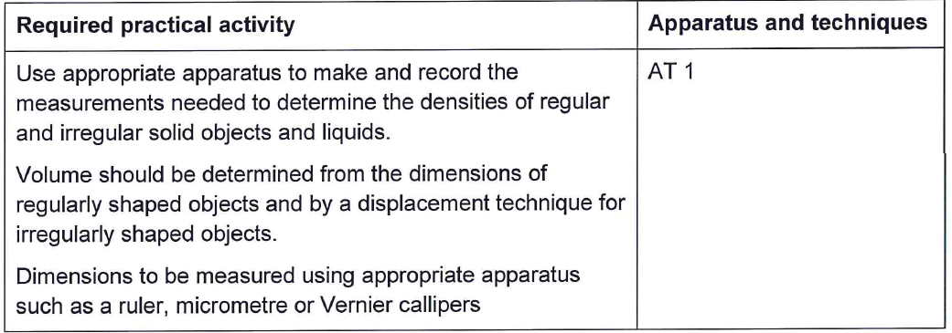
Required practical – exam boards
AQA

Slide 3
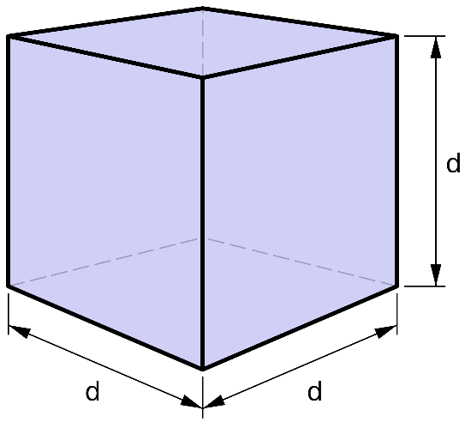
Practical procedure: Densities
Video 1
Video 2
Video 3
Notes:
Click on each of the tabs to take you to a YouTube clip. Please note these are external sites to PiXL, PiXL does not control the content of these sites.

Slide 4
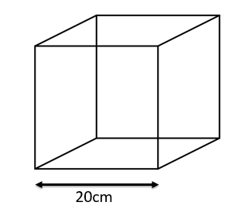
Possible examination style questions
Explain how to find the density of an irregularly shaped object such as a stone.
What are the units for density?
Calculate the density of the following cube. Mass = 75g.

Slide 5
Possible examination style questions answers
Explain how to find the density of an irregularly shaped object such as a stone.
ANSWER:
Place water in container
Measure volume
Place object in water
Measure volume
Calculate volume of water displaced
Volume of displaced water = volume of object
Description of Eureka can use

Slide 6
Possible examination style questions answers
What are the units for density?
ANSWER:
Kg/m³

Slide 7
Possible examination style questions answers
Calculate the density of the following cube.
Mass = 75g
ANSWER:
20cm = 0.2m
Volume = 0.2 x 0.2 x 0.2 = 0.008 m³
75g = 0.075Kg
Density = Mass/volume
0.075/ 0.008 = 9.375 Kg/m³

Slide 8
Key questions:
Think of examples of heavy objects that float on water.
Think of some light objects that sink in water.
Is the mass of an object the only factor that determines whether or not it will float on water?
Explain how a density column works.
Explain why the liquids move in a lava lamp.
http://qualifications.pearson.com/content/dam/pdf/GCSE/Science/2016/teaching-and-learning-materials/GCSE-9-1-Sciences-core-practical-guide.pdf

Slide 9
Summary document
A summary document is also available on Huddle which contains all the relevant information about this practical from the different examination boards. It includes practical methods and other potential examination questions

