Slide 1
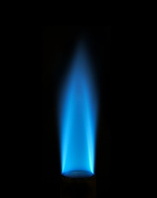
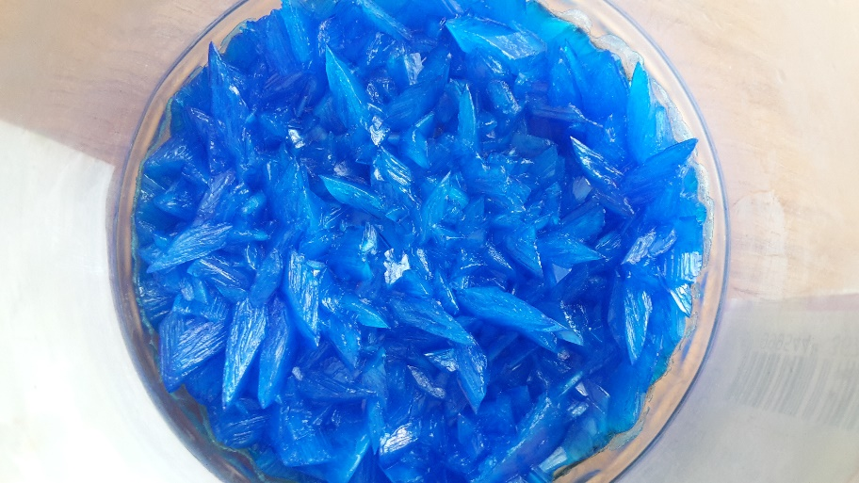
4.4.2.2 4.4.2.3
Wednesday, 06 January 2021
Reactions of Acids with Insoluble Bases
Starter: Discuss what is shown in the storyboard
1
2
3
1M H₂SO₄
4
5
6
7

Slide 2
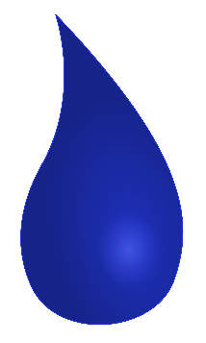
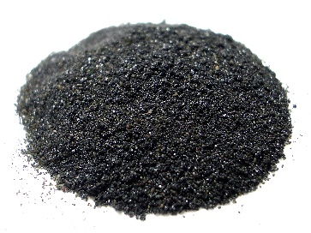
Neutralisation & Bases
Q: What is neutralisation?
Neutralisation is a type of reaction that occurs when an acid reacts with a base.
The resulting solution has a pH of 7, so the acid has been neutralised.
Q: What is a base?
Bases are a group of compounds that are able to neutralise acids.
There are two key types of base:
Bases soluble in water
Bases insoluble in water
Alkalis
Insoluble bases
We use as solutions
Typically used as solid powders

Slide 3
Examples of Bases
Base
Bases soluble in water
Bases insoluble in water
Alkalis
Insoluble bases
We use as solutions
Typically used as solid powders
Sodium hydroxide – NaOH
Lithium hydroxide – LiOH
Potassium hydroxide – KOH
Calcium hydroxide – Ca(OH)₂
Magnesium hydroxide – Mg(OH)₂
It’s the hydroxide anion OH⁻ that makes them alkalis!
Calcium oxide – CaO
Magnesium oxide – MgO
Copper (II) oxide – CuO
Sodium oxide – Na₂O
Calcium carbonate – CaCO₃
Magnesium carbonate – MgCO₃
Sodium carbonate – Na₂CO₃
Metal oxides and metal carbonates are typically insoluble bases.

Slide 4
Examples of Bases
Base
Bases soluble in water
Bases insoluble in water
Alkalis
Insoluble bases
We use as solutions
Typically used as solid powders
Sodium hydroxide – NaOH
Lithium hydroxide – LiOH
Potassium hydroxide – KOH
Calcium hydroxide – Ca(OH)₂
Magnesium hydroxide – Mg(OH)₂
It’s the hydroxide anion OH⁻ that makes them alkalis!
Calcium oxide – CaO
Magnesium oxide – MgO
Copper (II) oxide – CuO
Sodium oxide – Na₂O
Calcium carbonate – CaCO₃
Magnesium carbonate – MgCO₃
Sodium carbonate – Na₂CO₃
Metal oxides and metal carbonates are typically insoluble bases.

Slide 5
Task: Classify the following compounds as alkalis or insoluble bases
Potassium hydroxide
Calcium oxide
Copper (II) oxide
Sodium hydroxide
LiOH
Ca(OH)₂
Calcium carbonate
Mg(OH)₂
Metal hydroxide ∴ alkali

Slide 6
Task: Classify the following compounds as alkalis or insoluble bases
Potassium hydroxide
Calcium oxide
Copper (II) oxide
Sodium hydroxide
LiOH
Ca(OH)₂
Calcium carbonate
Mg(OH)₂
Metal hydroxide ∴ alkali
Metal oxide ∴ insoluble base
Metal oxide ∴ insoluble base
Metal hydroxide ∴ alkali
Metal hydroxide ∴ alkali
Metal hydroxide ∴ alkali
Metal carbonate ∴ insoluble base
Metal hydroxide ∴ alkali

Slide 7
Reactions of insoluble bases (oxides) with acids
The reactions of insoluble bases with acids depend on whether it’s an oxide or a carbonate:
Insoluble base + acid → soluble salt + water (Metal oxide)
Example 1:
Calcium oxide + hydrochloric acid → calcium chloride + water
CaO_{(s)} + 2 HCl_{(aq)} → CaCl₂ _{(aq)} + H₂O_{(l)}
Despite being insoluble in water. The insoluble base will dissolve in acid, for as long as there is acid to react with and neutralise.
Q: What would we see when all of the acid has reacted, but there is an excess of insoluble base?
When all the acid has been neutralised, there is no acid left to react with, so the insoluble base would stop dissolving.

Slide 8
Reactions of insoluble bases (oxides) with acids
Example 1:
Calcium oxide + hydrochloric acid → calcium chloride + water
CaO_{(s)} + 2 HCl_{(aq)} → CaCl₂ _{(aq)} + H₂O_{(l)}
Q: How would the products be different if we:
a) used sulfuric acid?
b) used nitric acid?
Example 2 :
Calcium oxide + sulfuric acid → calcium sulfate + water
CaO_{(s)} + H₂SO₄ _{(aq)} → CaSO₄ _{(aq)} + H₂O_{(l)}
Example 2 :
Calcium oxide + nitric acid → calcium nitrate + water
CaO_{(s)} + 2 HNO₃ _{(aq)}→ Ca(NO₃)₂ _{(aq)} + H₂O_{(l)}

Slide 9
Reactions of insoluble bases (carbonates) with acids
The reactions of insoluble bases with acids depend on whether it’s an oxide or a carbonate:
Insoluble base + acid → soluble salt + water + carbon dioxide (Metal carbonate)
Example 1:
Calcium carbonate + hydrochloric acid → calcium chloride + water + carbon dioxide
CaCO₃ _{(s)} + 2 HCl_{(aq)} → CaCl₂ _{(aq)} + H₂O_{(l)} + CO_{2 (g)}
Q: What would we see during this reaction?
The insoluble base would dissolve until all of the acid is neutralised.
Effervesence of CO₂ gas.

Slide 10
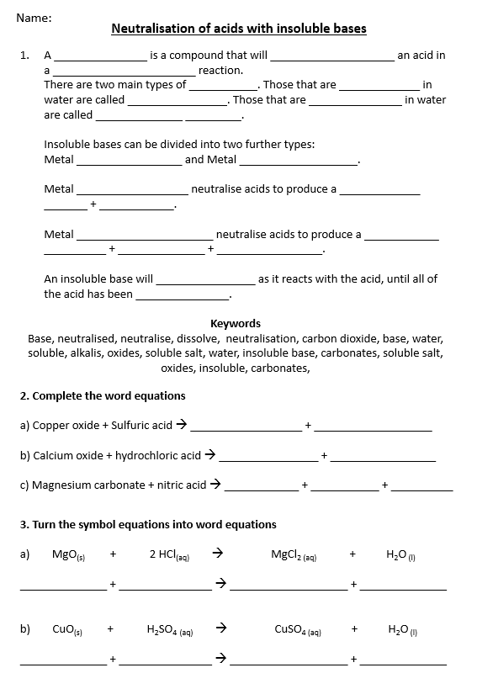
Task: Complete the reaction equations for these neutralisations.

Slide 11
Self assessment & Corrections
base
neutralise
A _______________ is a compound that will ____________________ an acid in a _______________________ reaction. There are two main types of ___________. Those that are _____________ in water are called ________________. Those that are _______________ in water are called ______________ _________. Insoluble bases can be divided into two further types: Metal _________________ and Metal ___________________. Metal __________________ neutralise acids to produce a _____________ _______ + ____________. Metal ______________________ neutralise acids to produce a ____________ __________ + ______________ + _________________. An insoluble base will ________________ as it reacts with the acid, until all of the acid has been _______________.
neutralisation
base
soluble
alkalis
insoluble
insoluble
bases
oxides
carbonates
oxides
soluble
salt
water
carbonates
soluble
salt
water
carbon dioxide
dissolve
neutralised

Slide 12
Self assessment & Corrections
2. Complete the word equations
a) Copper oxide + sulfuric acid → __________________ + ___________________
b) Calcium oxide + hydrochloric acid → ________________ + _________________
c) Magnesium carbonate + nitric acid → ____________ + ___________ + __________
copper sulfate
water
calcium chloride
water
magnesium nitrate
water
carbon dioxide

Slide 13
Self assessment & Corrections
3. Turn the symbol equations into word equations
a) MgO_{(s)} + 2 HCl_{(aq)} → MgCl_{2 (aq)} + H₂O _{(l)}
______________ + _______________ → ___________________ + ______________
b) CuO_{(s)} + H₂SO₄ _{(aq)} → CuSO_{4 (aq)} + H₂O _{(l)}
______________ + _______________ → ___________________ + ______________
magnesium oxide
hydrochloric acid
magnesium chloride
water
copper oxide
sulfuric acid
copper sulfate
water

Slide 14
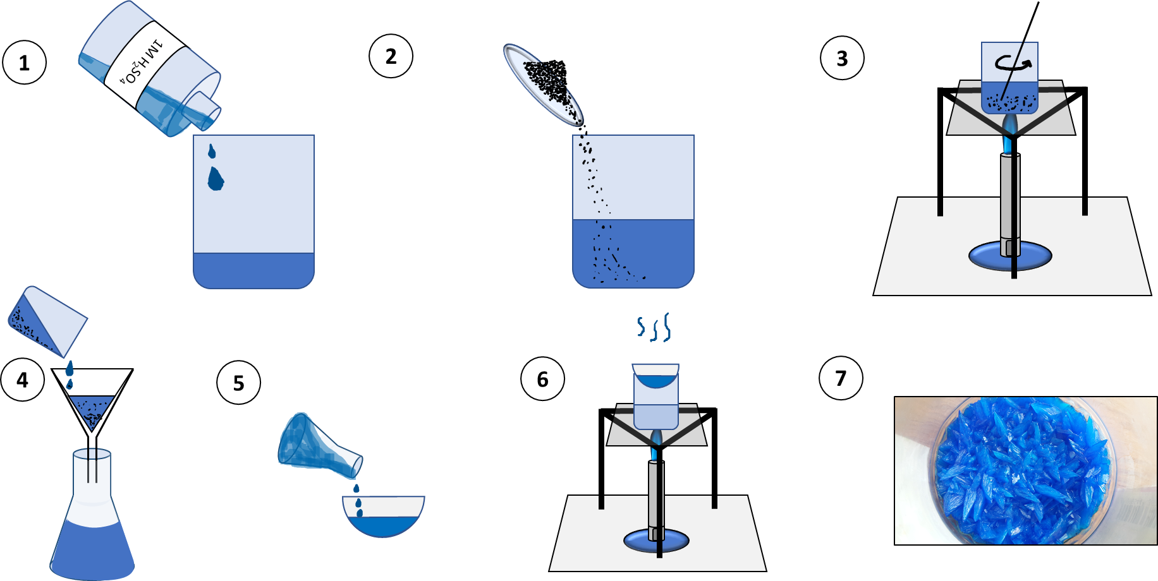
Practical: Did you work out the instructions?
We will now carry out the practical teased in the starter.
The insoluble base is copper oxide, and we will use it to neutralise sulfuric acid.
We will then use a process called crystallisation to get the soluble salt into a solid form.

Slide 15
Practical: Did you work out the instructions?
1
1M H₂SO₄
Transfer approximately 50 cm³ of sulfuric acid to a 250 cm³ beaker.
2
2. Add 3-4 spatulas of the insoluble base copper oxide.

Slide 16
Practical: Did you work out the instructions?
3
3. Heat above a blue Bunsen flame, keep stirring and adding more insoluble base, until no more will dissolve. Think about why it reaches a point where no more will dissolve!

Slide 17
Practical: Did you work out the instructions?
4
4. Allow the solution to cool, then use filtration to remove any unreacted insoluble base.
5
5. Transfer a small quantity of the filtrate to an evaporating basin.

Slide 18
Practical: Did you work out the instructions?
6
6. Use crystallisation to evaporate the water from the soluble salt.
7
7. This should leave behind solid crystals of the soluble salt for you to examine.

Slide 19
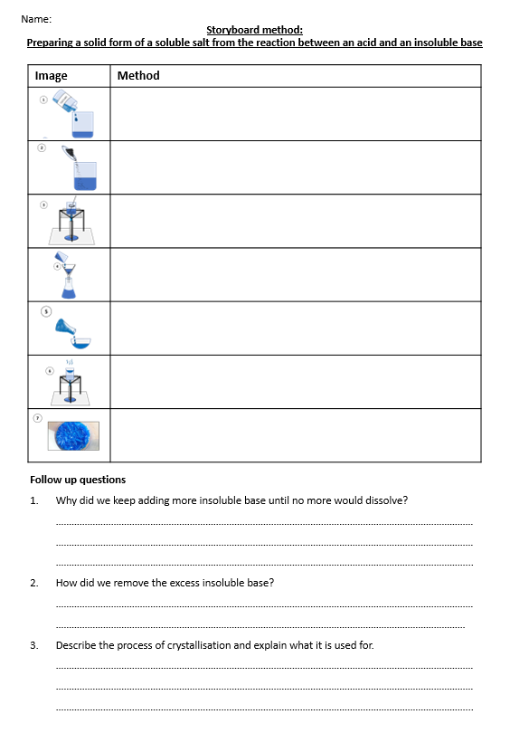
Practical: Did you work out the instructions?
Tasks:
Ensure you have completed a write up of the method on the supplied storyboard sheet.
Answer the follow up questions.
Follow up questions
Why did we keep adding more insoluble base until no more would dissolve?
How did we remove the excess insoluble base?
Describe the process of crystallisation and explain what it is used for.

Slide 20
Self assessment & Corrections
Follow up questions
Why did we keep adding more insoluble base until no more would dissolve? ……………………………………………………………………………………………………………………………………………………………………………………………………………………………………………………………………………………………………………………………………………………………………………………………………………………………………
How did we remove the excess insoluble base? ………………………………………………………………………………………………………………………………………………………………………………………………………………………………………………………………………………………
Describe the process of crystallisation and explain what it is used for. ……………………………………………………………………………………………………………………………………………………………………………………………………………………………………………………………………………………………………………………………………………………………………………………………………………………………………
to ensure that all of the acid would be neutralised.
so the maximum yield of soluble salt was produced.
by filtration
solids were caught in the filter paper, leaving a pure liquid filtrate of the soluble salt.
Crystallisation is a method used to obtain solid crystals of a soluble salt.
To do this, a solution of the soluble salt is heated until all of the water evaporates.
This leaves behind solid crystals.

