Slide 1
Metal oxides
4.4.1.1
Starter: Complete the word equations.
Extension: Can you name the type of reaction?
magnesium + oxygen →
magnesium oxide
sodium + oxygen →
sodium oxide
Metal oxides
aluminium + oxygen →
aluminium oxide
Oxidation reactions
“Oxygen has been added.”

Slide 2
Metal oxides
4.4.1.1
Starter: Complete the word equations.
Extension: Can you name the type of reaction?
magnesium + oxygen →
magnesium oxide
sodium + oxygen →
sodium oxide
Metal oxides
aluminium + oxygen →
aluminium oxide
Oxidation reactions
“Oxygen has been added.”

Slide 3
Task – Identify the metal oxides
Extension: Name as many of the metal oxides as you can!
Metal oxides contain a metal bonded only to oxygen!
Al₂O₃ | CaCO₃ | CO₂ | CaCl₂
ZnCO₃ | CaO | H₂SO₄ | Fe₂O₃
ZnO | Na₂O | Li₂O | SO₂
MgO | CH₄ | H₃PO₃ | ClO

Slide 4
Task – Identify the metal oxides
Extension: Name as many of the metal oxides as you can!
Metal oxides contain a metal bonded only to oxygen!
Al₂O₃ | CaCO₃ | CO₂ | CaCl₂
ZnCO₃ | CaO | H₂SO₄ | Fe₂O₃
ZnO | Na₂O | Li₂O | SO₂
MgO | CH₄ | H₃PO₃ | ClO

Slide 5
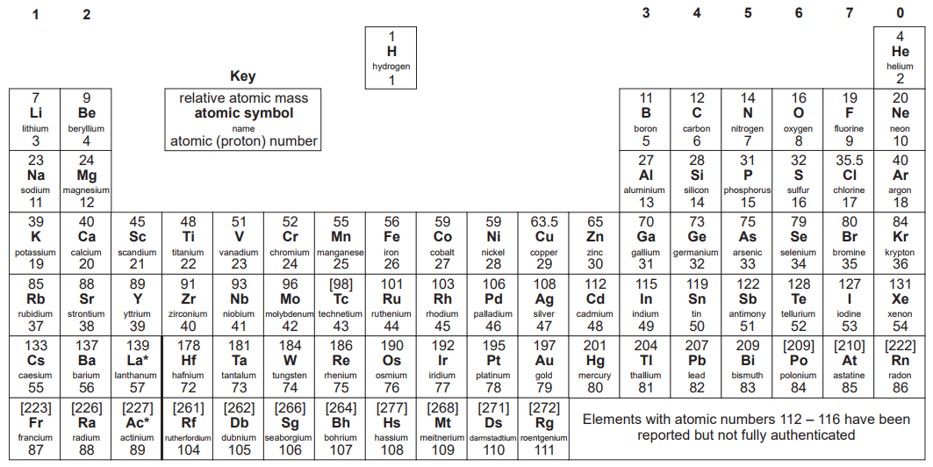
Formation of and bonding in Metal oxides
Q. What type of bonding is present in a metal oxide? e.g magnesium oxide.
Ionic bonding
Q. How do we know?
It contains a metal and a non-metal (oxygen)!

Slide 6
Formation of and bonding in Metal oxides
Q. Describe the formation of magnesium oxide.
1. Draw the outer shells of each atom.
Mg
O
Magnesium is in group 2, so has 2 electrons in its outer shell.
Any element in group 1, 2 or 3 (metals) will lose electrons to have a full outer shell.
Any element in group 5, 6 or 7 (non-metals) will gain electrons to get a full outer shell of 8.
Oxygen is in group 6, so has 6 electrons in its outer shell.

Slide 7
Formation of and bonding in Metal oxides
Q. Describe the formation of magnesium oxide.
2. Transfer electrons from the metal to the non-metal to fill outer shell.
1 atom of Mg loses 2 electrons to get a full outer shell.
1 atom of oxygen gains 2 electrons to get a full outer shell.
Mg
O
These 2 electrons are transferred to 1 atom of oxygen.
3. Draw ions
Mg
O
4. Write balanced formula:
MgO

Slide 8
Formation of and bonding in Metal oxides
Q. With respect to magnesium, why is this reaction described as oxidation?
Mg
O
Oxidation
1. The addition of oxygen.
Mg
O
2. The loss of electrons.
MgO

Slide 9
Reaction Equation
Q. What is wrong this this equation?
Formulae
Mg _{(s)} + O _{(g)} → MgO _{(s)}
2
O₂ _{(g)}
2
Balanced
State symbols
It suggests that oxygen exists as a lone atom!
Oxygen in an reaction equation must always be represented as O₂!
O
= O
It actually exists as a simple covalent - diatomic molecule
O
O
= O₂

Slide 10
Task – Complete the reaction equations.
calcium + oxygen → calcium oxide
2 Ca_{(s)}
O₂ _{(g)}
2
_____ + _____ → __ CaO _{(s)}
sodium + oxygen → sodium oxide
Q. Why does each metal oxide have different ratio of metal to oxide?
4 Na_{(s)}
O₂ _{(g)}
2
_____ + _____ → __Na₂O _{(s)}
aluminium + oxygen → aluminium oxide
4 Al_{(s)}
3 O₂ _{(g)}
2
_____ + _____ → __ Al₂O₃ _{(s)}

Slide 11
Task – Complete the reaction equations.
calcium + oxygen → calcium oxide
2 Ca_{(s)}
O₂ _{(g)}
2
_____ + _____ → __ CaO _{(s)}
sodium + oxygen → sodium oxide
Q. Why does each metal oxide have different ratio of metal to oxide?
4 Na_{(s)}
O₂ _{(g)}
2
_____ + _____ → __Na₂O _{(s)}
aluminium + oxygen → aluminium oxide
4 Al_{(s)}
3 O₂ _{(g)}
2
_____ + _____ → __ Al₂O₃ _{(s)}

Slide 12
The formulae of metal oxides
Magnesium oxide
Q. Why does each metal oxide have different ratio of metal to oxide?
O
O
=
O
-
-
MgO
Mg
O
+
-
+
-
=
Mg
Mg
Mg
+
+

Slide 13
The formulae of metal oxides
Sodium oxide
Q. Why does each metal oxides have different ratio of metal to oxide?
O
O
=
O
-
-
Na₂O
Na
+
O
-
Na
+
-
Na
Na
=
Na
+

Slide 14
The formulae of metal oxides
Aluminium oxide
Q. Why does each metal oxides have different ratio of metal to oxide?
Al₂O₃
O
O
=
O
-
Al
O
-
+
-
+
-
+
O
-
Al
+
-
+
O
Al
-
=
+
Al
Al
+
+
-
+

Slide 15
Now complete the extra link on the national academy.

