Slide 1
Decide whether the statements are true or false.
EXTENSION: Correct the
False ones.
The mass of the atom is found in the nucleus
Electrons have almost no mass.
The number of protons are equal to the number of electrons
JJ Thomson developed the plum pudding model of the atom
Protons are negatively charged
Electrons and neutrons are found in the nucleus
Niels Bohr discovered neutrons
Neutrons and protons have a mass of 1.
The number of neutrons is equal to the mass number + the atomic number
Ernst Rutherford proved the plum model was correct.
Electrons are positively charged
Protons are found on the electron shells
Chadwick discovered that electrons exist on electron shells

Slide 2
Decide whether the statements are true or false.
EXTENSION: Correct the
False ones.
The mass of the atom is found in the nucleus
Electrons have almost no mass.
The number of protons are equal to the number of electrons
JJ Thomson developed the plum pudding model of the atom
Protons are negatively charged
Electrons and neutrons are found in the nucleus
Niels Bohr discovered neutrons
Neutrons and protons have a mass of 1.
The number of neutrons is equal to the mass number + the atomic number
Ernst Rutherford proved the plum model was correct.
Electrons are positively charged
Protons are found on the electron shells
Chadwick discovered that electrons exist on electron shells

Slide 3
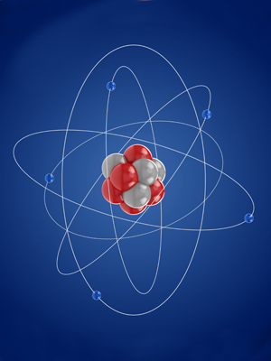
Overview Atomic structure
Atoms and nuclear radiation
Radioactive decay and nuclear radiation
Nuclear equations
Half lives and random nature of decay
Radioactive contamination

Slide 4
LearnIT!
KnowIT!
Atoms and nuclear radiation
Radioactive decay and nuclear radiation
Nuclear equations
Half life and the random nature of radioactive decay
Radioactive contamination

Slide 5
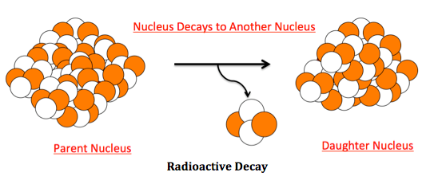
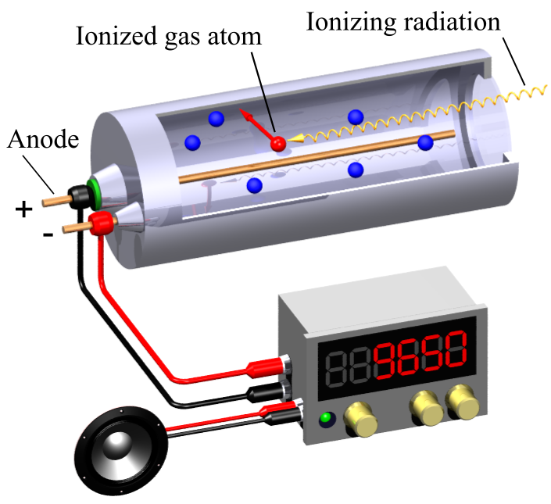
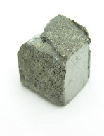
Radioactive decay and nuclear radiation
The nuclei of some atoms are unstable.
To become more stable these nuclei give out radiation.
This process is called radioactive decay.
Unstable atom
Stable atom
Activity = rate at which a source of unstable nuclei decays, measured in becquerels (Bq).
Radioactive decay
Count-rate = number of decays recorded each second by a detector (e.g. Geiger-Muller tube)
Radioactive rock
Different radioactive isotopes decay at different rates and emit different types of radiation.

Slide 6
Radioactive decay and nuclear radiation
There are three types of radioactive decay, alpha, beta and gamma. All come from the nucleus of the atom. In the examples below, only the nucleus is shown.
Alpha (symbol α or ) consist of 2 protons and 2 neutrons emitted from the nucleus. They have a positive charge as they contain 2 (+) protons.
Beta (symbol β or ) consist of an electron emitted from the nucleus. This results from a neutron splitting into a proton and an electron. Beta particles are negatively charged.
Gamma rays (symbol γ) are electromagnetic radiation emitted from the nucleus. Gamma radiation has no mass and no electrical charge.

Slide 7
Notes:
https://youtu.be/V-UtgheMNNU

Slide 8
Notes:
https://youtu.be/_xAC-ebPbfI

Slide 9
Notes:
https://youtu.be/L7NMOVJtmhk

Slide 10
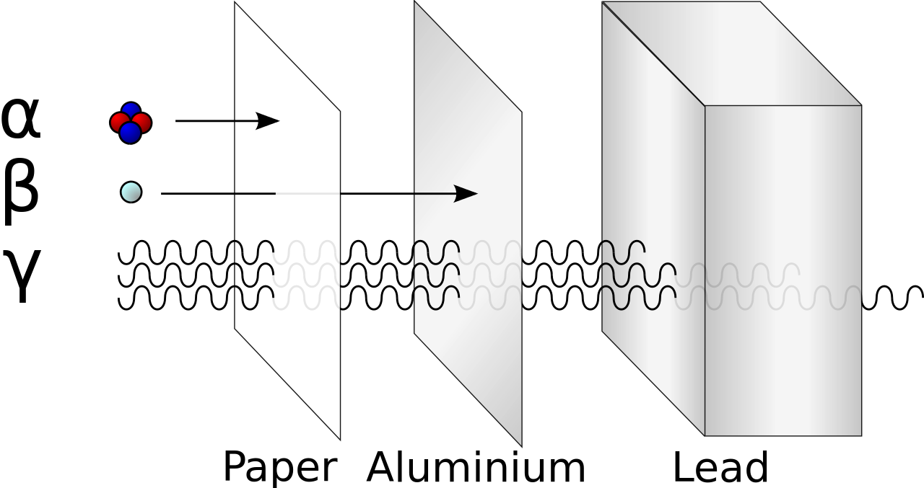
Radioactive decay and nuclear radiation
Properties of alpha, beta and gamma radiation.
Alpha, beta and gamma radiation can penetrate different materials due to their differing nature.
Alpha – easily stopped by a few
sheets of paper.
Beta – penetrates paper but stopped
by a thin sheet of aluminium.
Gamma – only stopped by thick lead
or several metres of concrete.
All three types of radiation cause ionisation of other atoms. If these atoms are in living cells it can cause damage which could lead to cancer.
Name | Symbol | Speed | Range in air | Ionising power
Alpha | α | Slowest | 6 - 8 cm | High
Beta | β | Medium | 1 – 2 m | Medium
Gamma | γ | Fastest | 300 -500 m | Low

Slide 11
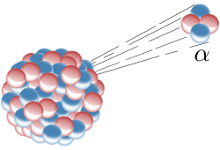

Slide 12
Alpha Radiation - α
An alpha particle consists of 2 protons and 2 neutrons.
An alpha particles relative mass is 4 and relative charge is +2
4
α
2
By how much does relative mass number of the atom change?
Reduces by 4
Does anything else change?
Atomic number reduces by 2

Slide 13
What happens during alpha decay?
An alpha particle consists of two protons and two neutrons. It is the same as a helium nucleus.
When an atom’s nucleus decays and releases an alpha particle, it loses two protons and two neutrons.
mass number decreases by 4
M
M - 4
4
X
Y
+
α
A
A - 2
2
atomic number
decreases by 2
The number of protons has changed, so the decayed atom has changed into a new element.
Notes:
Walk through the nuclear decay equation carefully.
Highlight A is Mass, Z is Atomic
Have students not clearly the forumla

Slide 14
Example
M
M - 4
4
X
Y
+
α
A
A - 2
2
mass number decreases by 4
238
234
4
U
Th
+
α
92
90
2
atomic number
decreases by 2
Notes:
Walk through the nuclear decay equation carefully.
Highlight A is Mass, Z is Atomic

Slide 15
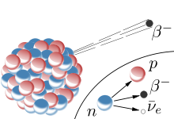

Slide 16
Beta Radiation - β
A beta particle consists of an electron emitted when a neutron in the nucleus turns into a proton.
A Beta particles relative mass is effectively 0 and relative charge is -1
0
β
-1
By how much does relative mass number of the atom change?
Stays the same
Does anything else change?
Atomic number increase by 1

Slide 17
What happens during beta decay?
An beta particle consists of a high energy electron, which is emitted by the nucleus of the decaying atom.
When an atom’s nucleus decays and releases a beta particle, a neutron turns into a proton, which stays in the nucleus, and a high energy electron, which is emitted.
mass number stays the same
M
M
0
X
Y
+
β
A
A+1
-1
atomic number
Increases by 1
The number of protons has changed, so the decayed atom has changed into a new element.
Notes:
Walk through the nuclear decay equation carefully.
Highlight A is Mass, Z is Atomic
Hammer home the proton changing into a neutron

Slide 18
Example
A
A
0
X
Y
+
β
Z
Z + 1
-1
mass number remains the same
14
14
0
C
N
+
β
6
7
1
atomic number
increases by 1
Notes:
Walk through the nuclear decay equation carefully.
Highlight A is Mass, Z is Atomic

Slide 19
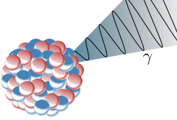
Notes:
Talk about gamma being a wave so is emitted as a result of an atom decaying but still not being stable. The gamma wave release is a release of excess energy the particle has.
Gamma usually happens at the same time as alpha or beta

Slide 20
Gamma Radiation - γ
Gamma radiation is a high energy, high frequency wave.
Gamma radiation has no mass and no charge as it is wave.
By how much does relative mass number of the atom change?
No change
Does anything else change?
No change

Slide 21
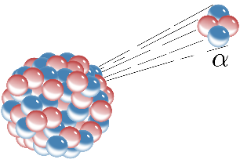
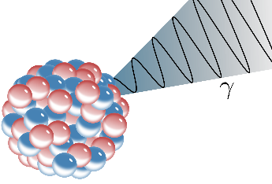
Nuclear equations
Nuclear equations show the changes to an atom when it emits radiation.
Alpha emission
Nucleus loses 2 protons and 2 neutrons.
Atomic number will reduce by 2 and atomic mass by 4.
Nucleus loses an electron which is produced when a neutron turns into a proton. So mass stays the same but atomic number of the product increases by one.
Beta emission
Gamma emission
No particles are emitted so there is no change to the nucleus. Atomic mass and atomic number stay the same.

Slide 22
Notes:
The last is false because it is a helium nucleus.

Slide 23
Notes:
The last is false because it is a helium nucleus.

Slide 24
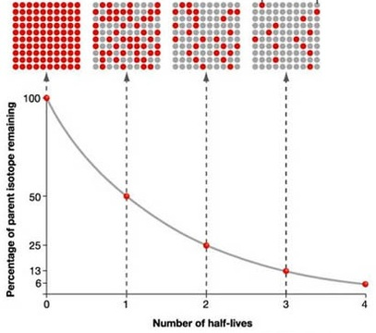
Half life and the random nature of radioactive decay
Radioactive decay is a random process so the likelihood of a decay taking place is a probability problem. For this reason, the half-life of an isotope is given rather than saying how long it will take to fully decay.
The half-life of a radioactive isotope is the time it takes for the number of nuclei of the isotope in the sample to halve, or the time it takes for the count rate from a sample containing the isotope to fall to half its initial level.
The net decline of the isotope is the fraction remaining after a number of half lives.
E.g. 100 50 25
After 2 half lives net decline is 75/100 = 3/4

Slide 25
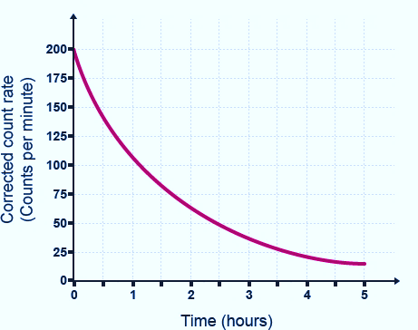
Half life and the random nature of radioactive decay
Calculating the half life of a radioactive isotope.
If you know the start and finish count rate and the time taken, you can calculate the half life.
Example:
The count rate of an isotope is 1008 Bq.
This falls to a count rate of 126 over a period of 21 days.
1 2 3
3 half lives for count rate to fall to 126.
These 3 half lives took 21 days so each half life took 7 days.
Half life if this isotope = 7 days
1
200 counts / min at the beginning.
100 counts/min occurred after 1.2 hours.
50 counts/min occurred after 2.4 hours.
It always takes 1.2 hours for the count rate to halve.
Half life of Fermium - 252 = 1.2 hours.
Radioactive sample of Fermium - 252
1008
504
252
126

Slide 26
Radioactive contamination
Radioactive substances can be hazardous by contamination or irradiation.
Irradiation is when an object or person is exposed to
radiation. Protection from irradiation means stopping the radiation from reaching you.
Medical dressings are often irradiated but present no danger to the user.
Contamination is when a radioactive source is in contact with an object or person, rather than the emissions are present.
The object remains radioactive until the contamination is removed or decays naturally.

Slide 27
Background radiation
Background radiation is the constant , low level radiation in the environment.
This can be natural radiation from rocks, building materials, cosmic rays etc.
Radioactive pollution from nuclear testing, nuclear power and industrial/medical waste also contributes to background radiation.
Sources of radioactive exposure and contamination.
Radiation dose is measured in:
sieverts (Sv)
1 Sv = 1000 millisieverts
Everyone receives background radiation but people who work or live in locations with high levels of radiation receive additional doses of radiation.
Some nuclear workers, medical staff, military and industrial workers may have higher doses due to working with radioactive sources.

Slide 28
QuestionIT!
Atoms and nuclear radiation
Radioactive decay and nuclear radiation
Nuclear equations
Half life and the random nature of radioactive decay
Radioactive contamination

Slide 29
Atoms and nuclear radiation – QuestionIT
Which part of an atom is involved with radioactive decay?
Explain the meaning of the term activity, as applied to
radioactive materials and state the units of activity.
3. What is meant by the term “count rate”?
Copy and complete the table to show the nature of alpha, beta
and gamma radiations.
Radiation | Symbol | Composition | Electrical charge
Beta | β
Gamma |  | Electromagnetic wave
Alpha |  |  | +2

Slide 30
Atoms and nuclear radiation – QuestionIT
A piece of radioactive rock shows a reading of 350 counts/min. When covered in aluminium foil, this drops down to 4 counts/min. Explain which type of radiation this rock is emitting.
Radioactive emissions are often described as ionising radiations. What does this mean?
Smoke detectors use americium-241 which is an alpha emitter. Explain why an alpha source is used in these detectors.
Why is an alpha particle often described as a helium nuclei?
Complete the nuclear equation for the beta decay of carbon.

Slide 31
Atoms and nuclear radiation – QuestionIT
Uranium-235 undergoes an alpha decay to produce thorium-231. (atomic number of uranium is 92). Complete the nuclear equation for this process.
When iodine 131 decays, there is no mass change in the nucleus and no new products formed. What type of radioactive emission is this?
Explain what is meant by the term “half life”.
A radioactive sample reduces its count rate from 240 counts/min to 30 counts/min over a period of 60 hours what is its half life?

Slide 32
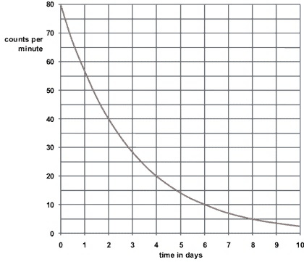
Atoms and nuclear radiation – QuestionIT
Use the decay curve below to work out the half-life of the isotope.
Calculate the net decline of the above isotope expressed as a ratio, during radioactive emission after 3 half-lives.

Slide 33
Atoms and nuclear radiation – QuestionIT
16. Explain the difference between radioactive irradiation and
radioactive contamination.
17. Copy and complete the table below to suggest one way of
preventing exposure to irradiation and contamination by
radioactive materials.
Type of exposure | Method of preventing exposure
Irradiation
Contamination

Slide 34
AnswerIT!
Atoms and nuclear radiation
Radioactive decay and nuclear radiation
Nuclear equations
Half life and the random nature of radioactive decay
Radioactive contamination

Slide 35
Atoms and nuclear radiation – AnswerIT
Which part of am atom is involved with radioactive decay?
The nucleus only.
Explain the meaning of the term activity as applied to
radioactive materials and state the units of activity.
The rate at which a source of unstable nuclei decays. Units Bq.
3. What is meant by the term “count rate”?
The number of radioactive decays recorded in a given time.
Copy and complete the table to show the nature of alpha, beta
and gamma radiations.
Radiation | Symbol | Composition | Electrical charge
Beta | β | an electron | -1
Gamma | γ | Electromagnetic wave | 0
Alpha | α | 2 protons and 2 neutrons | +2

Slide 36
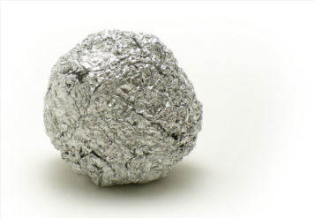
Atoms and nuclear radiation – AnswerIT
5. A piece of radioactive rock shows a reading of 350 counts/min.
When covered in aluminium foil, this drops down to 4 counts/min.
Explain which type of radiation this rock is emitting.
Could be alpha or beta as both would be stopped by the foil and
gamma would not be stopped by the foil.
6. Radioactive emissions are often described as ionising radiations. What does this mean?
The emissions knock off electrons from atoms which then become ions.
7. Smoke detectors use americium-241 which is an alpha emitter. Explain why an
alpha source is used in these detectors.
Alpha particles are easily stopped by smoke.
They do not travel far in air so are safe for the user.
8. Why is an alpha particle often described as a helium nuclei?
It contains 2 protons and 2 neutrons, the same as the nucleus of a helium atom.
9. Complete the nuclear equation for the beta decay of Carbon.
6

Slide 37
Atoms and nuclear radiation – AnswerIT
10.
11. When iodine 131 decays, there is no mass change in the
nucleus and no new products formed. What type of radioactive
emission is this?
Gamma emission
12. Explain what is meant by the term “half life”.
The time it takes a radioactive sample to lose half its
radioactivity (as measured by count rate).
13. A radioactive sample reduces its count rate from 240 counts/min to 30 counts/min over a period of 60 hours what is its half life?
1 2 3
Three half lives in 60 hours = 20 hour half life
Uranium-235 undergoes an alpha decay to produce thorium-231. (atomic number of Uranium is 92). Complete the nuclear equation for this process.
235 | U
92
231 | Th
90
240
120
60
30

Slide 38
Atoms and nuclear radiation – QuestionIT
Use the decay curve below to work out the half-life of the isotope.
(Physics only) Calculate the net decline of the above isotope expressed as a ratio, during radioactive emission after 3 half-lives.
80 = 0 day; 40 = 2 days. Difference = 2 days. Half-life = 2 days
Counts/ min reduce from 80 to 10 in 3 half-lives.
Decline is 70/80 or 7/8ths

Slide 39
Atoms and nuclear radiation – AnswerIT
16. Explain the difference between radioactive irradiation and
radioactive contamination.
Irradiation is exposure to emissions from radioactive materials
that are not in contact with an object. Contamination is when
radioactive materials are in contact with the object.
17. Copy and complete the table below to suggest one way of
preventing exposure to irradiation and contamination by
radioactive materials.
Type of exposure | Method of preventing exposure
Irradiation | Wear protective clothing, e.g., lead apron, to shield from radiation. Move away from the radiation. Shield the radiation with appropriate material.
Contamination | Avoid contact with radioactive materials. Prevent radioactive materials being released into the environment.

