Slide 1
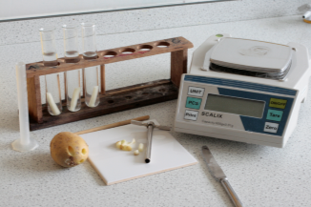
Osmosis Required Practical
Summer home learning

Slide 2
Instructions
Print out slide 3 or copy this into your books. This is simplified method of the required practical. It is a good starting point.
Follow the links on slide 4 and 5. Watch the video’s making notes if you wish.

Slide 3
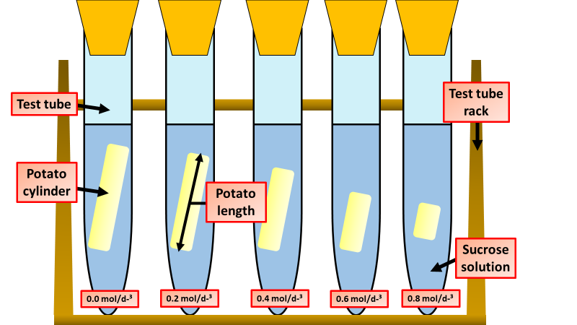
GCSE 1-9 Science Practical Methods
Osmosis
Method
Prepare a range of sucrose (sugar) solutions. The concentration of a solution is measured in moles per cubic decimetre written as mol dm-³. For example, in this experiment your range could be from 0.2 mol dm-³ to 1.0 mol dm-³.
Set up a series of boiling tubes with each of these solutions. Also, set up one containing distilled water. This will have a concentration of sucrose of 0.0 mol dm-³ and will act as the control in the experiment.
Make sure each tube is labelled with the concentration.
Carry out the investigation. Prepare a blank results table before you begin. Make sure when weighing the potato cylinders, that their masses are not mixed up when recording them. Each cylinder will have a different mass before and after the investigation.
For each sucrose concentration, repeat the investigation for several potato cylinders. This allows you to make the experiment more repeatable – not all potato cylinders might behave in the same way. Making a series of repeat experiments means that any anomalous results can be identified and ignored when a mean is calculated.
Questions
What was your independent variable?
What was your dependent variable?
How can you make it reliable?
How could you make it more accurate?

Slide 4
Follow the link at the bottom of the page and watch the video to revise what osmosis is.
https://youtu.be/g7phKY726X0
Notes:
https://youtu.be/g7phKY726X0

Slide 5
Follow the link at the bottom of the page and watch the video to revise how to due this required practical.
There is no talking to you must watch and read carefully.
https://youtu.be/3JS-VSsWmQA
Notes:
https://youtu.be/3JS-VSsWmQA

Slide 6
Instructions
3. Complete the tasks on slide 7
4. You then have a choice. Do the tasks on either slide 8 or 9.
If you get stuck there is help on the ICE slide. (Slide 13)
5. Self assess your work using slides 10, 11 and 12.
6. On slide 14 there is a general summary of the required practical.

Slide 7
LO: To be able to organize information, calculating averages and evaluate by suggesting reasons for errors.
Name: ____________________________
Osmosis
The section(s) I need to work on is/are : ____
Organise the method used to obtain results from the Osmosis of potatoes in different concentrations of sugar water. Measure and record the length and mass of each potato cylinder. Leave the potato cylinders in the boiling tubes overnight in the test tube rack. Measure 10 cm³ of the distilled water and put into the fifth boiling tube. Label boiling tube as water 0 M. Calculate the changes in length and mass of each potato cylinder. Add one potato cylinder to each boiling tube. Make sure you know the length and mass of each potato cylinder in each boiling tube, recording them in a table. Remove the cylinders from the boiling tubes and carefully blot them dry with the paper towels. Use a cork borer to cut five potato cylinders of the same diameter, trimming then to the same length. Re-measure the length and mass of each cylinder of potato, recording your measurements in the table. Measure 10 cm³ of the 1.0 M sugar solution and put into a boiling tube. Label boiling tube as: 1.0 M sugar. Repeat with concentrations of 0.75 M, 0.5 M. and 0.25 M. | Risk Assessment Write a risk assessment for this practical including what you would do to minimise these risks.
Calculate the missing numbers: | Errors
Concentration | 1M | 0.75M | 0.5M | 0.25M | 0M
Initial length | 30mm | 29mm | 31mm | 30mm | 29mm
Final length | 26mm | 27mm | 30mm | 31mm | 33mm
Change in length
Error | What could’ve caused it?
Potato weighs more and leaves water on the balance
Potato weighs much less than expected
A few anomalous results, with no pattern

Slide 8
LO: To be able to plan effectively, analyze results and evaluate methods of improvement.
Plan Without turning over (!) write a step by step plan for this experiment. | Results Calculate the mass increase/decrease. Why is percentage mass change better than just change in mass? Sketch the data from the table onto the graph below.
Concentration | 1M | 0.75M | 0.5M | 0.25M | 0M
Initial mass | 2.00g | 2.03g | 2.08g | 1.95g | 1.98g
Final mass | 1.85g | 1.92g | 1.99g | 1.99g | 2.07g
Mass Increase/Decrease
Change in mass (g)
Concentration (M)

Slide 9
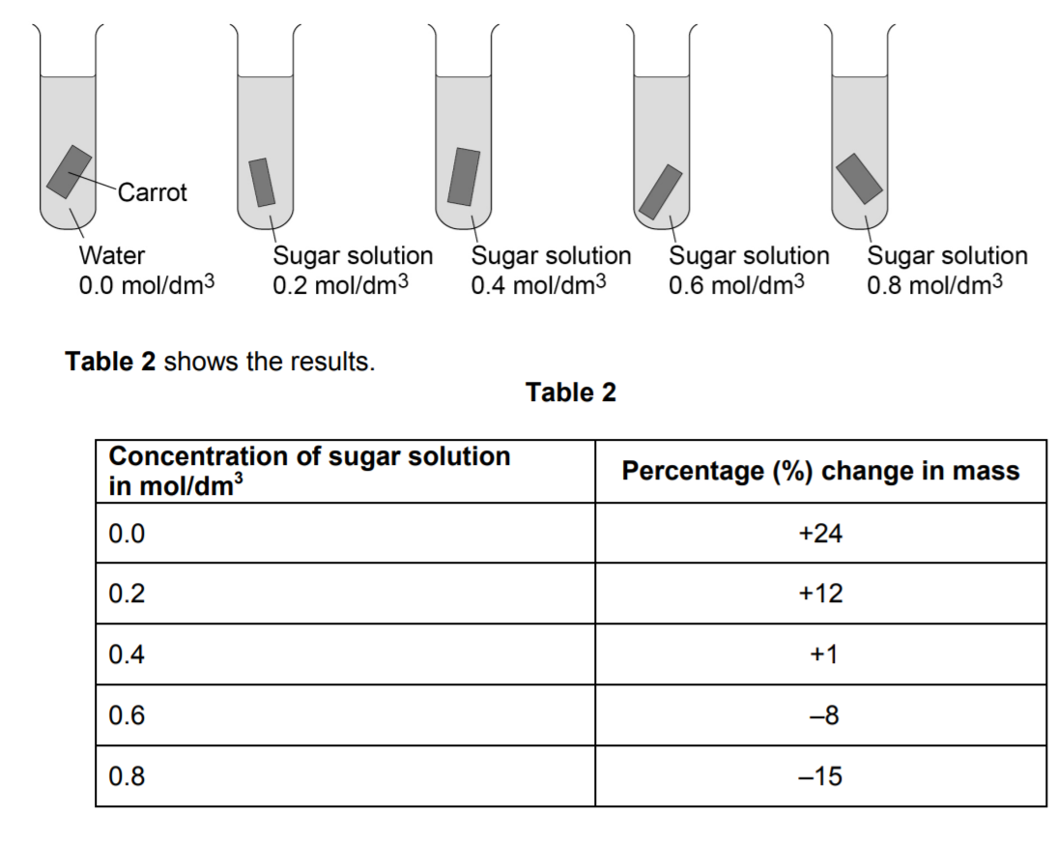
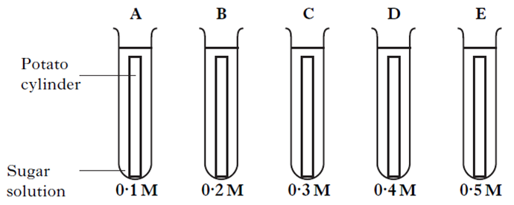
Required practical 3: Osmosis practical
State what is meant by osmosis
Identify two control variables in the experiment
A student investigated the effect of different concentrations of sugar solution on box pieces of carrot.
Q. Suggest why the student calculated the percentage (%) change in mass of each piece of carrot
.
The student repeated the investigation using boiled pieces of carrot. The pieces of carrot did not change in mass. Suggest why.
Explain why the mass of the carrot in the 0.6 mol/dm3 sugar solution changed.

Slide 10
Name: ____________________________
Osmosis
The section(s) I need to work on is/are : ____
Organise the method used to obtain results from the Osmosis of potatoes in different concentrations of sugar water. 4 Measure and record the length and mass of each potato cylinder. 6 Leave the potato cylinders in the boiling tubes overnight in the test tube rack. 3 Measure 10 cm³ of the distilled water and put into the fifth boiling tube. Label boiling tube as water 0 M. 9 Calculate the changes in length and mass of each potato cylinder. 5 Add one potato cylinder to each boiling tube. Make sure you know the length and mass of each potato cylinder in each boiling tube, recording them in a table. 7 Remove the cylinders from the boiling tubes and carefully blot them dry with the paper towels. 1 Use a cork borer to cut five potato cylinders of the same diameter, trimming then to the same length. 8 Re-measure the length and mass of each cylinder of potato, recording your measurements in the table. 2 Measure 10 cm³ of the 1.0 M sugar solution and put into a boiling tube. Label boiling tube as: 1.0 M sugar. Repeat with concentrations of 0.75 M, 0.5 M. and 0.25 M. | Risk Assessment Write a risk assessment for this practical including what you would do to minimise these risks. Cork Borers are sharp and could cause cuts, push the cork borer against the table, not against your hand.
Calculate the missing numbers: | Errors
Concentration | 1M | 0.75M | 0.5M | 0.25M | 0M
Initial length | 30mm | 29mm | 31mm | 30mm | 29mm
Final length | 26mm | 27mm | 30mm | 31mm | 33mm
Change in length | -4mm | -3mm | -1mm | +1mm | +4mm
Error | What could have caused it?
Potato weighs more and leaves water on the balance | Blotting paper not used on potatoes.
Potato weighs much less than expected | Blotting paper pushed too hard on potatoes. Zero error on Mass balance when measuring at the start.
A few anomalous results, with no pattern | Systematic error such as wrong labelling of solutions

Slide 11
Plan Without turning over (!) write a step by step plan for this experiment. • Measure and record the length and mass of each potato cylinder. • Leave the potato cylinders in the boiling tubes overnight in the test tube rack. • Measure 10 cm³ of the distilled water and put into the fifth boiling tube. Label boiling tube as water 0 M. • Calculate the changes in length and mass of each potato cylinder. • Add one potato cylinder to each boiling tube. Make sure you know the length and mass of each potato cylinder in each boiling tube, recording them in a table. • Remove the cylinders from the boiling tubes and carefully blot them dry with the paper towels. • Use a cork borer to cut five potato cylinders of the same diameter, trimming then to the same length. • Re-measure the length and mass of each cylinder of potato, recording your measurements in the table. • Measure 10 cm³ of the 1.0 M sugar solution and put into a boiling tube. Label boiling tube as: 1.0 M sugar. Repeat with concentrations of 0.75 M, 0.5 M. and 0.25 M. | Results Calculate the mass increase/decrease. Why is percentage mass change better than just change in mass? It takes into account the fact that the starting mass may not be the same for each potato. Sketch the data from the table onto the first graph. Sketch what the other graph
Concentration | 1M | 0.75M | 0.5M | 0.25M | 0M
Initial mass | 2.00g | 2.03g | 2.08g | 1.95g | 1.98g
Final mass | 1.85g | 1.92g | 1.99g | 1.99g | 2.07g
Mass Increase/Decrease | -0.15g | -0.11g | -0.09g | +0.04 | +0.09
Change in mass (g)
Concentration (M)

Slide 12
Required practical 3: Osmosis practical
State what is meant by osmosis
Identify two control variables in the experiment
Osmosis is the diffusion of water molecules, from a region where the water molecules are in higher concentration, to a region where they are in lower concentration, through a partially permeable membrane
Length of the potato cylinder
Surface area of the potato cylinders
Temperature
Type of potato
Time left in solution
A student investigated the effect of different concentrations of sugar solution on box pieces of carrot.
Q. Suggest why the student calculated the percentage (%) change in mass of each piece of carrot
To control for the starting mass (of the pieces of carrot), because the pieces of carrot were not all the same mass at the start
.
The student repeated the investigation using boiled pieces of carrot. The pieces of carrot did not change in mass. Suggest why.
The cell membrane was damaged
Explain why the mass of the carrot in the 0.6 mol/dm3 sugar solution changed.
Mass decreased
Due to loss of water by osmosis through a partially permeable membrane
because the concentration of sugar solution is greater than concentration of sugar (solution) inside cells / carrot
or
because the concentration of water is less outside the cells / carrot than the concentration inside the cells / carrot

Slide 13
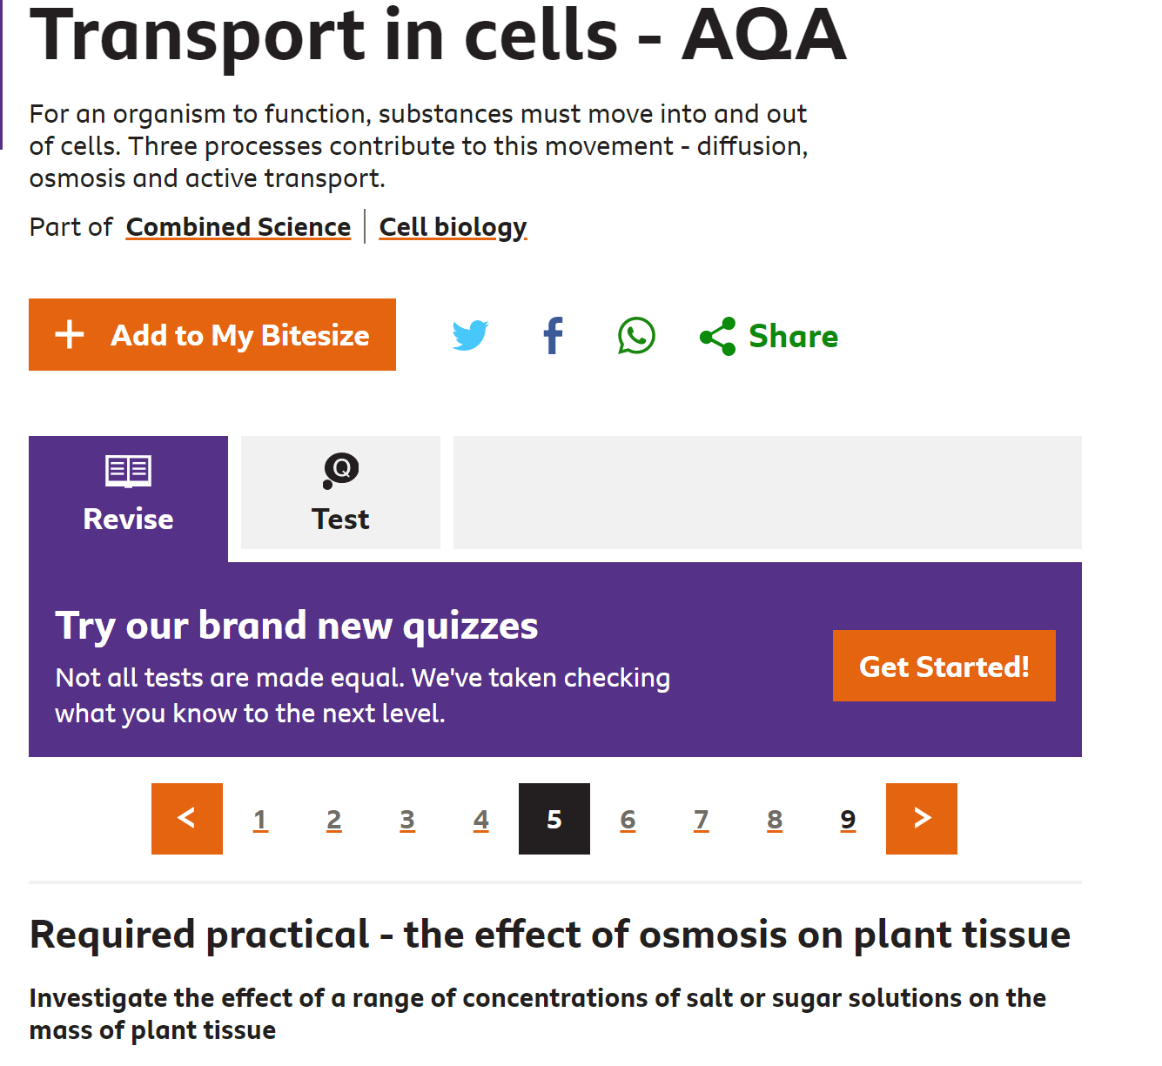
ICE Slide
I = In
C = Case of
E = Emergency
Follow the link to BBC bitesize and pages 5-7 will help you with this required practical.
https://www.bbc.co.uk/bitesize/guides/zs63tv4/revision/5
Notes:
https://www.bbc.co.uk/bitesize/guides/zs63tv4/revision/5

Slide 14
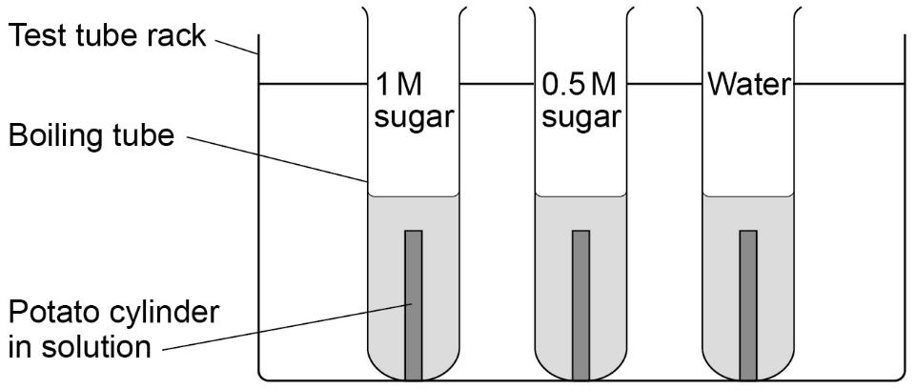
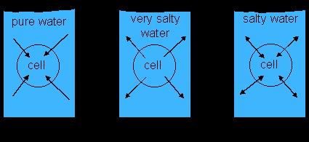
GCSE Required Practical – Biology 1 – Investigating Osmosis
Osmosis: the movement of water from an area with high concentration OF WATER, to an area with lower concentration OF WATER.
Solute: something that dissolves in water
Example Apparatus
Different concentrations of sugar (or salt)
Measure the length (or mass) of the potato cylinders before and after.
What’s the point of the practical?
To find out what happens to cells when you put them in different concentrations of sugar or salt solutions. (to see how the water moves in or out of the plant tissue)
Results
- High concentration of sugar in solution = water moves out of potato cells into the solution. Potato gets smaller.
Low concentration of sugar in solution = water moves into the potato cells from the solution. Potato gets bigger.
If no water goes in or out of the potato overall and it doesn’t change mass, then the solution is exactly the same concentration as inside the potato
What may they ask us about?
Control variables
Accuracy of measurements – why should you remove excess water with paper towel before weighing
Use a graph of results to find the concentration inside the potato cells
Why can the water, but not the sugar/salt move through the membrane?

