Slide 1
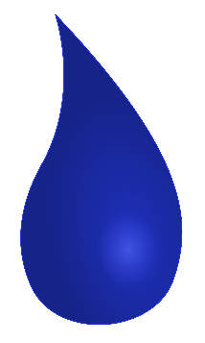
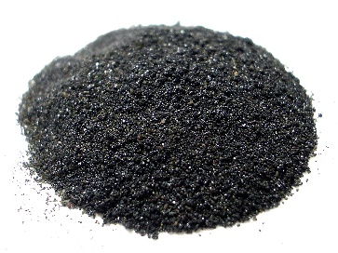
Alkalis
Recap: What is a base?
Bases are a group of compounds that are able to neutralise acids.
There are two key types of base:
Bases soluble in water
Bases insoluble in water
Alkalis
Insoluble bases
We use as solutions
Typically used as solid powders
Today we are going to look at alkalis.
Q: How can we recognise alkalis?

Slide 2
Alkalis
Q: How can we recognise alkalis?
Bases soluble in water
Alkalis
We use as solutions
Sodium hydroxide – NaOH
Lithium hydroxide – LiOH
Potassium hydroxide – KOH
Calcium hydroxide – Ca(OH)₂
Magnesium hydroxide – Mg(OH)₂
It’s the hydroxide anion OH⁻ that makes them alkalis!

Slide 3
Alkalis and pH
How the hydroxide ion makes them alkaline:
When dissolved in water, alkalis ionise into metal ions and hydroxide ions.
Na⁺
OH⁻
Na⁺
OH⁻
Na⁺
OH⁻
Na⁺
Na⁺
OH⁻
OH⁻
Na⁺
OH⁻
Na⁺
OH⁻
Na⁺
OH⁻
Na⁺
OH⁻
Na⁺
OH⁻
Na⁺
OH⁻
Na⁺
OH⁻
Na⁺
OH⁻
The presence of hydroxide OH⁻ ions in solution makes it alkaline.
The higher the concentration of OH⁻ the higher the pH
pH is a scale of how acidic or alkaline a solution is.
Alkalis pH ranges between 8-14.
pH 8 = Weak alkali low concentration of hydroxide
pH 14 = Strong alkali High concentration of hydroxide
The pH Scale:
0 1 2 3 4 5 6 7 8 9 10 11 12 13 14
pH 7 is neutral

Slide 4
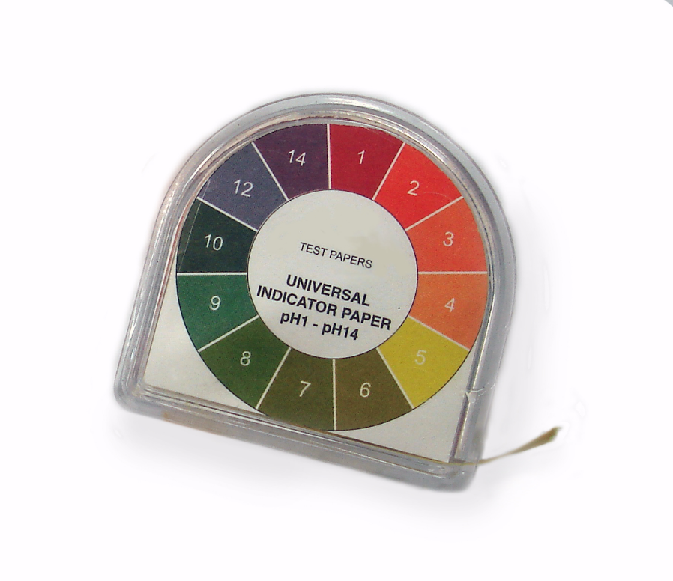
Alkalis and pH
Testing for alkalinity:
Universal indicator paper
Universal indicator solution
Universal indicator can be added to a solution to determine it’s pH.
The colours on this chart show that universal indicator turns blue in weak alkalis pH 8 , and purple in strong alkalis pH 14.
Green indicates a neutral solution (neither acidic nor alkaline).
0 1 2 3 4 5 6 7 8 9 10 11 12 13 14

Slide 5
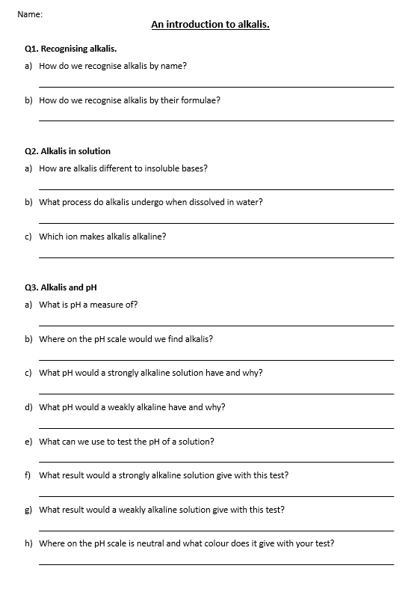
Task: Complete the questions on Alkalis
Q1. Recognising alkalis.
How do we recognise alkalis by name?
How do we recognise alkalis by their formulae?
Q2. Alkalis in solution
How are alkalis different to insoluble bases?
What process do alkalis undergo when dissolved in water?
Which ion makes alkalis alkaline?
Q3. Alkalis and pH
What is pH a measure of?
Where on the pH scale would we find alkalis?
What pH would a strongly alkaline solution have and why?
What pH would a weakly alkaline have and why?
What can we use to test the pH of a solution?
What result would a strongly alkaline solution give with this test?
What result would a weakly alkaline solution give with this test?
Where on the pH scale is neutral and what colour does it give with your test?

Slide 6
Self assessment & Corrections
Q1. Recognising alkalis.
How do we recognise alkalis by name?
How do we recognise alkalis by their formulae?
Q2. Alkalis in solution
How are alkalis different to insoluble bases?
What process do alkalis undergo when dissolved in water?
Which ion makes alkalis alkaline?
Q3. Alkalis and pH
What is pH a measure of?
Where on the pH scale would we find alkalis?
What pH would a strongly alkaline solution have and why?
What pH would a weakly alkaline have and why?
What can we use to test the pH of a solution?
What result would a strongly alkaline solution give with this test?
What result would a weakly alkaline solution give with this test?
Where on the pH scale is neutral and what colour does it give with your test?
M. 1a) They have “hydroxide in the name”
M. 1b) They have OH in the formula
M. 2a) Alkalis dissolve in water, insoluble bases do not
M. 2b) Ionisation
M. 2c) OH⁻ the hydroxide ion
M. 3a) Acidity or alkalinity
M. 3b) 8-14
M. 3c) High pH of 14, high concentration of hydroxide OH⁻
M. 3d) Lower pH of 8, low concentration of hydroxide OH⁻
M. 3e) Universal indicator paper or solution
M. 3f) Turns purple in colour.
M. 3g) Turns blue in colour.
M. 3h) pH 7, turns green in colour.

Slide 7
Acids
Q: Do you know the formulae of the acids?
Q: What do they all have in common?
Hydrochloric Acid
Sulfuric Acid
Nitric Acid
HCl
H₂SO₄
HNO₃
H⁺
Cl⁻
H⁺
H⁺
SO₄²⁻
H⁺
NO₃⁻
They all contain hydrogen ions!
H⁺
When dissolved in water, these acids fully ionise to release their H⁺ ions into solution.

Slide 8
Acids
How the hydrogen ion makes them acidic:
When dissolved in water, acids ionise into non-metal ions and hydrogen ions.
H⁺
Cl⁻
H⁺
Cl⁻
H⁺
Cl⁻
H⁺
H⁺
Cl⁻
Cl⁻
H⁺
Cl⁻
H⁺
Cl⁻
H⁺
Cl⁻
H⁺
Cl⁻
H⁺
Cl⁻
H⁺
Cl⁻
H⁺
Cl⁻
H⁺
Cl⁻
The presence of hydrogen H⁺ ions in solution makes it acidic
The higher the concentration of H⁺ the lower the pH
pH is a scale of how acidic or alkaline a solution is.
Acids range from pH 0 to pH 6.
pH 6 = Weak acid low concentration of H⁺
The pH Scale:
0 1 2 3 4 5 6 7 8 9 10 11 12 13 14
pH 0 = Strong acid High concentration of H⁺
pH 7 is neutral

Slide 9
Acids and pH
Testing for acidity
Universal indicator paper
Universal indicator solution
Universal indicator can be added to a solution to determine it’s pH.
The colours on this chart show that universal indicator turns yellow in weak acids pH 6, and red in strong acids pH 0.
Green indicates a neutral solution (neither acidic nor alkaline).
0 1 2 3 4 5 6 7 8 9 10 11 12 13 14

Slide 10
Neutralisation
When an alkali reacts with an acid, it neutralises it.
This brings the pH to 7, which we could confirm with universal indicator as it turns green.
0 1 2 3 4 5 6 7 8 9 10 11 12 13 14
pH 7 is neutral
When an acid and alkali react the following word equation applies:
Acid + Alkali → soluble salt + water
Example 1:
Hydrochloric acid + sodium hydroxide → sodium chloride + water
HCl _{(aq)} + NaOH _{(aq)} → NaCl _{(aq)} + H₂O _{(l)}
Let’s look at why neutralisation takes place.

Slide 11
Neutralisation
In solution. The acid ionises to produce H⁺ ions.
In solution. The alkali ionises to produce OH⁻ ions.
The H⁺ and OH⁻ ions react to form water.
This means the solution now has a low concentration of both H⁺ and OH⁻ so the pH falls right in the middle!
The spectator ions remain in solution as the soluble salt, until they are removed by crystallisation.
Na⁺
OH⁻
H₂O
H⁺
Cl⁻
0 1 2 3 4 5 6 7 8 9 10 11 12 13 14
We show the neutralisation ionic equation as:
H⁺ + OH⁻ → H₂O

Slide 12
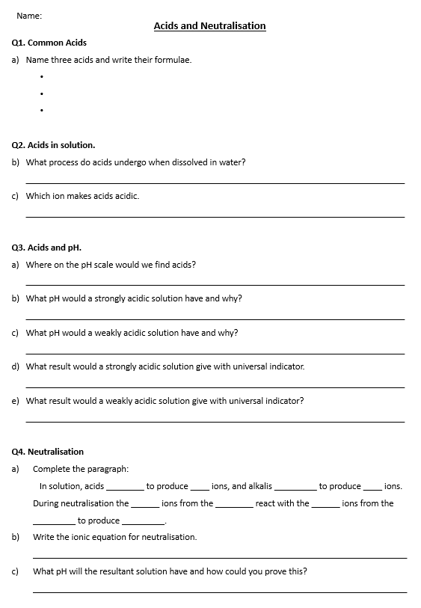
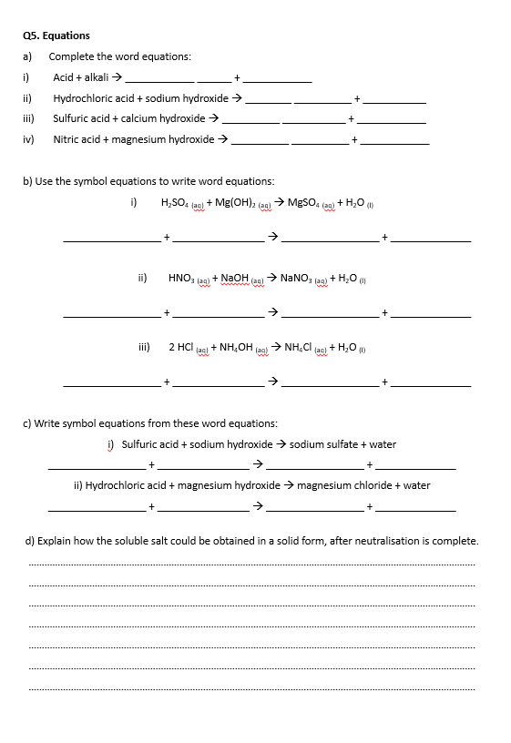
Task: Complete the questions on Acids & Neutralisation.

Slide 13
Self assessment & Corrections
Q1. Common Acids
Name three acids and write their formulae.
Q2. Acids in solution.
What process do acids undergo when dissolved in water? ________________________________________________________________________
Which ion makes acids acidic. ________________________________________________________________________
Hydrochloric acid
HCl
Sulfuric acid
H₂SO₄
Nitric acid
HNO₃
ionisation
H⁺ the Hydrogen ion!

Slide 14
Self assessment & Corrections
Q3. Acids and pH.
Where on the pH scale would we find acids? _____________________________________________________________________________
What pH would a strongly acidic solution have and why? _____________________________________________________________________________
What pH would a weakly acidic solution have and why? _____________________________________________________________________________
What result would a strongly acidic solution give with universal indicator. _____________________________________________________________________________
What result would a weakly acidic solution give with universal indicator? _____________________________________________________________________________
Low – between pH 0 and pH 6
pH 0 – as a high concentration of H⁺ ions.
pH 6 – as a low concentration of H⁺ ions.
Turns red in colour
Turns yellow in colour

Slide 15
Self assessment & Corrections
Q4. Neutralisation
Complete the paragraph: In solution, acids ________ to produce ____ ions, and alkalis _________ to produce ____ ions. During neutralisation the ______ ions from the ________ react with the ______ ions from the _________ to produce _________.
Write the ionic equation for neutralisation. ____________________________________________________________________________
What pH will the resultant solution have and how could you prove this? ____________________________________________________________________________
ionise
H⁺
ionise
OH⁻
H⁺
acid
OH⁻
alkali
water
H⁺ + OH⁻ → H₂O
pH 7 – Neutral – Will turn universal indicator green in colour.

Slide 16
Self assessment & Corrections
Q5. Equations
Complete the word equations:
Acid + alkali → ____________ ______ + ____________
Hydrochloric acid + sodium hydroxide → ________ __________ + ___________
Sulfuric acid + calcium hydroxide → __________ ___________ + ____________
Nitric acid + magnesium hydroxide → __________ __________ + ____________
soluble
salt
water
sodium
chloride
water
calcium
sulfate
water
magnesium
nitrate
water

Slide 17
Self assessment & Corrections
5b) Use the symbol equations to write word equations:
H₂SO₄ _{(aq)} + Mg(OH)₂ _{(aq)} → MgSO₄ _{(aq)} + H₂O _{(l)} _________________ + ________________ → _________________ + ______________
HNO₃ _{(aq)} + NaOH _{(aq)} → NaNO₃ _{(aq)} + H₂O _{(l)} _________________ + ________________ → _________________ + ______________
2 HCl _{(aq)} + NH₄OH _{(aq)} → NH₄Cl _{(aq)} + H₂O _{(l)} _________________ + ________________ → _________________ + ______________
magnesium hydroxide
magnesium sulfate
Sulfuric acid
water
sodium hydroxide
sodium nitrate
Nitric acid
water
ammonium hydroxide
ammonium chloride
Hydrochloric acid
water

Slide 18
Self assessment & Corrections
c) Write symbol equations from these word equations:
i) Sulfuric acid + sodium hydroxide → sodium sulfate + water
_________________ + ________________ → _________________ + ______________
ii) Hydrochloric acid + magnesium hydroxide → magnesium chloride + water
_________________ + ________________ → _________________ + ______________
H₂SO_{4 (aq)}
2 NaOH _{(aq)}
Na₂SO_{4 (aq)}
H₂O _{(l)}
2 HCl _{(aq)}
Mg(OH)₂ _{(aq)}
MgCl_{2 (aq)}
H₂O _{(l)}

