Slide 1
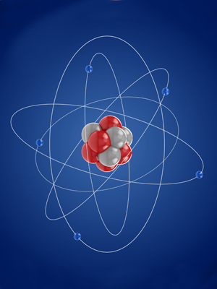
Overview Atomic structure
Atoms and isotopes
Structure of an atom
Mass number, atomic number and isotopes
Development of the atomic model
Atoms and nuclear radiation
Radioactive decay and nuclear radiation
Nuclear equations
Half lives and random nature of decay
Radioactive contamination

Slide 2
LearnIT!
KnowIT!
Atoms and isotopes
Structure of an atom
Mass number, atomic number
and isotopes
Development of the model of
the atom.

Slide 3
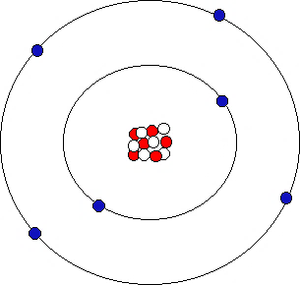
Structure of an atom
Atoms are made up of different numbers of protons, neutrons and electrons.
Atoms have the same number of + protons as – electrons so they are electrically neutral.
Electrons (-1 charge) arranged in orbits or energy levels around the nucleus.
Energy levels can hold a maximum of:
2 e⁻ in the first level
8 e⁻ in the second level
8 e⁻ in the third level
An atom of Carbon
. 9 x 10¹³ atoms
in this dot of ink
Nucleus made up of:
Protons: charge +1
Neutrons: charge 0
Nucleus of an atom has a positive charge
The radius of the nucleus is less than 1/10 000 the radius of the atom – the atom is 99.9999999% empty space!
Radius of an atom 1 x 10 ⁻¹⁰m
The nucleus holds 99% of the mass of the atom

Slide 4
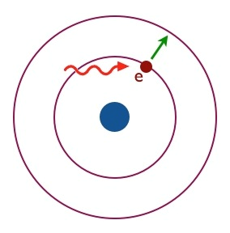
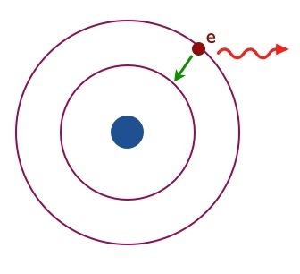
Structure of an atom
Electrons can absorb electromagnetic radiation. This excites the electron and can cause it to “jump” to a higher energy level.
It can then release this energy as an electromagnetic wave by falling back to its original energy level.
Electromagnetic radiation
absorbed by the electron causes it to move to a higher energy level.
The electron can emit this stored energy as electromagnetic radiation.
As it loses energy the electron returns to its original energy level.
A photon is the amount of energy needed to make an electron jump an energy level. This same amount of energy will be emitted as a photon of electromagnetic radiation as the electron drops back to its original ground state.

Slide 5
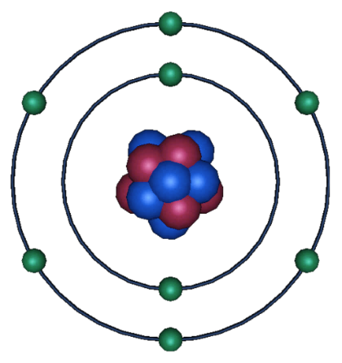
Mass number, atomic number and isotopes
All atoms of a particular element have the same number of protons. The number of protons in an element is called its atomic number.
Protons
Neutrons
Electrons
Neutrons
The total number of protons and neutrons in an atom is called its mass number. Oxygen has a mass number of 16. If it has 8 protons it must therefore have 8 neutrons to make a mass number of 16.
Protons
On the periodic table, oxygen is shown as having an atomic number of eight, therefore 8 protons.
Electrons
Atoms are electrically neutral so there must be the same number of electrons (-) as protons (+); 8 electrons.
Oxygen has: 8 protons, (16 – 8) = 8 neutrons, and 8 electrons

Slide 6
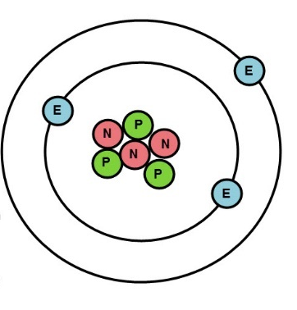
Mass number, atomic number and isotopes
Isotopes are elements with different atomic masses.
The number of protons can not change or it would not be the same element so an isotope is an element with different numbers of neutrons.
Lithium has two stable isotopes, Lithium 6 and Lithium 7
Lithium 6 has
3 protons
3 neutrons
Lithium 7 has
3 protons
4 neutrons
N
Both isotopes have the same number of protons and the same number of electrons.
Only the number of neutrons changes in an isotope.

Slide 7
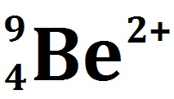
Mass number, atomic number and isotopes
Atoms can form ions if they gain or lose electrons. Atoms do this so they have full outer energy levels.
Beryllium can lose 2 electrons from its outer energy level to become an ion.
If Beryllium loses 2 e⁻
it now has:
4 protons 4+
2 electrons 2-
2+
Berylium ²⁺
Atoms can lose (-) electrons to become positive (+) ions
or gain (-) electrons to become negative (-) ions.

Slide 8
History of the Atom
This lesson is broken down into two parts:
A general overview of the scientists involved in revealing the structure of the atom
A comprehensive comparison of the plum pudding vs nuclear models.

Slide 9
Notes:
https://www.youtube.com/watch?v=xazQRcSCRaY&t
Watch to 2 mins 52 seconds.

Slide 10
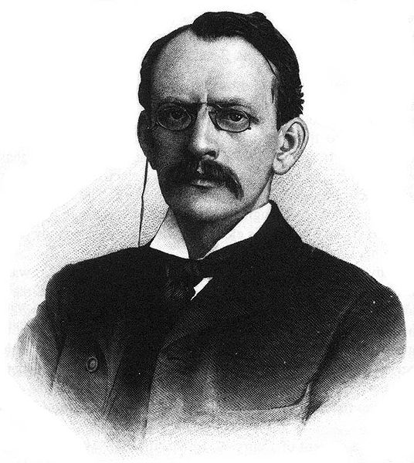
Early models of the atom
One of the earliest models (concepts) of the atom was proposed by J.J Thomson in 1904.
I think the atom is like a Plum Pudding

Slide 11
The Plum Pudding atomic model
-
-
Discuss
Q. Where is the mass in this model of the atom?
Q. How is the charge distributed in this model of the atom?
+
A positively charged sphere.
Negatively charged electrons embedded throughout the whole sphere.
-
-
-

Slide 12
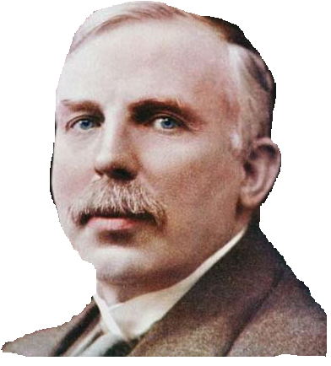
A challenger approaches

Slide 13
Rutherford’s experiment
I’ve devised an experiment to test your model of the atom.

Slide 14
+
+
If the plum pudding model is true:
By firing positively charged alpha particles at the atom, they will all go straight through.

Slide 15
+
+
+
What I saw in my experiment
Actually, most of the alpha particles passed straight through, but a tiny proportion were deflected back!

Slide 16
Notes:
https://youtu.be/wzALbzTdnc8

Slide 17
What did Rutherford’s experiment tell us?
Observation The fact that the majority of alpha particles passed straight through.
+
+
Explanation The atom is mostly empty space

Slide 18
What did Rutherford’s experiment tell us?
Observation A tiny proportion of particles were scattered by large angles
+
+
+
+
Explanation The mass of the atom is contained within a tiny nucleus at the centre.
The nucleus must be positively charged (because it repels the positive alpha particle)

Slide 19
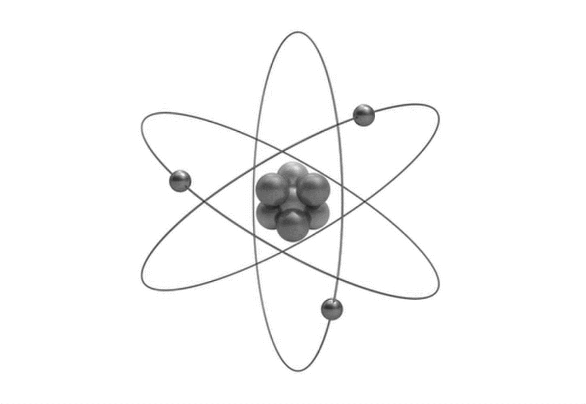
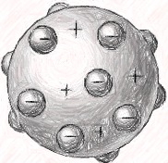
Development of the model of the atom
Pre 1900
Pre 1911
1911 to present
Sphere | Plum pudding model | Nuclear model
Before the discovery of the electron, atoms were thought to be tiny spheres that could not be divided. | The discovery of the electron led to the plum pudding model of the atom. The plum pudding model suggested the atom is a ball of positive charge with negative electrons embedded in it. | Alpha scattering experiment – mass of the atom is concentrated in the nucleus, which is charged. Niels Bohr – electrons orbit nucleus at different distances. Later experiments – positive charge in nucleus divided into whole number of smaller particles with positive charge. James Chadwick – 20 years after nucleus accepted – provided evidence for existence of neutrons in nucleus.

Slide 20
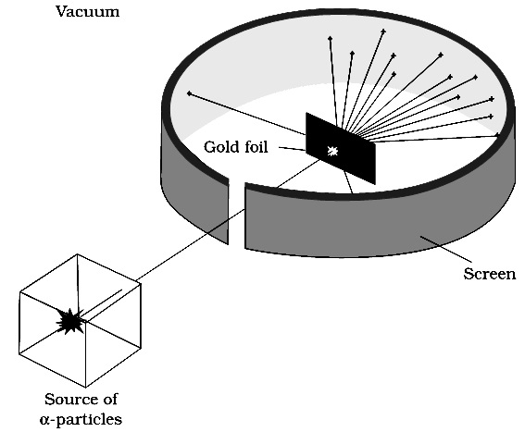
Atoms and isotopes – Development of the model of the atom
Rutherford’s alpha scattering experiment
A beam of alpha particles are directed at a very thin gold foil screen.
A few (+) alpha particles are deflected by a positive nucleus within the gold atoms.
Most (99.99%) of the alpha particles pass straight through the gold foil unaffected by its presence.
A tiny number of alpha particles are reflected because they collide with the nucleus of the gold atoms.
(α particles have a + charge)
Rutherford concluded that the gold atoms are mostly empty space with a positively charged nucleus that contains nearly all the mass of the atom.

Slide 21
QuestionIT!
Atoms and isotopes
Structure of an atom
Mass number, atomic number
and isotopes
Development of the model of
the atom.

Slide 22
Atoms and isotopes - QuestionIT
The diameter of an atom is about 0.000 000 000 2 m. What is this distance in standard form?
What is the nucleus of an atom composed of?
Describe what happens when an electron drops to a lower energy level in an atom.
An atom of sodium is represented by:
Use this information to determine the number of protons, neutrons and electrons in an atom of sodium.
What is the electrical charge attached to:
a neutron
an electron
a proton

Slide 23
Atoms and isotopes - QuestionIT
What is the mass number and the atomic number for fluorine?
Beryllium has the chemical symbol:
Use this information to draw a representation of an atom of beryllium.
A different isotope of beryllium has an extra neutron. Give the chemical symbol of this new isotope of beryllium.
9 | Be
4

Slide 24
Atoms and isotopes – AnswerIT
The radioactive element Uranium has two common isotopes.
Complete the table to show the number of protons, neutrons and electrons in each isotope.
Sodium can lose its outer electron to have a full outer energy level. What will the atom now become?
236 | U
92
and
238 | U
92
Isotope | Protons | Neutrons | Electrons
236 | U
92
238 | U
92

Slide 25
Atoms and isotopes – AnswerIT
Which scientific discovery resulted in the solid atom theory being adapted into the “plum pudding” model of the atom?
Rutherford carried out an experiment to show alpha particles either passing through gold leaf, being scattered by it. Summarise the conclusions he made from this experiment.
What contribution did Niels Bohr make to the arrangement of electrons in the atomic model?

Slide 26
AnswerIT!
Atoms and isotopes
Structure of an atom
Mass number, atomic number and isotopes
Development of the model
of the atom.

Slide 27
Atoms and isotopes - AnswerIT
The diameter of an atom is about 0.000 000 000 2 m. What is this distance in standard form?
2 x 10 ⁻¹⁰ m
What is the nucleus of an atom composed of?
Protons and neutrons (except Hydrogen which has no neutrons).
Describe what happens when an electron drops to a lower energy level in an atom.
It releases a photon of electromagnetic radiation.
An atom of sodium is represented by:
Use this information to determine the number of protons, neutrons and electrons in an atom of sodium.
Protons = 11 Neutrons = 12 Electrons = 11
What is the electrical charge attached to:
a neutron Neutral
an electron Negative
a proton Positive

Slide 28
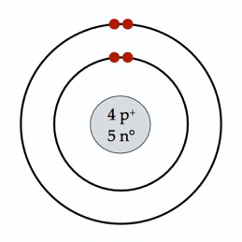
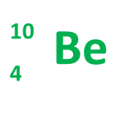
Atoms and isotopes - QuestionIT
What is the mass number and the atomic number for fluorine?
Mass number = 19; atomic number = 9
Beryllium has the chemical symbol:
Use this information to draw a representation of an atom of beryllium.
A different isotope of beryllium has an extra neutron. Give the chemical symbol of this new isotope of beryllium.
9 | Be
4

Slide 29
Atoms and isotopes – AnswerIT
The radioactive element Uranium has two common isotopes.
Complete the table to show the number of protons, neutrons and electrons in each isotope.
Sodium can lose its outer electron to have a full outer energy level. What will the atom now become?
An ion with a charge of 1+
236 | U
92
and
238 | U
92
Isotope | Protons | Neutrons | Electrons
 | 92 | 144 | 92
 | 92 | 146 | 92
236 | U
92
238 | U
92

Slide 30
Atoms and isotopes – AnswerIT
Which scientific discovery resulted in the solid atom theory being adapted into the “plum pudding” model of the atom?
Discovery of the electron (in 1897).
Rutherford carried out an experiment to show alpha particles either passing through gold leaf, being scattered off it. Summarise the conclusions he made from this experiment.
Most passing through suggests atoms are mostly empty space.
Some being deflected suggests the nucleus has the same charge as the alpha particle (positive).
A few reflected suggests the nucleus is where most of the mass of the atom is.
What contribution did Niels Bohr make to the arrangement of electrons in the atomic model?
He realised that electrons orbit the nucleus in clearly defined energy levels, at different distances from the nucleus.

